Slide 1

Global Standards enabling interoperability – a case study
Feargal Mc Groarty, National Centre for Hereditary Coagulation Disorders, St James’s Hospital, Ireland

Slide 2
Agenda
Why do we need standards in the medication supply chain?
Who is GS1 and how do GS1 Standards help?
The Irish haemophilia story
Exploiting smartphone technology - allowing patients to scan their medication within the home
Outcomes/ROI
Conclusions

Slide 3

WHY?
Notes:
Why do we need standards?

Slide 4
To prevent communication misunderstanding!

Slide 5


Slide 6
Sounds obvious?
Medicines are supposed to save lives…
Dying from a disease is sometimes unavoidable; dying from a medicine is unacceptable.
(Lepakhin V. Geneva 2005)

Slide 7
Lets look at the legitimate supply chain

Slide 8
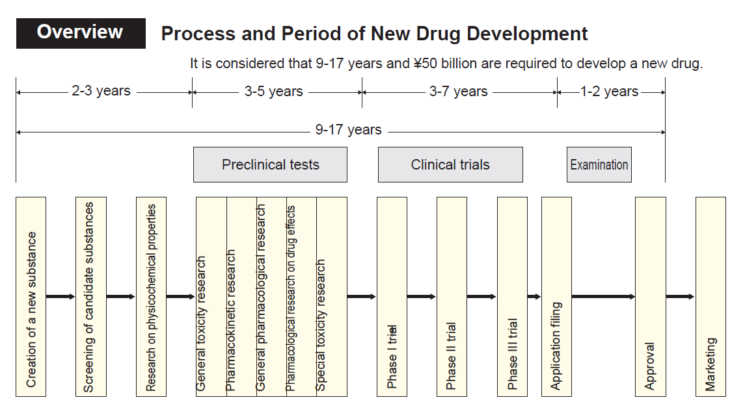
Pharma Drug manufacturing

Slide 9
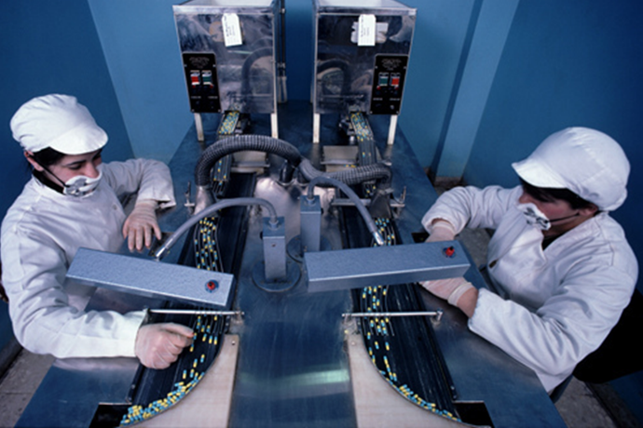
Drug development….excellent!

Slide 10

Quality and Validation…excellent!

Slide 11
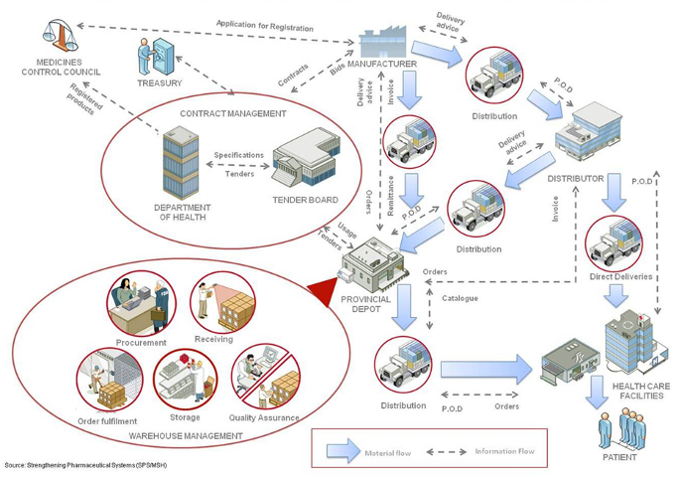
Pharma Supply Chain… excellent!

Slide 12
And then after 17 years development what do they do…?

Slide 13
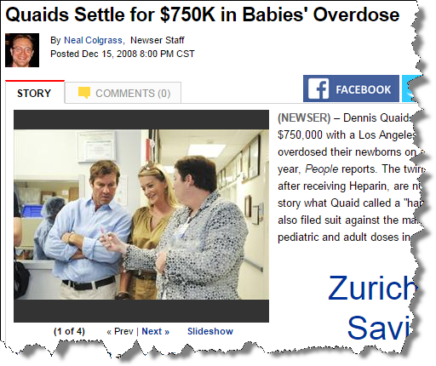
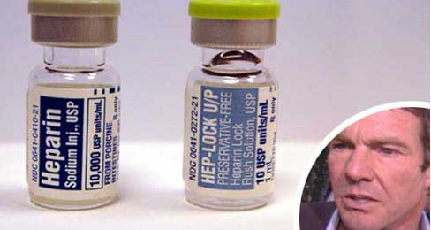
When the drug gets to the patient….
Not counterfeit but just as dangerous!
Would barcode scanning have prevented this? Absolutely!

Slide 14
How did this happen?
“The main causes (of medication error) are human factors including….”*
Fatigue
Inattention
Memory Lapse
Lack of Knowledge
Failure to communicate
*American College of Obstetrics and Gynaecologists – August 2012

Slide 15
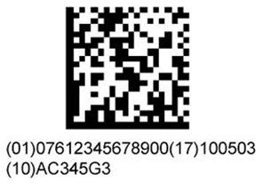

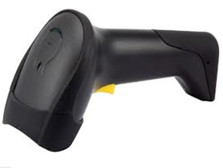
Do these suffer from any of the causes listed?

Slide 16

Benefits for Patient Safety
Reduction of medical errors
Improved recall procedure and adverse event reporting
Documentation of product/patient relationship – in Electronic Health Records (EHR) and registries
Visibility of inventory – availability of devices
Supply chain security/anti-counterfeiting

Slide 17
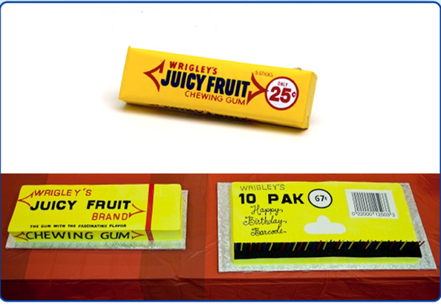
First Barcode scanned in Retail in 1974

Slide 18
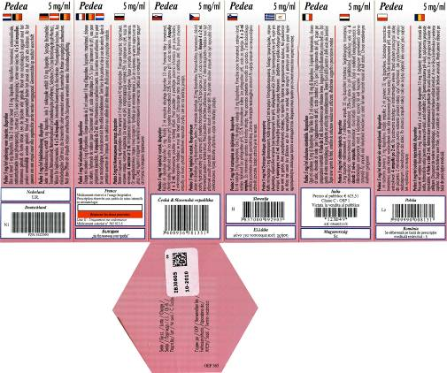
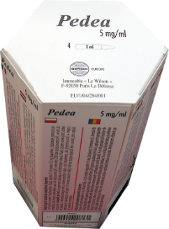
First Barcode scanned in Healthcare…..1991…but

Slide 19
How standard are standards in healthcare?
‘The nice thing about standards is that there are so many to choose from’
(Andrew Tannenbaum, the Vrije Universiteit, Amsterdam)
to which has been added …………
‘and if I can’t find one I like, I’ll make up my own!’
(Paul Amos, Information Standards Board for Health and Social Care in England, UK).

Slide 20
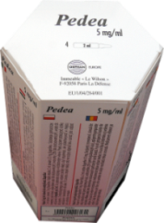
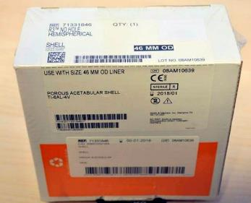

..in Healthcare it is dangerous and ineffecient!
Multiple bar codes on one package – which one to scan?
Different types of bar codes – inconsistency; incompatibility
No bar code – need to bar code; re-package; re-label
Notes:
This is paediatric product from Belgium, look at all the different flags and sides – imagine you were a nurse on a ward and you were presented with this product. You would have to look for your country’s flag and then scan the bar code related to that or use the identifier. I would be very easy to make mistakes. And then consider the supplier – how expensive and difficult has it been to engineer that packaging. The other product is a medical device from The Netherlands – if you were scanning this in the operating theatre in a high pressure environment which bar code would you choose? there i

Slide 21
WHO?
Notes:
Why do we need standards?

Slide 22

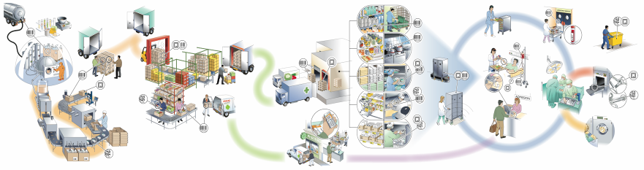
GS1 Healthcare - Voluntary, Global
User Group
To lead the healthcare sector to the successful development and implementation of global standards by bringing together experts in healthcare to enhance patient safety and supply chain efficiencies.

Slide 23
WHY GS1?
Notes:
Why do we need standards?

Slide 24

McKinsey & Company report quantifies supply chain issues in Healthcare
New McKinsey report “Strength in unity: The promise of global standards in healthcare”
Highlights the cost savings and patient safety benefits of adopting a single global supply chain standard in healthcare
Available at:
http://www.gs1.org/healthcare/mckinsey or
http://www.gs1.org/docs/healthcare/McKinsey_Healthcare_Report_Strength_in_Unity.pdf
Source: http://www.mckinsey.com

Slide 25
Huge cost savings and patient safety benefits when adopting a single global standard in healthcare
“Implementing global standards across the entire healthcare supply chain could save 22,000-43,000 lives and avert 0.7 million to 1.4 million patient disabilities”
“Rolling out such standards-based systems globally could prevent tens of billions of dollars’ worth of counterfeit drugs from entering the legitimate supply chain”
[We] “estimate that healthcare cost could be reduced by $40 billion-$100 billion globally” from the implementation of global standards
“Adopting a single set of global standards will cost significantly less than two” (between 10-25% less cost to stakeholders)
SOURCE: McKinsey report, “Strength in unity: The promise of global standards in healthcare”, October 2012

Slide 26
Imagine….
If all medication could be tracked from manufacturer to the patient
Imagine if the patient could verify that the medication was safe to take even in their own home
Imagine that hospitals could remotely monitor patient medication compliance
Imagine if governments/regulators could be assured of a total medication recall

Slide 27
Case Study
The use of GS1 standards to enhance patient safety, improve medication recording compliance and reduce costs

Slide 28
National Centre for Hereditary Coagulation Disorders (NCHCD)
Located at St James’s Hospital, Dublin, Ireland
Manages patients with inherited and acquired bleeding disorders
Approximately 2000 patients with Haemophilia
Approximately 200 patients with severe haemophilia (require intensive care/treatment)
Medication budget is ~ €45 M
Over 75% Patients with severe Haemophilia self medicate at home

Slide 29
What is Haemophilia and why is traceability important?
Haemophilia is a Chronic Disease, it is a bleeding disorder caused by a deficiency of a clotting factor
Incidence is between 1:5,000 and 1: 10,000 Males
The treatment of haemophilia involves the replacement of the clotting factor (previously prepared from pooled plasma) using a concentrated preparation “Clotting Factor Concentrate” (CFC)
Patients required to self treat at home
Lack of prompt response can lead to prolonged hospitalisation, decreased quality of life and misuse or wastage of expensive plasma and recombinant products

Slide 30
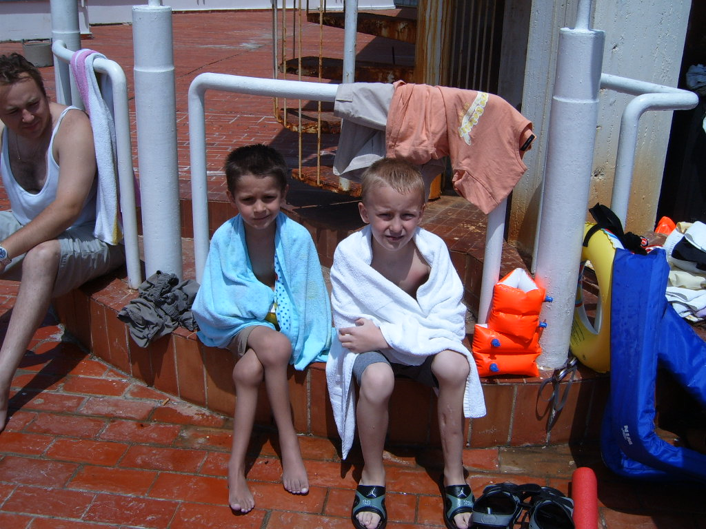

Slide 31
What triggered the initiative?
Catastrophic Event
Failure of Supply Chain-
Infection of patients with Hepatitis C and HIV due to contaminated blood products. Infected medication remained in the supply chain after recall - leading to subsequent infection
Over 100 people died in Ireland alone

Slide 32
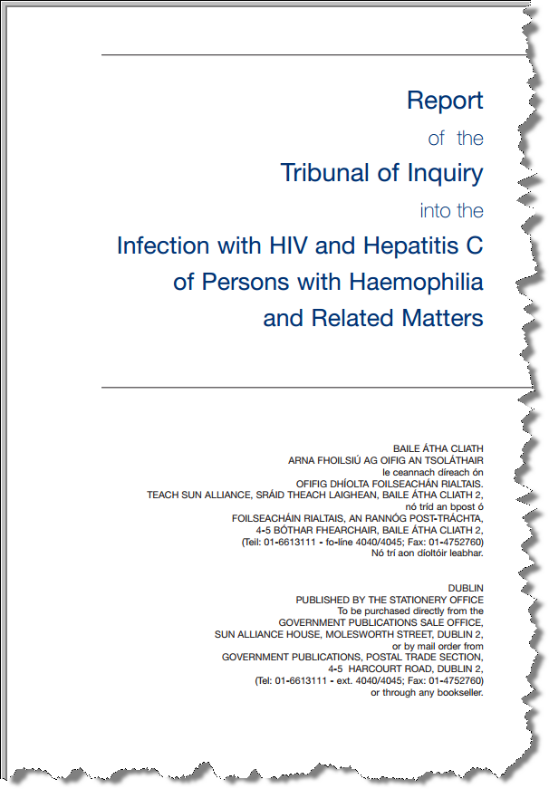
Lindsay Report 2001
Main Recommendations
  Improve communication between treatment centres
  The blood products supplied to persons with haemophilia should be of the highest standard and of the safest nature that are available

Slide 33





Medication Supply chain…..where we were

Slide 34
Redesign the Supply Chain
Cold Chain Supplier
Medication
Manufacturer
Hospital
Patient Home
Patient

Slide 35
Medication
Manufacturer
Cold Chain Supplier
Hospital
Patient
Patient Home

Slide 36
Piece missing!
Manufacturer
Cold Chain Supplier
Medication
Patient
Hospital
Patient Home

Slide 37
GS1 Global standards!
Manufacturer
Cold Chain Supplier
Medication
GS1 Barcodes
Patient
Hospital
Patient Home

Slide 38
Solution – Adopt the Retail Track and Trace Model based on GS1 Standards
Unique identification (barcode) of patient – PMGSRN
Unique identification (barcode) of medication - Serialised GTIN
Unique identification (barcode) of locations (Hospital/Home/Pharmacy/Transport) - GLN

Slide 39



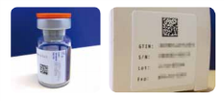
Solution
Notes:
GS1 Standards make it possible for companies to speak the same language and connect with each other by identifying, capturing, and sharing information about products, business locations, and more.
39

Slide 40

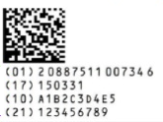
Identify
Product Name
(GTIN)
Expiry Date
Batch/lot Number
Serial Number

Slide 41





Capture

Slide 42
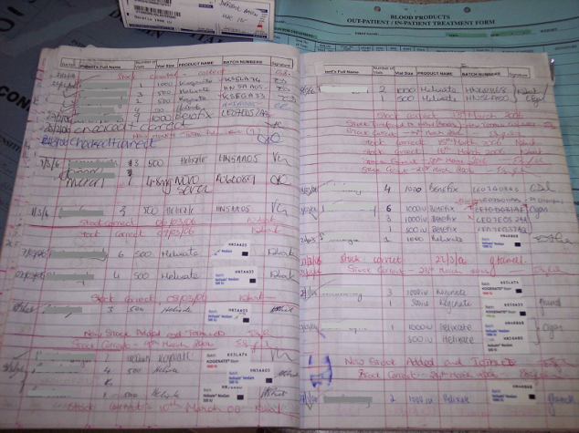
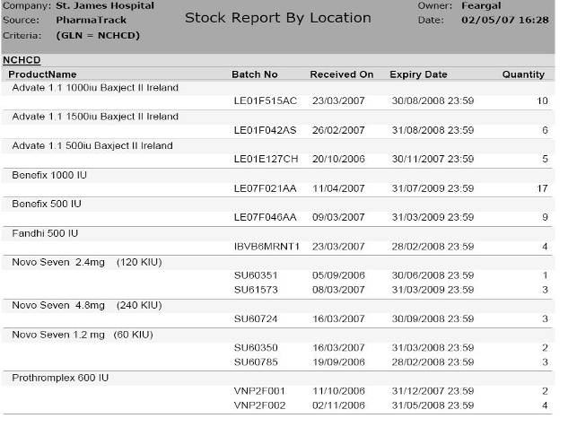
Share

Slide 43
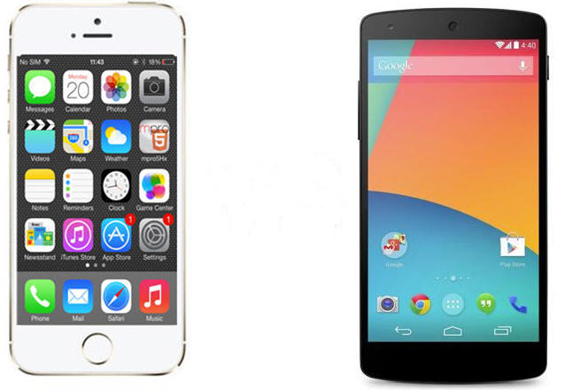
Smartphones with scanning App
Notes:
43

Slide 44


Slide 45
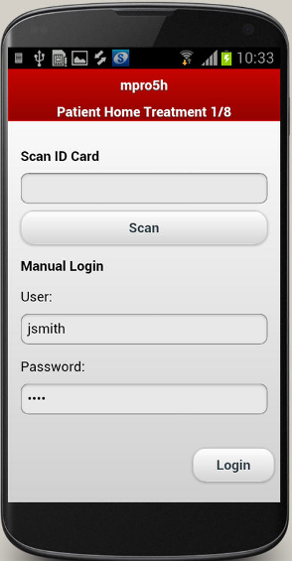
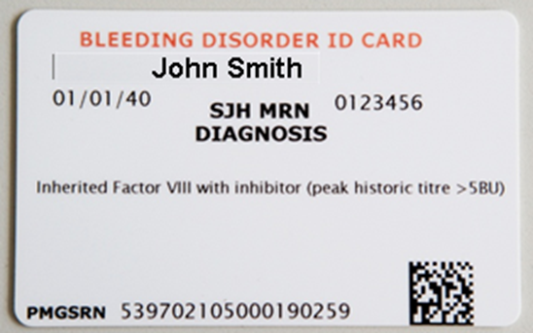
Log-in
Secure Login by
Username/Password
or
Scanning unique GS1 ID on Card
Notes:
45

Slide 46
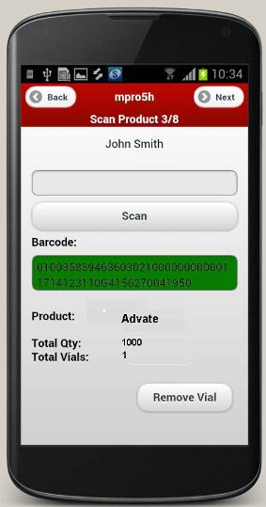
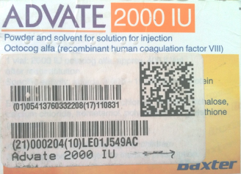
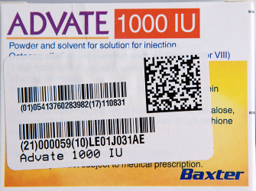
Scan Product
Barcode on Vial box is scanned to check
product detail (prescription)
expiry date
Recall status
Notes:
46

Slide 47
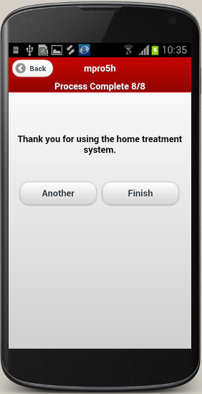
Process Complete
Process concludes, system synchronises data wirelessly to web application
Notes:
47

Slide 48

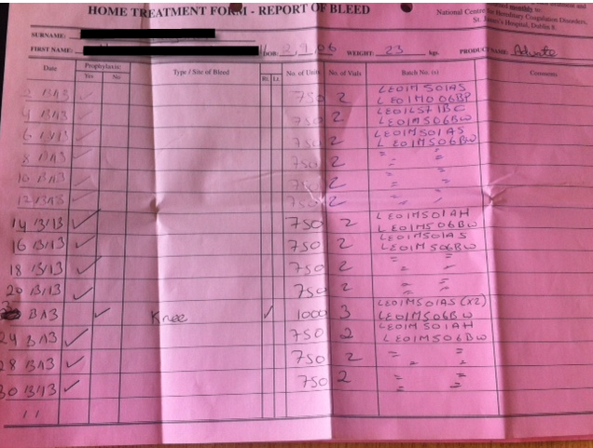
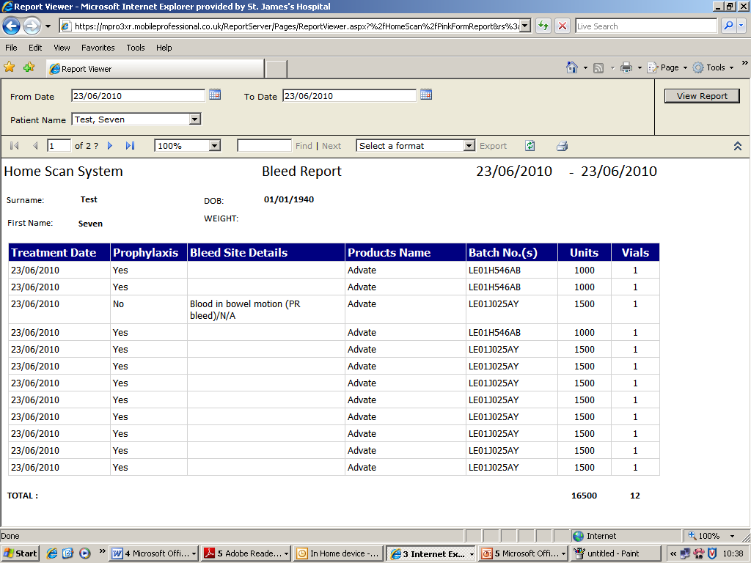
Share

Slide 49
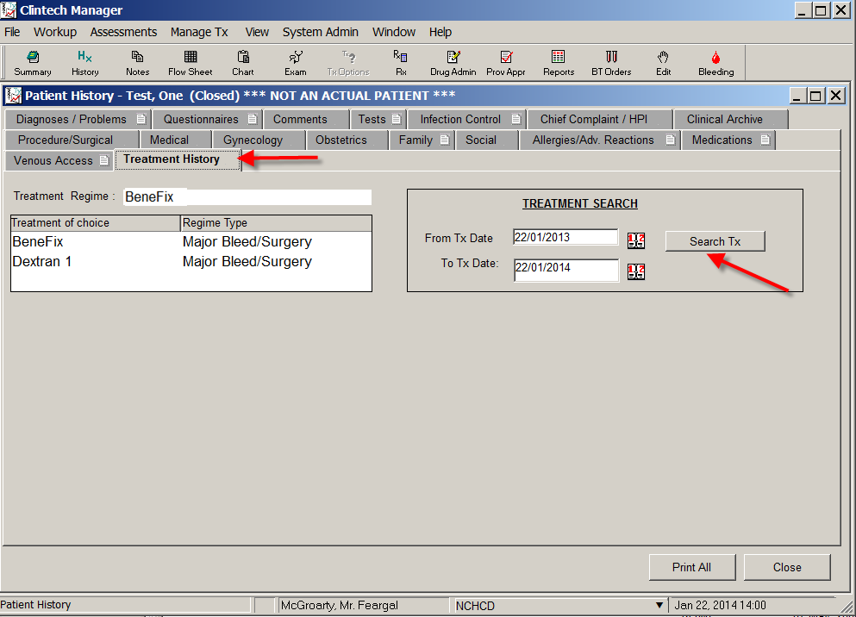
Share

Slide 50

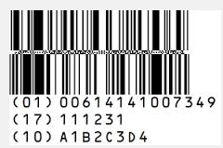
Haemophilia Project Timeline
Cold Chain distribution service for medication commenced
Datamatrix barcodes
Smartphone App
Start of migration from linear to GS1 2D (Datamatrix) barcodes on medication
First 20 patients commence scanning with smartphone App
Haemophilia EPR implemented
2003
2004
2006
2007
2010
2014
Patient data integration
GS1 Barcodes
Hospital tracking
barcodes (linear)
implementation on medication and embedded in Cold Chain delivery service
Hospital track and trace of haemophilia medication using barcode scanning implemented
Patient home treatment data from App fully integrated with EPR

Slide 51
Outcomes/ROI
Validated Cold Chain delivery Service using GS1 Datamatrix Bar coding on medication packaging
Since Cold Chain delivery started all products verifiably delivered between 2⁰-5⁰ Celsius
Documentation errors reduced from 12 to zero in the year post service implementation
€ 5 Million worth of medication stock has been removed from the supply chain
Stock rotation in 2011 saved €600,000 worth of stock
Mock Recall identified location of all (100%) Medication within 10 minutes along with quantities of alternate stock available

Slide 52
Patient usage trends

Slide 53
Immediate outcomes post implementation of smartphone App
(launched June 2010)
Real-time recall alert
Timeliness of infusion
Prescription compliance (2000iu instead of recommended 1750iu)
Automatic compliance (no manual record keeping)
Compliance > 90% (for those with phone App)
Real-time Alerts for specific bleeds
Patient empowerment
Significant savings (over €70,000 within first 3 months with only 20 users)

Slide 54


Where we are

Slide 55
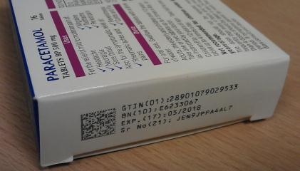
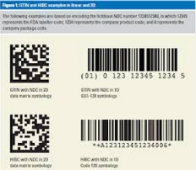
What are the Regulators saying?
EU Falsified Medicines Directive (FMD)
Product Code
Batch
Expiry
Serial Number
US Drug Quality and Security Act (DQSA) 2013
Within 4 years a Unique Serial Number on all packages
Within 10 years this must be upgrades to an electronic code
55

Slide 56
What’s Next?
Alert if shorter dated stock in fridge
Alert if a patient has not scanned in 7 days
Bolt on a QOL survey
Apply this model to other disease groups

Slide 57
Conclusions
TCP Batch Number & expiry date per CFC per Patient/Hospital
TX Type
Product | Benifix 1000 IU
Batch Number | Expiry Date | Name | Trans-Date | Total
LE07E055AA | 31/10/2008 | SJH, Blood Transfusion Lab. | 06/09/2006 | 1
 |  |  | 05/09/2006 | 2
 |  |  | 27/09/2006 | 2
 |  |  | 08/09/2006 | 1
 |  |  | 15/09/2006 | 2
 |  |  | 08/11/2007 | 2
 |  | Total issued to SJH |  | 9
 |  | Total issued to OLCHC | 11/09/2006 | 20
 |  | Patient name
 | Home Patient | XXXX, XXXXXXX | 11/09/2006 | 10
 | Home Patient | XXXX, XXXXXXX | 21/09/2006 | 25
 | Home Patient | XXXX, XXXXXXX | 01/09/2006 | 10
 | Home Patient | XXXX, XXXXXXX | 29/09/2006 | 6
 | Home Patient | XXXX, XXXXXXX | 21/09/2006 | 30
 | Issued to Patients |  |  | 493
Grand TOTAL
TCP Batch Number & expiry date per CFC per Patient/Hospital
TX Type
Product | Benifix 1000 IU
Batch Number | Expiry Date | Name | Trans-Date | Total
LE07E055AA | 31/10/2008 | SJH, Blood Transfusion Lab. | 06/09/2006 | 1
 |  |  | 05/09/2006 | 2
 |  |  | 27/09/2006 | 2
 |  |  | 08/09/2006 | 1
 |  |  | 15/09/2006 | 2
 |  |  | 08/11/2007 | 2
 |  | Total issued to SJH |  | 9
 |  | Total issued to OLCHC | 11/09/2006 | 20
 |  | Patient name
 | Home Patient | XXXX, XXXXXXX | 11/09/2006 | 10
 | Home Patient | XXXX, XXXXXXX | 21/09/2006 | 25
 | Home Patient | XXXX, XXXXXXX | 01/09/2006 | 10
 | Home Patient | XXXX, XXXXXXX | 29/09/2006 | 6
 | Home Patient | XXXX, XXXXXXX | 21/09/2006 | 30
 | Issued to Patients |  |  | 493
Grand TOTAL
  Measures need to be implemented to ensure patient safety
  Measures need to be implemented to help Anti counterfeiting
  Measures need to be implemented to improve Supply Chain efficiency (reduce costs)
  Barcodes work!
  Standards are the key
  Standards and technology already exists to help improve patient safety and reduce supply chain costs
Appendix A
Appendix A

Slide 58
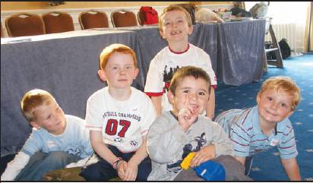
Our patients….your citizens!

Slide 59
Acknowledgements
All staff in National Centre for Hereditary Coagulation Disorders, in particular…..
Dr. Barry White (Clinical Director)
Evelyn Singleton (National Co-ordinator for CFC)
Rachel Bird (National Haemophilia system data manager)
Vincent Callan (Director of Facilities Management)

Slide 60
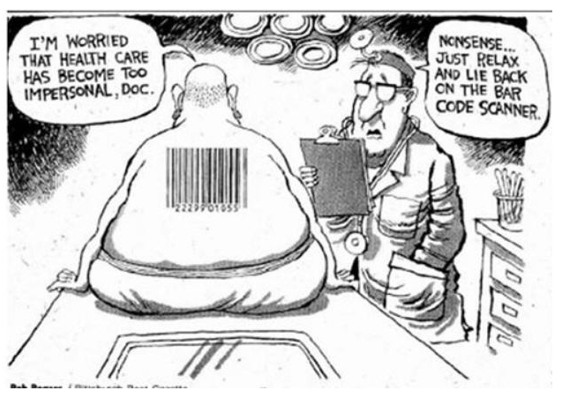
Remember, standards are just a tool……..

Slide 61
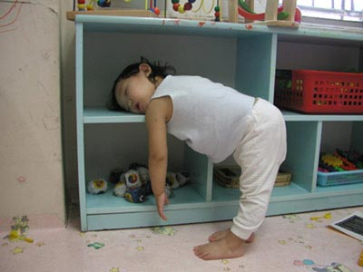
Thank you for listening

Slide 62

Any Questions ?

