Slide 1
Training Module 2.2 Open Data & Metadata Quality
PwC firms help organisations and individuals create the value they’re looking for. We’re a network of firms in 158 countries with close to 180,000 people who are committed to delivering quality in assurance, tax and advisory services. Tell us what matters to you and find out more by visiting us at www.pwc.com.
PwC refers to the PwC network and/or one or more of its member firms, each of which is a separate legal entity. Please see www.pwc.com/structure for further details.

Slide 2
This presentation has been created by PwC Authors: Makx Dekkers, Nikolaos Loutas, Michiel De Keyzer and Stijn Goedertier
Presentation metadata
Disclaimers
The views expressed in this presentation are purely those of the authors and may not, in any circumstances, be interpreted as stating an official position of the European Commission.
The European Commission does not guarantee the accuracy of the information included in this presentation, nor does it accept any responsibility for any use thereof.
Reference herein to any specific products, specifications, process, or service by trade name, trademark, manufacturer, or otherwise, does not necessarily constitute or imply its endorsement, recommendation, or favouring by the European Commission.
All care has been taken by the author to ensure that s/he has obtained, where necessary, permission to use any parts of manuscripts including illustrations, maps, and graphs, on which intellectual property rights already exist from the titular holder(s) of such rights or from her/his or their legal representative.
This presentation has been carefully compiled by PwC, but no representation is made or warranty given (either express or implied) as to the completeness or accuracy of the information it contains. PwC is not liable for the information in this presentation or any decision or consequence based on the use of it.. PwC will not be liable for any damages arising from the use of the information contained in this presentation. The information contained in this presentation is of a general nature and is solely for guidance on matters of general interest. This presentation is not a substitute for professional advice on any particular matter. No reader should act on the basis of any matter contained in this publication without considering appropriate professional advice.
Open Data Support is funded by the European Commission under SMART 2012/0107 ‘Lot 2: Provision of services for the Publication, Access and Reuse of Open Public Data across the European Union, through existing open data portals’(Contract No. 30-CE-0530965/00-17).
© 2014 European Commission

Slide 3
Learning objectives
By the end of this training module you should have an understanding of:
What (open) data quality means;
The open data quality determinants and criteria;
Good practices for publishing high-quality (linked) open data.

Slide 4
Content
This modules contains...
A definition of data quality;
An overview of the dimensions of data and metadata quality;
A selection of best practices for publishing good quality data and metadata.
Find more on: training.opendatasupport.eu

Slide 5
What is data (and metadata) quality?
Data is of high quality "if they are fit for their intended uses in operations, decision making and planning."
Or more specifically:
“High quality data are accurate, available, complete, conformant, consistent, credible, processable, relevant and timely.”

Slide 6
The data quality dimensions What are the main dimensions to be taken into account for delivering good quality (meta)data?

Slide 7
Data quality dimensions
Accuracy: is the data correctly representing the real-world entity or event?
Availability: Can the data be accessed now and over time?
Completeness: Does the data include all data items representing the entity or event?
Conformance: Is the data following accepted standards?
Consistency: Is the data not containing contradictions?
Credibility: Is the data based on trustworthy sources?
Processability: Is the data machine-readable?
Relevance: Does the data contain the necessary information to support usage and the application?
Timeliness: Is the data representing the actual situation and is it published soon enough?

Slide 8
Accuracy
The accuracy of data is the extent to which it correctly represents the characteristics of the real-world object, situation or event.
For example:
Correct measurement of weather conditions (temperature, precipitation).
Correct indication of re-use conditions of the dataset.
Recommendations:
Balance the accuracy of your data against the cost in the context of the application; it needs to be good enough for the intended use.
Make sure that there is organisational commitment and investment in procedures and tools to maintain accuracy .

Slide 9
Accuracy by example
High accuracy
Cloud cover = 60%
Less accuracy
Partly cloudy

Slide 10
Availability
The availability of data is the extent to which it can be accessed; this also includes the long-term persistence of data.
For example:
A Dataset that is identified by a http: URI that resolves persistently to the right resource (and does not give back 404 Not found).
A description of the dataset that is included in the search engine of a data portal.
Recommendations:
Follow best practices for the assignment and maintenance of URIs.
Make sure that responsibility for the maintenance of data is clearly assigned in the organisation.
See also:
http://www.slideshare.net/OpenDataSupport/design-and-manage-persitent-uris

Slide 11
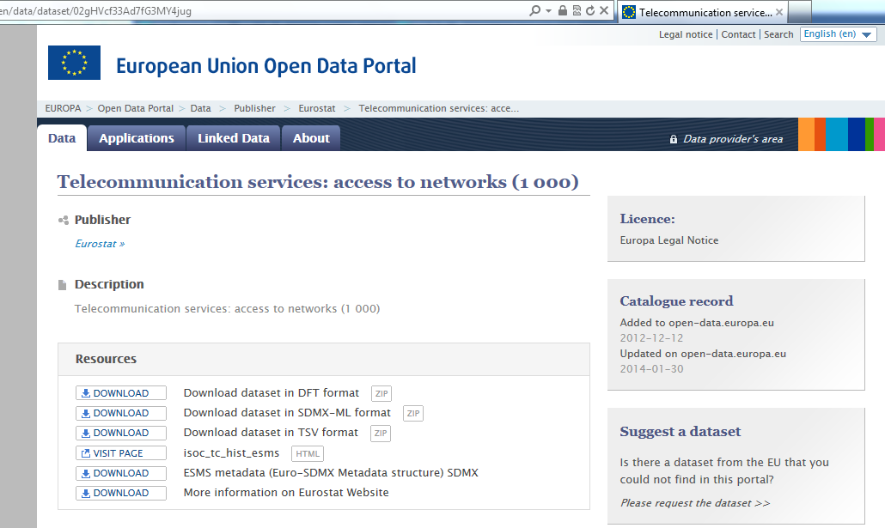
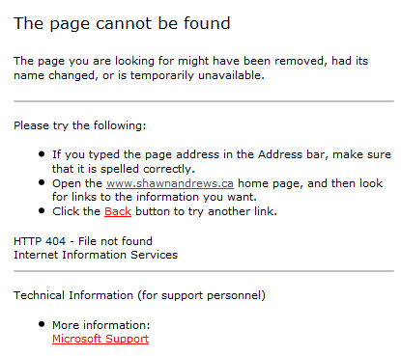
Availability by example
High availability
Less availability

Slide 12
Completeness
The completeness of data is the extent to which it includes the data items or data points that are necessary to support the application for which it is intended.
For example:
A Dataset that includes spending data for all ministries enables a complete overview of government spending.
A description of data that is generated in real time that includes the date and time of last modification.
Recommendations:
Design the capture and publication process to include the necessary data points.
Monitor the update mechanisms on a continuous basis.

Slide 13
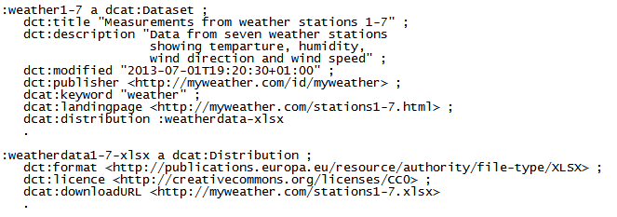
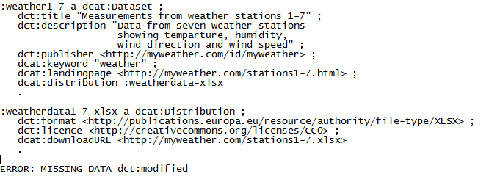
Completeness by example
High completeness
Less completeness

Slide 14
Conformance
The conformance of data is the extent to which it follows a set of explicit rules or standards for capture, publication and description
For example:
A Dataset that expresses coordinates in WGS84 and statistics in SDMX.
A description of a dataset according to the DCAT Application Profile.
Recommendations:
Apply the most used standards in the domain that is most relevant for the data or metadata.
Define local vocabularies if no standard is available, but publish your vocabularies according to best practice (e.g. dereferenceable URIs).

Slide 15
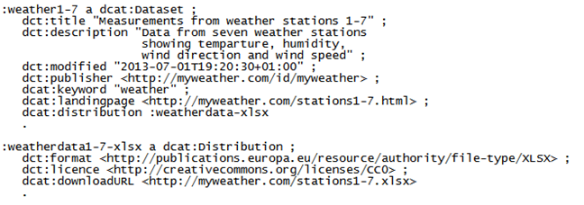
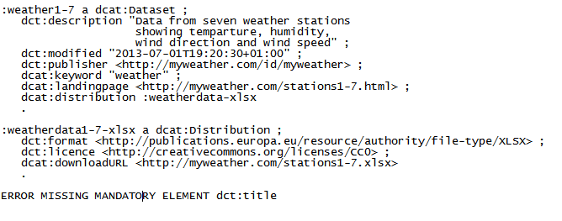
Conformance by example
High conformance
Less conformance
See also:
https://joinup.ec.europa.eu/asset/adms_foss/news/just-released-admssw-validator-verify-and-visualise-rdf-software-metadata

Slide 16
Consistency
The consistency of data is the extent to which it does not contain contradictions that would make its use difficult or impossible.
For example:
A dataset that combines data from different sources that has been processed to detect conflicting statements which have been resolved.
A description of a dataset that does not contain multiple licence statements or where the data of last modification is not before the creation date.
Recommendations:
Process all data before publication to detect conflicting statements and other errors (in particular if data is aggregated from different sources).

Slide 17
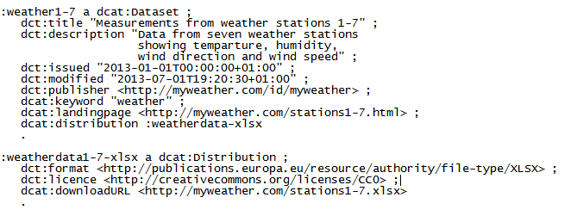
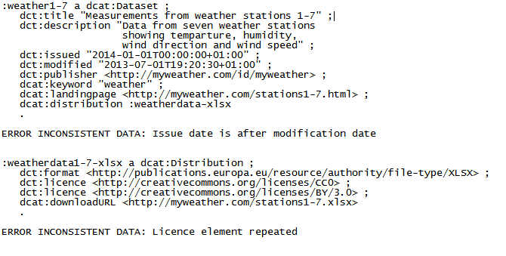
Consistency by example
High consistency
Less consistency

Slide 18
Credibility
The credibility of data is the extent to which it is based on trustworthy sources or delivered by trusted organisations.
For example:
A dataset that contains data from processes that can be independently verified, e.g. election results or parliamentary proceedings.
A description of a dataset that is published by a government agency.
Recommendations:
Base data on sources that can be trusted or on explicit Service Level Agreements where possible and appropriate.
Make appropriate attributions so that re-users can determine whether or not they can trust the data.

Slide 19
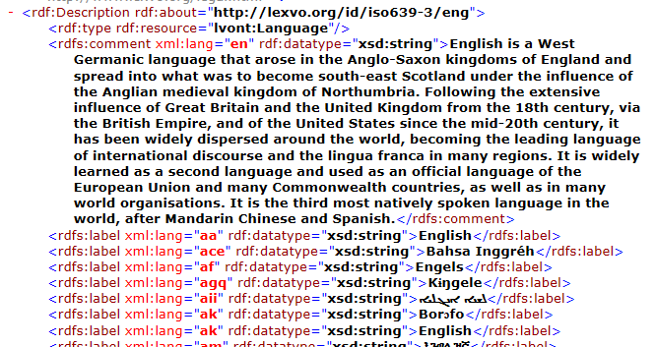
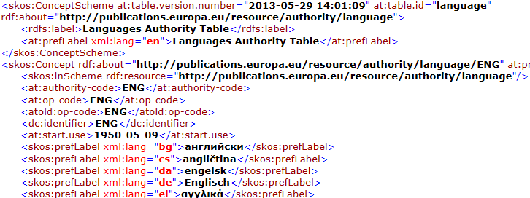
Credibility by example
High credibility
Data coming from the Publications Office of the EU:
Less credibility
Data coming from Lexvo:
Lingvoj/Lexvo data may not be of less quality than Publications Office data, but the Publications Office is an authoritative source, while Linvoj and Lexvo are initiatives of individuals.

Slide 20
Processability
The processability of data is the extent to which it can be understood and handled by automated processes.
For example:
A dataset that contains coded information based on publicly available controlled vocabularies and code lists.
A description of a dataset that expresses dates in W3C Date and Time Format (e.g. 2013-06-01) rather than as text (e.g. 1 June 2013).
Recommendations:
Identify the source of terminology and codes used in the data in machine-readable manner.
Apply recommendations for syntax of data given in common standards and application profiles.

Slide 21
Processability by example
High processability
Less processability

Slide 22
Relevance
The relevance of data is the extent to which it contains the necessary information to support the application.
For example:
A Dataset that contains temperature measurements rounded to degrees Celsius for climate calculations; a dataset with precision of a thousandth of a degree for chemical reactions.
A description of a dataset that only contains temporal coverage data if necessary for its processing .
Recommendations:
Match coverage and granularity of data to its intended use within constraints of available time and money.
However, also consider potential future usages of the data.

Slide 23
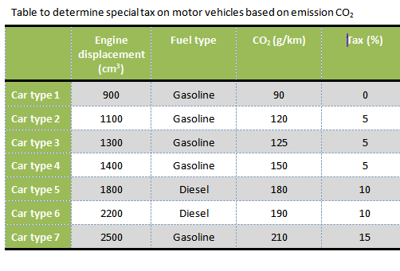
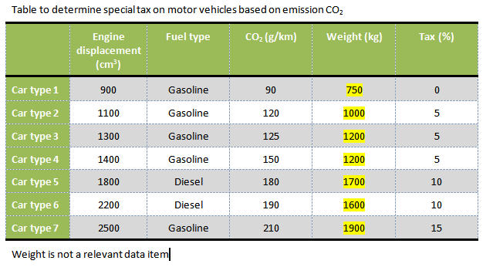
Relevance by example
High relevance
Less relevance

Slide 24
Timeliness
The timeliness of data is the extent to which it correctly reflects the current state of the entity or event and the extent to which the data (in its latest version) is made available without unnecessary delay
For example:
A dataset that contains real-time traffic data that is refreshed every few minutes.
A description of a dataset containing annual crime statistics that is made available within days of publication of the dataset.
Recommendations:
Adapt the update frequency of data to the nature of the data and its intended use.
Make sure that processes and tools are in place to support the updating.

Slide 25
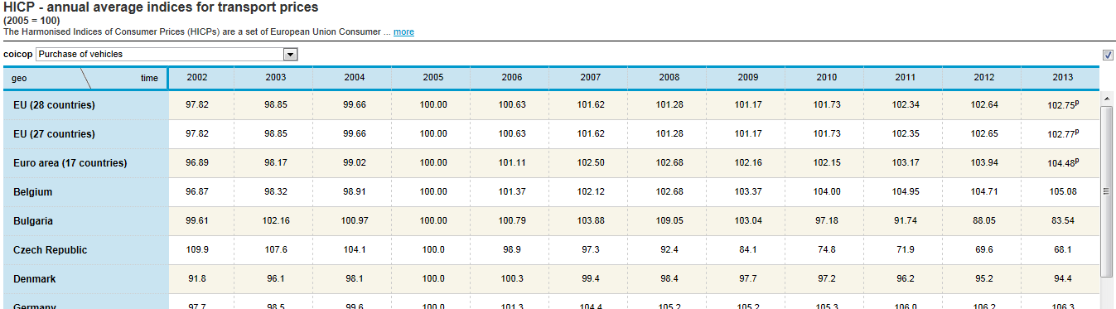
Timeliness: examples
High timeliness
Less timeliness

Slide 26
Best practices Best practices for publishing high-quality data and metadata.

Slide 27
Best practices for publishing high-quality data and metadata
Provide appropriate descriptions of data (i.e. metadata).
Use standard vocabularies for metadata and data whenever such vocabularies exist.
Specify the license under which the data may be re-used.
Adhere to legal requirements concerning protection of personal and other sensitive data.
Represent metadata and data according to the Linked Data principles using persistent URIs for identifying things.
Provide information about the source of the data.
Maintenance of metadata and data is critical!
See also:
http://www.slideshare.net/OpenDataSupport/introduction-to-metadata-management

Slide 28
Conclusions
The quality of data is determined by its fitness for (re-)use by data consumers.
Metadata is “data about data”, i.e. metadata is a type of data.
The same quality considerations apply to data and metadata alike.
Data quality has multiple dimensions and is about more than the correctness of data.
Accuracy, availability, completeness, conformance, consistency, credibility, processability, relevance, timeliness.

Slide 29
Group questions
In your opinion, which factors contribute the most to data and/or metadata quality?
Improving quality can require time and resources. To which extent would your organisation be willing to invest in data and/or metadata quality?
http://www.visualpharm.com
http://www.visualpharm.com

Slide 30
Thank you! ...and now YOUR questions?
Notes:
See also: http://europa.eu/rapid/press-release_MEMO-11-891_en.htm

Slide 31
References
Juran, Joseph M. and A. Blanton Godfrey, Juran's Quality Handbook, Fifth Edition, p. 2.2, McGraw-Hill, 1999
National Information Standards Organization, http://www.niso.org/publications/press/UnderstandingMetadata.pdf
Mark David Hansen. Zero Defect Data: Tackling the Corporate Data Quality Problem. 1991. http://dspace.mit.edu/handle/1721.1/13812
Kevin Roebuck. Data Quality: High-impact Strategies - What You Need to Know: Definitions, Adoptions, Impact, Benefits, Maturity, Vendors. Emereo Pty Limited, 2011. http://bit.ly/19Qb6Ov
Thomas R. Bruce, Diane Hillmann. The Continuum of Metadata Quality: Defining, Expressing, Exploiting. ALA Editions, 2004. http://www.ecommons.cornell.edu/handle/1813/7895
Sharon Dawes. Open data quality: a practical view. Open Data Roundtable. October 2012. http://www.slideshare.net/cityhub/sharon-dawes-ctg
Joshua Tauberer. Open Government Data. Section 5.2 Data Quality: Precision, Accuracy, and Cost. June 2012. http://opengovdata.io/2012-02/page/5-2/data-quality-precision-accuracy-and-cost
Stefan Urbanek. Data Quality: What is It? January 2011. http://ckan.org/2011/01/20/data-quality-what-is-it/
Amrapali Zaveri, Anisa Rula, Andrea Maurino, Ricardo Pietrobon, Jens Lehmann, Sören Auer. Quality Assessment Methodologies for Linked Open Data. Semantic Web Journal (unpublished), 2012. http://www.semantic-web-journal.net/content/quality-assessment-methodologies-linked-open-data
ISA Programme. 10 Rules for Persistent URIs. https://joinup.ec.europa.eu/community/semic/document/10-rules-persistent-uris
W3C. Best Practices for Publishing Linked Data. W3C Note 06 June 2013. https://dvcs.w3.org/hg/gld/raw-file/default/bp/index.html
OPQUAST. 72 Open data good practices. http://checklists.opquast.com/en/opendata
Notes:
To be updated.

Slide 32
Further reading
Joshua Tauberer. Open Government Data. http://opengovdata.io/
Juran, Joseph M. and A. Blanton Godfrey, Juran's Quality Handbook

Slide 33
Related projects and initiatives
Best Practices for Publishing Linked Data. https://dvcs.w3.org/hg/gld/raw-file/default/bp/index.html
OPQUAST. Open data good practices. http://checklists.opquast.com/en/opendata

Slide 34
Be part of our team...
Find us on
Join us on
Open Data Support
http://www.slideshare.net/OpenDataSupport
Open Data Support
http://goo.gl/y9ZZI
http://www.opendatasupport.eu
Follow us
Contact us
@OpenDataSupport
contact@opendatasupport.eu

