Slide 1

Semantic Interoperability
Courses
Course Module 1
Introduction and overview of existing initiatives

Slide 2
Disclaimer
This training material was prepared for the ISA programme of the European Commission by PwC EU Services.
The views expressed in this report are purely those of the authors and may not, in any circumstances, be interpreted as stating an official position of the European Commission.
The European Commission does not guarantee the accuracy of the information included in this study, nor does it accept any responsibility for any use thereof.
Reference herein to any specific products, specifications, process, or service by trade name, trademark, manufacturer, or otherwise, does not necessarily constitute or imply its endorsement, recommendation, or favouring by the European Commission.
All care has been taken by the author to ensure that s/he has obtained, where necessary, permission to use any parts of manuscripts including illustrations, maps, and graphs, on which intellectual property rights already exist from the titular holder(s) of such rights or from her/his or their legal representative.

Slide 3
Learning objectives
By the end of this training you should have an understanding of:
Interoperability and semantic interoperability and how they relate.
The basics on semantic interoperability
The basics to achieve semantic interoperability.
Existing semantic interoperability initiatives.

Slide 4
Outline
1. Definitions
3. Examples of existing initiatives
Introductory definitions
ISA Programme Action 1.1
Interoperability
2. Semantic interoperability conflicts
EU Large-scale pilots
US National Information Exchange Model
Data-level conflicts
Schema-level conflicts
What conflicts can arise without managing interoperability?
UN/CEFACT
Semantic interoperability
How to achieve semantic interoperability?
INSPIRE Data Models

Slide 5
What is interoperability?
Interoperability, within the context of European public service delivery, is the ability of disparate and diverse organisations to interact towards mutually beneficial and agreed common goals, involving the sharing of information and knowledge between the organisations, through the business processes they support, by means of the exchange of data between their respective ICT systems.
Source: EIF, http://ec.europa.eu/isa/documents/isa_annex_ii_eif_en.pdf

Slide 6
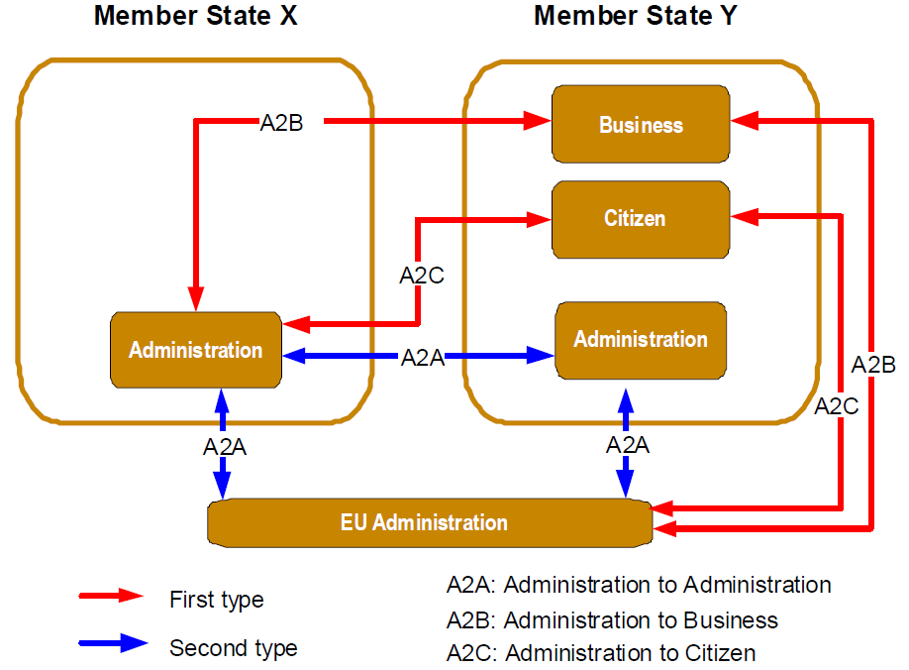
The ABC of interoperability
Administrations, Business and Citizens must interact efficiently and effectively.
They therefore need interoperable electronic information exchange.
Interoperability addresses the need for:
  Cooperation among public administrations with the aim to establish public services;
  Exchanging information among public administrations to fulfil legal requirements or political commitments;
  Sharing and reusing information among public administrations to increase administrative efficiency and cut red tape for citizens and businesses.
Source: EIF, http://ec.europa.eu/isa/documents/isa_annex_ii_eif_en.pdf

Slide 7
Levels of interoperability
Technical
Preservation of precise meaning of information
Semantic
Coordinated processes
Organisational
Aligned legislation and legal meaning
Legal
Technical linking of systems
Source: EIF, http://ec.europa.eu/isa/documents/isa_annex_ii_eif_en.pdf

Slide 8
Definition: semantic interoperability
Preservation of meaning
Semantic interoperability enables organisations to process information from external sources in a meaningful manner.
It ensures that the precise meaning of exchanged information is understood and preserved throughout exchanges between parties.
Benefits of semantic interoperability are:
  Reduction of errors
  Management of costs
  Monitoring and responding to trends & problems
  Expanding knowledge
Source: EIF, http://ec.europa.eu/isa/documents/isa_annex_ii_eif_en.pdf

Slide 9
Definition: structural metadata
Indication of meaning and structure
Metadata is data that defines and describes other data (ISO/IEC 11179-1).
Structural metadata: data that gives meaning to data and indicates how it is structured:
A data model is a collection of entities, their properties and the relationships among them, which aims at formally representing a domain, a concept or a real-world thing.
Reference data is a small, discrete set of values that are not updated as part of business transactions but are usually used to impose consistent classiﬁcation. Reference data normally has a low update frequency.
See also: NISO, Understanding Metadata, 2004
http://www.niso.org/publications/press/UnderstandingMetadata.pdf

Slide 10

How to achieve?
Forge a semantic interoperability agreement on structural metadata
Semantic interoperability agreement:
A social approach to agree on common specifications for naming things.
An agreement on structural metadata (models and reference data) used in information exchanges.
It ensures that data elements are understood in the same way by communicating parties.
Read more: Process and methodology for developing semantic agreements, June 2013.

Slide 11
How to achieve?
Governance and management of structural metadata
Inter-organisational coordination requires:
Metadata governance: decision mechanism
Metadata management: process to manage the lifecycle of structural metadata
Metadata standards and tools: common standards and tools to support the management process.
Read more: Specification for metadata management and governance for EU institutions and Member States, May 2014.

Slide 12
Outline
1. Definitions
3. Examples of existing initiatives
Introductory definitions
ISA Programme Action 1.1
2. Semantic interoperability conflicts
EU Large-scale pilots
US National Information Exchange Model
Data-level conflicts
Schema-level conflicts
What conflicts can arise without managing interoperability?
UN/CEFACT
Interoperability
Semantic interoperability
How to achieve semantic interoperability?
INSPIRE Data Models

Slide 13
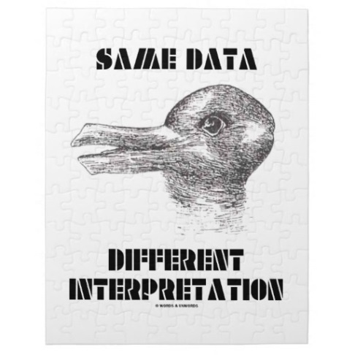
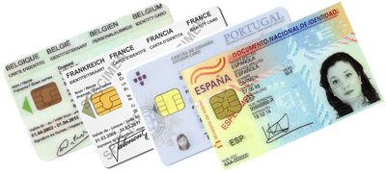
Without semantic interoperability
Interoperability conflicts arise
Semantic conflicts can occur at two different levels, at the data level and at the schema level. Conflicts on a data level occur due to data differences in different domains. Conflicts on schema level are semantic conflicts characterized by differences in logical structures
Data-level conflicts
Different representation and interpretation of similar data
Schema-level conflicts
Different logical structure or inconsistencies in metadata
How do you interpret this data?
Schema isomorphism conflict
i.e. Different attributes on ID cards in different states
More on semantic conflicts: Peristeras - JIS-2008-34-6-877 - A conceptual analysis of semantic conflicts in pan-European e-government services

Slide 14
Data-level conflicts
Data value
“adult” = 17 or 18 years old?
Data representation
Date formats: DMY, MDY, YMD?
Data units
lbs or kg?
Data precision
Miles or kilometres
Granularity
School grade scales
“name” = full name or only surname?
More on semantic conflicts: Peristeras - JIS-2008-34-6-877 - A conceptual analysis of semantic conflicts in pan-European e-government services

Slide 15
Schema-level conflicts
Naming
Citizen information is verified against the wrong source*
Entity identifier
Citizens identified by ID card number or national number or none?
Schema isomorphism
Different attributes on ID cards in different states
Generalization
Aggregation
Birth certificate of one state can contain all info of birth and family certificates of another state
Schematic discrepancies
“full name” or “surname”, “middle name”, “first name”
Detailed Information cannot be exchanged due to schematic differences (ex. different xml schemas)
* Naming conflicts: evidence placeholders with the same name but different purpose and usage may exist in different Member States, or evidence placeholders with different names may have similar usage and hold similar evidence items.
More on semantic conflicts: Peristeras - JIS-2008-34-6-877 - A conceptual analysis of semantic conflicts in pan-European e-government services

Slide 16
Outline
1. Definitions
3. Examples of existing initiatives
Introductory definitions
ISA Programme Action 1.1 – SEMIC
2. Semantic interoperability conflicts
UN/CEFACT
US National Information Exchange Model (NIEM)
Data-level conflicts
Schema-level conflicts
What conflicts can arise without managing interoperability?
Large-scale pilots
Interoperability
Semantic interoperability
How to achieve semantic interoperability?
INSPIRE Data Models

Slide 17
Examples of existing initiatives
ISA Programme – Action 1.1
ISA supports and facilitates efficient and effective cross-border electronic collaboration between European public administrations. The programme enables the delivery of electronic public services and ensures the availability, interoperability, re-use and sharing of common solutions.
SEMIC is a European Commission initiative funded under Action 1.1 of the ISA Programme to improve the semantic interoperability of interconnected
e-Government systems. It focuses on the following activities:
  Make visible existing solutions: ADMS & catalogue of semantic standards.
  Develop, promote and use core vocabularies at the European, national and local level to reach a minimum level of semantic interoperability.
  Foster the interoperability of open data portals by building consensus on the DCAT Application profile for data portals in Europe (DCAT-AP).
  Raising awareness on semantic interoperability and metadata management
Sources: http://ec.europa.eu/isa/ http://semic.eu

Slide 18
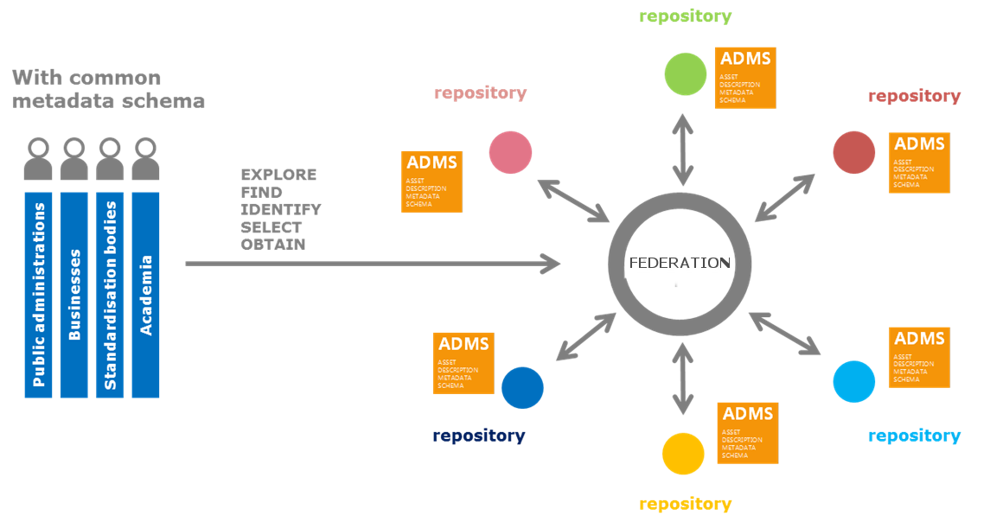
Examples of existing initiatives
ISA Programme – Action 1.1
The Asset Description Metadata Schema (ADMS) is a common way to describe semantic interoperability assets making it possible for everyone to search and discover them.
Source: https://joinup.ec.europa.eu/asset/adms/description

Slide 19
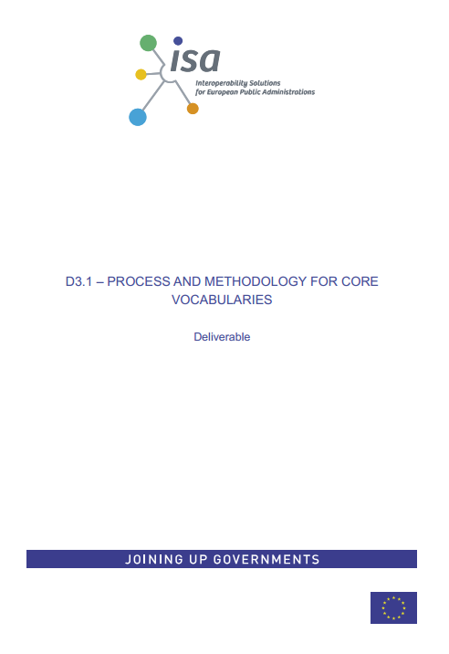


Examples of existing initiatives
ISA Programme – Action 1.1
Core Vocabularies: agreements on basic semantics
Part of action 1.1 highlights the importance to agree on a small set of simplified, reusable, context-free Core Vocabularies as a fundamental semantic basis for interoperable electronic public services.
Simplified, re-usable, and extensible data models that capture the fundamental characteristics of a data entity in a context-neutral fashion.
More on Core Vocabularies: see Course Module 2
Source: http://semic.eu

Slide 20
Examples of existing initiatives
ISA Programme – Action 1.1
DCAT: application profile for European data portal
The DCAT Application profile for data portals in Europe (DCAT-AP) is a specification based on the Data Catalogue vocabulary (DCAT) for describing public sector datasets in Europe. Its basic use case is to enable cross-data portal search for data sets and make public sector data better searchable across borders and sectors. This can be achieved by the exchange and federation of descriptions of data sets among data portals
Source: https://joinup.ec.europa.eu/asset/dcat_application_profile/description

Slide 21
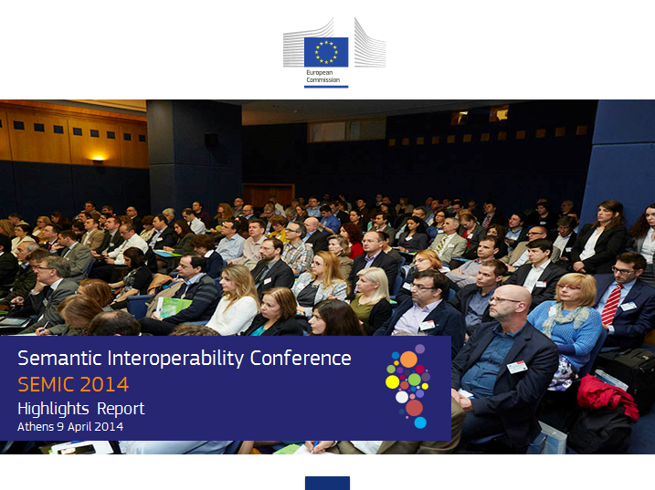

Examples of existing initiatives
ISA Programme – Action 1.1
Raising awareness on semantic interoperability and metadata management
To bring the issue of semantic interoperability to the attention of policy makers and ICT solution developers, a Semantic Interoperability Conference (SEMIC) is held annually.
Furthermore, Action 1.1 acts as an observatory and brings news and events about initiatives and issues related to semantic interoperability to the Joinup platform and to social media such as Twitter, and LinkedIn.
Source: http://semic.eu

Slide 22
Examples of existing initiatives
INSPIRE Data Models
The INSPIRE directive aims to create a European Union (EU) spatial data infrastructure. This will enable the sharing of environmental spatial information among public sector organisations and better facilitate public access to spatial information across Europe.
A European Spatial Data Infrastructure will assist in policy-making across boundaries. Therefore the spatial information considered under the directive is extensive and includes a great variety of topical and technical themes.
Themes:
Agricultural and Aquaculture Facilities
Area Management / Restriction / Regulation Zones and Reporting Units
Atmospheric Conditions and Meteorological Geographical Features
Bio-geographical Regions
Buildings
Energy Resources
Geology
Habitats and Biotopes
Land Cover
Mineral Resources
Natural Risk Zones
Oceanographic geographical features
Orthoimagery
Population Distribution
Sea Regions
Species Distribution
Statistical Units

Slide 23




Examples of existing initiatives
Semantic interoperability solutions by EU large-scale pilots
The "Large Scale Pilot" projects (LSPs) develop practical solutions tested in real government service cases across Europe. The LSP Programme is active in five main areas; eID, eProcurement, eBusiness, eHealth and eJustice to engage public authorities, service providers and research centres across the EU.
Examples of large scale pilots are:
e-CODEX: making justice faster
epSOS: making healthcare better
Stork: making access smarter
SPOCS: making business easier
PEPPOL: making procurement better
e-SENS: move services forward
http://ec.europa.eu/digital-agenda/en/egovernment

Slide 24
Examples of existing initiatives
UN/CEFACT Core Component Technical Specification (CCTS)
Within the United Nations framework of the Economic and Social Council, the United Nations Economic Commission for Europe (UNECE) serves as the focal point for trade facilitation recommendations and electronic business standards, covering both commercial and government business processes that can foster growth in international trade and related services. In this context, the United Nations Centre for Trade Facilitation and Electronic Business (UN/CEFACT) was established, as a subsidiary, intergovernmental body of the UNECE Committee on Trade, mandated to develop a programme of work of global relevance to achieve improved worldwide coordination and cooperation in these areas.
Methodology for:
creating new business vocabularies
restructuring existing business vocabularies to achieve semantic interoperability of data.
Source: http://www.unece.org/fileadmin/DAM/cefact/codesfortrade/CCTS/CCTS-Version3.pdf

Slide 25
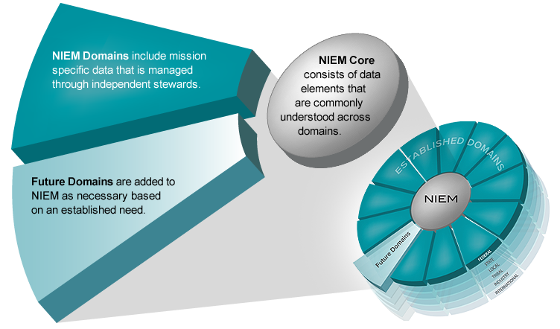
Examples of existing initiatives
NIEM (US initiative)
NIEM—the National Information Exchange Model—is a community-driven, government-wide, standards-based approach to exchanging information.
NIEM is designed as a core set of building blocks that are used as a consistent baseline for creating exchange documents and transactions across government.
NIEM is a framework consisting out of
2 key Components:
  A data dictionary of 6,000 agreed-upon
  terms that are commonly used in an
  information exchange, and
  A repeatable, reusable process for
  developing information exchange
  requirements
Source: https://www.niem.gov/Pages/default.aspx

Slide 26
References
European Interoperability Framework (EIF) for European public services. http://ec.europa.eu/isa/documents/isa_annex_ii_eif_en.pdf
ISO/IEC 11179-1, Information Technology – Metadata Registries (MDR) – Part 1: Framework (2004)
NISO, Understanding Metadata, 2004. http://www.niso.org/publications/press/UnderstandingMetadata.pdf
Peristeras, V., Loutas, N., Goudos, S. K., & Tarabanis, K. (2008). A conceptual analysis of semantic conflicts in pan-European e-government services. Journal of Information Science, 34(6), 877-891.

Slide 27

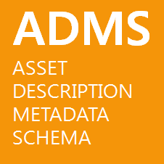



Project Officers Vassilios.Peristeras@ec.europa.eu
Suzanne.Wigard@ec.europa.eu
Athanasios.Karalopoulos@ec.europa.eu
Visit our initiatives
Get involved
Follow @SEMICeu on Twitter
Join the SEMIC group on LinkedIn
Join the SEMIC community on Joinup

