Slide 1
ISA Action 1.3: Catalogue of Services
CPSV Application Profile WG Virtual Meeting 2014-11-03

Slide 2
Outline
Round-table and collaboration in the working group (25’)
Context and discussion (35’)
First results of analysing the PSCs (20’)
Next steps (5’)
Common working terminology of key concepts (20’)
Q & A (5’)

Slide 3
Round-table and collaboration in the working group (20’)

Slide 4

Purpose of the
Working Group
1
  Building a standard data model for describing:
    Key business events (KBE) and related public services;
    Based on the ISA Core Public Service Vocabulary;
  Which will enable to:
    Provide high-quality descriptions of public services from a user-centric perspective by grouping them in key business events;
    Describe public services only once;
    Standardise descriptions of public services;
    Ease the integration of information available on other one-stop-shops.
KGBE
PS
PS
PS

Slide 5

Follow-up work
2
  Making available reusable tools for:
    Describing key business events and related public services;
    Publishing information about key business events and related public services on the PSCs;
    Setting up national public service portfolio management;
  Which will enable to:
    Provide machine-readable descriptions of KBEs and public services;
    Export and transform descriptions of KBEs and public services;
    Federate descriptions from regional and local portals and other one-stop-shops.
Results and deliverables from SPOCS will be reused where this meets the objectives.

Slide 6
Round table: Who is who?
Working group
Collaboration in the working group:
          Conference call system
          Public mailing list archive
          Issue tracker
          Contributor licence agreement
More information on process and tools to support the Working Group:
https://joinup.ec.europa.eu/asset/cpsv-ap/description

Slide 7
Process & methodology
CPSV
Current model
Proposed new classes & properties
Analysing the models for describing public services & business events PSCs
Commonalities & differences
Comparison with CPSV
Webinar meeting
Comments
New draft with proposed solutions
CPSV-AP

Slide 8
CPSV-AP: planning
EUGO subgroup:
EUGO subgroup:
EUGO subgroup:
EUGO subgroup:
All members of EUGO Network:
Webinar 1: November 3 14:00-16:00
Webinar 2: November 19 14:00-16:00
Webinar 3: December 1 14:00-16:00
Consultation period:
5 December – 8 January
Webinar 4: January 14 14:00-16:00
More information on process and tools to support the Working Group:
https://joinup.ec.europa.eu/asset/cpsv-ap/description

Slide 9
Context and discussion (35’)

Slide 10
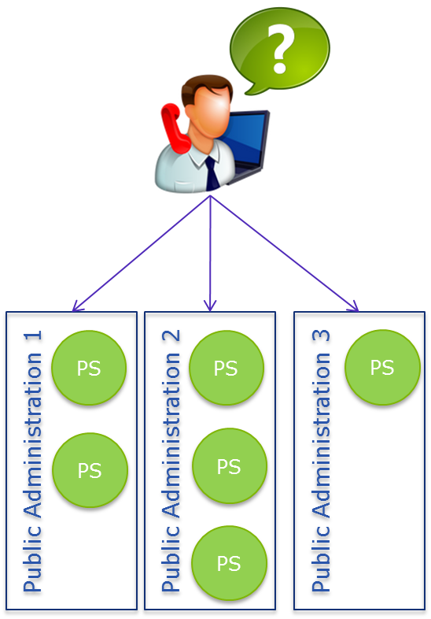
Points of Single Contact in EU Member States are facing several challenges:
Our understanding of the challenges PSCs face
Lack of coordination between the electronic
PSCs within the same country;
Fragmentation of responsibilities;
Different ways of describing and
representing business events and public services;
Lack of multilingual descriptions;
Redundant descriptions of business events and
public services;
Lack of business-centric approach for the PSCs;
Higher costs for maintenance of information;
No “single window” for accessing/initiating/ executing and following up on public services within and across borders.

Slide 11

What are your challenges?

Slide 12
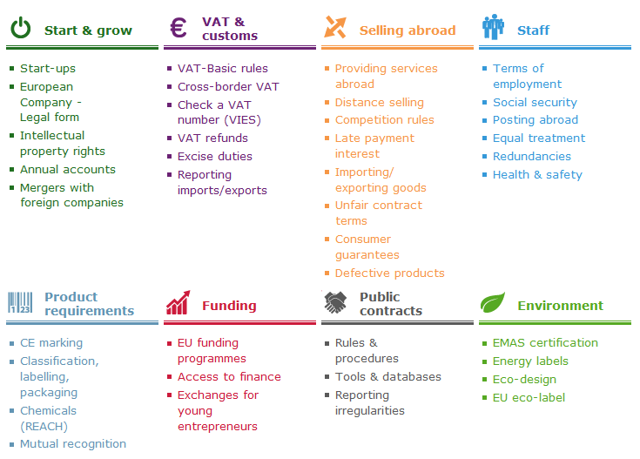
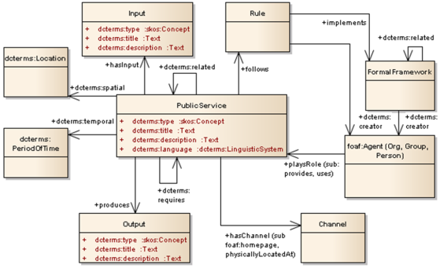
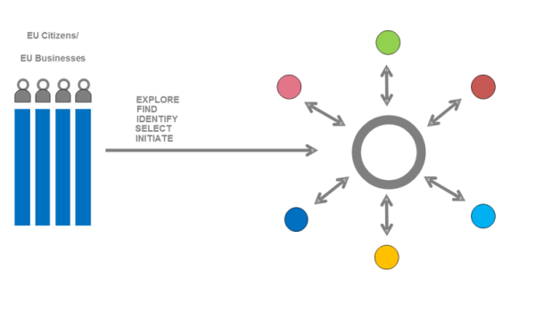
How are we going to tackle those challenges?
Organise PSCs around key business events – harmonised across the EU;
Standard and business-centric way of describing key business events and public services;
Flexible ways of integrating/connecting other one-stop-shops, such as PSCs, eGoverment portals, websites of Chamber of Commerce, by means of re-usable tools and specifications.

Slide 13
What’s the value?
  For public administrations…
  Improve the Points of Single Contact in an easy, efficient and interoperable manner through a standard data model;
  Mapping different public service models to a common model;
  Cost savings and reduction of administrative burden as a result of:
      Having more efficient communication with businesses and reducing the amount of interactions with the front office;
      Better management of public service information, i.e. describing public services only once and sharing these descriptions within and across MSs;
      Reusing software solutions and specifications for implementing the PSCs;
      Managing the lifecycle of public services and key business event, e.g. identifying gaps, retiring unused services, collecting service evaluation information for better informed investment in new services.

Slide 14
What’s the value?
  For businesses…
  It will lower administrative burden for businesses, while also improving their access to and experience of digital public services;
  Improve the efficiency and lower costs for businesses in taking care of administrative procedures;
  It will improve the perception of administration.

Slide 15
Common working terminology of key concepts (20’)

Slide 16
Common terminology
key concepts
Term | Definition
Administrative formality | Based on our analysis we conclude that the term “administrative formality” is a synonym of “public service”. We therefore refer to the definition of “public service”.
Public Service | A set of deeds and acts performed by or on behalf of a public administration for the benefit of a citizen, a business or another public administration.
Business Event | A certain stage in the business lifecycle with which a bundle of public services is associated in the context of a particular Member State.
Key Business Event | A Key Business Event comprises the generic stages of the business lifecycle, regardless from a specific Member State’s context, through which any business carries out its business activities and interaction with Government. We identify 12 Key Business Events: Starting a business Employing Staff Funding Business Operations & Trade Taxation and Finance Legal & Regulatory Innovation Premises & Environment Returns and Other Obligations Expanding your Business Selling to Government Closing or Selling a business
Public Service Portfolio | The complete set of public services that is managed by a governmental service provider. The service portfolio is used to manage the entire lifecycle of all public services, and includes three categories: service pipeline (proposed or in development), service catalogue (live or available for deployment), and retired services.
Catalogue of Public Services | A catalogue of public services is a collection of descriptions of active public services that are provided by a public administration at any administrative level (i.e. local, regional, national or pan-European). These descriptions are created following a common data model for representing public services.

Slide 17
CPSV: Working Group
Following the ISA Process and Methodology for developing core vocabularies, the CPSV Working Group was set up for the creation of the vocabulary. It consisted of the following types of stakeholders that partake in the public service provision process:
Owners/managers of e-Government portals operating at different
government levels.
Representatives of e-Government interoperability frameworks and strategies from the Member States and the Commission.
Experts from EU-funded Large Scale Pilot projects, e.g. SPOCS.
Representatives of standardisation bodies already active in service modelling, e.g. W3C, OASIS, The Open Group and OMG.
Representatives of software vendors and IT companies already active in service modelling, e.g. SAP and IBM.
Experts on service modelling (SOA, service science) from research institutes and universities across Europe and beyond.
The CPSV has been endorsed by the ISA TIE cluster Member State Representatives.

Slide 18

Current CPSV
  The Core Public Service Vocabulary is a simplified, reusable and extensible data model that captures the fundamental characteristics of a service offered by public administration. It has been designed to make it easy to exchange basic information about individual public sector services.

Slide 19
Known implementations
of the CPSV
EU - ISA Programme. The CPSV pilot “Describe your public service once to publish on multiple Government Access Portals” demonstrates that the Core Public Service can be used as a foundational RDF Vocabulary to homogenise public service data that originates from local, regional, and national e-Government portals. Finally the implementation shows that a linked data infrastructure can provide access to homogenised, linked and enriched public service data.
BE - Flemish Government. The Flemish Government is piloting the CPSV to publish its intergovernmental product and service catalogue as Linked Data.
EE – Integrated portfolio management of public services. The Estonian Ministry of Economic Affairs created an extension of the CPSV to address local needs, as well as to cover the public service lifecycle. New classes and properties were introduced to cover information related to security, evaluation and the underlying Web Service(s) supporting the delivery of a public service.

Slide 20
CPSV-AP
An Application Profile is a specification that re-uses terms from one
or more base standards, adding more specificity by identifying
mandatory, recommended and optional elements to be used for a
particular application, as well as recommendations for controlled
vocabularies to be used.
The CPSV-AP will:
  Add new classes and properties to the CPSV;
  Cover the representation of business events;
  Define a set of mandatory, recommended and optional properties for describing public services;
  Recommend a number of controlled vocabularies for different properties, with a primary focus on the identification of a common controlled vocabulary for public service types, which can then be linked to business events;
  Create formal, machine-readable mappings to the public service models of the 8 participating MSs to enable the semi-automatic exchange of information related to public services and key business events

Slide 21
First results of analysing the PSCs (20’)

Slide 22
First results of
analysing the PSCs
Presentation on the performed analysis of key business events and public services on the PSCs in the Member States
https://joinup.ec.europa.eu/node/107357
Presentation of the performed analysis of data models used for describing key business events and related public services in the Member States
https://joinup.ec.europa.eu/node/107361/

Slide 23
Next steps (5’)

Slide 24
What is expected
from you?
Get familiar with the CPSV-AP (section 6) and;
Review the analysis of the data model(s) to describe business events and public services on your country’s PSC (section 3):
https://joinup.ec.europa.eu/node/107361/
Review of analysis of key business events and public services available on your country’s PSC (spreadsheet):
https://joinup.ec.europa.eu/node/107357/

Slide 25
Next steps
Information about the next webinar:
https://joinup.ec.europa.eu/node/104692/
EUGO subgroup:
EUGO subgroup:
EUGO subgroup:
EUGO subgroup:
All members of EUGO Network:
Webinar 1: November 3 14:00-16:00
Webinar 2: November 19 14:00-16:00
Webinar 3: December 1 14:00-16:00
Consultation period:
5 December – 8 January
Webinar 4: January 14 14:00-16:00

Slide 26
Questions?
?

Slide 27

Contact us
Project Officer Miguel.Alvarez-Rodriguez@ec.europa.eu
Peter.Burian@ec.europa.eu
Contractors Nikolaos.Loutas@be.pwc.com
Michiel.de.Keyzer@be.pwc.com
Visit our initiatives

