Slide 1
Training Module 1.4
Introduction to metadata management
PwC firms help organisations and individuals create the value they’re looking for. We’re a network of firms in 158 countries with close to 180,000 people who are committed to delivering quality in assurance, tax and advisory services. Tell us what matters to you and find out more by visiting us at www.pwc.com.
PwC refers to the PwC network and/or one or more of its member firms, each of which is a separate legal entity. Please see www.pwc.com/structure for further details.

Slide 2
This presentation has been created by PwC
Authors:
Makx Dekkers, Michiel De Keyzer, Nikolaos Loutas and Stijn Goedertier
Presentation metadata
Disclaimers
The views expressed in this presentation are purely those of the authors and may not, in any circumstances, be interpreted as stating an official position of the European Commission.
The European Commission does not guarantee the accuracy of the information included in this presentation, nor does it accept any responsibility for any use thereof.
Reference herein to any specific products, specifications, process, or service by trade name, trademark, manufacturer, or otherwise, does not necessarily constitute or imply its endorsement, recommendation, or favouring by the European Commission.
All care has been taken by the author to ensure that s/he has obtained, where necessary, permission to use any parts of manuscripts including illustrations, maps, and graphs, on which intellectual property rights already exist from the titular holder(s) of such rights or from her/his or their legal representative.
This presentation has been carefully compiled by PwC, but no representation is made or warranty given (either express or implied) as to the completeness or accuracy of the information it contains. PwC is not liable for the information in this presentation or any decision or consequence based on the use of it.. PwC will not be liable for any damages arising from the use of the information contained in this presentation. The information contained in this presentation is of a general nature and is solely for guidance on matters of general interest. This presentation is not a substitute for professional advice on any particular matter. No reader should act on the basis of any matter contained in this publication without considering appropriate professional advice.
Open Data Support is funded by the European Commission under SMART 2012/0107 ‘Lot 2: Provision of services for the Publication, Access and Reuse of Open Public Data across the European Union, through existing open data portals’(Contract No. 30-CE-0530965/00-17).
© 2014 European Commission

Slide 3
Learning objectives
By the end of this training module you should have an understanding of:
  What metadata is;
  The terminology and objectives of metadata management;
  The different dimensions of metadata quality;
  The use of controlled vocabularies for metadata;
  Metadata exchange and aggregation;
  Metadata management in Open Data Support.
Notes:
UPDATE: fixed typo (5th bullet point)

Slide 4
Content
This module contains ...
An explanation of what is metadata;
An outline of the metadata lifecycle;
  An introduction to metadata quality;
  An overview of the metadata management and exchange approach implemented by Open Data Support through the Open Data Interoperability Platform.

Slide 5
What is metadata?
Definition, examples and reusable standards.

Slide 6
What is metadata?
“Metadata is structured information that describes, explains, locates, or otherwise makes it easier to retrieve, use, or manage an information resource. Metadata is often called data about data or information about information.”
-- National Information Standards Organization
http://www.niso.org/publications/press/UnderstandingMetadata.pdf
Metadata provides information enabling to make sense of data (e.g. documents, images, datasets), concepts (e.g. classification schemes) and real-world entities (e.g. people, organisations, places, paintings, products).

Slide 7
Types of metadata
  Descriptive metadata, describe a resource for purposes of discovery and identification.
Structural metadata, e.g. data models and reference data.
  Administrative metadata, provides information to help manage a resource.
In this tutorial we are focusing mainly on descriptive metadata for datasets.
Administrative metadata is also partly covered.
Notes:
Added slide.

Slide 8

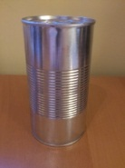
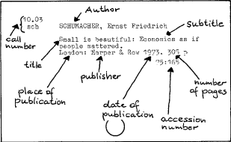

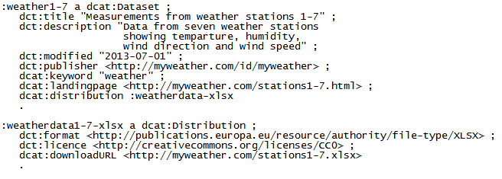
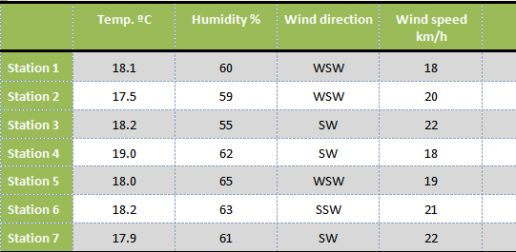
Examples of metadata
Label
Catalogue card
Dataset description (DCAT)
Can
Book
Dataset
Provides metadata on

Slide 9
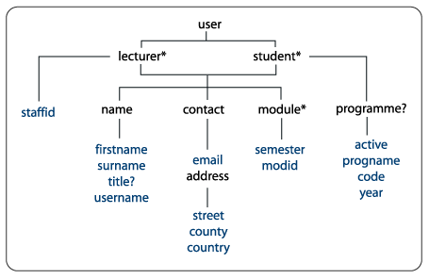
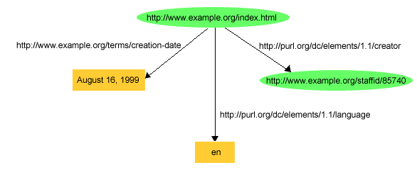
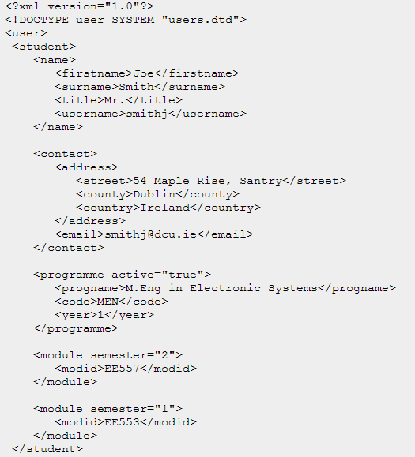

Two approaches for providing metadata on the Web
XML (Tree/container approach)
RDF (Triple-based approach)

Slide 10
Managing the metadata of your datasets
Notes:
Updated text on slide.

Slide 11
Metadata management is important
Metadata needs to be managed to ensure ...
  Availability: metadata needs to be stored where it can be accessed and indexed so it can be found.
  Quality: metadata needs to be of consistent quality so users know that it can be trusted.
  Persistence: metadata needs to be kept over time.
  Open License: metadata should be available under a public domain license to enable its reuse.
The metadata lifecycle is larger than the data lifecycle:
  Metadata may be created before data is created or captured, e.g. to inform about data that will be available in the future.
  Metadata needs to be kept after data has been removed, e.g. to inform about data that has been decommissioned or withdrawn.

Slide 12
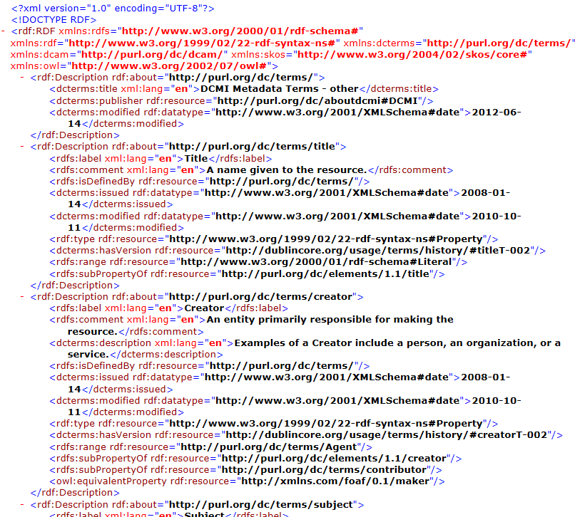
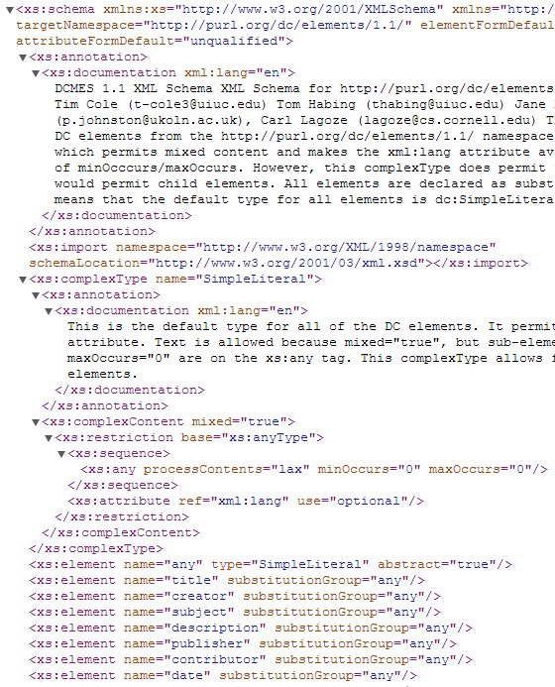
Metadata schema
“A labelling, tagging or coding system used for recording cataloguing information or structuring descriptive records. A metadata schema establishes and defines data elements and the rules governing the use of data elements to describe a resource.”
XML Schema
RDF Schema

Slide 13
Reuse existing vocabularies for providing metadata to your resources
General purpose standards and specifications:
  Dublin Core for published material (text, images), http://dublincore.org/documents/dcmi-terms/
  FOAF for people and organisations, http://xmlns.com/foaf/spec/
  SKOS for concept collections, http://www.w3.org/TR/skos-reference
  ADMS for interoperability assets, http://www.w3.org/TR/vocab-adms/
Specific standard for datasets:
  Data Catalog Vocabulary DCAT, http://www.w3.org/TR/vocab-dcat/
Specific usage of DCAT and other vocabularies to support interoperability of data portals across Europe:
  DCAT application profile for data portals in Europe, http://joinup.ec.europa.eu/asset/dcat_application_profile/description
Notes:
Slide moved here.

Slide 14
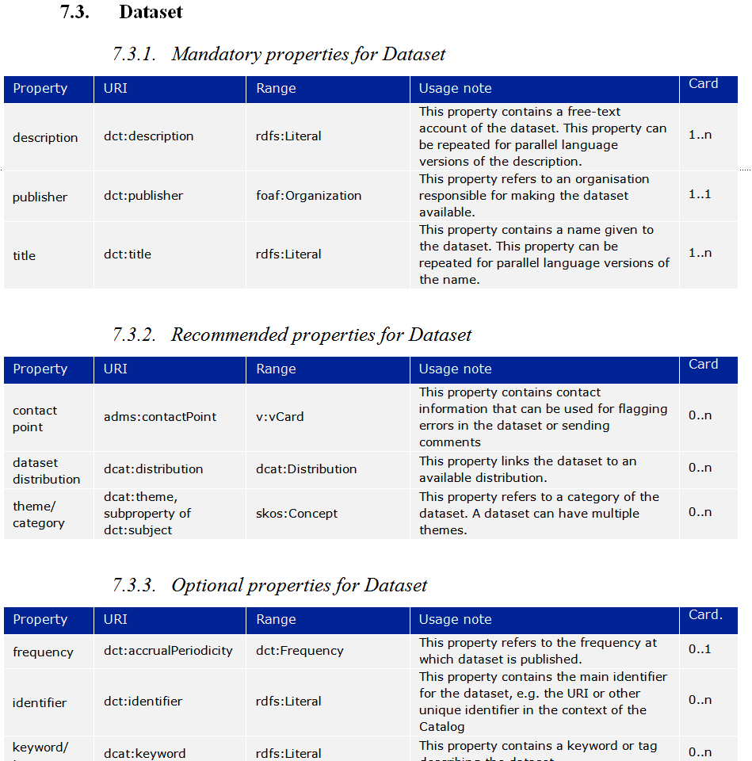
Designing your metadata schema with RDF Schema (RDFS) – reuse where possible
RDF schema is particularly good in combining terms from different standards and specifications.
Do not re-invent terms that are already defined somewhere else , when designing RDF schemas – reuse terms where possible.
  For example, the DCAT Application Profile for data portals in Europe (DCAT-AP) reuses terms from DCAT, Dublin Core, FOAF, SKOS, ADMS and others.

Slide 15
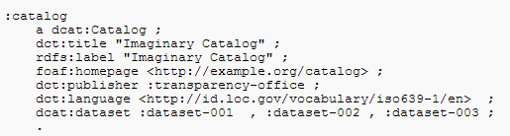
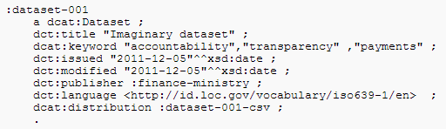
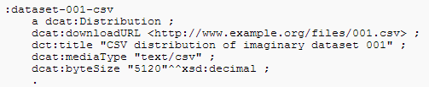
Example: description of an open dataset with the DCAT-AP
Description of the Catalogue
Description of the
Dataset
Description of the Distribution

Slide 16
Controlled vocabularies
Using thesauri, taxonomies and standardised lists of terms for assigning values to metadata properties.

Slide 17
What are controlled vocabularies?
A controlled vocabulary is a predefined list of values to be used as values for a specific property in your metadata schema.
  In addition to careful design of schemas, the value spaces of metadata properties are important for the exchange of information, and thus interoperability.
  Common controlled vocabularies for value spaces make metadata understandable across systems.

Slide 18

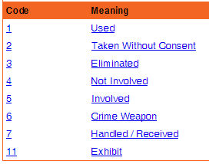
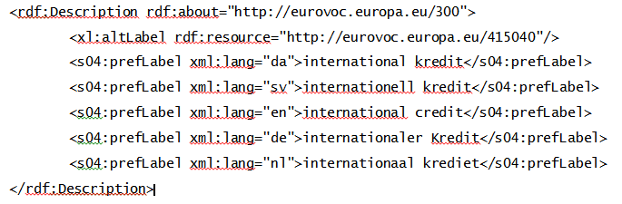
Which controlled vocabulary to be used for which type of property
  Use code lists as controlled vocabulary for free text or “string” properties.
Example DCAT-AP property:
Example code list - ObjectInCrimeClass (ListPoint)
  Use concepts identified by a URI for reference to “things”.
Example DCAT-AP property:
  Example taxonomy with terms having a URI - EuroVoc

Slide 19
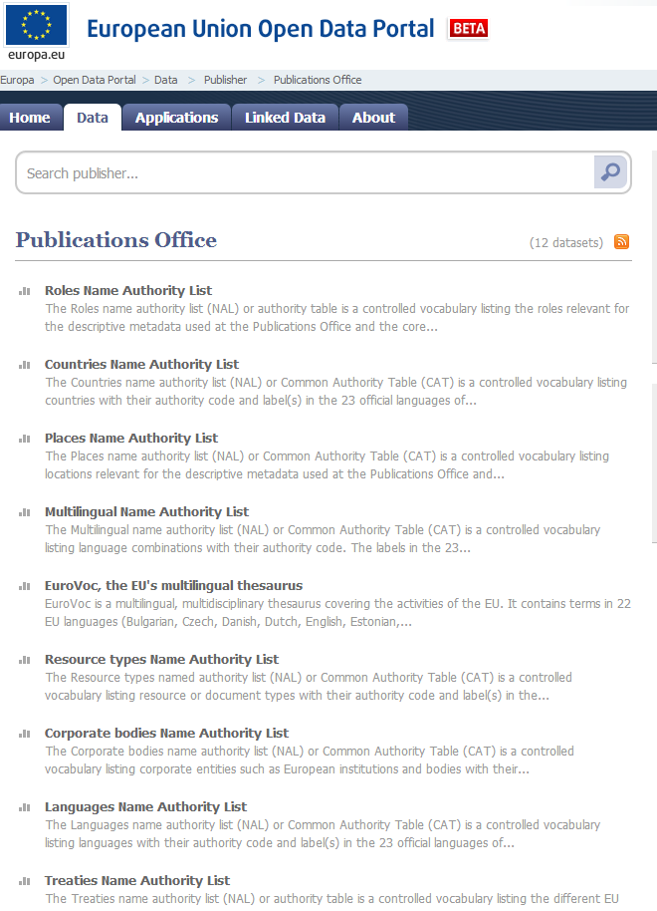
Example –Publications Office’s Named Authority Lists
  The Named Authority Lists offer reusable controlled vocabularies for:
      Countries
      Corporate bodies
      File types
      Interinstitutional procedures
      Languages
      Multilingual
      Resource types
      Roles
      Treaties

Slide 20
The metadata lifecycle
Creating, maintaining, updating, storing, publishing metadata and handling deletion of data.

Slide 21
Creating your metadata
Metadata creation can be supported by (semi-)automatic processes.
  Document properties generated in (office) tools, e.g. creation date.
  Spatial and temporal information captured by cameras, sensors...
  Information from publication workflow, e.g. file location or URL
However, other characteristics require human intervention:
  What is the resource about (e.g. linking to a subject vocabulary)?
  How can the resource be used (e.g. linking to a licence)?
  Where can I find more information about this resource (e.g. linking to a Web site or documentation that describes the resource)?
  How can quality information be included?

Slide 22
Maintaining your metadata
Approaches for maintaining metadata need to be appropriate for the type of data that is being published.
  If data does not change, metadata can be relatively stable. Changes (bulk conversions) can take place off-line when needed.
  If data changes frequently (e.g. real-time sensor data), metadata needs to be closely coupled to the data workflow and changes need to be practically instantaneous.

Slide 23
Updating your metadata – planning for change
Metadata operates in a global context that is subject to change!
  Organisation – departments are established, merge with others, responsibilities are handed over.
  Usage of the data – new applications emerge around data.
  Reference data – controlled vocabularies evolve and get linked.
  Data standards and technologies – technology lifecycle is getting shorter all the time; what will tomorrow’s Web look like?
  Tools and systems – evolution of storage, bandwidth, mobile...
  Metadata needs to be kept up-to-date to the extent possible, taking into account the available time and budget.

Slide 24
Storing your metadata – what are the options?
  Depending on operational requirements, metadata can be embedded with the data or stored separately from the data.
  Embedding the metadata in the data (e.g. office documents, MP3, JPG, RDF data) embedding makes data exchange easier.
  Separating metadata from data (e.g. in a database), with links to corresponding data files makes management easier.
  Depending on the availability of tools and requirements on performance and capacity, metadata can be stored in a ‘classic’ relational database or an RDF triple store.

Slide 25
Handling deletions of data
In many cases, metadata must survive even after deletion of the data it describes.
Decommissioning or deletion of data happens, for example:
  When data is no longer necessary.
  When data is no longer valid.
  When data is wrong.
  When data is withdrawn by the owner/publisher
In that case the metadata should, contain information that the data was deleted, and if it was archived, how and where an archival copy can be requested.

Slide 26
Publishing your metadata – what are the options?
  ‘Open’ publication: direct access on URIs
    This is the option most in line with the vision of Linked Open Data and allows the ‘follow-your-nose’ principle.
  Make your metadata available through a SPARQL endpoint
    This allows external systems to send queries to an RDF triple store.
    Requires knowledge about the schema used in the triple store.
  Deferred publication: access to exported file in RDF
    Produced by converting non-RDF data to RDF.
    Allows off-line bulk harvesting and caching of data collections.
    Allows implementation of access control.
See also:
http://www.slideshare.net/OpenDataSupport/licence-your-data-metadata

Slide 27
Metadata quality
The quality and completeness of the description metadata of your datasets, directly affects their searchability and reuse.
Notes:
UPDATE: replaced “infect” by “affects”

Slide 28
Metadata quality is about... (1/3)
  The accuracy of your metadata - are the characteristics of the resource correctly reflected?
    e.g. indicating the right title, the right license, the right publisher enables users to discover resources that they need.
  The availability of your metadata – can the metadata be accessed now and over time into the future?
    e.g. making it available for indexing and downloading, and include it in in a regular back-up process.
  The completeness of your metadata – are all relevant characteristics of the resource captured (as far as practically and economically feasible and necessary for the application)?
    e.g. indicating the licence that governs reuse or the format of the distribution enables filters on those aspects.
See also:
http://www.slideshare.net/OpenDataSupport/open-data-quality
Notes:
Fixed typos.

Slide 29
Metadata quality is about ... (2/3)
  The conformance of your metadata to accepted standards – is the metadata conforming to a specific metadata standard or an Application Profile?
    e.g. the description of a dataset conforms to the DCAT-AP.
  The consistency of your metadata – does the data not contain contradictions?
    e.g. not having multiple and contradictory license statements for the same piece of data.
  The credibility and provenance of your metadata – is the metadata based on trustworthy sources?
    e.g. linking to reference data published and managed by a stable organisation (e.g. the EU Publications Office).
Notes:
Updated first example.

Slide 30
Metadata quality is about ... (3/3)
  The processability of the metadata – is the metadata properly machine-readable?
    e.g. making the metadata of a dataset available in RDF and/or XML, and not as free text.
  The relevance of the metadata – does the metadata contain the right amount of information for the task at hand?
    e.g. limit the information to optimally serve the users’ needs.
  The timeliness of your metadata – is the metadata corresponding to the actual (current) characteristics of the resource and is it published soon enough?
    e.g. indicating the last modification date of the resource, thus making sure the metadata is fresh so that users will see the latest information.
Notes:
Updated examples 1 & 3.

Slide 31
Exchanging metadata of datasets
Mapping your metadata to a common metadata vocabulary, such as the DCAT-AP, and exchanging the metadata across platforms.
Notes:
Updated text.

Slide 32
Homogenising metadata
When exchanged between systems, metadata should be mapped to a common model so that the sender and the recipient share a common understanding on the meaning of the metadata.
  On the schema level metadata coming from different sources can be based on different metadata schemas, e.g. DCAT, schema.org, CERIF, own internal model...
  On the data (value) level, the metadata properties should be assigned values from different controlled vocabularies or syntaxes, e.g.:
    Language: English can be expressed as http://publications.europa.eu/resource/authority/language/ENG or as http://id.loc.gov/vocabulary/iso639-1/en
    Dates: ISO8601 (“20130101”) versus W3C DTF (“2013-01-01”)

Slide 33
Example: Homogenising metadata about datasets The DCAT Application Profile for data portals in Europe
The DCAT-AP can be used as the common model for exchanging metadata with open data platforms across Europe and/or with a data broker (e.g. The Open Data Interoperability Platform - ODIP).
See also:
http://joinup.ec.europa.eu/asset/dcat_application_profile/home

Slide 34
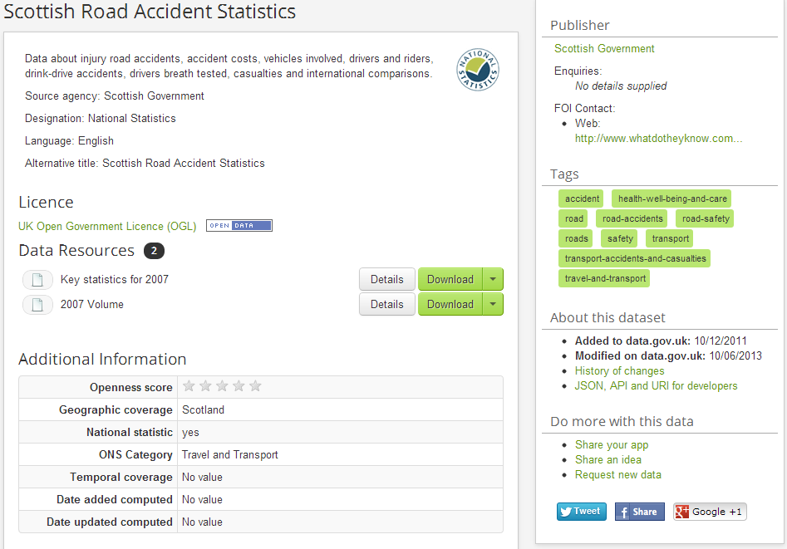
Mapping example – data.gov.uk
dct:title (Dataset)
dct:publisher
dct:description
adms:contactPoint
dct:language
dct:license
Dcat:accessURL
dcat:keyword
dct:title (Distribution)
dcat:downloadURL, dct:issued, dct:format, dct: description
dct:issued
dct:modified
dct:spatial
dct:theme
dct:temporal

Slide 35
What can the Open Data Interoperability Platform do?
  Harvest metadata from an Open Data portal.
  Transform the metadata to RDF.
  Harmonise the RDF metadata
  produced in the previous steps with DCAT-AP.
  Validate the harmonised metadata
  against the DCAT-AP.
  Publish the description metadata as Linked Open Data.
ODIPP
Pan-European Data portal
See also:
http://www.slideshare.net/OpenDataSupport/promoting-the-re-use-of-open-data-through-odip

Slide 36
Conclusions
  Metadata provides information on your data and resources. The quality of the metadata directly affects the discoverability and reuse of your the resources.
  A structured approach should be followed for metadata management.
  The metadata lifecycle extends the lifecycle of datasets (metadata before publication and after deletion).
  Homogenised metadata enable the operation of metadata brokers, which can in turn lower the access barriers to your resources, leading to improved visibility and discoverability, and thus increasing their reuse potential.
Notes:
This should be rather the take home messages.

Slide 37

Group exercise and questions
  In groups of two, select one dataset from your country and describe it with the DCAT Application Profile.
  Does your organisation have a minimum set of metadata to be provided together with Open Data?
  What would be the main barriers, according to you, for the (re)use of standard controlled vocabularies in your metadata?
  Do you have any data and/or metadata governance methodology at the corporate level?
http://www.visualpharm.com
http://www.visualpharm.com
http://www.visualpharm.com
http://www.visualpharm.com
Take also the online test here!
Notes:
UPDATE: added “take also the...” + link

Slide 38
Thank you!
...and now YOUR questions?

Slide 39
References
Slide 6, 7:
NISO. Understanding Metadata. http://www.niso.org/publications/press/UnderstandingMetadata.pdf
Slide 9:
  Dublin City University. Chapter 3: Introduction to XML. http://wiki.eeng.dcu.ie/ee557/g2/326-EE.html
W3C. RDF Primer. http://www.w3.org/TR/rdf-primer/
Slide 12:
http://gondolin.rutgers.edu/MIC/text/how/catalog_glossary.htm
  Dublin Core. Example XML Schema. http://dublincore.org/schemas/xmls/qdc/dc.xsd
  Dublin Core, Example RDF Schema. http://dublincore.org/2012/06/14/dcterms.rdf
Slide 14, 33:
  The ISA Programme. DCAT Application Profile for Data Portals in Europe - Final Draft. https://joinup.ec.europa.eu/asset/dcat_application_profile/asset_release/dcat-application-profile-data-portals-europe-final-draf
Slide 18:
  ListPoint. ObjectInCrimeClass. http://www.listpoint.co.uk/CodeList/details/ObjectInCrimeClass/1.2/1
Slide 19:
  Publications Office. Countries Name Authority List. http://open-data.europa.eu/en/data/dataset/2nM4aG8LdHG6RBMumfkNzQ
Notes:
Updated.

Slide 40
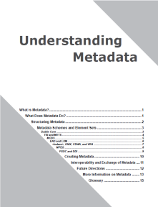
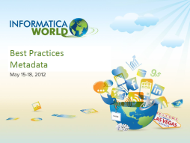
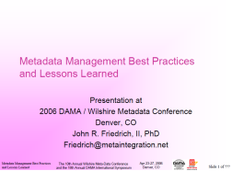
Further reading
Understanding Metadata, NISO. http://www.niso.org/publications/press/UnderstandingMetadata.pdf
Ben Jareo and Malcolm Saldanha. The value proposition of a metadata driven data governance program. Best Practices Metadata. May 2012. https://community.informatica.com/mpresources/Communities/IW2012/Docs/bos_30.pdf
John R. Friedrich, II. Metadata Management Best Practices and Lessons Learned. The 10th Annual Wilshire Meta-Data Conference and the 18th Annual DAMA International Symposium. April 2006. http://www.metaintegration.net/Publications/2006-Wilshire-DAMA-MetaIntegrationBestPractices.pdf

Slide 41





Related initiatives
  Metadata Management. Trainer screencasts, http://managemetadata.com/screencasts/msa/
MIT Libraries. Data Management and Publishing. Reasons to Manage and Publish Your Data, http://libraries.mit.edu/guides/subjects/data-management/why.html
ISA Programme. DCAT Application Profile for European Data Portals, https://joinup.ec.europa.eu/asset/dcat_application_profile/description
Generating ADMS-based descriptions of assets using Open Refine RDF, https://joinup.ec.europa.eu/asset/adms/document/generate-adms-asset-descriptions-spreadsheet-refine-rdf
The Dublin Core Medatata Initiative, http://dublincore.org/

Slide 42





Be part of our team...
Find us on
Join us on
Open Data Support
http://www.slideshare.net/OpenDataSupport
Open Data Support
http://goo.gl/y9ZZI
http://www.opendatasupport.eu
Follow us
Contact us
@OpenDataSupport
    contact@opendatasupport.eu

