Slide 1
Training Module 1.5
Promoting the reuse of Open Government Data through the Open Data Interoperability Platform (ODIP)
PwC firms help organisations and individuals create the value they’re looking for. We’re a network of firms in 158 countries with close to 180,000 people who are committed to delivering quality in assurance, tax and advisory services. Tell us what matters to you and find out more by visiting us at www.pwc.com.
PwC refers to the PwC network and/or one or more of its member firms, each of which is a separate legal entity. Please see www.pwc.com/structure for further details.

Slide 2
This presentation has been created by PwC
Authors:
Michiel De Keyzer, Nikolaos Loutas and Stijn Goedertier
Presentation metadata
Disclaimers
The views expressed in this presentation are purely those of the authors and may not, in any circumstances, be interpreted as stating an official position of the European Commission.
The European Commission does not guarantee the accuracy of the information included in this presentation, nor does it accept any responsibility for any use thereof.
Reference herein to any specific products, specifications, process, or service by trade name, trademark, manufacturer, or otherwise, does not necessarily constitute or imply its endorsement, recommendation, or favouring by the European Commission.
All care has been taken by the author to ensure that s/he has obtained, where necessary, permission to use any parts of manuscripts including illustrations, maps, and graphs, on which intellectual property rights already exist from the titular holder(s) of such rights or from her/his or their legal representative.
This presentation has been carefully compiled by PwC, but no representation is made or warranty given (either express or implied) as to the completeness or accuracy of the information it contains. PwC is not liable for the information in this presentation or any decision or consequence based on the use of it.. PwC will not be liable for any damages arising from the use of the information contained in this presentation. The information contained in this presentation is of a general nature and is solely for guidance on matters of general interest. This presentation is not a substitute for professional advice on any particular matter. No reader should act on the basis of any matter contained in this publication without considering appropriate professional advice.
Open Data Support is funded by the European Commission under SMART 2012/0107 ‘Lot 2: Provision of services for the Publication, Access and Reuse of Open Public Data across the European Union, through existing open data portals’ (Contract No. 30-CE-0530965/00-17).
© 2014 European Commission

Slide 3
Learning objectives
By the end of this training module you should have an understanding of:
How you can overcome the barriers of reuse for your datasets.
How Open Data Support can promote the reuse of datasets.
What the DCAT Application Profile is and how it can be used.
  What Open Data Interoperability Platform (ODIP) is and how it can be used.

Slide 4
Content
This module contains...
An outline of the context of Open Government Data in Europe.
An outline of the Open Data Support project.
  Information about the DCAT Application Profile for Data Portals in Europe as a homogenised metadata model.
Information on how to use the Open Data Interoperability Platform.

Slide 5

There are more than 160 portals in Europe hosting Open Government Data
Provenance?
Persistence?
Licence?
Availability?
Trust?
Quality?
160+
Notes:
Updated slide.

Slide 6






Open Data has a great potential to create social and economic value
Publishing data
Public administrations share data online
Developers / Companies integrate data into app (services)
Developers / Companies search for data
Citizens/businesses benefits from the app (services)
Reusing data

Slide 7
Barriers to Open Data publishing and reuse
Data publishers | Data reusers
No view on which data is more likely to be reused / has a higher ROI potential. | Lack of overview of existing/available datasets.
Unclear business model for publishing Open Data. | Unclear business model for reusing Open Data.
Limited tool support. | Data is often of low quality, outdated, unstructured and/or not machine-readable.
Competing licenses for datasets. | Lack of licensing information or incompatible licenses.
Competing vocabularies for describing datasets. | Different vocabularies when searching for datasets.
Domain-specific metadata needs. | Lack of (good quality) metadata.
Effort required for keeping the metadata up-to-date. | Lack of provenance information.
Metadata
Metadata

Slide 8

No reuse = No social and economic value
Public administrations share data online
Developers / Companies integrate data into app (services)
Developers / Companies search for data
Citizens/businesses benefits from the app (services)

Slide 9
Open Data Support
...funded by the European Commission, DG CONNECT, aims at lowering accessibility and awareness barriers.

Slide 10



Open Data Support mission...
To Improve the and facilitate the to datasets published on local and national Open Data portals in order to increase their within and across borders.
See also:
http://www.slideshare.net/OpenDataSupport

Slide 11


By ...
Providing
to metadata descriptions of open datasets via a
Pan-European Data portal
ODIPP

Slide 12
DCAT Application Profile
A common vocabulary for describing datasets hosted in data portals in Europe, based on the Data Catalogue vocabulary (DCAT).

Slide 13




A shared initiative of ...
Funded by the ISA Programme under Action 1.1. “Improving semantic interoperability in European eGovernment systems” (a.k.a the SEMIC project).

Slide 14
An international Working Group of experts
Chair: Antonio Carneiro (Publications Office)
59 Working Group members representing:
    15 different European Member States (UK,IT,ES,DK,DE,SK,BE,AT,SE,FI,FR,IE,NL,GR,SI )
    US
    Several European Institutions and international organisations
    40 different Data Portals
See also:
https://joinup.ec.europa.eu/asset/dcat_application_profile/description
Notes:
Updated the number and the list of EU MSs, removed Norway.

Slide 15
By using a common metadata schema to describe datasets and sharing metadata...
  Data publishers increase discoverability and thus reuse of their data.
  Data reusers can uniformly search across platforms without facing difficulties caused by the use of separate models or language differences.
The quality and the availability of the description metadata directly affects how easily datasets can be found!

Slide 16
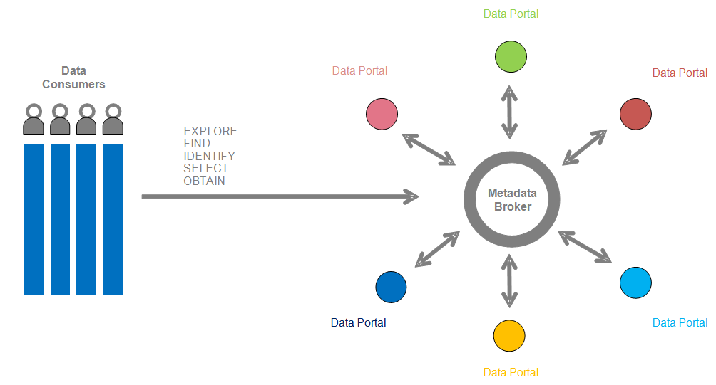
The DCAT-AP enables the exchange of description metadata between data portals

Slide 17
What’s in the specification?

Slide 18
The DCAT Application Profile data model

Slide 19
Usage of the DCAT Application Profile
Mandatory class: a receiver of data must be able to process information about instances of the class; a sender of data must provide information about instances of the class.
Recommended class: a receiver of data must be able to process information about instances of the class; a sender of data must provide information about instances of the class, if it is available.
Optional class: a receiver must be able to process information about instances of the class; a sender may provide the information but is not obliged to do so.
Mandatory property: a receiver must be able to process the information for that property; a sender must provide the information for that property.
Recommended property: a receiver must be able to process the information for that property; a sender should provide the information for that property if it is available.
Optional property: a receiver must be able to process the information for that property; a sender may provide the information for that property but is not obliged to do so.

Slide 20
Controlled vocabularies
Property URI | Used for Class | Proposed vocabulary
dcat:mediaType | Distribution | MDR File types Name Authority List
dcat:theme | Dataset | EuroVoc domains
dcat:themeTaxonomy | Catalog | EuroVoc
dct:accrualPeriodicity | Dataset | Dublin Core Collection Description Frequency Vocabulary
dct:format | Distribution | MDR File Type Named Authority List
dct:language | Catalog, Dataset | MDR Languages Named Authority List
dct:publisher | Catalog, Dataset | MDR Corporate bodies Named Authority List
dct:spatial | Catalog, Dataset | MDR Countries Named Authority List, MDR Places Named Authority List
adms:status | CatalogRecord | ADMS change type vocabulary
dct:type | License Document | ADMS license type vocabulary

Slide 21
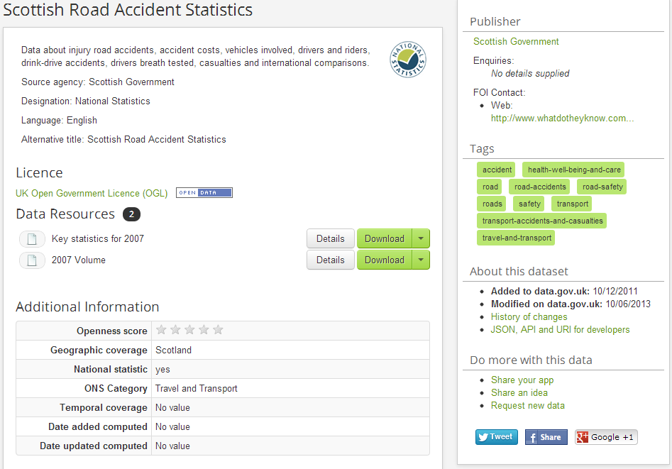
Mapping example – data.gov.uk
dct:title (Dataset)
dct:publisher
dct:description
adms:contactPoint
dct:language
dct:license
Dcat:accessURL
dcat:keyword
dct:title (Distribution)
dcat:downloadURL, dct:issued, dct:format, dct: description
dct:issued
dct:modified
dct:spatial
dct:theme
dct:temporal

Slide 22
Example description of dataset with the DCAT-AP
<rdf:Description rdf:about=“http://data.gov.uk/data ">
<rdf:type rdf:resource=“http://www.w3.org/ns/dcat#Catalog”/>
<dct:title xml:lang=“en”>data.gov.uk</dct:title>
<dct:description xml:lang=“en”>Description of the data portal</dct:description>
<dct:license rdf:resource=” http://www.nationalarchives.gov.uk/doc/open-government-licence”/>
</rdf:Description>
<rdf:Description rdf:about=“http://data.gov.uk/dataset/east-sussex-county-council-election-results”/>
<rdf:type rdf:resource=“http://www.w3.org/ns/dcat#Dataset”/>
<dct:title xml:lang=”en”>East Sussex County Council election results</dct:title>
<dct:description xml:lang=“en”>A list of elections to East Sussex County Council, which leads to data about candidates, parties, electoral divisions and votes cast. Uses the Open Election Data RDF vocabulary from http://openelectiondata.org/
</dct:description>
</rdf:Description>
<rdf:Description rdf:adbout=“http://www.eastsussex.gov.uk/yourcouncil/localelections/election2009/default.aspx”/>
<rdf:type rdf:resource=“http://www.w3.org/ns/dcat#Distribution”/>
<dct:title xml:lang=“en”>East Sussex County Council election 4 June 2009, and subsequent bi-elections</dct:title>
<dcat:accessURL rdf:resource=“http://www.eastsussex.gov.uk/yourcouncil/localelections/election2009/default.aspx “/>
<dct:license rdf:resource=“http://www.nationalarchives.gov.uk/doc/open-government-licence”/>
</rdf:Description>

Slide 23
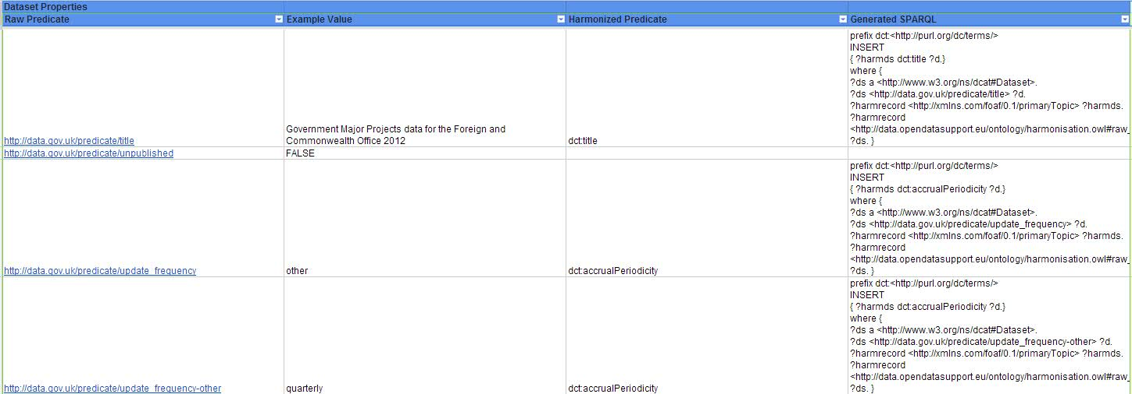
Creating mappings to the DCAT-AP

Slide 24
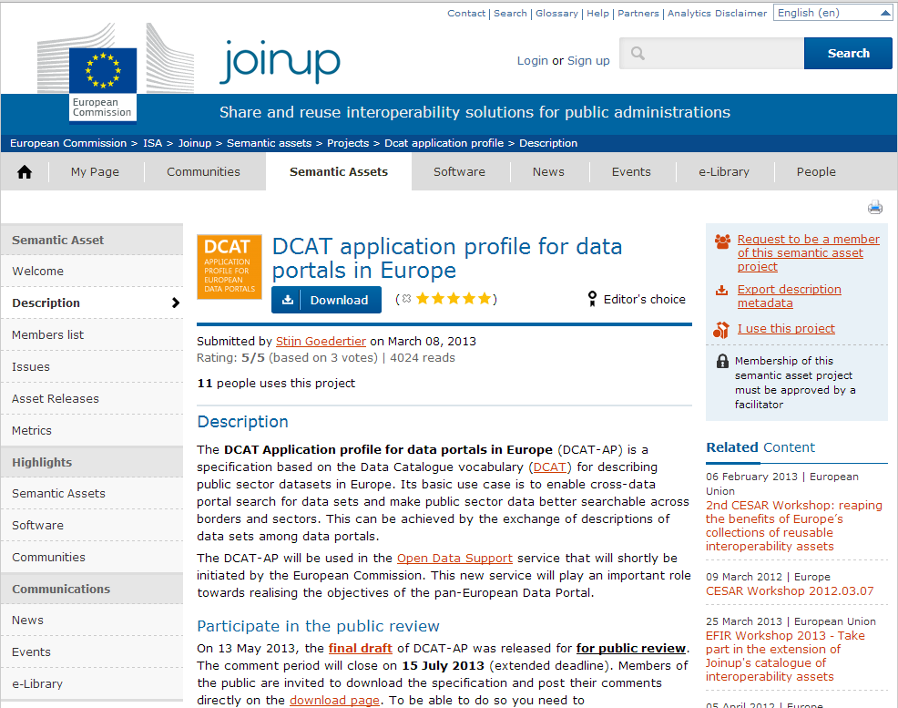
Where can you find it?
https://joinup.ec.europa.eu/asset/dcat_application_profile/description
Notes:
Moved the slide here.

Slide 25
Share the metadata of you datasets on ODIP
The Open Data Interoperability Platform (ODIP) enables you to share metadata of datasets described using the DCAT-AP, thus improving the discoverability and visibility of your datasets, eventually leading to wider reuse.
Notes:
Updated text.

Slide 26
What can ODIP do?
  Harvest metadata from an Open Data portal.
  Transform the metadata to RDF.
  Harmonise the RDF metadata
  produced in the previous steps with DCAT-AP.
  Validate the harmonised metadata
  against the DCAT-AP.
  Publish the description metadata as Linked Open Metadata.
  Translate metadata automatically in English
ODIPP
Pan-European Data portal
Notes:
UPDATE: translate function

Slide 27
How can ODIP help you improve your metadata?
ODIP maps your metadata to a standard model, i.e. the DCAT-AP.
  ODIP helps you reuse standardised multilingual controlled vocabularies in your metadata, replacing error-prone text values or tailor-made lists.
  By means of its validation services, ODIP allows you to detect inconsistencies and errors in your metadata.
  ODIP assigns persistent URIs to your metadata.
  ODIP links your metadata with other metadata, thus adding context to it and enriching its meaning.
  ODIP automatically translates the title and description of the metadata to English.
Notes:
UPDATE: last point

Slide 28
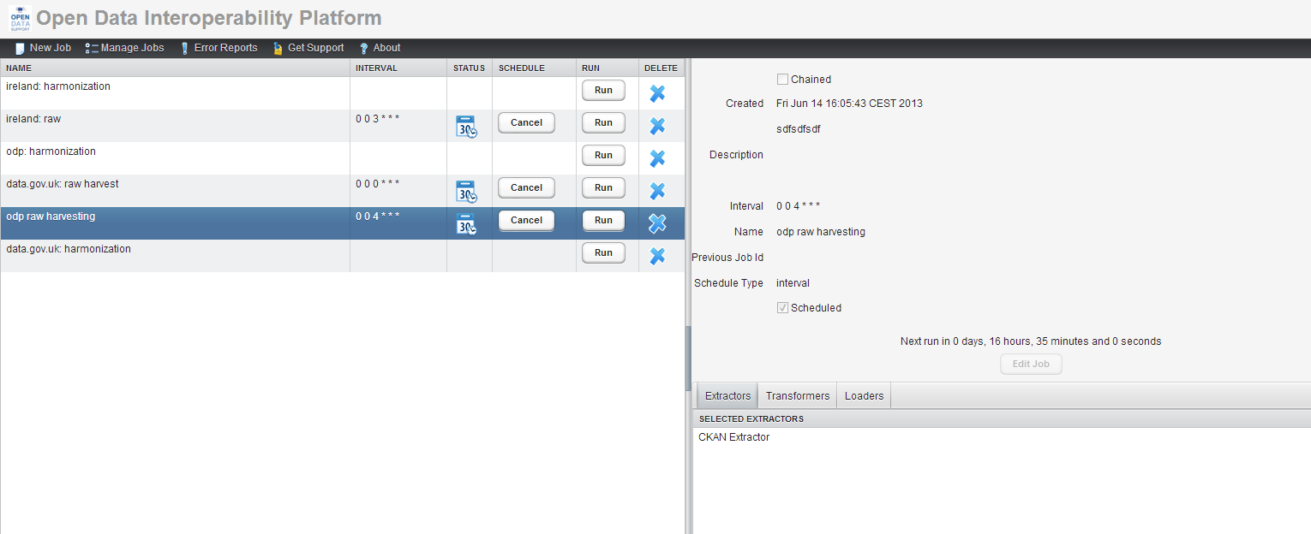
How does ODIP look like?
http://odip.opendatasupport.eu

Slide 29
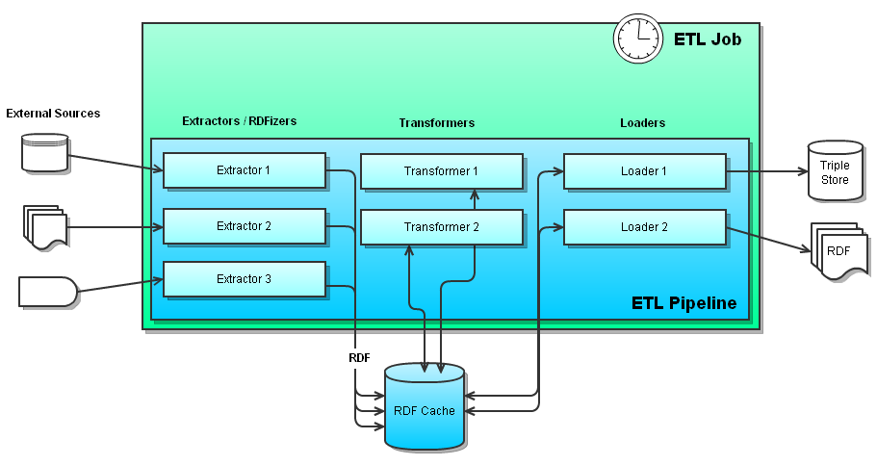
An ODIP Job
The ODIP job consists of three possible phases which need to be ran in order and that are composed of several plug-ins :
Extraction
Transformation
Loading
Furthermore these jobs can be scheduled to be launched periodically, in succession or manually.

Slide 30
Overview of ODIP’s Extract-Transform-Load process

Slide 31
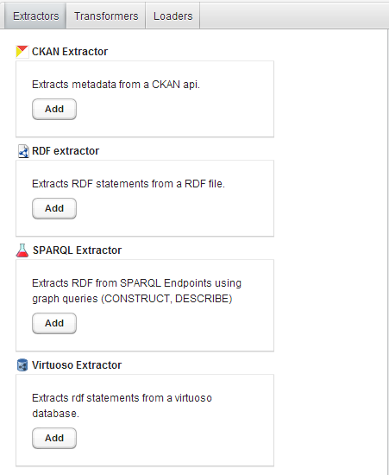
1. Extraction
  The extraction phase entails retrieving (extracting) raw data from a given source Open Data portal using the appropriate plug-in, depending on the technology of the source.
  Available extractors:
    CKAN Extractor
    RDF extractor
    SPARQL Extractor
    Virtuoso Extractor
    CSV Extractor

Slide 32
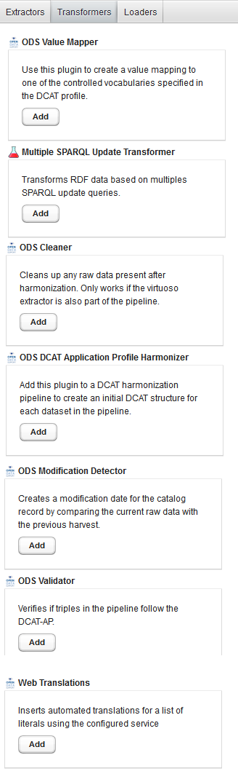
2. Transformation (1/3)
  The goal of the transformation phase is to harmonise, cleanse and prepare for storing on ODIP metadata harvested from Open Data portals.
  Available transformers:
    ODS Value Mapper.
    SPARQL Update Query Transformer.
    ODS Cleaner.
    ODS DCAT Application Profile Harmoniser.
    ODS Modification Detector.
    ODS Validator.
    Web Translations.
Notes:
UPDATE: available trans

Slide 33
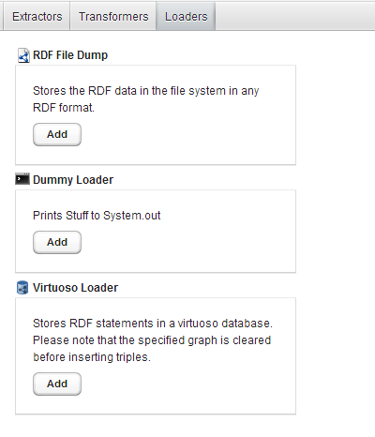
Loading
  In the loading phase, the harvested and harmonised metadata is stored on Virtuoso’s RDF repository using the Virtuoso Loader.

Slide 34
Example
Harvesting a CKAN-based Open Data portal
Create a new job on ODIP
Extraction phase
    Add and Configure a CKAN Extractor to harvest data from a CKAN API.
Transformation phase
    Add ODS Value mapper
    Add a SPARQL Update Query Transformer with the pertinent queries
    Add ODS Cleaner
    Add and configure DCAT Application Profile Harmoniser
    Add Modification detector
    Add ODS Validator
    Add Web Translations
Loading phase
    Load the extracted data in a Virtuoso RDF Store via the Virtuoso Loader
Scheduling the job on ODIP
Notes:
UPDATE: TRANSFORMATION PHASE
Transforming the metadata according to the DCAT-AP (3/3)

Slide 35
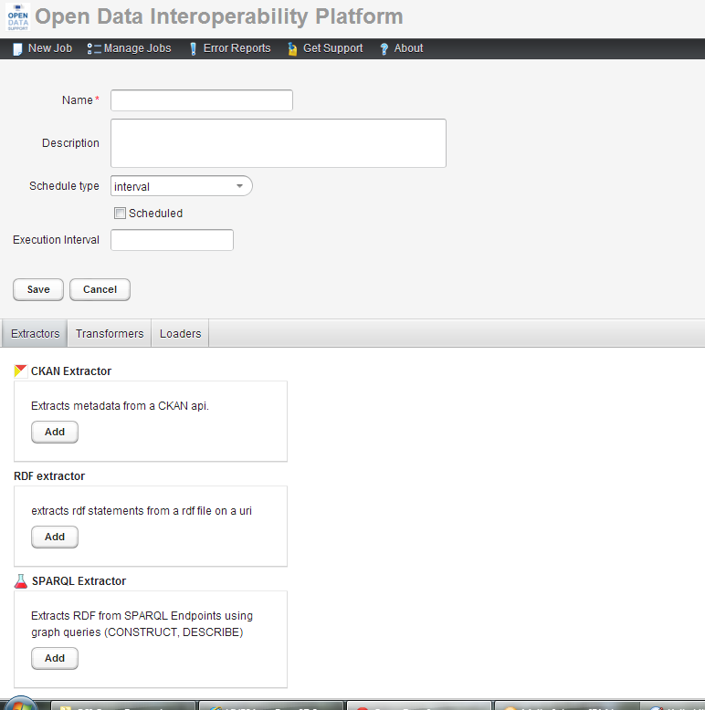
Example – 1. Create Job : Creating a job on ODIP
Provide a name for the Job.
  To create a new job, click on “New Job”.
  At the bottom part of the screen you can configure the actual tasks within each of the three phases by selecting a tab.
  For each phase you can add and configure modules accordingly.
Present the job with a short description.
Press the “Add” button to determine the plug-ins to deploy.

Slide 36
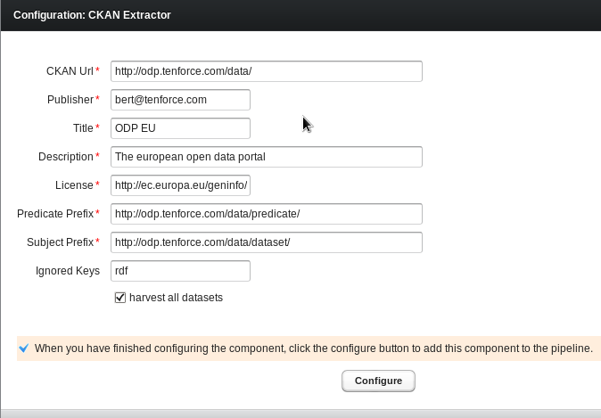
Example – 2.Extraction : Adding and Configuring a CKAN Extractor to harvest data from a CKAN API
After adding the CKAN extractor plugin you will be prompted to fill out the following form:
The Web location of the CKAN portal you wish to harvest.
    The portal should support API version 3 and the API must be enabled.
Publisher, license, title and description: Used in the stored catalog for the dct:publisher, dct:license, dct:title and dct:description properties.
Predicate prefix: JSON attributes are converted to predicates by appending them to the predicate prefix.
    The CKAN API response is in JSON, we then convert this into RDF.
Subject prefix: The prefix used to create a URI for each the metadata of harvested dataset.
The subject is created as <subjectprefix>/dataset/<datasetid>
Ignored keys: A comma seperated list of JSON attributes that should not be converted to RDF triples.

Slide 37
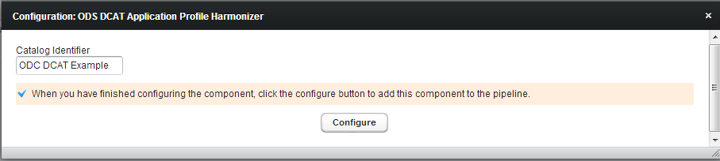
Example – 3. Transformation : Adding and configuring plug-ins to harmonise data(1/3)
  Start by adding the ODS DCAT Application Profile Harmonizer.
    This plugin will create the harmonized catalog data and a basic skeleton for each dataset it identifies.
  Use the Modification Detector to compare provenance data generated by the CKAN extractor between the current and previous version of the raw data to set the dct:modified field of the catalog records.
    No configuration is required.
  Provide a name to identify the catalog

Slide 38
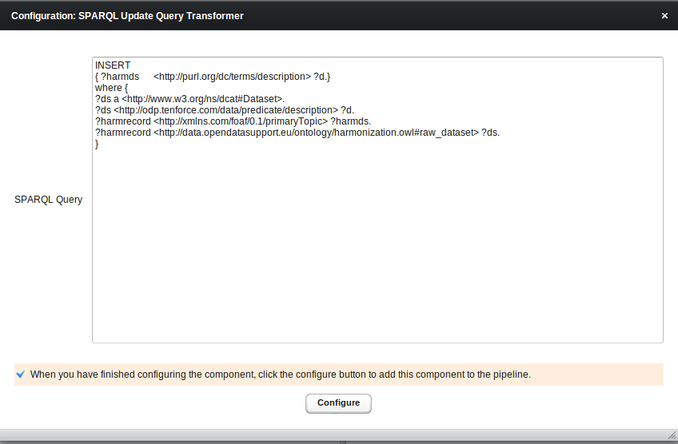
Example – 3. Transformation : Adding and configuring plug-ins to harmonise data (2/3)
  Mapping the description of dataset to dct:description as required by the DCAT-AP.
  Use the ODS Cleaner Plugin to remove raw data loaded into the working set before storing it into a harmonized graph.
    No configuration is required.
  Use the SPARQL Update Query Transformer to map existing properties and values to the ones of recommended by the DCAT-AP.

Slide 39
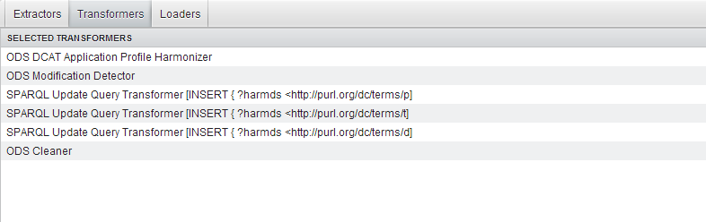
Example – 3. Transformation : Adding and configuring plug-ins to harmonise data (3/3)
Result
The final result of your harmonisation pipeline should look similar to the following :
Configure the Virtuoso Loader to load the harmonized data into Virtuoso.

Slide 40
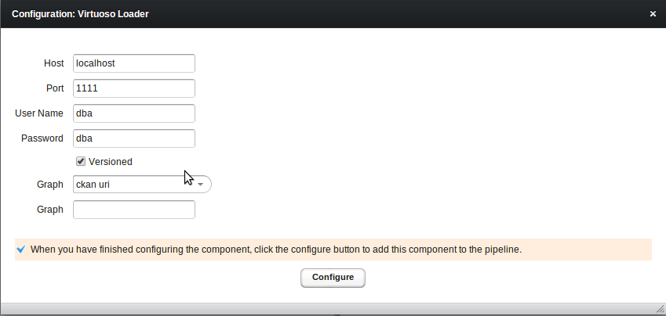
Example – 4. Loading: Load the extracted data in a Virtuoso RDF Store via the Virtuoso Loader
The Virtuoso Loader will store the generated triples in the Virtuoso RDF store. The triples will be inserted into a graph of your choice.
The Virtuoso Loader needs host, port and user credentials to connect to your Virtuoso server.

Slide 41
5. Scheduling a job on ODIP
A job can be scheduled to run at a set interval or chained after another job:
  Interval Scheduling:
  <sec> <min> <hour> <day-of-month> <month> <day-of-week>
    Example:
      0 0 4 * * * - each day at 4 am
      0 0 0 * * 1 - each Monday at midnight
      0 30 * * * - every half past the hour
  Chained scheduling: Select a job after which this job should be executed.

Slide 42
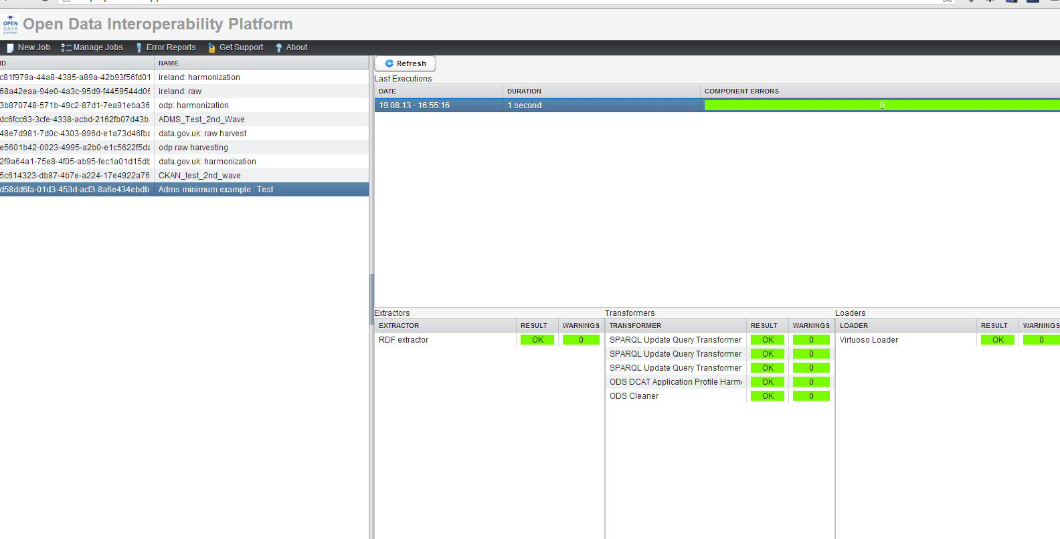
ODIP Reporting tool
Whenever a “job” is ran, a report is created and can be reviewed as can be seen in the following screenshot:
Informs user whether or not a plug-in functioned correctly or not.
Select the appropriate job

Slide 43
Discover datasets through ODIP
The Open Data Interoperability Platform (ODIP) enables you to share metadata of datasets described using the DCAT-AP, thus improving the discoverability and visibility of your datasets, eventually leading to wider reuse.

Slide 44
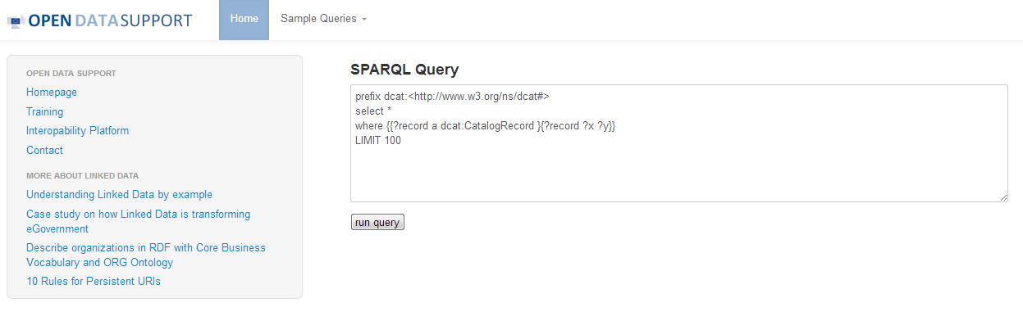
The public SPARQL endpoint of ODIP
Query interface
http://data.opendatasupport.eu

Slide 45
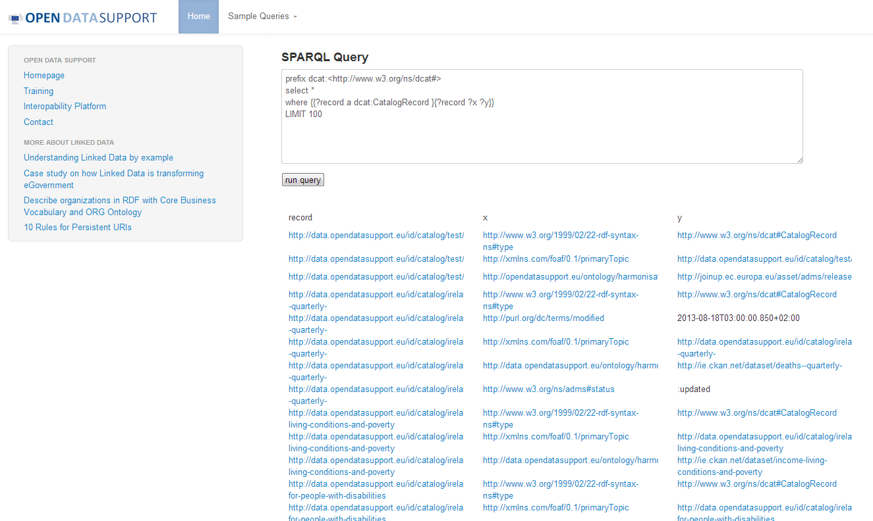
The public SPARQL endpoint of ODIP
Result set

Slide 46



More about ODIP
  ODIP is based on the LOD Management Suite, originally created by the Semantic Web Company in the context of LOD2 FP7 project.
  The LOD Manager Suite was further extended by TenForce in the context of Open Data Support for the deployment of ODIP.
  It will be made available on GitHub under GPLv2.

Slide 47
Conclusions
  Good quality description metadata can improve the discoverability of open datasets.
  DCAT-AP can be used for homogenising metadata of datasets hosted on different Open Data portals and allows for querying them using a uniform vocabulary.
  ODIP can support harvesting, harmonising according to the DCAT-AP and publishing as linked data metadata of datasets published on different Open Data portals.
  ODIP, through its public SPARQL endpoint, provides a single point of access to datasets from all over Europe.
  Easier access to datasets means higher reuse of datasets.

Slide 48

Group questions
How many Open Government Data portals do you know in your country?
In your country, are you aware of any applications or services that were built upon Open Government Data?
How would you compare the visibility of Open Government Data portals with that of traditional data providers such as national statistics offices?
Have you heard about the Open Government Data initiatives of the European Commission?
http://www.visualpharm.com
http://www.visualpharm.com
http://www.visualpharm.com
Take also the online test here!
http://www.visualpharm.com

Slide 49
Thank you!
...and now YOUR questions?
Notes:
See also: http://europa.eu/rapid/press-release_MEMO-11-891_en.htm

Slide 50
References
Slide 4, 6, 9, 10, 11 & 12:
  Open Data Support: How can we help you?. Open Data Support. http://www.slideshare.net/OpenDataSupport/open-data-support-service-description
  Slide 12:
  Data Catalogue Vocabulary. http://www.w3.org/TR/vocab-dcat/
Slide 13-21:
  DCAT Application Profile for data portals in Europe Community. ISA Programme. https://joinup.ec.europa.eu/asset/dcat_application_profile/description
  https://joinup.ec.europa.eu/asset/dcat_application_profile/asset_release/all
Slide 23-35:
LODMS User Manual for Open Data Support. Open Data Support
Slide 29:
  Figure from http://www.semantic-web.at/linked-open-data-management-suite-lodms
Notes:
To be updated.

Slide 51




Related projects and initiatives
DCAT Application Profile for Data Portals in Europe, https://joinup.ec.europa.eu/asset/dcat_application_profile/description
  Publicdata.eu, http://www.w3.org/2011/gld/wiki/Main_Page
  LOD2 FP7 Project, http://lod2.eu/
  The Semantic Web Company, http://www.semantic-web.at/
  Linked Open Data Management Suite, http://www.semantic-web.at/linked-open-data-management-suite-lodms
  OpenLink Virtuoso, http://virtuoso.openlinksw.com/
  Data Catalog Interoperability Protocol, http://spec.datacatalogs.org/

Slide 52





Be part of our team...
Find us on
Join us on
Open Data Support
http://www.slideshare.net/OpenDataSupport
Open Data Support
http://goo.gl/y9ZZI
http://www.opendatasupport.eu
Follow us
Contact us
@OpenDataSupport
    contact@opendatasupport.eu

