Slide 1
Training Module 2.1
The Linked Open Government Data & Metadata Lifecycle
PwC firms help organisations and individuals create the value they’re looking for. We’re a network of firms in 158 countries with close to 180,000 people who are committed to delivering quality in assurance, tax and advisory services. Tell us what matters to you and find out more by visiting us at www.pwc.com.
PwC refers to the PwC network and/or one or more of its member firms, each of which is a separate legal entity. Please see www.pwc.com/structure for further details.

Slide 2
This presentation has been created by PwC
Authors:
Michiel De Keyzer, Nikolaos Loutas and Stijn Goedertier
Presentation metadata
Disclaimers
The views expressed in this presentation are purely those of the authors and may not, in any circumstances, be interpreted as stating an official position of the European Commission.
The European Commission does not guarantee the accuracy of the information included in this presentation, nor does it accept any responsibility for any use thereof.
Reference herein to any specific products, specifications, process, or service by trade name, trademark, manufacturer, or otherwise, does not necessarily constitute or imply its endorsement, recommendation, or favouring by the European Commission.
All care has been taken by the author to ensure that s/he has obtained, where necessary, permission to use any parts of manuscripts including illustrations, maps, and graphs, on which intellectual property rights already exist from the titular holder(s) of such rights or from her/his or their legal representative.
This presentation has been carefully compiled by PwC, but no representation is made or warranty given (either express or implied) as to the completeness or accuracy of the information it contains. PwC is not liable for the information in this presentation or any decision or consequence based on the use of it.. PwC will not be liable for any damages arising from the use of the information contained in this presentation. The information contained in this presentation is of a general nature and is solely for guidance on matters of general interest. This presentation is not a substitute for professional advice on any particular matter. No reader should act on the basis of any matter contained in this publication without considering appropriate professional advice.
Open Data Support is funded by the European Commission under SMART 2012/0107 ‘Lot 2: Provision of services for the Publication, Access and Reuse of Open Public Data across the European Union, through existing open data portals’(Contract No. 30-CE-0530965/00-17).
© 2014 European Commission

Slide 3
Learning objectives
By the end of this training module you should have an understanding of:
What a lifecycle for Linked Open Government Data (LOGD) is.
The difference between supply and demand of data.
The different steps of an LOGD lifecycle.
Tools and best practices associated with each step in the lifecycle.

Slide 4
Content
This module contains ...
  An overview of existing lifecycles for Linked Open Government Data (LOGD).
  An hybrid lifecycle for LOGD and metadata, covering both the supply and the demand side.
  An overview of existing technologies for LOGD and metadata – including the Open Data Interoperability Platform (ODIP).

Slide 5
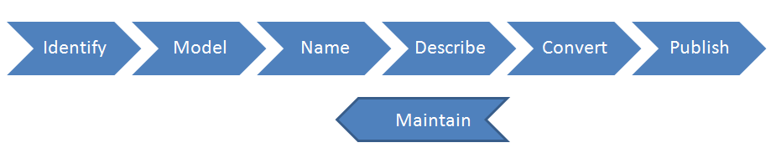
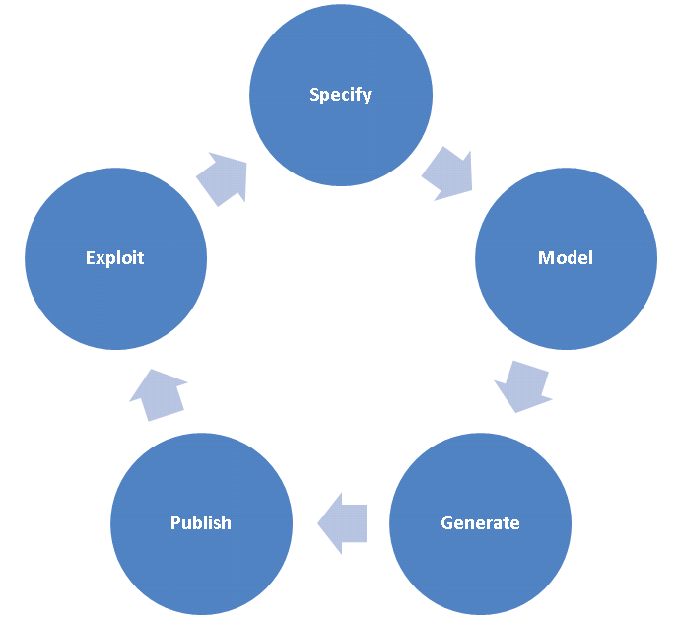
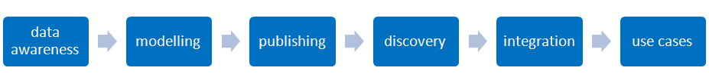
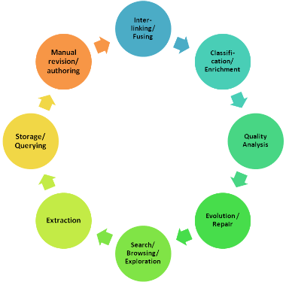
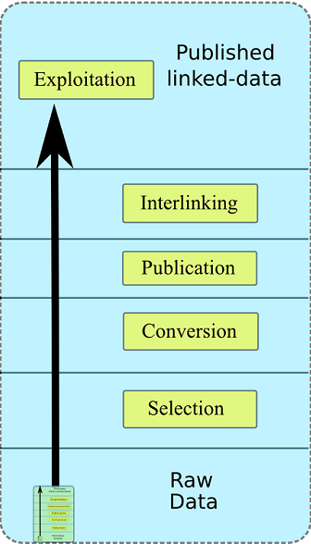
Different LOGD lifecycles
The state of play
See also:
http://www.w3.org/2011/gld/wiki/GLD_Life_cycle
Hyland et al.
Hausenblas et al.
Datalift Vision
LOD2 Linked
Open Data Lifecycle
Villazon-Terrazas et al.

Slide 6
Different LOGD lifecycles
Observations
No standardised LOGD lifecycle.
  Most approaches agree on a core set of phases, e.g. identify model, publish.
The current lifecycles mainly focus on the supply of open data:
    Identification and selection of LOGD.
    Modelling and cleansing of LOGD.
    Publishing and linking of data.
But what about the demand side?
    Find and retrieve LOGD.
    Integrate and reuse of open data.
    Provide feedback on LOGD.

Slide 7
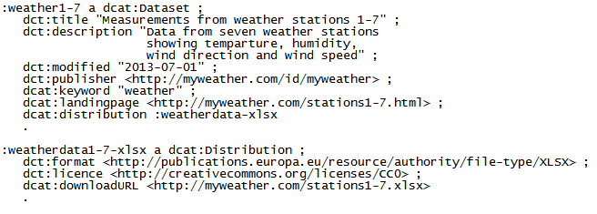
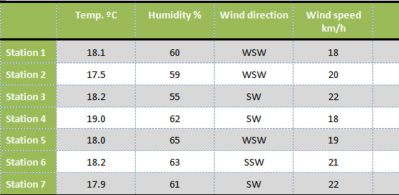
What is metadata?
“Metadata is structured information that describes, explains, locates, or otherwise makes it easier to retrieve, use, or manage an information resource. Metadata is often called data about data or information about information.”
-- National Information Standards Organization
http://www.niso.org/publications/press/UnderstandingMetadata.pdf
Dataset description (DCAT)
Dataset

Slide 8
Best practices for publishing your data & metadata
W3C Linked Data Cookbook
      Model the data;
      Name things with URIs;
      Reuse existing vocabularies whenever possible;
      Publish human and machine readable descriptions – metadata;
      Convert the data to RDF;
      Specify an appropriate license;
      Host the linked dataset and its metadata publicly and announce it!
See also:
http://www.w3.org/TR/gov-data/) http://www.w3.org/2011/gld/wiki/Linked_Data_Cookbook

Slide 9
LOGD and metadata lifecycle focusing on supply and demand
Supply
Demand

Slide 10
LOGD & metadata supply
Governments opening up their data and publishing it as linked data along with appropriate metadata descriptions.

Slide 11
Selection of high-value data
Several dimensions can be considered in the selection process of Linked Open Government Data, both from the publisher’s and the re-user’s point of view:
  Transparency: Does the publication of the dataset increase transparency and openness of the government towards its citizens?
  Legal requirements: Is there a law that makes open publication mandatory or is there no specific obligation?
  Relation to public task: Is the data the direct result of the primary public task of government or is it a product of a non-essential activity?
  Current status of open publication: Is the data already openly available or does it still need to be opened up?
  Type of value: Is the data useful for social engagement or does it have commercial value?
  Audience: Is the data primarily intended for the public or is it primarily aimed at back-office integration?
Notes:
UPDATE: added “both from the publisher’s and the re-user’s point of view” + added “Transparancy: Does the publication of the dataset increase transparency and openness of the government towards its citizens?”

Slide 12
Selection based on transparency
In some cases the publication of a dataset can increase the transparency and openness of the government towards its citizens, e.g.:
  Parliaments’ data, such as election results.
  The way governmental budgets are spent.
  Staff cost of public administrations
  All the above-mentioned examples contribute to the transparency of the way public administrations are working.
Notes:
UDPATE: additional slide

Slide 13
Selection based on legal requirements
Some data may be covered by a law or regulation that mandates its open publication, e.g.:
  Text of laws, directives, regulations etc.
  Proposals and proceedings of parliament and committees.
  Election results.
  Public budgets and expenditures.
  Invitations to tender and contract awards.
Other data may be the by-product of government activity and would be useful for citizens and business to have access to, e.g.:
  Condition of infrastructure and public spaces (roads, trees) .
  Timetables of public transport and schedules of garbage collection.

Slide 14
Selection based on relation to public task
Some data may be the direct result of the primary public task of government, for example the functions listed in COFOG, e.g.:
  Executive, legislative organs, financial/fiscal affairs etc.).
  Public order and safety.
  Environmental protection.
  Health.
  Culture.
  Education.
Other data produced by government are non-essential (they could be – and sometimes are – provided by the private sector) e.g.:
  Mapping for navigation (cf. Google Street View)
  Weather forecasts (cf. Weather Channel)

Slide 15
Selection based on status of openness
Some data is already published openly and electronically, e.g. (in some countries):
  Cadastral information.
  Topographic maps.
  Traffic information.
  Weather forecasts.
Other data may still be hidden from the public (maybe because it is hard to publish or includes personal data, sensitive data or is partly subject to third-party licensing).

Slide 16
Selection based on type of value
Some data may have primarily societal value, e.g.:
  Laws and parliamentary data (e.g. voting records of representatives)
  Pre-election information (e.g. programmes of political parties)
  eDemocracy and eParticipation (e.g. public consultations)
Other data may have more commercial value (business model), e.g.:
Road maps, real-time traffic information
  Real-time weather information
  Business information
Notes:
UPDATE: added “(business model)”

Slide 17
Selection based on type of audience
Some data is aimed at society (citizens and business), e.g.:
  Legal information.
  eDemocracy, eParticipation and public consultation.
  Procurement.
Other data are focused on internal usage or for integration in the back office, e.g.:
  Various sources that are used for law enforcement.
  Service performance indicators.
  Job descriptions of civil servants.

Slide 18
Selection based on size of audience
Some data are aimed at large audiences and mass markets, e.g.:
  Traffic information.
  Public transport.
  Election data.
Other data are essential for small groups of people and niche markets, e.g.:
  Information about facilities and financial support for people with special needs.
  Economic statistics.
  Court decisions.

Slide 19
High value from a re-users perspective
From a re-user’s perspective, the value of a dataset depends primarily on its use and re-use potential, which can effectively lead to the generation of (new) business models.
The use and re-use potential of a dataset is defined by:
The size and the dynamics of the target audience of the dataset; and
The number of new and existing systems and services that are using the dataset.
Opening up datasets with a high use and re-use potential leads to the creation of new products and/or services that have direct or indirect economic or social impact and/or positive economic externalities.
Notes:
UPDATE: additional slide

Slide 20
Selection based on the needs of the audience
What data do the reusers need/want?
According to a Spanish study, the following types of information are reused the most by businesses:
See also:
http://datos.gob.es/datos/sites/default/files/files/Estudio_infomediario/121001%20RED%20007%20Final%20Report_2012%20Edition_vF_en.pdf

Slide 21
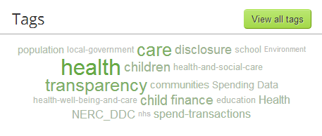
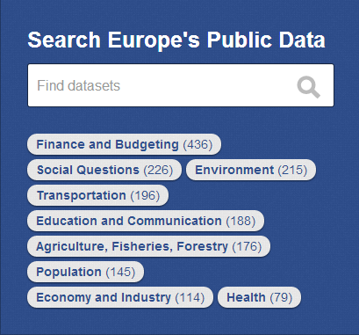
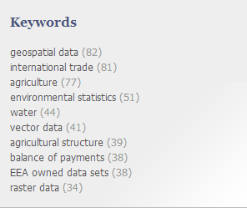
Datasets domains in European data portals
Source:[http://data.gov.uk/data]
Source:[http://publicdata.eu/]
Source:[http://open-data.europa.eu/en/data/dataset]
Metadata

Slide 22
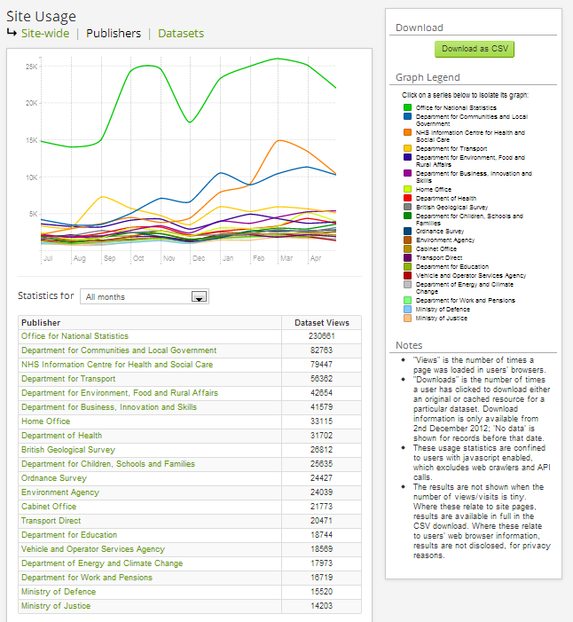
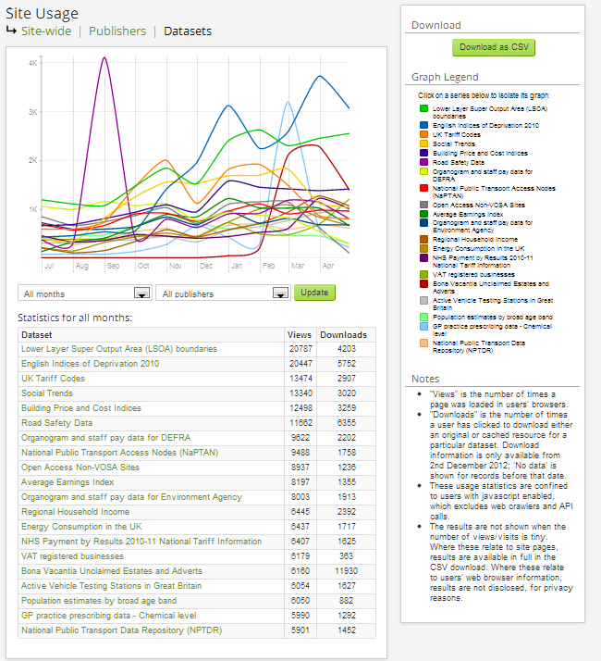
Which datasets are mostly viewed on Data.gov.uk
Per publisher
Per dataset
http://data.gov.uk/data/site-usage/publisher?month=
http://data.gov.uk/data/site-usage/dataset

Slide 23
Modelling your data & metadata is about ...
  Making your data available in a structured, comprehensible and machine-readable way.
  Reusing what already exists in terms of vocabularies and reference data.
Reaching the right quality level by cleansing your data.
  Providing licensing information so that data consumers know what the conditions of reuse are.
  Providing a rich description (metadata).
  Using semantic technologies (RDF, HTTP URIs...) for describing your data.

Slide 24
Model your data – reuse if possible, mint if necessary
Reuse existing vocabularies as much as possible.
  If you determine there is no reusable, authoritative source for the specific domain, create your own using:
      RDF Schema (RDFS): Basic RDF vocabulary to describe the classes and properties of classes.
      Web Ontology Language (OWL): knowledge representation language for describing ontologies.
See also:
http://www.slideshare.net/OpenDataSupport/model-your-data-metadata
http//www.w3.org/TR/owl-features/
http://www.w3.org/TR/rdf-schema/

Slide 25









Reuse common vocabularies to model and describe your data ... (in RDF)
General purpose vocabularies: DCMI, RDFS
To name things: rdfs:label, foaf:name, skos:prefLabel
To describe people: FOAF, vCard, Core Person Vocabulary
  To describe registered organisations: Registered Organisation Vocabulary
To describe addresses: vCard, Core Location Vocabulary
To describe public services: Core Public Service Vocabulary
  ...and metadata...
  To describe datasets (metadata): DCAT, DCAT Application Profile, VoID
To describe projects: DOAP, ADMS.SW
To describe interoperability assets: ADMS

Slide 26
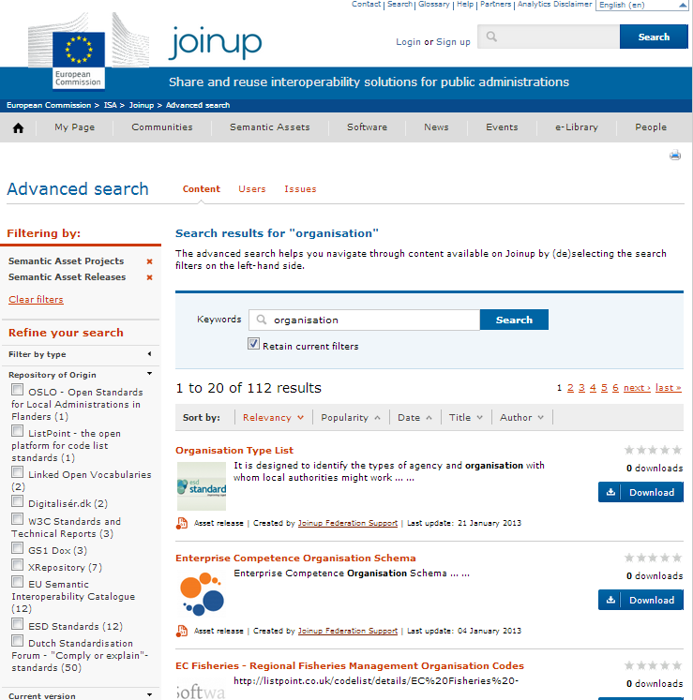
Find reusable vocabularies
Joinup
  Online platform for searching for and sharing interoperability assets described with ADMS.
    Developed by the ISA Programme of the EC.
1
Enter a search keyword to find interoperability assets available on different websites.
Refine the search results via the faceted search filters.
The search results contain a relevant description of the assets and the link from where they can be downloaded.
3
2
http://joinup.ec.europa.eu/

Slide 27
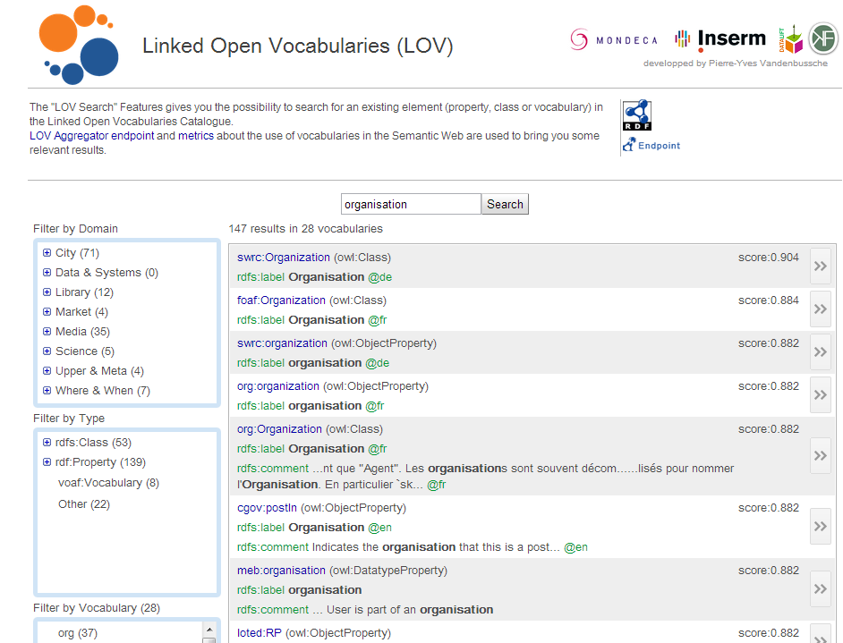
Find reusable vocabularies
Linked Open Vocabularies
  Provides easy access methods to the ecosystem of vocabularies .
  Makes the ways they link to each other explicit.
  Provides metrics on how they are used in the LOGD cloud.
  Developed by the Open Knowledge Foundation.
http://lov.okfn.org/

Slide 28
Cleansing your data & metadata
To ensure data and metadata can be published with an appropriate level of quality and minimum errors.
This means:
Fixing errors.
Transforming/homogenising formats.
Aligning inconsistencies in data and metadata.
Removing duplicate/redundant information.
Adding lacking information.
Making sure the information is up-to-date.
See also:
http://www.slideshare.net/OpenDataSupport/introduction-to-rdf-sparql
Cleanse your data with Open Refine (Google Refine) - https://code.google.com/p/google-refine/

Slide 29
Cleansing data - example
Duplicate
Formatting issue
error
Company_name | Registration date | Country | E-mail | # Establishments
Nikè | 1991-04-28 | Belgium | niké | 7
BARCO | 15 September 1986 | BE | Barco@email.be | 2
Nikè |  | België
Coca-Cola |  | United States | coca@cola.com | 3
Missing information
Redundant information
Cleansing operations
Inconsistent
information
Company_name | Registration date | Country | E-mail
Nikè | 1991-04-28 | BE | niké@sport.org
BARCO | 1986-09-05 | BE | Barco@email.be
Coca-Cola | 1964-03-26 | US | coca@cola.com

Slide 30
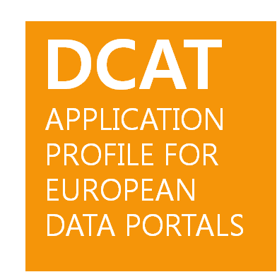
Model your metadata
The DCAT Application profile for data portals in Europe (DCAT-AP) is a specification based on the Data Catalogue vocabulary (DCAT) for describing public sector datasets in Europe.
DCAT-AP improves the discovery of public sector datasets across borders and sectors.
See also:
https://joinup.ec.europa.eu/asset/dcat_application_profile/description

Slide 31
Use persistent Uniform Resource Identifiers (URI) for naming things
Persistent URIs sets the foundations for Linked Data.
See also:
http://www.slideshare.net/OpenDataSupport/design-and-manage-persitent-uris
https://joinup.ec.europa.eu/community/semic/document/10-rules-persistent-uris

Slide 32
Licensing your data and metadata is about...
  Informing potential reusers on how the data and metadata can be (re)used and/or adapted.
  Not associating your data and metadata with licensing information, is an important barrier for reuse and thus lowers the value opening your data will create.
  Open data should be, by definition, published under an open license.
  Metadata should be published under a licence indicating it is public domain to reinforce the reuse and discoverability of your data.
See also:
http://www.slideshare.net/OpenDataSupport/licence-your-data-metadata

Slide 33
Open licenses
See also:
http://discovery.ac.uk/files/pdf/Licensing_Open_Data_A_Practical_Guide.pdf
Creative Commons (CC) (http://creativecommons.org/licenses/)
    Attribution (BY): The creator of the work should be mentioned.
    Non Commercial (NC): The work can not be used for commercial purposes.
    No Derivatives (ND): The work cannot be adapted or merged with other work.
    Share Alike (SA): The work can be adapted but must be attributed with the same license if you make it available.
    CC Zero (CC0): The work is public domain
    Open Data Commons (http://opendatacommons.org/licenses/)
    Open Data Commons Attribution Licence (ODC-By): compatible with CC BY
    Open Data Commons Open Database Licence (ODC-ODbL): compatible with CC BY SA)
    Public Domain Dedication Licence (PDDL): compatible with CC Zero
      The Open Government Licence (http://www.nationalarchives.gov.uk/doc/open-government-licence/)

Slide 34
Publishing linked data is about ...
    Breaking down the walls of the silos in order to create more value.
  Making your data and metadata publically and easily accessible on the Web.
  Linking your data and metadata to other data (or metadata) in order to:
    Attach meaning and content to it.
    Give context to it.
    Enrich it.
    Allow people to discover more.

Slide 35
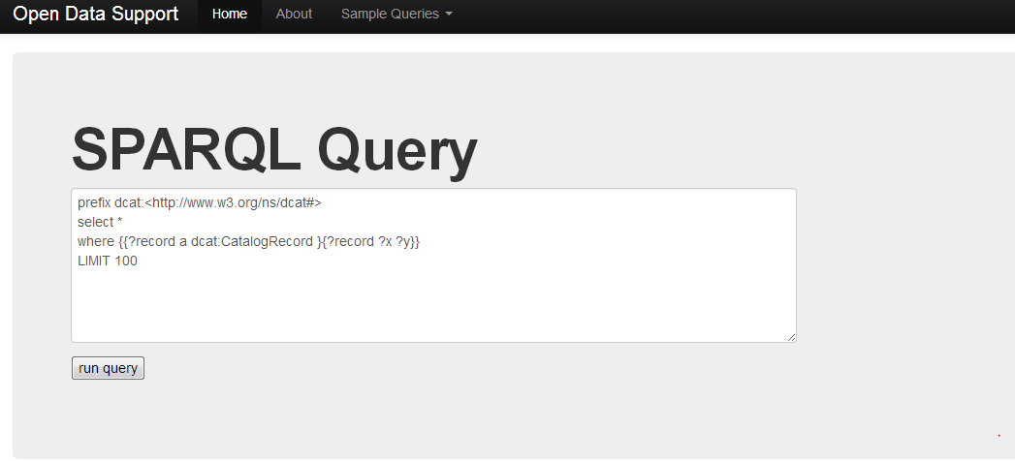
Provide a SPARQL Endpoint
A SPARQL Endpoint is a service that allows others to query your linked data (and/or metadata).
http://data.opendatasupport.eu

Slide 36
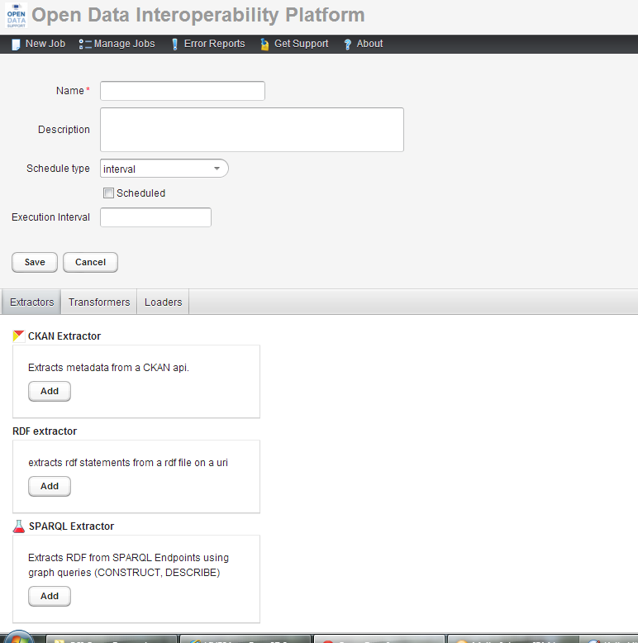
Publish your metadata
Publish your metadata on a central data broker to give it more visibility and increase the reuse of your datasets.
The Open Data Interoperability Platform (ODIP):
  ODIP is a central data broker developed by the European Commission to enable the cross-border European search for datasets.
  ODIP data publishers and data portals to publish description metadata of datasets centrally.
See also:
http://www.slideshare.net/OpenDataSupport/promoting-the-re-use-of-open-data-through-odip

Slide 37
Data & metadata management is about...
  Managing the lifecycle of the data – creation, update and keeping up to data, and decommissioning of datasets.
  Managing the lifecycle of the metadata.
  Putting in place processes for making sure your data and metadata has an appropriate level of quality.
Stating ownership of data(sets) and metadata.
See also:
http://www.slideshare.net/OpenDataSupport/introduction-to-metadata-management

Slide 38
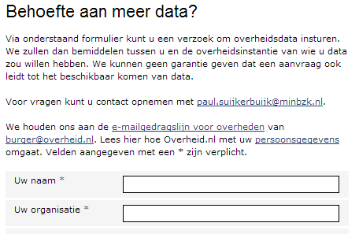
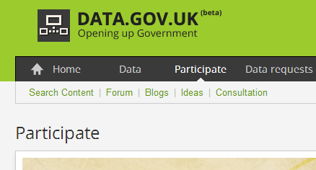
Collecting feedback from the reusers of your data
Ask feedback to the (potential) users of data:
Which data do they need.
How did they use the data.
  What did they think about the quality.
  Make sure that requests and fixes reach you – crowdsource data quality!
data.overheid.nl
data.gov.uk

Slide 39
LOGD demand
The needs of businesses, entrepreneurs, researchers and governments for linked data.

Slide 40






The LOGD lifecycle demand side is about ...
Data reusers being able to
find appropriate datasets;
use the datasets for analysis, building apps and services;
know what their government is doing (transparency);
save costs.
Publishing data
Public administrations share data online
Developers / Companies integrate data into app (services)
Developers / Companies search for data
Citizens/businesses benefits from the app (services)
Reusing data
Notes:
Updated the text – added two bullet points.

Slide 41
Where to find datasets?
Datasets are made available on various platforms spread across Europe.
“A Data Broker collects the metadata from various open data platforms and publishes it using a common metadata model. This way the datasets are searchable in a uniform way from a single point of access.”
Local Open Data Portals, e.g.
    opendatamanchester.org.uk
    Data.gent.be
Regional Open Data Portals e.g.
    opendata.regionpaca.fr
    Open public data of the government of Catalonia
National Open Data Portals
    Opendata.at
    opendata.lu
European Open Data Portals, e.g.
    open-data.europa.eu
Open Data Brokers, e.g.
    Publicdata.eu
    ODIP

Slide 42
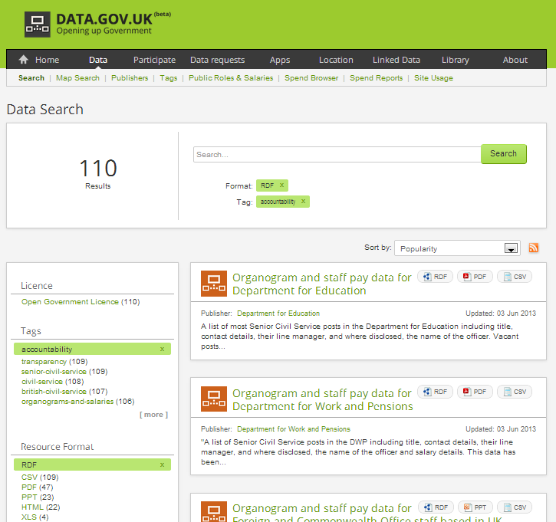
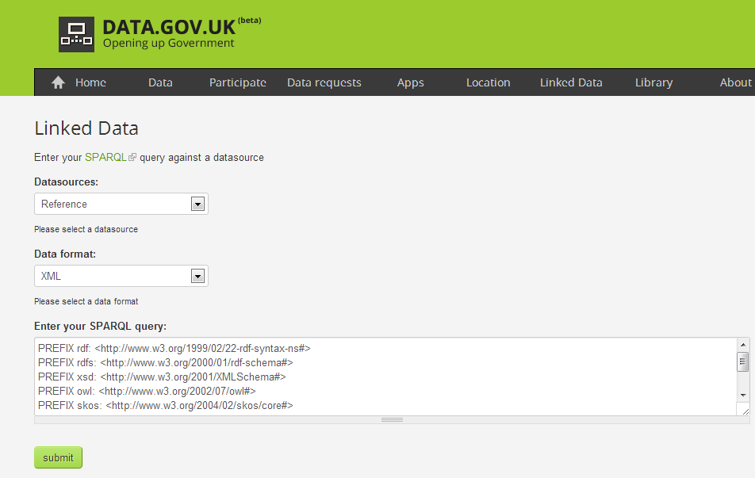
Use SPARQL endpoint or faceted browser to find datasets
A user looking can execute a SPARQL query on a SPARQL endpoint to find datasets or “filter his way” through the collection of datasets using a faceted browser.
Faceted browser
SPARQL endpoint
http://data.gov.uk/sparql
http://data.gov.uk/data/search

Slide 43
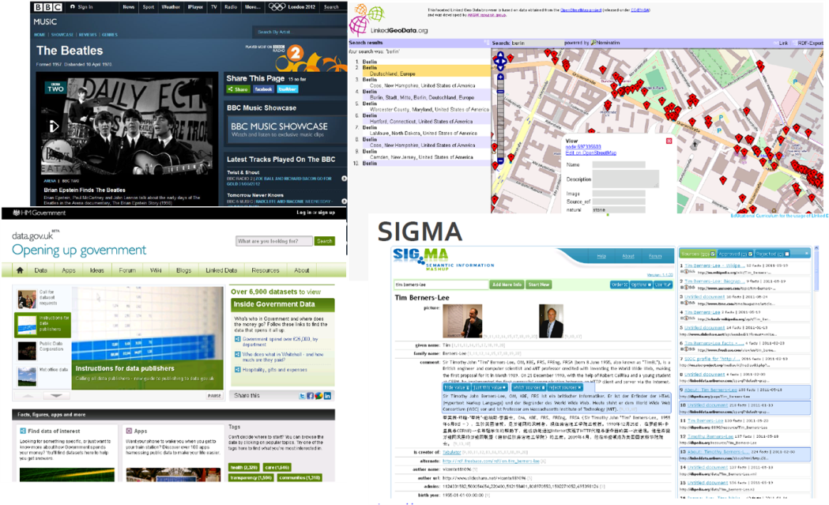
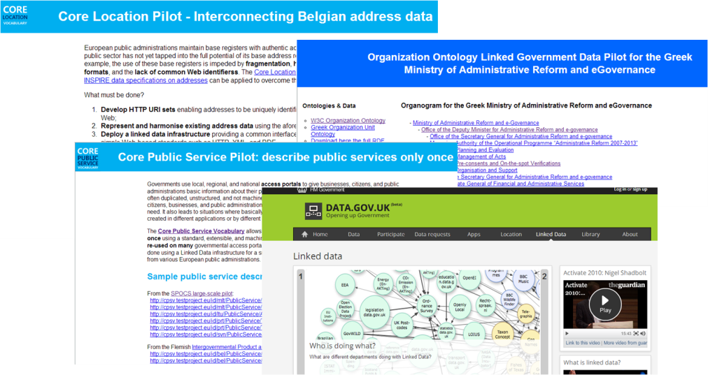
Integrating datasets and building apps & services
Some tools for integrating datasets:
Karma (http://www.isi.edu/integration/karma/)
Talend (http://www.talend.com/products/data-integration)
See also:
http://www.slideshare.net/OpenDataSupport/introduction-to-linked-data-23402165

Slide 44
Publishing LoGD using Open Refine

Slide 45
Using Open Refine to model and publish open data Getting started
Install Open Refine from: https://github.com/OpenRefine
Install the RDF extension : http://refine.deri.ie/
And then...
        Describe your data in a spreadsheet.
        Create a project and upload it in Open Refine.
        Map your data to appropriate RDF classes & properties.
        Export the data in RDF.
1
2
3
4

Slide 46
Describe your data in a spreadsheet
1
Company_name | Registration date | Country | E-mail
Nikè | 1991-04-28 | BE | niké@sport.org
BARCO | 1986-09-05 | BE | Barco@email.be
Coca-Cola | 1964-03-26 | US | coca@cola.com

Slide 47
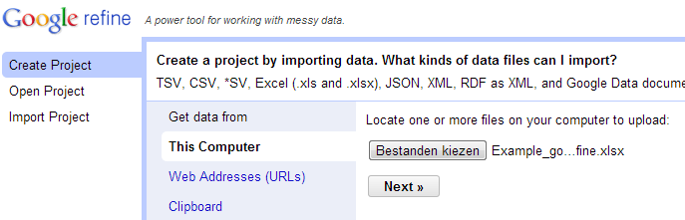
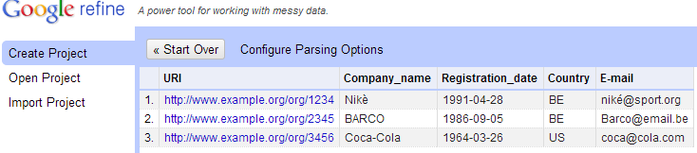
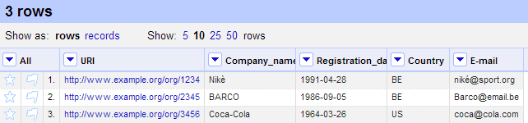
Create a project and upload it in Google Refine
2
Upload the spreadsheet
Select relevant tabs
Create the project

Slide 48
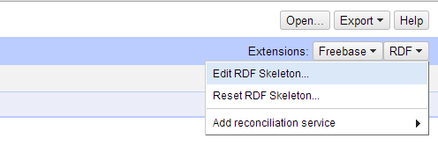
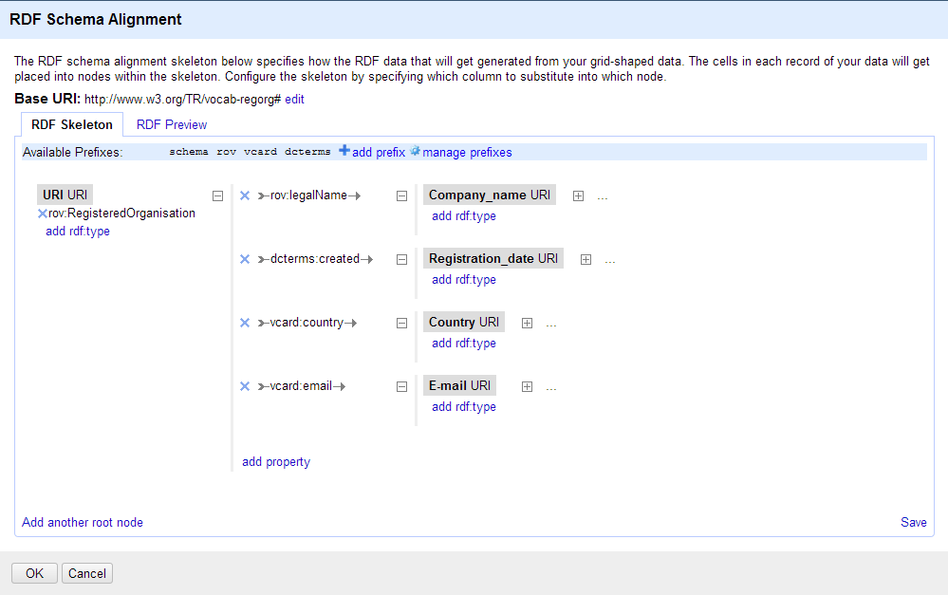
Map your data to appropriate RDF classes & properties (model your data)
3
Define a skeleton to transform your spreadsheet data to RDF

Slide 49
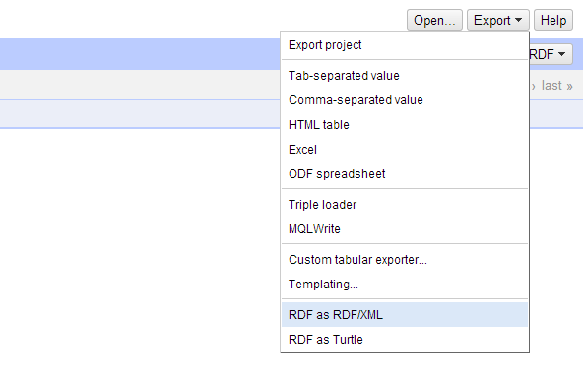
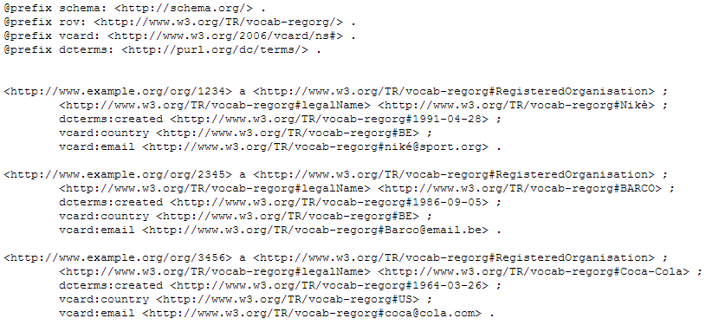
Export your data to RDF/XML or Turtle
4

Slide 50
The LOD2 Stack tools for publishing and querying LOGD

Slide 51
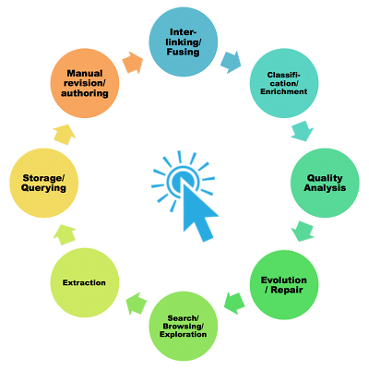
Publishing your data with the LOD2 Stack
“The LOD2 stack is an integrated distribution of aligned tools which support the lifecycle of Linked (Open) Data from extraction, authoring/creation over enrichment, interlinking, fusing to visualization and maintenance. The stack comprises tools from the LOD2 partners and third parties.”
Source: [http://stack.lod2.eu/]

Slide 52
Silk – A tool for linking your data
“The Silk framework is a tool for discovering relationships between data items within different Linked Data sources.
Data publishers can use Silk to set RDF links from their data sources to other data sources on the Web.”
For download and more information:
http://wifo5-03.informatik.uni-mannheim.de/bizer/silk

Slide 53
Conclusions
  The LOGD and metadata lifecycle should address both the supply and demand side.
  Choosing on which data and metadata to open up means taking into account different dimensions.
  Modelling is about getting the data and metadata structured and reaching an appropriate quality level.
  Publishing is about making the data and metadata public, easily accessible and searchable.
  Data and metadata management should ensure that processes and policies are in place to govern the lifecycle of data and metadata.
  The data publisher should provide means to receive feedback from the data reuser – sensing demand and crowd sourcing quality.
  Several tools are available for modelling and publishing LOGD –few are at production-level quality.

Slide 54

Group questions
  Do you have any data and/or metadata governance methodology at the corporate level?
  Is there supply and demand for (Linked) Open Government Data in your country? If so, who provides what to whom?
  In your opinion, what are the main obstacles to the provision of (Linked) Open Government Data in your country?
http://www.visualpharm.com
http://www.visualpharm.com
http://www.visualpharm.com
Take also the online test here!
Notes:
UPDATE: added “take also...” + link

Slide 55
Thank you!
...and now YOUR questions?
Notes:
See also: http://europa.eu/rapid/press-release_MEMO-11-891_en.htm

Slide 56
References
Slide 5:
GLD Life cycle. W3C. http://www.w3.org/2011/gld/wiki/GLD_Life_cycle
Slide 8:
  Linked Data Cookbook. W3C. http://www.w3.org/2011/gld/wiki/Linked_Data_Cookbook
Slide 14:
  United Nations Statistics Division. COFOG (Classification of the Functions of Government). http://unstats.un.org/unsd/cr/registry/regcst.asp?Cl=4
Slide 21:
  Characterization Study of the Infomediary Sector - 2012 Edition. Datos.gob.es. http://datos.gob.es/datos/sites/default/files/files/Estudio_infomediario/121001%20RED%20007%20Final%20Report_2012%20Edition_vF_en.pdf
Slide 21:
http://data.gov.uk/data
http://publicdata.eu/
http://open-data.europa.eu/en/data/dataset
Slide 21:
http://data.gov.uk/data/site-usage/publisher?month=
http://data.gov.uk/data/site-usage/dataset
Slide 24-25:
  Cookbook for translating Data Models to RDF Schemas. IAS Programme. https://joinup.ec.europa.eu/community/semic/document/cookbook-translating-data-models-rdf-schemas
Slide 26:
  ADMS Brochure. ISA Programme. https://joinup.ec.europa.eu/elibrary/document/adms-brochure
Slide 27:
http://lov.okfn.org/
Slide 29:
  DCAT application profile for data portals in Europe. ISA Programme. https://joinup.ec.europa.eu/asset/dcat_application_profile/description
Slide 31:
  10 Rules for Persistent URIs. ISA Programme. https://joinup.ec.europa.eu/community/semic/document/10-rules-persistent-uris
Slide 32-33:
  Licensing Open Data: A Practical Guide. Naomi Korn and Professor Charles Oppenheim. http://discovery.ac.uk/files/pdf/Licensing_Open_Data_A_Practical_Guide.pdf
Slide 51:
  Announcement of intermediate LOD2 Stack release, March 2012. Martin Kaltenboeck. http://lod2.eu/BlogPost/1034-announcement-of-intermediate-lod2-stack-release-march-2012.html
Slide 52:
  Silk - A Link Discovery Framework for the Web of Data. University of Mannheim. http://wifo5-03.informatik.uni-mannheim.de/bizer/silk/
Notes:
UPDATED

Slide 57
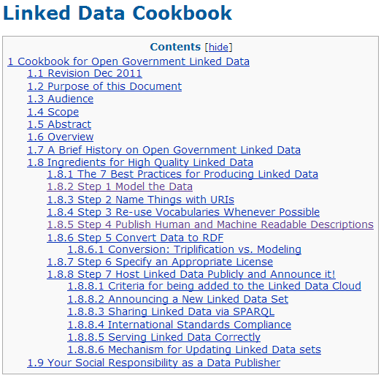

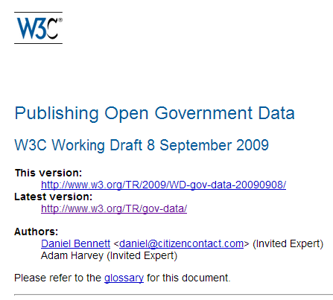
Further reading (1/2)
Linked Data Cookbook. W3C.
http://www.w3.org/2011/gld/wiki/Linked_Data_Cookbook
Cookbook for translating Data Models to RDF Schemas. ISA Programme. https://joinup.ec.europa.eu/community/semic/document/cookbook-translating-data-models-rdf-schemas
Publishing Open Government Data. Daniel Bennett & Adam Harvey. http://www.w3.org/TR/gov-data/
N. Korn & C. Oppenheim, Licensing Open Data: A Practical Guide.
http://discovery.ac.uk/files/pdf/Licensing_Open_Data_A_Practical_Guide.pdf
Notes:
TODO: add also the business models for LOGD – here or even as a slide in the ppt as you did in one of the other ones.

Slide 58




Further reading (2/2)
Linked Open Data: The Essentials. Florian Bauer, Martin Kaltenböck.
http://www.semantic-web.at/LOD-TheEssentials.pdf
Linked Data: Evolving the Web into a Global Data Space. Tom Heath and Christian Bizer.
http://linkeddatabook.com/editions/1.0/
Linked Open Government Data. Li Ding Qualcomm, Vassilios Peristeras and Michael Hausenblas.
http://ieeexplore.ieee.org/stamp/stamp.jsp?tp=&arnumber=6237454
EUCLID - Course 1: Introduction and Application Scenarios
http://www.euclid-project.eu/modules/course1

Slide 59




Related projects and initiatives (1)
LOD2 Technology Stack, http://stack.lod2.eu/
Open Data Publishing Pipeline DERI, http://sw.deri.ie/content/odpp
  W3C Linked Data Cookbook,
  http://www.w3.org/2011/gld/wiki/Linked_Data_Cookbook
  Cookbook for translating Data Models to RDF Schemas, https://joinup.ec.europa.eu/community/semic/document/cookbook-translating-data-models-rdf-schemas
Notes:
UPDATE: moved Euclid and LOD to next slide + (1) in the title

Slide 60



Related projects and initiatives (2)
  EUCLID FP7 Project, http://projecteuclid.org/
  LOD Around The Clock FP7 project, http://latc-project.eu/
  Generic Statistical Business Process Model, http://www1.unece.org/stat/platform/display/GSBPM/Generic+Statistical+Business+Process+Model+Paper
Notes:
UPDATE: addition of slide

Slide 61





Be part of our team...
Find us on
Join us on
Open Data Support
http://www.slideshare.net/OpenDataSupport
Open Data Support
http://goo.gl/y9ZZI
http://www.opendatasupport.eu
Follow us
Contact us
@OpenDataSupport
    contact@opendatasupport.eu

