Slide 1
Training Module 2.4
Designing and developing RDF vocabularies
PwC firms help organisations and individuals create the value they’re looking for. We’re a network of firms in 158 countries with close to 180,000 people who are committed to delivering quality in assurance, tax and advisory services. Tell us what matters to you and find out more by visiting us at www.pwc.com.
PwC refers to the PwC network and/or one or more of its member firms, each of which is a separate legal entity. Please see www.pwc.com/structure for further details.

Slide 2
This presentation has been created by PwC
Authors:
Nikolaos Loutas, Michiel De Keyzer and Stijn Goedertier
Presentation metadata
Disclaimers
The views expressed in this presentation are purely those of the authors and may not, in any circumstances, be interpreted as stating an official position of the European Commission.
The European Commission does not guarantee the accuracy of the information included in this presentation, nor does it accept any responsibility for any use thereof.
Reference herein to any specific products, specifications, process, or service by trade name, trademark, manufacturer, or otherwise, does not necessarily constitute or imply its endorsement, recommendation, or favouring by the European Commission.
All care has been taken by the author to ensure that s/he has obtained, where necessary, permission to use any parts of manuscripts including illustrations, maps, and graphs, on which intellectual property rights already exist from the titular holder(s) of such rights or from her/his or their legal representative.
This presentation has been carefully compiled by PwC, but no representation is made or warranty given (either express or implied) as to the completeness or accuracy of the information it contains. PwC is not liable for the information in this presentation or any decision or consequence based on the use of it.. PwC will not be liable for any damages arising from the use of the information contained in this presentation. The information contained in this presentation is of a general nature and is solely for guidance on matters of general interest. This presentation is not a substitute for professional advice on any particular matter. No reader should act on the basis of any matter contained in this publication without considering appropriate professional advice.
Open Data Support is funded by the European Commission under SMART 2012/0107 ‘Lot 2: Provision of services for the Publication, Access and Reuse of Open Public Data across the European Union, through existing open data portals’(Contract No. 30-CE-0530965/00-17).
© 2014 European Commission

Slide 3
Learning objectives
By the end of this training module you should have an understanding of:
  What the best practices are for creating an RDF vocabulary for modelling your data
Where to find RDF vocabularies for reuse.
How you can create your own RDF vocabulary.
How to publish your RDF vocabulary.
  The process and methodology for developing semantic agreements developed by the ISA Programme of the European Commission.

Slide 4
Content
This module is about...
The steps for modelling your data.
How to reuse existing vocabularies to model your data.
  How to create new classes and properties in RDF.
  How and where to publish your RDF vocabulary so that it can be reused by others.

Slide 5
RDF Vocabulary
“A vocabulary is a data model comprising classes, properties and relationships which can be used for describing your data and metadata.”
RDF Vocabularies are sets of terms used to describe things.
A term is either a class or a property.
    Object type properties (relationships)
    Data type properties (attributes)

Slide 6
What are classes, relationships and properties?
Class. A construct that represents things in the real and/or information world, e.g. a person, an organisation, a concepts such as “health” or “freedom”.
Relationship. A link between two classes; for the link between a document and the organisation that published it (i.e. organisation publishes document), or the link between a map and the geographic region it depicts (i.e. map depicts geographic region). In RDF relationships are encoded as object type properties.
Property. A characteristic of a class in a particular dimension such as the legal name of an organisation or the date and time that an observation was made.
Notes:
UPDATE: lay-out – italic and color

Slide 7
Examples of classes, relationships and properties
Class
RegisteredOrganisation
Address
Relationship
a
a
site
http://.../org/2172798119
http://example.com/site/1234
Property
legalName
fullAddress
“Nikè”
Dahliastraat 24, 2160 Wommelgem

Slide 8
Model your data
How to reuse from other vocabularies, define your own terms and publish and promote your vocabularies to describe the data.

Slide 9
6 steps for modelling your data
1
Start with a robust Domain Model developed following a structured process and methodology.
Research existing terms and their usage and maximise reuse of those terms.
Where new terms can be seen as specialisations of existing terms, create sub class and sub properties.
Where new terms are required, create them following commonly agreed best practice.
Publish within a highly stable environment designed to be persistent.
Publicise the RDF schema by registering it with relevant services.
2
3
4
5
6
See also:
https://joinup.ec.europa.eu/community/semic/document/cookbook-translating-data-models-rdf-schemas
Notes:
UDPDATE: lay-out - bold

Slide 10
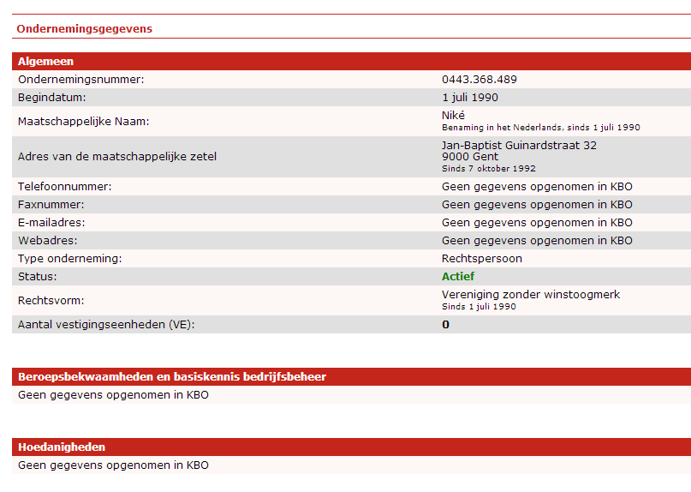
Start with a robust Domain Model
1

Slide 11





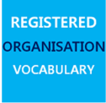



Reuse existing terms and vocabularies
2
General purpose vocabularies: DCMI, RDFS
To name things: rdfs:label, foaf:name, skos:prefLabel
To describe people: FOAF, vCard, Core Person Vocabulary
To describe projects: DOAP, ADMS.SW
To describe interoperability assets: ADMS
  To describe registered organisations: Registered Organisation Vocabulary
To describe addresses: vCard, Core Location Vocabulary
To describe public services: Core Public Service Vocabulary
To describe datasets: DCAT, DCAT Application Profile, VoID
Notes:
UPDATE: added logo for Registered Organisation Vocabulary

Slide 12
Creating application profiles
  Different domains have different requirements for domain-specific semantics, e.g. classification concepts.
  Generic RDF vocabularies usually provides the core base classes needed to allow extensions to add specific sub-class structures or classification schemes as required.
  In such cases, reusers are encouraged to define application profiles particular to an application domain by specifying (if required) sub-classes, sub-properties and controlled vocabularies.
  For example,
    DCAT Application profile for data portals in Europe
    Registered Organization vocabulary as an application profile of the Organization ontology.
See also:
joinup.ec.europa.eu/asset/dcat_application_profile/home
Notes:
UPDATE: lay-out – bold
+
Link on the examples

Slide 13
Advantages of reuse
  Reuse greatly aids interoperability of your data
      Use of dcterms:created, for example, the value for which should be a data typed date such as 2013-02-21^^xsd:date, is immediately processable by many machines. If your schema encourages data publishers to use a different term and date format, such as ex:date "21 February 2013" – data published using your schema will require further processing to make it the same as everyone else's.
  Reuse adds credibility to your schema.
      It shows it has been published with care and professionalism, again, this promotes its reuse.
  Reuse is easier and cheaper.
    Reusing classes and properties from well defined and properly hosted vocabularies avoids your having to replicate that effort.

Slide 14
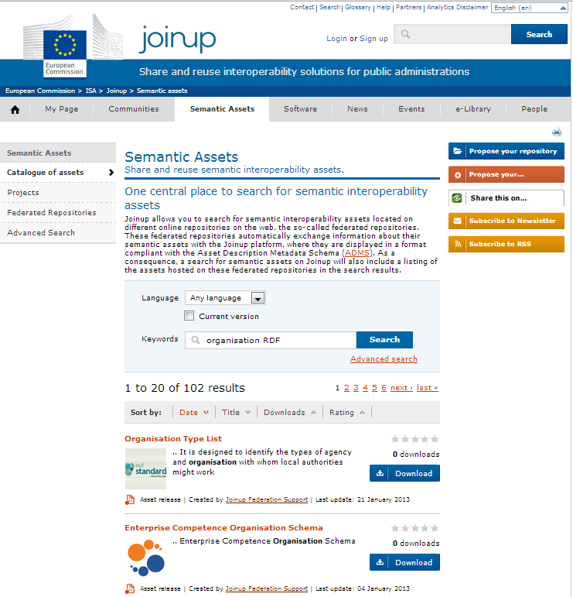
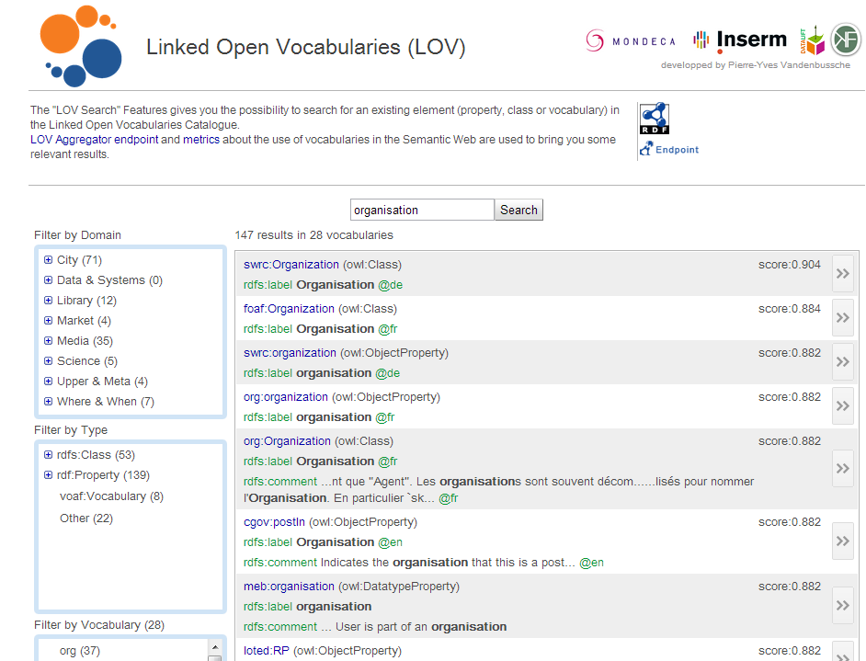
You can find reusable RDF vocabularies on...
http://lov.okfn.org/
http://joinup.ec.europa.eu/

Slide 15
Creation of sub-classes and sub-properties
3
  RDF schemas and vocabularies often include terms that are very generic.
  By creating sub-class and sub-property relationships, systems that understand the super property or super class may be able to interpret the data even if the more specific terms are unknown.
  Do not create sub-classes and sub-properties simply to allow you to use your own term for something that already exists.

Slide 16
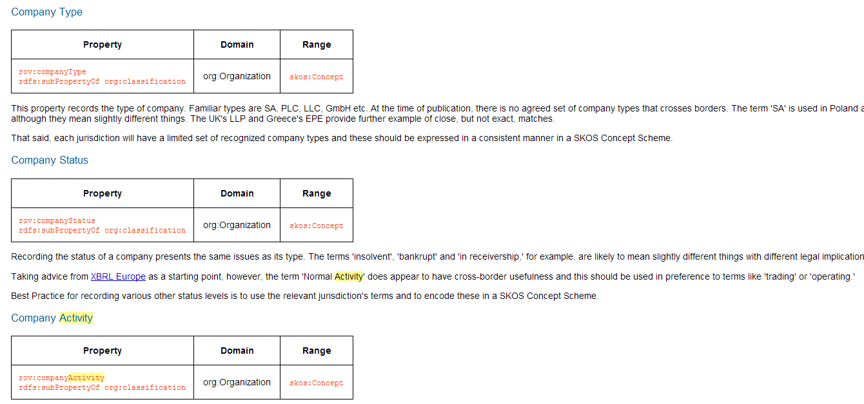
Creation of sub-properties - example
The Registered Organization vocabulary defines three sub-properties of org:classification: companyType, companyStatus and companyActivity.

Slide 17
Defining a sub-property in RDF
<rdf:Property rdf:about="rov:companyType">
<rdfs:label xml:lang="en">company type</rdfs:label>
<rdfs:comment xml:lang="en" rdf:parseType="Literal">
        This property records the type of company. Familiar types are SA, PLC, LLC, GmbH etc. Each jurisdiction will have a limited set of recognised company types and these should be used in a consistent manner using a skos:Concept as described in the <a href="#skos:Concept">Code</a> Class.
</rdfs:comment>
<rdfs:isDefinedBy rdf:resource="http://www.w3.org/ns/regorg#"/> <rdfs:range rdf:resource="skos:Concept"/>
<rdfs:subPropertyOf rdf:resource="org:classification" /> <dcterms:identifier>legal:companyType</dcterms:identifier>
</rdf:Property>

Slide 18
Where new terms are required, create them following commonly agreed best practices
4
  Classes begin with a capital letter and are always singular, e.g. skos:Concept.
Properties begin with a lower case letter, e.g. rdfs:label.
Object properties should be verbs, e.g. org:hasSite.
Data type properties should be nouns, e.g. dcterms:description.
  Use camel case if a term has more than one word, e.g. foaf:isPrimaryTopicOf.

Slide 19
Defining a new class - Organisation
<rdf:RDF
xmlns:rdfs=“http://www.w3.org/2000/01/rdf-schema#”
xmlns:org=“htpp://example.org/organisation-schema”>
<rdf:Class rdf:about=“org:Organisation">
<rdfs:label xml:lang="en">Organisation</rdfs:label>
<rdfs:comment xml:lang:”en”>
Legal entity that is registered in an official national or regional register.
</rdfs:comment>
</rdf:Class>

Slide 20
Defining a new property - registrationNumber
<rdf:RDF
xmlns:rdfs=“http://www.w3.org/2000/01/rdf-schema#”
xmlns:org=“htpp://example.org/organisation-schema”>
<rdf:Property rdf:about=“org:registrationNumber">
<rdfs:label xml:lang="en">registrationNumber</rdfs:label>
<rdfs:comment xml:lang:”en”>
The number that a registered organisation receives upon registration in the official register.
</rdfs:comment>
</rdf:Class>

Slide 21
Defining domain and range restrictions
<rdf:RDF
xmlns:rdfs=“http://www.w3.org/2000/01/rdf-schema#”
xmlns:org=“htpp://example.org/organisation-schema”
xmlns:locn=“http://www.w3.org/ns/locn#”>
<rdf:Property rdf:about=“org:isLocated">
<rdfs:label xml:lang="en">isLocated</rdfs:label>
<rdfs:comment xml:lang:”en”>
The official address of the registered organisation’s headquarters.
</rdfs:comment>
<rdfs:domain rdf:resource=“org:Organisation”/>
<rdfs:range rdf:resource=“locn:Address”>
</rdf:Class>
http://example.org/org/1234 org:isLocated http://dbpedia.org/page/Brussels

Slide 22
Publish within a highly stable environment designed to be persistent
5
Choose a stable namespace for your RDF schema (e.g. W3C, Purl...)
  Use good practices on the publication of persistent Uniform Resource Identifiers (URI) sets, both in terms of format and of their design rules and management.
  Examples:
    http://www.w3.org/ns/adms
    http://purl.org/dc/elements/1.1
See also:
https://joinup.ec.europa.eu/community/semic/document/cookbook-translating-data-models-rdf-schemas
http://www.slideshare.net/OpenDataSupport/design-and-manage-persitent-uris

Slide 23
Publicise the RDF schema by registering it with relevant services
6
Once your RDF schema is published you will want people to know about it. To reach a wider audience register it Joinup and Linked Open Vocabularies.
http://lov.okfn.org
http://joinup.ec.europa.eu

Slide 24
Conclusions
Start with a robust Domain Model developed following a structured process and methodology.
Analyse
Research existing terms and their usage and maximise reuse of those terms.
Where new terms can be seen as specialisations of existing terms, create sub class and sub properties as appropriate.
Model
Where new terms are required, create them following commonly agreed best practice in terms of naming conventions etc
Publish within a highly stable environment designed to be persistent.
Publish
Publicise the RDF schema by registering it with relevant services.

Slide 25

Group exercise
In groups of 2, create the RDF description of a vocabulary for representing a citizen.
According to you, what are the main barriers to the reuse of existing RDF vocabularies?
http://www.visualpharm.com
http://www.visualpharm.com
Take also the online test here!
Notes:
UPDATE: text and link to test

Slide 26
Thank you!
...and now YOUR questions?

Slide 27
References
Slides 9:
  Linked Data Cookbook. W3C. http://www.w3.org/2011/gld/wiki/Linked_Data_Cookbook
Slide 10-23:
  ISA Programme. Cookbook for translating Data Models to RDF Schemas. https://joinup.ec.europa.eu/community/semic/document/cookbook-translating-data-models-rdf-schemas
Slide 16, 18,-21:
W3C. An organization ontology. http://www.w3.org/TR/vocab-org/
Slide 23:
  ADMS Brochure. ISA Programme. https://joinup.ec.europa.eu/elibrary/document/adms-brochure
Notes:
Updated.

Slide 28
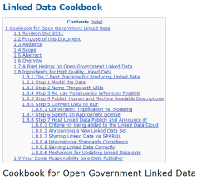


Further reading
Linked Data Cookbook, W3C Government Linked Data Working Group,
http://www.w3.org/2011/gld/wiki/Linked_Data_Cookbook
EC, ISA Process and methodology for developing semantic agreements, https://joinup.ec.europa.eu/community/core_vocabularies/document/process-and-methodology-developing-semantic-agreements
EC ISA, Cookbook for translating Data Models to RDF Schemas https://joinup.ec.europa.eu/community/semic/document/cookbook-translating-data-models-rdf-schemas

Slide 29






Related projects and initiatives
Joinup, http://joinup.ec.europa.eu
  Linked Open Vocabularies (LOV), http://lov.okfn.org/
EC ISA, e-Government Core Vocabularies,
https://joinup.ec.europa.eu/community/core_vocabularies/home
  W3C Schools – Learn RDF http://www.w3schools.com/rdf/default.asp
  EUCLID, http://euclid-project.eu/
  XML Summer School http://xmlsummerschool.com/

Slide 30





Be part of our team...
Find us on
Join us on
Open Data Support
http://www.slideshare.net/OpenDataSupport
Open Data Support
http://goo.gl/y9ZZI
http://www.opendatasupport.eu
Follow us
Contact us
@OpenDataSupport
    contact@opendatasupport.eu

