Slide 1
Training Module 2.5 Data & metadata licensing
PwC firms help organisations and individuals create the value they’re looking for. We’re a network of firms in 158 countries with close to 180,000 people who are committed to delivering quality in assurance, tax and advisory services. Tell us what matters to you and find out more by visiting us at www.pwc.com.
PwC refers to the PwC network and/or one or more of its member firms, each of which is a separate legal entity. Please see www.pwc.com/structure for further details.

Slide 2
This presentation has been created by PwC Authors: Makx Dekkers, Nikolaos Loutas, Michiel De Keyzer and Stijn Goedertier
Presentation metadata
Disclaimers
The views expressed in this presentation are purely those of the authors and may not, in any circumstances, be interpreted as stating an official position of the European Commission.
The European Commission does not guarantee the accuracy of the information included in this presentation, nor does it accept any responsibility for any use thereof.
Reference herein to any specific products, specifications, process, or service by trade name, trademark, manufacturer, or otherwise, does not necessarily constitute or imply its endorsement, recommendation, or favouring by the European Commission.
All care has been taken by the author to ensure that s/he has obtained, where necessary, permission to use any parts of manuscripts including illustrations, maps, and graphs, on which intellectual property rights already exist from the titular holder(s) of such rights or from her/his or their legal representative.
This presentation has been carefully compiled by PwC, but no representation is made or warranty given (either express or implied) as to the completeness or accuracy of the information it contains. PwC is not liable for the information in this presentation or any decision or consequence based on the use of it.. PwC will not be liable for any damages arising from the use of the information contained in this presentation. The information contained in this presentation is of a general nature and is solely for guidance on matters of general interest. This presentation is not a substitute for professional advice on any particular matter. No reader should act on the basis of any matter contained in this publication without considering appropriate professional advice.
Open Data Support is funded by the European Commission under SMART 2012/0107 ‘Lot 2: Provision of services for the Publication, Access and Reuse of Open Public Data across the European Union, through existing open data portals’(Contract No. 30-CE-0530965/00-17). © 2014 European Commission

Slide 3
Learning objectives
By the end of this training module you should have an understanding of:
The importance of licensing.
The meaning of “open” in Open Data.
The licensing requirements in the revised PSI Directive.
Creative Commons and the Open Data Commons.
The licensing options for data and metadata and the consequences for sharing and reuse.
The Europeana Licensing Framework as a practical example.

Slide 4
Content
This modules contains...
The importance of licensing
Licensing in the Open Data Principles
Licensing in the revised PSI Directive
Licensing options and good practice for reuse of data
Licensing options and good practice for reuse of metadata
A scenario for reuse of metadata
Case study: Europeana

Slide 5
The importance of Licensing

Slide 6
Clear licence information is important because...
It tells users and reusers exactly what they can do with your data and metadata.
It encourages the use and reuse of your data and metadata the way you want them to be used and reused.
It creates visibility of your efforts downstream (if you ask for attribution).
If no explicit licence is provided, a user does not know what can be done with the data/metadata – the default legal position is that nothing can be done without contacting the owner on a case-by-case basis.

Slide 7
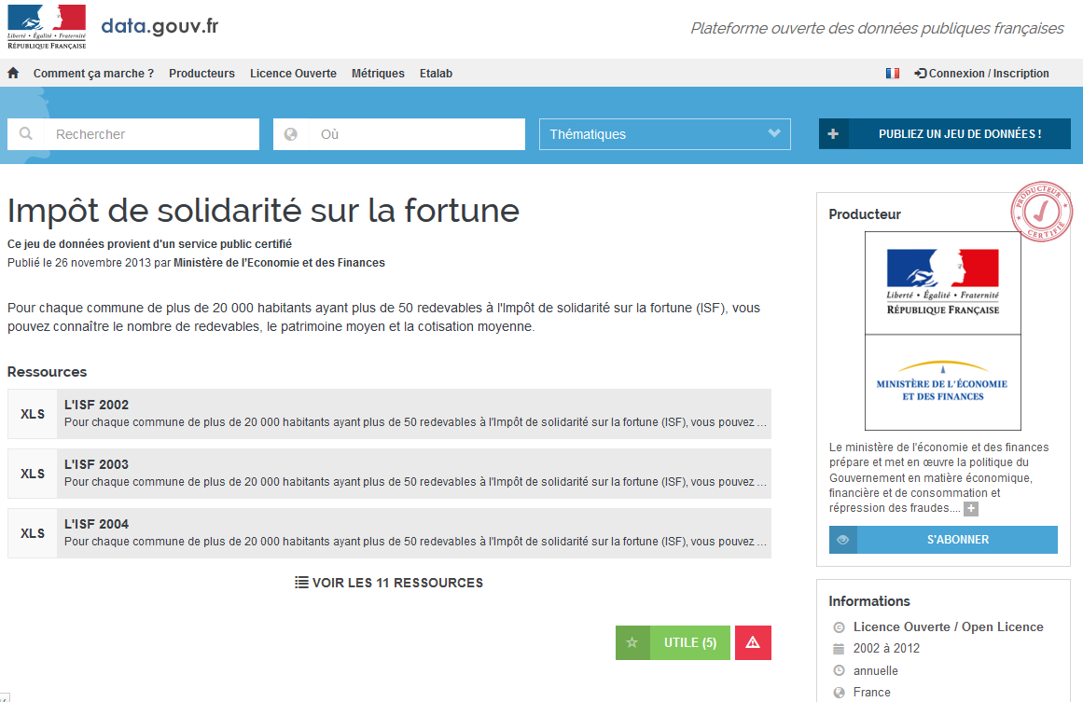
Clear licence information - example
Notes:
UPDATE: addition of this slide as an example

Slide 8
Licensing in the Open Data Principles How licences appear in the basic principles of open data and why licensing of open (meta)data is important.

Slide 9
The Open Data Definition It also covers metadata
“A piece of data or content is open if anyone is free to use, reuse, and redistribute it — subject only, at most, to the requirement to attribute and/or share-alike” -- opendefinition.org
This means, according to the Open Knowledge Foundation:
Availability and Access: the data must be available as a whole and at no more than a reasonable reproduction cost, preferably by downloading over the internet. The data must also be available in a convenient and modifiable form.
Reuse and Redistribution: the data must be provided under terms that permit reuse and redistribution including the intermixing with other datasets.
Universal Participation: everyone must be able to use, reuse and redistribute - there should be no discrimination against fields of endeavour or against persons or groups. For example, ‘non-commercial’ restrictions that would prevent ‘commercial’ use, or restrictions of use for certain purposes (e.g. only in education), are not allowed

Slide 10
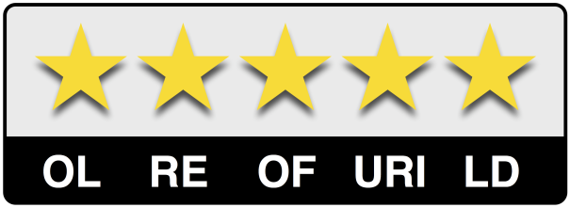
Licensing is the first star...
One star: publish data under an open licence
Two stars: publish in machine-readable format
Three stars: publish in open format
Four stars: assign URIs to data
Five stars: create links to other data
See also:
http://www.slideshare.net/OpenDataSupport/introduction-to-linked-data-23402165

Slide 11
Licensing in the revised PSI Directive

Slide 12
Obligations of Member States according to the PSI Directive
Public sector bodies are obliged, for all information they hold related to their public task and that is not explicitly mentioned in one of the exceptions, to:
Make information reusable for commercial or non-commercial purposes under non-discriminatory conditions.
Process requests and provide access within 20 days (or 40 if request is complex); justify negative decision and inform about how to appeal.
Charge no more than the marginal cost incurred for reproduction, provision and dissemination; the charges (if any) and the calculation basis for those charges are to be pre-established and published, through electronic means where possible and appropriate.
Publish licences in digital format.
Make information available in pre-existing format and language, and where possible and appropriate, in open and machine- readable format together with their metadata. Both the format and the metadata should, in so far as possible, comply with formal open standards.
Put in place practical arrangements that facilitate the search for documents available for reuse, such as assets lists, accessible preferably online, of main documents, and portal sites that are linked to decentralised assets lists.
Notes:
UPDATE : lay-out - bold

Slide 13
Directive 2013/37/EU says...
Any licences […] should […] place as few restrictions on reuse as possible […]. Open licences available online, which grant wider reuse rights without technological, financial or geographical limitations and relying on open data formats, should play an important role in this respect. Therefore, Member States should encourage the use of open government licences […]. - Recital (26)
Public sector bodies may allow reuse without conditions or may impose conditions, such as indication of source, where appropriate through a licence. These conditions shall not unnecessarily restrict possibilities for reuse and shall not be used to restrict competition. - Article 8, paragraph 1
See also:
http://www.slideshare.net/OpenDataSupport/the-psi-directive-and-open-government-data

Slide 14
Consequences of the PSI Directive with regards to licensing
Make information re-usable for commercial or non-commercial purposes under non-discriminatory conditions
Conditions need to be pre-established, transparent and the same for everyone. The Directive encourages the use of an open licence.
Publish licenses in digital format
Explicit licences should be associated with the available data.
Facilitate search for information, preferably online (e.g. portal)
This implies public availability of descriptions of available data.

Slide 15
Licensing options and good practices The case of data – different options exist for licensing your data depending on its nature.

Slide 16
Licensing datasets
If you want to attach no restrictions to your data: Say it!
Every dataset should have a licence associated to it.
Without an explicit licence, reuse is restricted.
The objective should be to make data(sets) as openly available as possible, within the boundaries of the law.
But how can I know which licence is fit for purpose?

Slide 17
Different data have different licensing needs
Some data(sets) may be required to be openly available.
e.g. subject to a Freedom of Information Act
Some data(sets) may be subject to restrictions.
e.g. privacy, national security, third party rights
Some data(sets) may be available for reuse but not for modification.
e.g. legal texts, public budgets (if modifications are made, it must be made clear that the data is not the actual authentic version)
Some data(sets) may be published allowing derivations with attribution of authoritative source.
e.g. legal commentary, translations

Slide 18
Licensing approaches: Creative Commons (1)
Public domain - No rights reserved – allows licensors to waive all rights and place a work in the public domain. others may freely build upon, enhance and reuse the works for any purposes without restriction under copyright or database law.
Public Domain Mark – “No know copyright”– allows licensors to waive all rights and place a work in the public domain. It indicates that a work is no longer restricted by copyright and can be freely used by others.
Attribution – Others can distribute, remix, tweak, and build upon your work, even commercially, as long as they credit you for the original creation.
Attribution-ShareAlike – Others can remix, tweak, and build upon your work even for commercial purposes, as long as they credit you and license their new creations under the identical terms.
See also:
http://creativecommons.org/licenses/
Notes:
UPDATE: split this slide in 2 (see next slide)
+ title and text of first license
+ everything about Public Domain Mark – “No know copyright”

Slide 19
Licensing approaches: Creative Commons (2)
Attribution-NoDerivs – Allows for redistribution, commercial and non-commercial, as long as it is passed along unchanged and in whole, with credit to you.
Attribution-NonCommercial – Others can remix, tweak, and build upon your work non-commercially, and although their new works must also acknowledge you and be non-commercial, they don’t have to license their derivative works on the same terms.
Attribution-NonCommercial-ShareAlike – Others can remix, tweak, and build upon your work non-commercially, as long as they credit you and license their new creations under the identical terms.
Attribution-NonCommercial-NoDerivs – Only allows others to download your works and share them with others as long as they credit you, but they can’t change them in any way or use them commercially.
See also:
http://creativecommons.org/licenses/
Notes:
UPDATE: added slide (split from previous slide)

Slide 20
Good practices for licensing your data
Good practices:
If the original data is in the public domain (e.g. by law), keep it there – use for example the Creative Commons Zero Public Domain Dedication or the Open Data Commons Public Domain Dedication and License (PDDL)
For some documentation integrity needs to be protected – use a No-Derivatives licence, for example Creative Commons Attribution-NoDerivs, but only if really necessary
Avoid Non-Commercial licences if at all possible, as these seriously restrict reuse.
Licences for data should provide appropriate security and control (but not more than that).

Slide 21
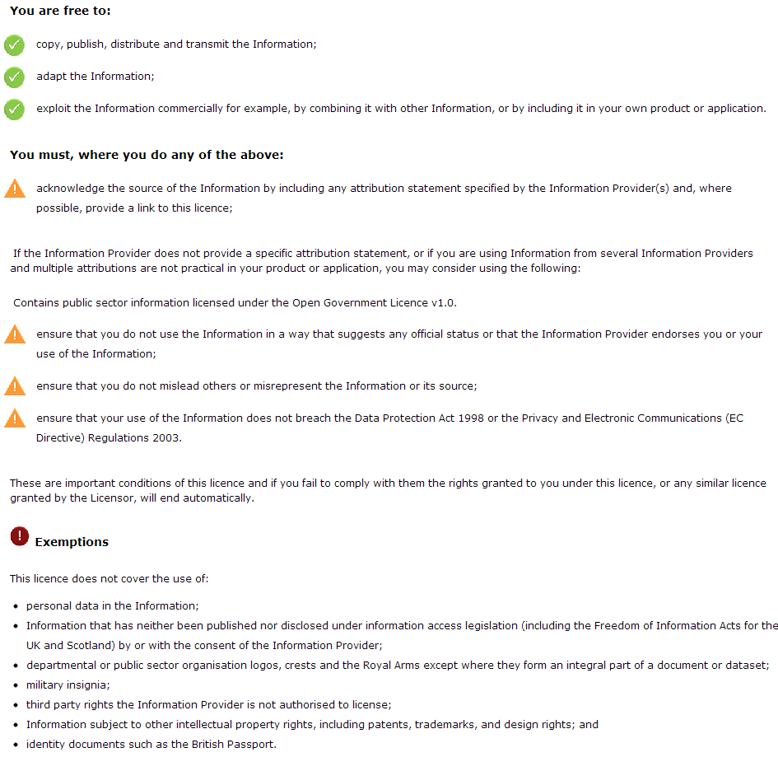
UK Government licence for PSI
http://www.nationalarchives.gov.uk/doc/open-government-licence/version/2/
Notes:
UPDATE: link (previous link was dead)

Slide 22
Using an open and unrestricting licence for your data
Whenever data is licensed for open and unrestricted access, reusers can create new knowledge from combining it.
For example,
Cross-referencing public spending with geographic data to visualise which regions are better funded.
Matching public transport timetables with GPS data to be able to give real time information on delays.
Measuring performance of public services based on transaction counters and waiting times.
Deriving recommendations for prevention policies relating accident statistics with weather data and road maps.

Slide 23
Protecting against liability
Liability risks are related to:
Infringement on third-party rights (personal data, copyright, database rights etc.)
Rights must be cleared and data must be anonymised
(In)correctness of data
A disclaimer makes clear in how far the publisher guarantees correctness of the data
Unfair competition to market parties already selling the information
In such cases, market parties need to be consulted, e.g. providing a phasing-in period
Source: Marc de Vries. Open Data and Liability. EPSIplatform Topic Report No. 2012/13.
http://epsiplatform.eu/sites/default/files/Final%20TR%20Open%20Data%20and%20Liability.pdf

Slide 24
Licensing options and good practices The case of metadata – publish your metadata under a public domain licence to ensure wide distribution & reuse.

Slide 25
Which licences are suited for metadata?
The following licenses allow fully open reuse:
Public Domain Mark
Creative Commons Zero Public Domain Dedication
Open Data Commons Public Domain Dedication and license (PDDL)
The following licenses are also used but lead to “attribution stacking”, the need to keep track of a chain of attributions:
CC-BY
ODC Attribution
ISA Open Metadata licence 1.1
Open Government licence
Other licences (non-commercial, non-derivatives, share-alike) are less suited; they make reuse of metadata for Linked Data applications difficult because they place restrictions on how metadata can be shared, used and enhanced.

Slide 26
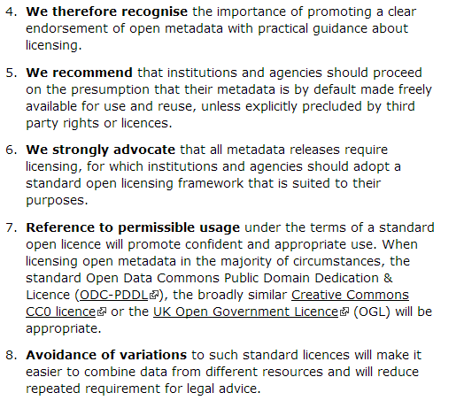
Example: Discovery Open Metadata Principles

Slide 27
Good practices for licensing your metadata
What you need to think about:
Metadata helps people to discover your data.
The wider your metadata is distributed, the higher your visibility is.
Others may want to add to it, enhance it, link to other resources.
Good practices:
Licences for metadata should be as open as possible.
A public domain licence allows the widest reuse.
An attribution licence ensures you get credit downstream, but may cause problems if data is shared multiple times (attribution stacking).

Slide 28
A scenario for reuse of metadata A reuse scenario for metadata published under a public domain licence.

Slide 29
What can reusers do with metadata in the public domain
Copy & include your metadata in search engines and brokers that refer back to the location of your data.
Correct them if the original metadata contains errors.
Enhance your metadata, for example by converting text strings to links.
This can happen if the reuser is aware of URI sets for organisations, subjects and other things to which your metadata refers
Augment the metadata by making additional assertions about your data.
By harvesting metadata back from the reusers, you may be able to increase the quality of your metadata.
See also:
http://www.slideshare.net/OpenDataSupport/promoting-the-reuse-of-open-data-through-odip

Slide 30
Reuse scenario of metadata for datasets (1/2)
Catalogue B reuses description of Dataset A
Catalogue C reuses description of Dataset A (as modified by Catalogue B) and Dataset D
Catalogue A
Catalogue B
Catalogue C
Metadata A
Metadata A+
Metadata A++
Metadata B
Metadata D
Metadata D+
Metadata C
Metadata E
Metadata F
Dataset A
Dataset B
Dataset C
Dataset D
Dataset E
Dataset F
Catalogue A provides descriptions of Datasets A, B and C
Catalogue B provides description of Datasets D and E and enhances description of Dataset A
Catalogue C provides description of Dataset F and enhances description of Datasets A (as modified by Catalogue B) and D

Slide 31
Reuse scenario of metadata for datasets (2/2)
Original metadata in Catalogue A
Modified metadata in Catalogue B; added local identifier “CatB-IdX”
Modified metadata in Catalogue C; added keyword “example”

Slide 32
Pros & cons of public domain licence
Release of ownership:
No-one will know that you created the initial metadata.
Enables community-driven enhancement.
Loss of control:
You will not know what statements are made about your data.
Quality control will emerge from the community (cf. Wikipedia).
Reliability:
A user will not know whether the metadata is accurate and up-to-date.
Network partners (chains of aggregators) will be able to track quality.
Misrepresentation:
Additions and modifications may be wrong or not to your liking.
Anyone can say anything about anything in any case; if based on your original metadata there is a higher chance the metadata is correct.

Slide 33
Case study: Europeana How Europeana overcame data and metadata licensing challenges.

Slide 34
Europeana – original approach
In 2009, Provider and Aggregator Agreements were signed. These included the restriction that metadata could only be used for non-commercial purposes.
However, this made it impossible for metadata to be:
Published as Linked Open Data.
Used on sites that include advertisements.
Shared with Wikipedia (which does not allow such restriction).
Used by commercial companies, e.g. for listing in search engines.
Used by commercial apps.

Slide 35
Perceived risks of providing open metadata? (1/2)
Loss of quality: the high-quality metadata provided will be divorced from the original trusted source and corrupted by third parties.
Loss of control: institutions will no longer be able to control the metadata if anyone can reuse or distribute it.
Loss of unity: metadata will get scattered across the digital universe while it should be (contextually) kept together.
Loss of brand value: by releasing data openly the institution risks being associated with reusers that they do not want to be associated with.
Loss of attribution: by releasing data under an open licence institutions will not be credited as the source/owner of the metadata.

Slide 36
Perceived risks of providing open metadata? (2/2)
Loss of income: institutions are afraid that they cannot replace current revenues from metadata with other sources of income.
Loss of potential income: in the future, institutions may think of a way to make money from metadata, but if they release it openly now someone else may do this.
Unwanted spill-over effects: institutions find it unfair that others make money with the metadata that they provide.
Losing customers: if data is openly available customers will go elsewhere to get the information they are looking for.
Privacy: there are privacy restrictions on the use of certain data.

Slide 37
Identified benefits of open metadata (1/2)
Increasing relevance: open metadata can be used in places where online users congregate (including social networks). This helps providers to maintain their relevance in today’s digital society.
Increasing channels to end users: providers releasing data as open metadata increase the opportunities that users see their data and their content.
Data enrichment: open metadata can be enriched by Europeana and other parties and can then be returned to the data provider. Opening the metadata will increase the possibility of linking that data and the heritage content it represents with other related sources/collections.
Brand value (prestige, authenticity, innovation): releasing data openly demonstrates that the provider is working in the innovation vanguard and is actively stimulating digital research.
Specific funding opportunities: releasing metadata openly will potentially grant providers access to national and/or European funding (European and most national governments are actively promoting open metadata).

Slide 38
Identified benefits of open metadata (2/2)
Discoverability: increased use and visibility of data drives traffic to the provider’s website.
New customers: releasing data openly offers new ways to interact with and relate to customers.
Public mission: releasing metadata openly aligns the provider with the strategic public mission of allowing the widest possible access to cultural heritage.
Building expertise: releasing metadata openly will strengthen the institution’s expertise in this area, which will become a marketable commodity such as consulting services.
Desired spill-over effects: institutions and creative industries will be able to create new businesses, which in turn will strengthen the knowledge economy.

Slide 39
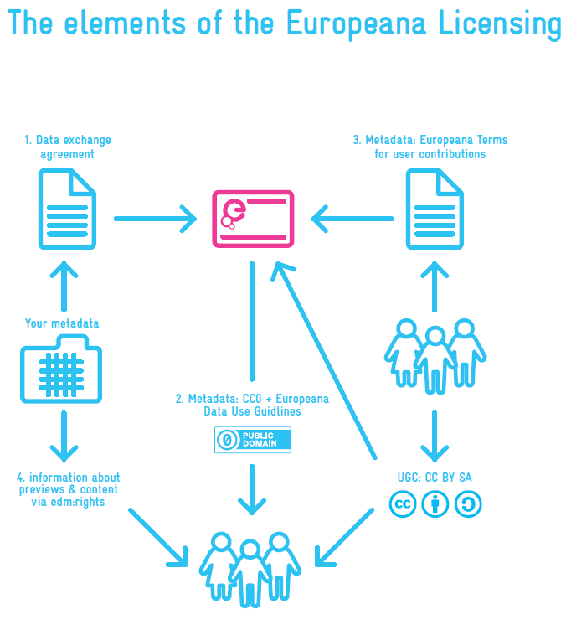
Europeana Licensing Framework
Four layers:
Physical objects: ownership or public domain as appropriate.
Digital objects representing the physical objects: rights statement to be either Public Domain, or a Creative Commons licence or Rights Reserved (free, paid, or restricted access).
Previews (e.g. thumbnails): Europeana has right to use but not to distribute unless licence allows this.
Descriptive metadata: to be provided under CC Zero Public Domain Dedication, so reuse is unrestricted; in addition, provider should make best effort to correctly state intellectual property rights of digital objects.

Slide 40
Conclusions
Data and metadata should be provided with an explicit licence so that reusers know what to do with the metadata and data and allow for maximum interoperability.
Metadata should be made as open as possible, ideally CC Zero or Public Domain Dedication to allow for network effects.
Data should be released under a licence that enables appropriate protection (but not more than necessary).
and don’t forget...
If no explicit licence is provided, a user does not know what (if anything) can be done with the data.
No reuse = no social and economic value.

Slide 41
Group questions
Do you have in your country a licence for open data and/or metadata? If not, which should, in your opinion, be the preferred approach?
What are/were the greatest barriers to publishing your data under an open licence?
http://www.visualpharm.com
http://www.visualpharm.com
Take also the online test here!
Notes:
UPDATE: added text and link to test

Slide 42
Thank you! ...and now YOUR questions?
Notes:
See also: http://europa.eu/rapid/press-release_MEMO-11-891_en.htm

Slide 43
References
Slide 9:
The Open Knowledge Foundation. Open Definition. http://opendefinition.org/
The Open Knowledge Foundation. Open Data - An Introduction. http://okfn.org/opendata/
Slide 10:
LOD Around The Clock (LATC). 5 ★ Open Data. http://5stardata.info/
Slide 12:
Directive 2013/37/EU of the European Parliament and of the Council amending Directive 2003/98/EC on the reuse of public sector information. http://eur-lex.europa.eu/LexUriServ/LexUriServ.do?uri=OJ:L:2013:175:0001:0008:EN:PDF
European Commission. Revision of the PSI Directive. http://ec.europa.eu/information_society/policy/psi/revision_directive/index_en.htm
Slide 18:
Creative Commons. About the licenses. http://creativecommons.org/licenses/
Slide 21:
(UK) National Archives. Government license for public sector information. http://www.nationalarchives.gov.uk/doc/open-government-licence/version/2/
Slide 23:
Marc de Vries. Open Data and Liability. EPSIplatform Topic Report No. 2012/13. http://epsiplatform.eu/sites/default/files/Final%20TR%20Open%20Data%20and%20Liability.pdf
Slide 26:
Discovery. Discovery Open Metadata Principles. http://discovery.ac.uk/businesscase/principles/
Slide 33-38:
Europeana. The Problem of the Yellow Milkmaid: A Business Model Perspective on Open Metadata. White Paper No.2. November 2011. http://pro.europeana.eu/documents/858566/2cbf1f78-e036-4088-af25-94684ff90dc5
Jill Cousins. Europeana. Data Exchange Agreements. May 2011. http://bit.ly/14Hwe5D
Slide 39:
The Europeana Licensing Framework. http://pro.europeana.eu/documents/858566/7f14c82a-f76c-4f4f-b8a7-600d2168a73d
Notes:
UPDATE: slide numbering
+ link “http://www.nationalarchives.gov.uk/doc/open-government-license/version/1/open-government-license.htm” to “http://www.nationalarchives.gov.uk/doc/open-government-licence/version/2/ ”

Slide 44
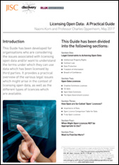
Further reading
N. Korn and C. Oppenheim. Licensing Open Data: A Practical Guide. http://discovery.ac.uk/businesscase/principles/
Europeana. The Problem of the Yellow Milkmaid: A Business Model Perspective on Open Metadata. White Paper No.2. November 2011. http://pro.europeana.eu/documents/858566/2cbf1f78-e036-4088-af25-94684ff90dc5

Slide 45
Related projects and initiatives
Revision of the PSI Directive, http://ec.europa.eu/information_society/policy/psi/revision_directive/index_en.htm
Europeana Licensing Framework, http://pro.europeana.eu/documents/858566/7f14c82a-f76c-4f4f-b8a7-600d2168a73d
Creative Commons Licenses, http://creativecommons.org/licenses/
Open Data Commons – Licenses, http://opendatacommons.org/licenses/
The European Thematic Network on Legal Aspects of Public Sector Information, http://www.lapsi-project.eu/
EC ISA Programme, ISA Open Metadata licence v1.1. https://joinup.ec.europa.eu/category/license/isa-open-metadata-license-v11

Slide 46
Be part of our team...
Find us on
Join us on
Open Data Support
http://www.slideshare.net/OpenDataSupport
Open Data Support
http://goo.gl/y9ZZI
http://www.opendatasupport.eu
Follow us
Contact us
@OpenDataSupport
contact@opendatasupport.eu

