Slide 1
DCAT-AP change and release management Policy & usage analysis 8 December 2017 ISA² action 2016.07: promoting semantic interoperability among EU Member States

Slide 2
Topics of today
Opening
Presentation of the Change and Release Management Policy
Presentation of results of DCAT-AP usage analysis
Discussion of initial set of change requests
W3C Data Exchange Working Group (DXWG)
Next steps

Slide 3
Opening | ToUR DE TABLE

Slide 4
Change & Release management policy for DCAT-AP

Slide 5
Reminder - objectives of the work
Objective: Update the change and release management policy for DCAT-AP
Rationale:
Need for a transparent, well-managed and predictable change process
Avoid disruption in the interoperability across data portals
Allow flexibility to make changes based on evolving needs and external events:
DCAT-AP will be further developed to meet changing needs
DCAT is being updated by W3C’s DXWG

Slide 6
The change & release management policy
WHAT & WHEN
Bug fixes – every 6 months* Correction of errors or unresolved references. No effect on interoperability.
Minor semantic changes – yearly* Changes that may affect interoperability in non-disruptive ways. E.g. addition of optional properties or deprecation of unused, optional properties.
Major semantic changes – every 2 years* or following W3C Changes that have more serious consequences for interoperability, such as addition of mandatory properties or changes in the mandatory controlled vocabularies.
*if changes are required & if not combined with other release types (e.g. a major releases will also include minor updates and bug fixes)

Slide 7
The change & release management policy
WHAT & WHEN
At least eight months before a scheduled date for a major release, a decision is taken by the ISA² Programme Management Team and communicated to the Working Group to open a discussion round in the Working Group in order to discuss and agree major semantic changes.
Evolution of the W3C Recommendation could lead to the need for major semantic changes. Whenever W3C plans to publish a new version of DCAT, it may be foreseen that the process towards a major semantic release will be scheduled to enable the Working Group to review W3C work and determine implications for DCAT-AP.

Slide 8
The change & release management policy
PROCESS FOR CHANGE REQUESTS – 24 MONTHS
Month
1
2
3
4
5
6
7
8
9
10
11
12
1
2
3
4
5
6
7
8
9
10
11
12
Publication
Publication
Publication
Publication
Bug fix
Closing change requests
1m
Closing change requests
1m
Closing change requests
1m
Closing change requests
1m
2w
2w
2w
2w
WG Informed
WG Informed
WG Informed
WG Informed
Publication
Publication
Minor
3m
3m
Closing change requests
Closing change requests
WG Review
6w
WG Review
6w
Publication
Major
8m
Closing change requests
≥ 3m
1m
≥ 1m
WG Discuss & Agree
Public Review
WG Review & Resolve
Report

Slide 9
The change & release management policy
STAKEHOLDER INVOLVEMENT
All stakeholders are invited to become member of the DCAT-AP Working Group:
maintainers of national and regional application profiles;
developers of solutions that implement DCAT-AP; and
managers of systems that are built on the functionality of DCAT-AP implementations.
➔ Become a member via Joinup
Notes:
Become a member: https://joinup.ec.europa.eu/rdf_entity/http_e_f_fdata_ceuropa_ceu_fw21_fac376c94_b74cf_b4dd7_bade7_b267d6a4ec4dc/members

Slide 10
The change & release management policy
ROLE OF THE WORKING GROUP
Bug fixes
submit change requests until 1 month ahead of publication
WG is informed 2 weeks ahead of publication and can raise objections
Minor semantic changes
submit change requests until 3 months before publication
WG is informed 6 weeks ahead of publication for review
Major semantic changes
submit change requests until 8 months before publication
discuss and agree on changes during a period of at least 3 months participate in the public review of at least 1 month review and resolve issues raised during the last month before publication

Slide 11
The change & release management policy
PROCESS FOR CHANGE REQUESTS
Problems & requests can be submitted via GitHub: https://github.com/SEMICeu/DCAT-AP
Name, affiliation, portal, clear description of the requirement and proposed solution should be mentioned.
The editor (European Commission contractor’s team) classifies issues, schedules their processing and replies within two weeks.
At least every 3 months, the editor prepares a status report for the DCAT-AP Working Group with an overview of change requests received in each of the three categories: bug fix, minor or major semantic change.

Slide 12
The change & release management policy
IMPLICATIONS FOR IMPLEMENTERS
Bug fixes: no implications
Minor semantic changes: no immediate implementation needed, existing implementations remain conformant.
Major semantic changes: no backward compatibility guaranteed, introduction of a release needs to be accompanied by a well-managed software upgrade process.
SUGGESTED PRACTICE
Indicate which version you have implemented
Include upgrades to newer versions in your release planning

Slide 13
The change & release management policy
RELEASE DOCUMENTATION
Specification: PDF, DOCX & ODT
UML diagram: PNG/JPG, SVG & XMI
Machine-readable distributions: RDF, JSON-LD and SHACL/OWL
Decision log
Change log
POLICY REVIEW
The change and release management policy will be reviewed by the European Commission every two years. The next review is scheduled to take place in second half of 2019.

Slide 14
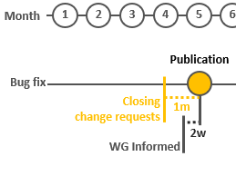
Where are we in the release cycle?
TIMELINE
We’re in a pre-cycle period: first upcoming cycle: bug fix release for publication May 2018
In the meantime: gathering change requests for all categories on GitHub
Planning future releases: minor semantic changes November 2018, major semantic changes in 2019
ROLE OF THE WORKING GROUP
Contribute change requests on GitHub
Participate in discussion on GitHub
https://github.com/SEMICeu/DCAT-AP

Slide 15
DCAT-AP usage analysis

Slide 16
Objectives of the analysis
Objective: Assess the usage of DCAT-AP on the European Data Portal to propose recommendations to the DCAT-AP working group.
Rationale:
Analyse how DCAT-AP is used in practice to identify changing needs
Use SPARQL queries to collect information about the DCAT-AP classes and properties present on the EDP
The European Data Portal is harvesting 73 catalogues in Europe with 788,671 datasets, representing the biggest single source of information compliant with the DCAT-AP.

Slide 17
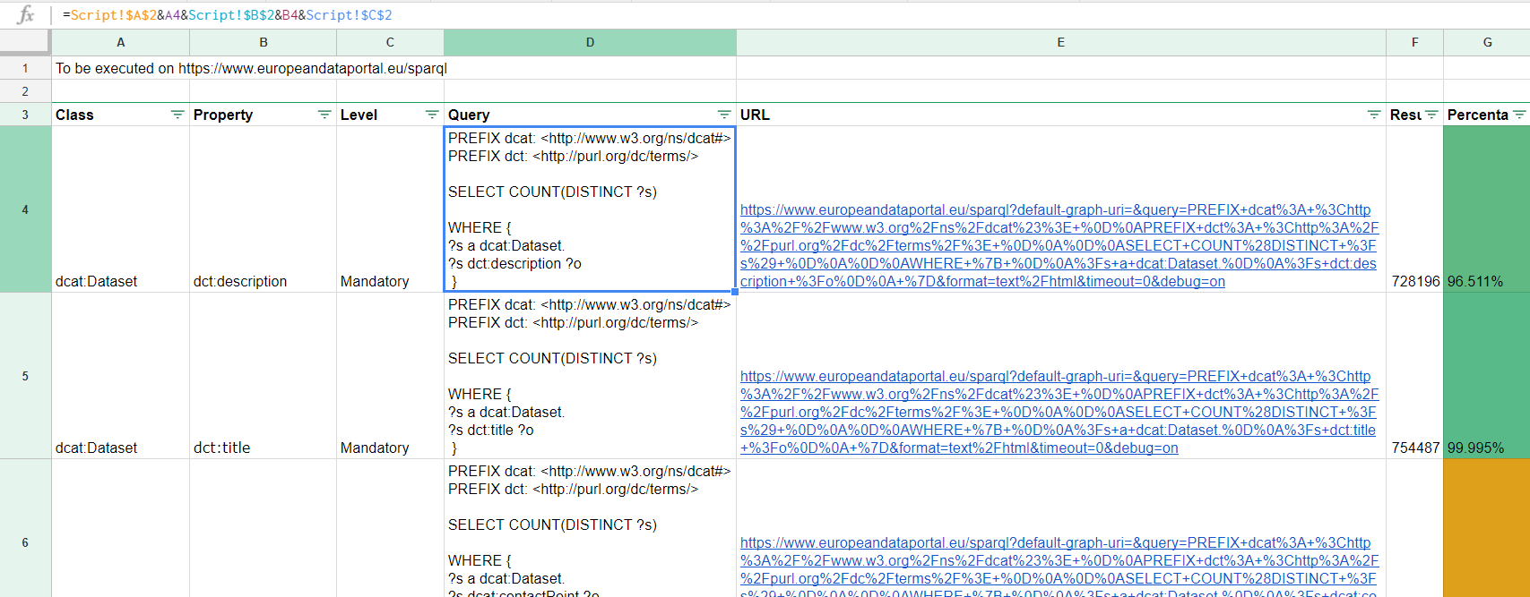
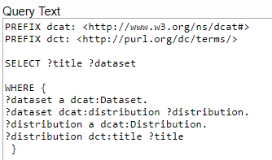
Statistics:
And specific queries:

Slide 18
Dcat:Catalog
dcat:themeTaxonomy
Usage: 100% of the catalogues queried by the European Data Portal
Should this property be made mandatory?
dct:spatial
Usage: 83.75% with almost all countries represented
Should this property be made recommended?
dct:language, dct:rights, dct:isPartOf and dct:hasPart
Usage: 0%
Should these properties be removed/withdrawn/deprecated?

Slide 19
Dcat:Dataset
dct:description
Usage: 96.46% of the datasets queried
Should we somehow encourage addition of description to the 26,328 datasets that don’t use this mandatory property?
dct:publisher and dcat:contactPoint
Usage: 43.85% and 45.44% respectively; 5.2% use both properties
How could we promote the usage of these recommended properties, in addition to the guideline “How are publisher and contact point modelled”?.

Slide 20
Dcat:Dataset
dct:spatial
Usage: 76.79%
Should this property be made recommended?
adms:sample, adms:versionNotes, dct:accessRights, dct:hasVersion, dct:isVersionOf, dct:relation, dct:source, dct:type, owl:versionInfo
Usage: 0%
Should these properties be removed/withdrawn/deprecated?

Slide 21
Dcat:Dataset
dct:accrualPeriodicity
Usage: 44.98%
Issue: some datasets are using the URIs of the MDR Frequencies NAL while other datasets use the label of the same authority list.
Example: IRREG and IRREGULAR at http://publications.europa.eu/mdr/resource/authority/frequency/html/frequencies-eng.html
Is there a need for guidelines to harmonise usage across implementations?

Slide 22
Dcat:Distribution
dct:title and dct:format
Usage: 77.17% and 12.17% respectively
Issue: Some distributions use dct:title instead of dct:format to provide information about the format of the distribution.
Is there a need for guidelines to explain how to use dct:title and dct:format?
dct:rights, dcat:byteSize, dct:language, spdx:checksum, dct:conformsTo
Usage: near-zero %
Should these properties be removed/withdrawn/deprecated?

Slide 23
Dcat:Distribution
dct:format and dcat:mediaType
Usage: 12.17% and 25.52% respectively
Issue: dct:format is a recommended property but Distributions use the optional property dcat:mediaType, which is more restrictive (IANA media type).
Is there a need for guidelines explaining how to use dct:format and dcat:mediaType similar to guideline “How to use accessURL and downloadURL?”, e.g. if specific media type(s) can be provided, duplicate value of the media type(s) in both dcat:mediaType and dct:format?
adms:sample, foaf:page
Usage: 0%
Should these properties be removed/withdrawn/deprecated?

Slide 24
Dcat:catalogrecord
dct:conformsTo, dct:title, dct:source, dct:language, dct:description
Usage: 0%
Should these properties be removed/withdrawn/deprecated?

Slide 25
Other Change requests
Cardinality dct:type on Licence Document
Currently set to max 1
More than one concept from ADMS licence types controlled vocabulary can apply
Should we consider to increase cardinality to 0…n?
Longer term: should we discuss other approaches to licence types, e.g. Open Digital Rights Language (ODRL), Creative Commons CC REL?

Slide 26
Discussion on change requests
All change requests are managed on GitHub at https://github.com/SEMICeu/DCAT-AP
Discussion will take place on GitHub, publicly visible
DCAT-AP Working Group members are invited to contribute new change requests and comment on existing change requests
DCAT-AP Editor to report on status and progress in March 2018

Slide 27
W3C Data Exchange Working Group (DXWG)

Slide 28
W3C Data Exchange Working Group (DXWG)
INTENDED OUTCOMES
DCAT 1.1
An update and expansion of the current DCAT Recommendation. The new version may deprecate, but MUST NOT delete, any existing terms.
Guidance on publishing application profiles of vocabularies
A definition of what is meant by an application profile and an explanation of one or more methods for publishing and sharing them.
Content Negotiation by Application Profile
An explanation of how to implement the expected RFC and suitable fall-back mechanisms as discussed at the SDSVoc workshop.

Slide 29
W3C Data Exchange Working Group (DXWG)
SOME RELEVANT DISCUSSIONS SO FAR
Versioning
Initial agreement not to prescribe what a version is, but make sure that DCAT can describe various types of versioning relationships
Differences between Distributions
Consensus that all Distributions of a Dataset should be 'informationally equivalent'
Granularity and combination of profiles
Including a profile into another, e.g. vCard profile for contact point in DCAT-AP
‘Extension points’ for other vocabularies
Combining DCAT with vocabularies for provenance, data quality, service descriptions but not include those in specification of DCAT itself

Slide 30
W3C Data Exchange Working Group (DXWG)
PARTICIPANTS
Chairs
Karen Coyle, Dublin Core Metadata Initiative (DCMI)
Caroline Burle, Brazilian Network Information Center (NIC.br)
Editors:
Use Cases and Requirements: Ixchel Faniel (OCLC), Jaroslav Pullmann (Fraunhofer), Rob Atkinson (Metalinkage/Open Geospatial Consortium
DCAT: Alejandra González Beltrán (U. Oxford eResearch Centre), Dave Browning (Thomson Reuters), Simon Cox (CSIRO), Peter Winstanley (Scottish Government)
W3C team contact: Dave Raggett (replaced Phil Archer)

Slide 31
W3C Data Exchange Working Group (DXWG)
CURRENT STATUS
First Public Working Draft “Use Cases and Requirements” ready for publication December 2017
Sub-group for DCAT 1.1 established;
Profiles sub-group being set up
FURTHER PLANNING
First Public Working Drafts DCAT 1.1 and Profile Negotiation 1st Quarter 2018
Candidate Recommendations 4th Quarter 2018

Slide 32
NEXT STEPS

Slide 33
Timeline next 6 months
December 2017 – Publish DCAT-AP usage analysis
December 2017 to early April 2018 – Gather change requests from Working Group
Early April 2018 – Close change requests for bug fixes, if such change requests were introduced
Mid-April 2018 – Inform the WG
Late April/early May 2018 – Publish the new release, if necessary
Submitted change requests for semantic changes will be retained for next minor semantic release (November 2018) or major semantic release (November 2019)

Slide 34
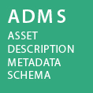
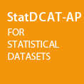
Stay connected!
Promoting semantic interoperability in Europe
Project officers Susanne.Wigard@ec.europa.eu
Fidel.Santiago@ec.europa.eu
Get involved
Follow @SEMICeu on Twitter
Join the SEMIC group on Linkedin
Join the SEMIC community on Joinup
Visit our initiatives

Slide 35
Document metadata
Disclaimer
The views expressed in this report are purely those of the authors and may not, in any circumstances, be interpreted as stating an official position of the European Commission. The European Commission does not guarantee the accuracy of the information included in this study, nor does it accept any responsibility for any use thereof. Reference herein to any specific products, specifications, process, or service by trade name, trademark, manufacturer, or otherwise, does not necessarily constitute or imply its endorsement, recommendation, or favouring by the European Commission.
All care has been taken by the author to ensure that s/he has obtained, where necessary, permission to use any parts of manuscripts including illustrations, maps, and graphs, on which intellectual property rights already exist from the titular holder(s) of such rights or from her/his or their legal representative.
Version: 1.0 Publication date: 7 December 2017
Created by: Brecht Wyns, Florian Barthelemy [PwC EU Services]
Makx Dekkers [AMI Consult] Reviewed by: Fidel Santiago [ISA² Programme, European Commission]

