Slide 1
ISA² Action 2016.29: Catalogue of public services
Harmonising national
and European service
catalogues

Slide 2
Agenda
Chatbot pilot
  Presentation from the Provincia Autonomia di Trento
3
Welcome and overview
1
4
List of generic public services
  Presentation from the Department of Internal Affairs, New Zealand
  Presentation from Logius, Ministerie van Binnenlandse Zaken en Koninkrijksrelaties, The Netherlands
Cross-border pilot: Spain & Portugal
2
5
AOB and wrap-up

Slide 3
Cross-border pilot: Spain & Portugal

Slide 4


Cross-border pilot: Spain & Portugal
Country profiles
System of Administrative Information (SIA)
Study to map the SIA catalogue against the CPSV-AP
Ultimate goal is to integrate public services information at national level
CPSV-AP as a base data model
Creation of the CPSV-AP_PT
Implementing a national catalogue of public services
Notes:
SIA is the inventory of public information of the National State Administration. SIA consists of a web application enabling users to browse it and a catalogue of Web services. SIA already existed before the establishment of the European Interoperability Framework and other interoperability initiatives of the European Commission. One of the main undertakings of the SIA has been to gather information on all public services, assess the degree of digitalisation of these public services, and provide this information to citizens over digital channels.
The Spanish government has conducted a study to map the SIA catalogue against the CPSV-AP. The results of the mapping showed a greater level of details in the Spanish model, which features more mandatory attributes than the CPSV-AP. Another observation was that certain formal details about procedures contained in the CPSV-AP are too specific for the SIA system, making it impossible to match.

Slide 5
Cross-border pilot: Spain & Portugal
Test usability of the CPSV-AP in a cross-border context to display common public services on a user-friendly interface
17
13
1
common public services *
additional public services *
searchable portal
* Based on proposed list in Annex II SDG Regulation

Slide 6



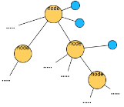

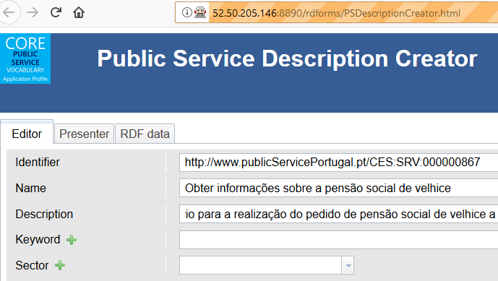
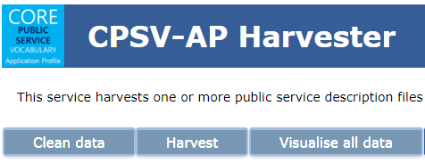




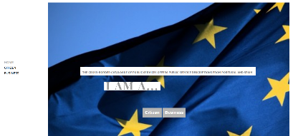
Transforming the data (tool chain)
Portugal
JSON
Description
creator
Harvester
From tabular to hierarchical data
Excel
Linked data CPSV-AP
compliant
Data
base
Spain
Automatedprocess
Web
Portal

Slide 7
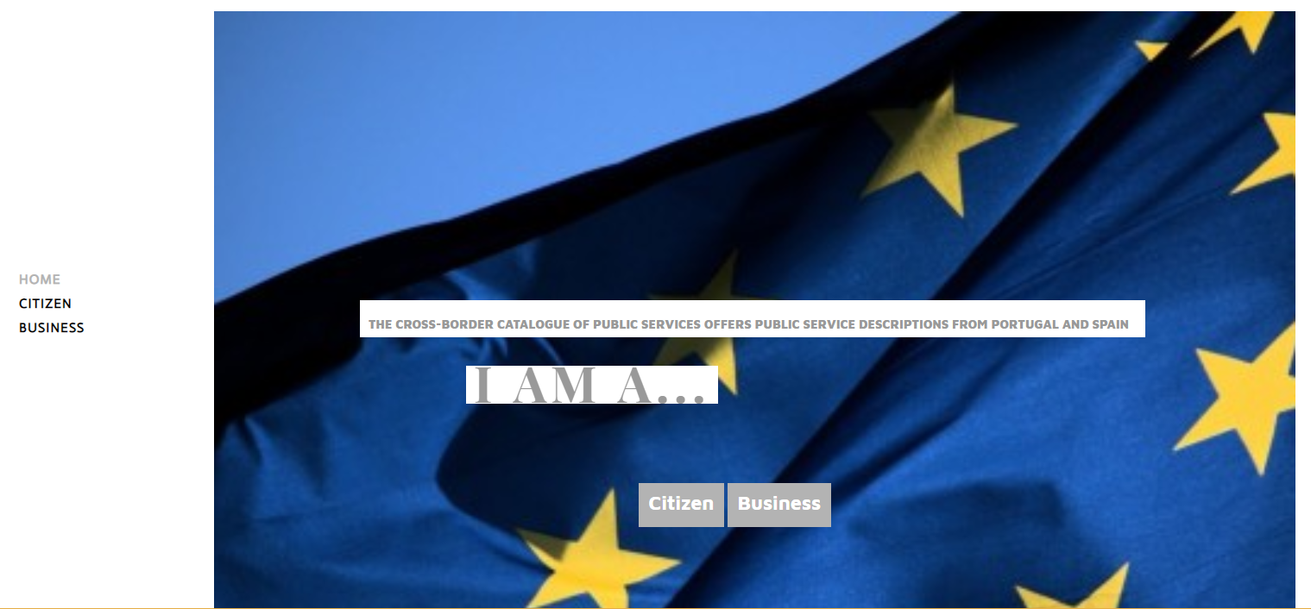
Cross-border pilot: Spain & Portugal

Slide 8
Chatbot

Slide 9
Pilot activity with BOSA and Epirus
Questions:
Can CPSV-AP help structure the information for building a chatbot?
Is the type of information required by a user in searching for a specific public service modelled by CPSV-AP?

Slide 10

Pilot process
BOSA (Belgium)
Extraction to MySQL
CPSV-AP 2.0 template
Data
base
Epirus (Greece)

Slide 11
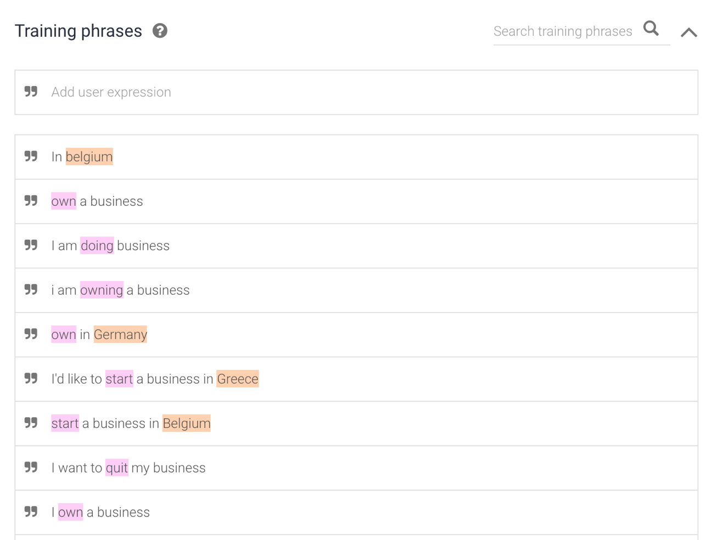
Training phase

Slide 12
Pilot chatbot
Demonstration.

Slide 13
Pilot chatbot
Lessons learnt from the pilot:
The CPSV-AP:
Structures this information in an easy way, enabling a chatbot to make use of multiple sources of interoperable data;
Enables scalability as you can easily add public service descriptions aligned with the CPSV-AP from different public administrations; and
Models a core set of information required for answering specific questions about public services from a user perspective.

Slide 14
Presentation from the Provincia autonomia di Trento

Slide 15







The Trentino Open Data HackaBot 2018 experience
https://www.youtube.com/watch?v=zGpfpjNNGnA&feature=youtu.be
10/09/2018 JOINUP CPSV-AP virtual meeting

Slide 16
The ODHB context
Who: Open Data in Trentino Project (PaT), as part of the INTERREG Europe Project OSIRIS
What: initiatives correlate to an Hackabot (Hackathon + Chatbot)
Why: Using open government data, boosting a data driven economy in Trentino, creating opportunities for companies and public administrations to develop new digital service/products
When: 2 - 3 March 2018
Numbers:
50 solvers (18-23 years old students)
More than 6 SMEs as mentors (SW, chatbots)
11 Challenges faced by 11 teams (3-4pp x team)
6 PA institution from Trentino
More than 2m preparation (seminar with SMEs,training to solvers, meetings tutors)
48h of full work (2 days hackabot)

Slide 17
How it works (organizational)
Hackabot Opendata
Day 1 Group Making and POC Design
Workshop Innovation Academy (SMEs client) in Trentino Sviluppo
Preparatory
Workshop
Data Cleaning, Chatbot 101
For solvers
dati, clienti e sviluppatori
Hackabot
Opendata
@C-Lab Trento
Day 1 POC Development
Day 1 User Test
Solvers Call
Published
Solvers
Selected
Day 2 POC finalization
30
1
19
28
2-3
Day 2 Pitch preparation and Presentation
January
February
March
Preparatory activities
Main event

Slide 18
11 Challenges with 6 different Customers
2 challenges on interaction between citizens and groups related with the activities of the Provincial Unique Emergency Centre - single EU Emergency call number "112" (PaT);
2 challenges on interaction between citizens and Provincial Health Services Agency (APSS) to get general information or targeted information about specific services pertaining to the public service (APSS);
1 challenge on interaction between citizens and public administration regarding public services under the responsibility of the Provincial General Direction (PaT);
2 challenge on interaction between citizens and public administration regarding use of information collected through web platforms for event organization (Trentino Municipality Consortium);
2 challenges on interaction with customers of a Trento Science Museum (MUSE);
2 challenges on interaction with citizens related with energy certification provided by Provincial Agency for Water Resources and Energy (APRIE PaT)

Slide 19
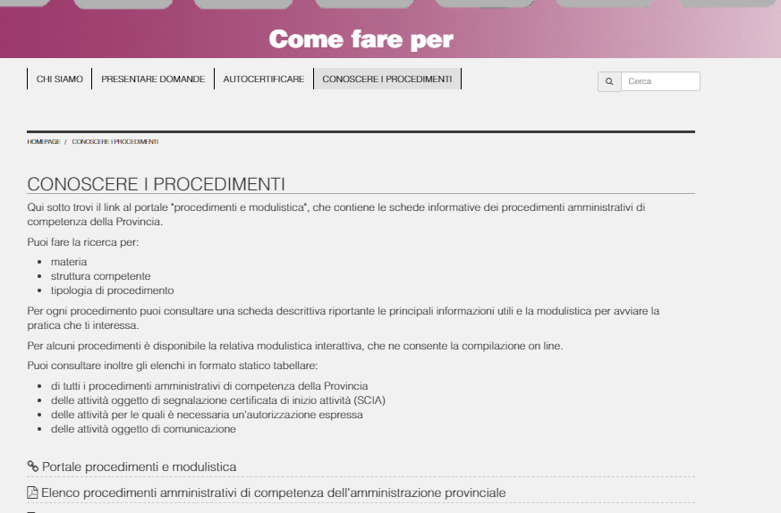
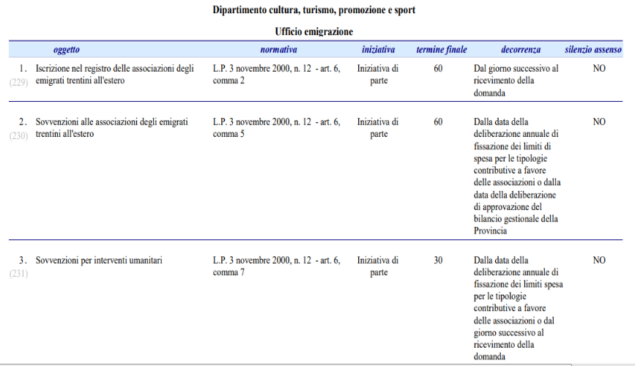
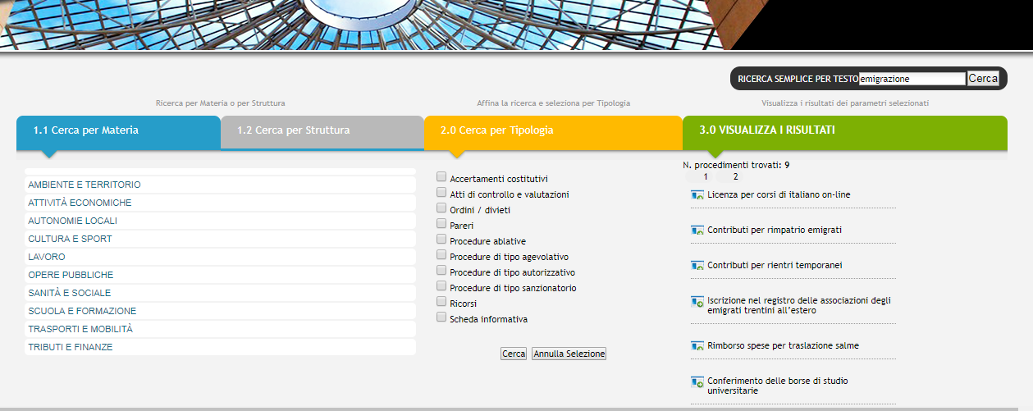
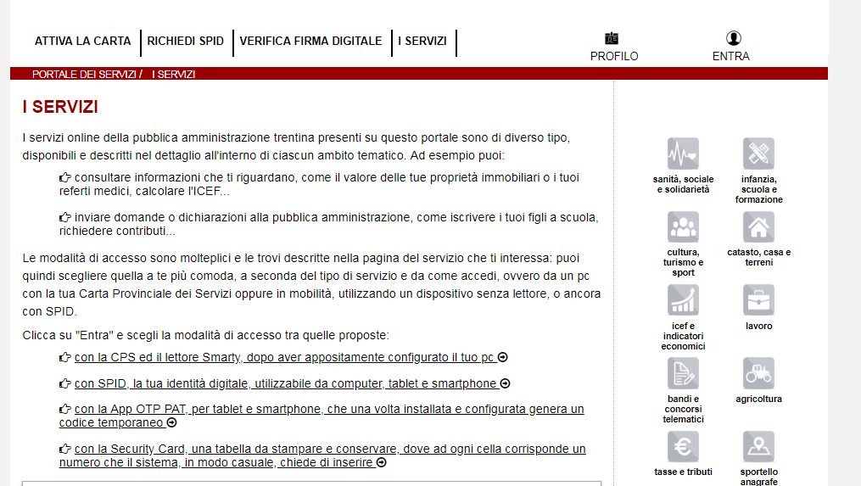
Challenge - find out a service - as is
comefareper.provincia.tn.it
Timing of procedures/service
procedimenti.provincia.tn.it
servizionline.provincia.tn.it

Slide 20
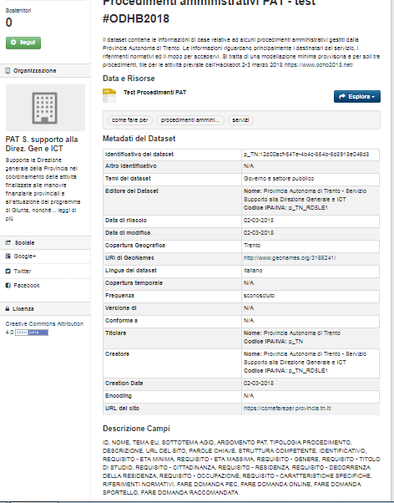
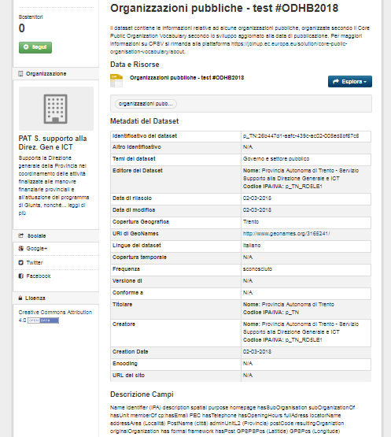
Challenge - find out a service -> Improve open data quality
https://dati.trentino.it/dataset/organizzazioni-pubbliche-test-odhb2018
https://dati.trentino.it/dataset/procedimenti-amministrativi-pat-test-odhb2018

Slide 21

Public Services standard data modeling
TN ODHB | CPSV_AP_EU
ID, | PSURI
NOME | Name
TEMA EU, | Thematic Area
SOTTOTEMA AGID,
ARGOMENTO PAT, | Sector
TIPOLOGIA PROCEDIMENTO, | Type
DESCRIZIONE | Description
URL DEL SITO
PAROLE CHIAVE, | Keyword
STRUTTURA COMPETENTE, | Has Competent Authority
IDENTIFICATIVO STRUTTURA | Has Competent Authority
REQUISITO - ETA MINIMA, | Has Criterion
REQUISITO - ETA MASSIMA, | Has Criterion
REQUISITO - GENERE, | Has Criterion
REQUISITO - TITOLO DI STUDIO, | Has Criterion
REQUISITO - CITTADINANZA, | Has Criterion
REQUISITO - RESIDENZA, | Has Criterion
REQUISITO - DECORRENZA DELLA RESIDENZA, | Has Criterion
REQUISITO - OCCUPAZIONE, | Has Criterion
REQUISITO - CARATTERISTICHE SPECIFICHE, | Has Criterion
RIFERIMENTI NORMATIVI, | Has Legal Resource
FARE DOMANDA PEC, | Has Channel
FARE DOMANDA ONLINE, | Has Channel
FARE DOMANDA SPORTELLO, | Has Channel
FARE DOMANDA RACCOMANDATA, | Has Channel
QUANDO FARE DOMANDA,
COSTO | Has Cost
TEMPI PER LA RISPOSTA | Processing Time
SCIA | Requires
SILENZIO ASSENSO | Requires
Complete
Sheet
A first data modeling has been made between the public services available inside the legacy system and the CPSV-AP.
The modeling was made to create a “persistent” dataset (file) available to solvers, with very a limited quantity of real data (few services)
https://docs.google.com/spreadsheets/d/1RatAwwvbIzHa21jjv-8KvrhI4xl4fkHMg2Op5xAH3fA/edit#gid=0

Slide 22
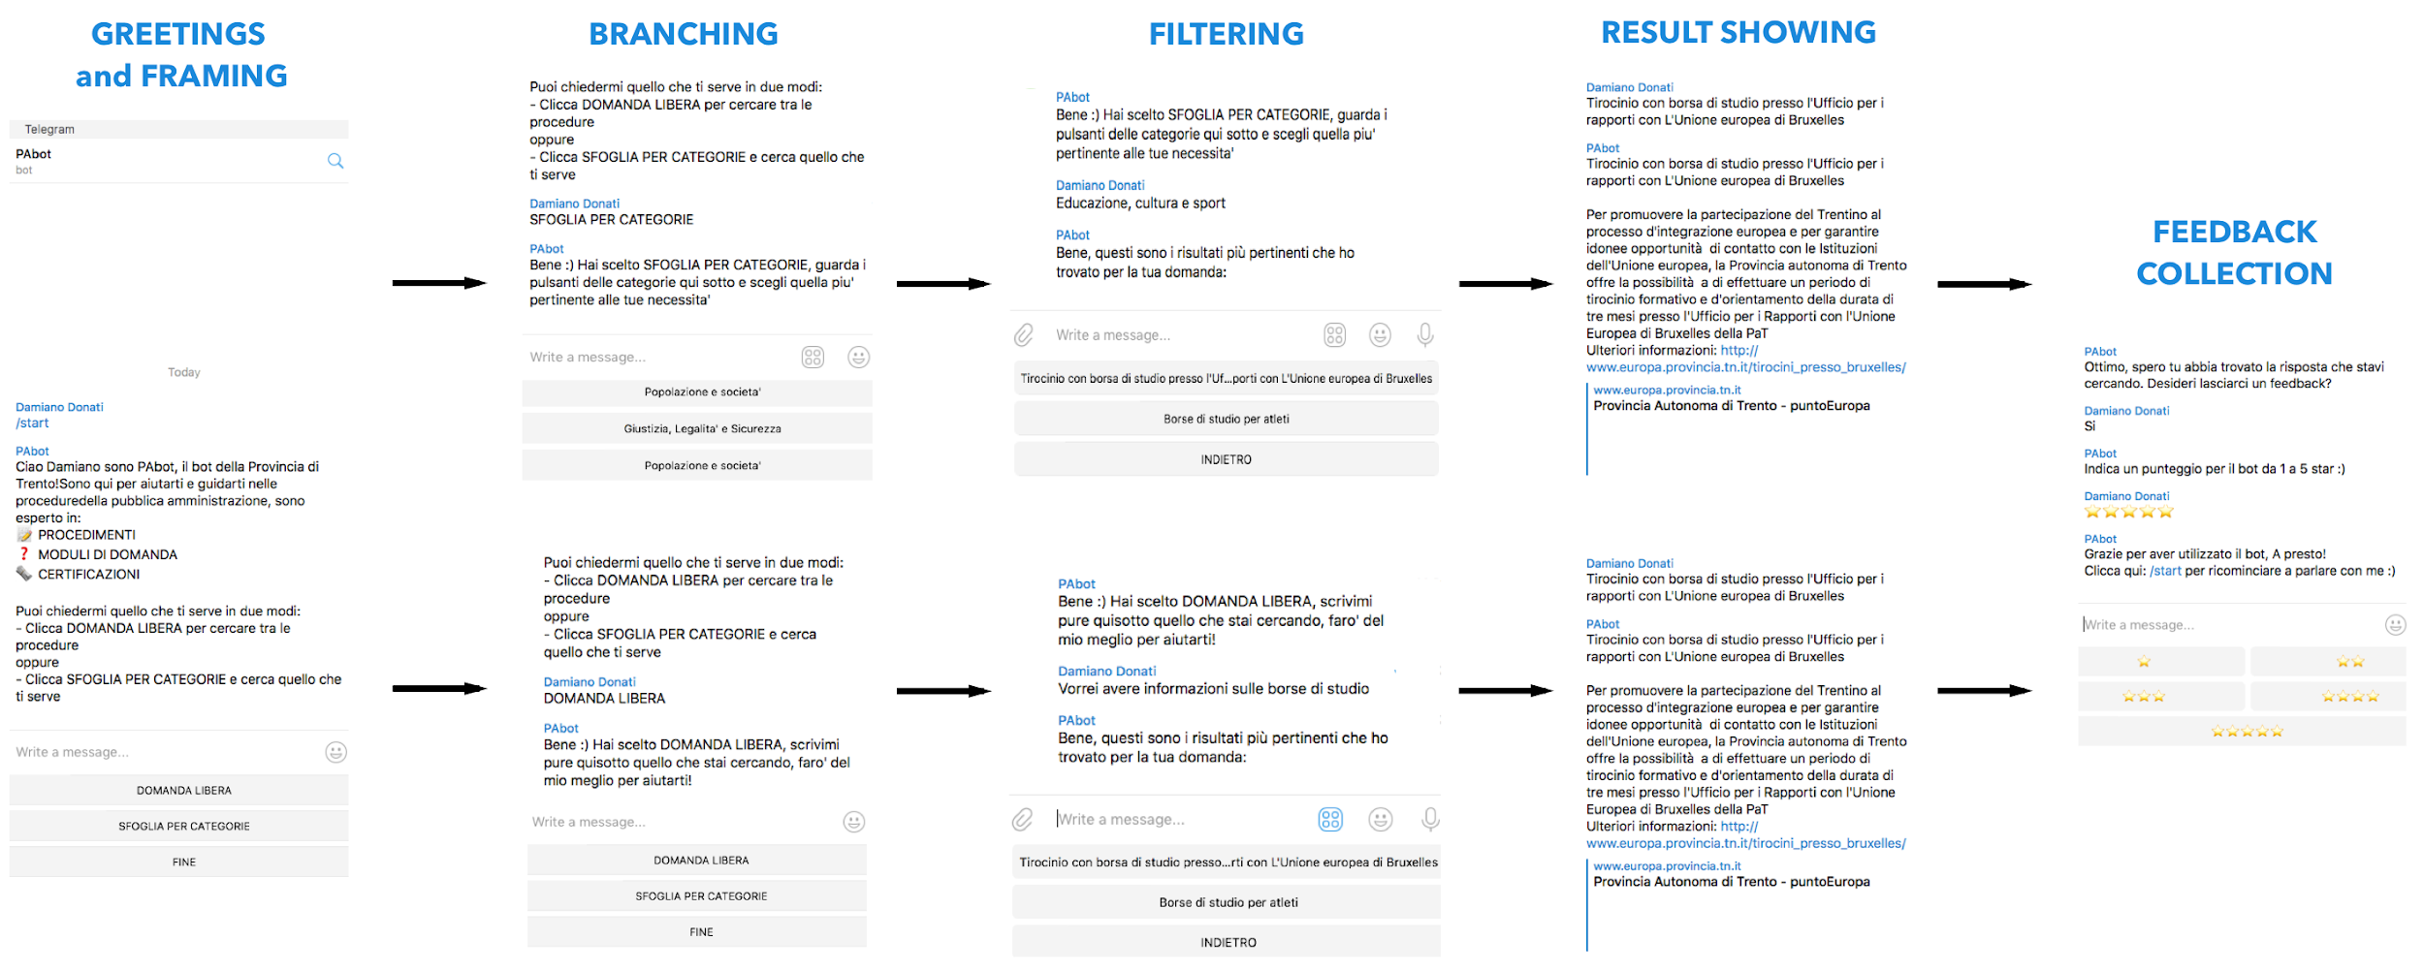



Challenge - find out a service -> create a telegram chatbot (PoC)
Looking for what I need between available public services
Source code: https://github.com/damdo/hackabot-bottega-pabot

Slide 23
Lesson learned 1/2
Chatbot simulate a conversation between robot and a human being
The robot reads and links data from very different sources: databases, custom data entered by the user, IoT (sensors), etc.
It is an “immediate” and “everywhere” channels for conversation/interaction among citizens, companies, institutions, etc.
Chatbot conversational style force us to put "citizen into the center" of the interactional job/process
Chatbot are extremely agile in collecting user-contextual data and crowdsourcing data, allow workgroups establishment on specific topics, integrate personal assistant services with sensor data and/or natural language processing, enabling “automated standard interactions” with citizens.
Stimulate thinking about data culture/digital literacy - because of their versatility - their easy- approach - lots of different platforms available today - they are a "killer technology" to spread awareness on the economic value of hi-quality interoperable data

Slide 24
Lesson learned 2/2
Working together the 4-helix - SMEs, solvers, PS officers, final users - for 48 hours around a prototyped new interaction solution between citizens and public service create a kind of community of practices that:
Accelerates awareness of the value of interoperable data modeling
Increases commitment to allocate resources (time) to align available data to interoperable standards
Shows in practice - even if only with prototypes - such as technologies available today could allow innovative communication modalities
Involves SMEs in a competitive-collaborative way in the process of valorization of the standards and to create a common cultural background
From our experience, chatbots developed through such a participated hackabot can be a vehicle for the dissemination of good practices in view of the digital single gateway change.
Notes:
Lavorare insieme , smi, solver, PS officers, final user per 48 ore
attorno ad una soluzione prototipale
di nuova interazione fra cittadini e servizio pubblico
Crea una comunità di pratiche che:
accelera la consapevolezza sul valore di una modellazione interoperabile dei dati
Individua quindi la necessità di dedicare risorse (tempo) per allineare i dati a standard cross-border
mostra concretamente anche se solo con prototipi come le tecnologie oggi permettano modalità interattive innovative
Permette di coinvolgere le SMI in modo competitivo-collaborativo nel processo di valorizzazione degli standard
Pensiamo che i Chatbot sviluppati in questa modalità partecipata tramite hackabot possano essere un veicolo importante di diffusione di buone pratiche in vista del Digital single gateway

Slide 25
Next Steps
Mapping our public service using UE tools on CPSV-AP
Starting from our online service + Annex DSG regulamentation + other EU regions plans (october - december 2018)
Take in account also CPSV-AP-IT development
Evaluation of potential integration of CPSV-AP tools inside the CMS platform adopted in Trentino
Launch an Hackabot (spring) in Italy using PS list open on our OGD cataloge
Could be interesting open the Hackabot for some PoC in cross-border direction
Find out a strategy together with SMEs for disseminate good practices in ICT solutions using/adopting ISA2 Corevoc standards

Slide 26
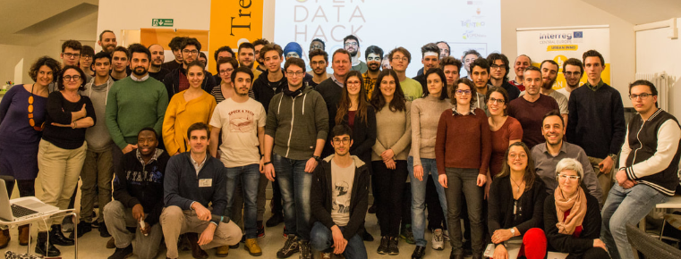
The people
LINKS
https://www.odhb2018.net/
https://www.interregeurope.eu/osiris/news/news-article/2812/open-data-hackabot-in-trento/
http://www.innovazione.provincia.tn.it/eventi/pagina79.html
PEOPLE

Slide 27
Questions?

Slide 28
List of generic public services

Slide 29
List of generic public services
Objective:
Take some first steps towards defining a list of generic public services.
Approach:
Find common denominator between existing lists of public services, or in other words, generic public services.

Slide 30
Methodology
Preparation work
Incremental work on the list
Review cycle
Contact
Collect
Translate
Transform
Analyse
Build
Review
Gap
analysis

Slide 31
Methodology
ISA² contacted different public administrations for collecting lists of public services. We received or were able to access lists from:
  Italy
  New Zealand
  The Region of Trento
  The Netherlands
  Single Digital Gateway
Each list contained one or more of the following attributes:
Public service | Description | Other categorisation (e.g. theme) | Categorisation of generic public services

Slide 32
Example of input
Taxonomy Element ID | Taxonomy Element Name | Taxomomy Element Combined ID and Name | Taxonomy Element Description
B2 | Individuals & Communities | B2 Individuals & Communities | In the Individuals & Communities domain we have functions that deliver services specifically to New Zealand individuals and communities.
B2.01 | Adoption and Fostering | B2.01 Adoption and Fostering | Adoption and fostering supports a person assumes the parenting of another, usually a child, from that person's biological or legal parent or parents.
B2.01.01 | Adoption | B2.01.01 Adoption | Manage adoption services; arranging, assessment, education, reporting, counselling, mediation, and approval of adoption-related matters. The three main options for adopting a child are: - Adopting a child within New Zealand - Adopting a step or surrogate child - Adopting a child from overseas
B2.01.02 | Fostering | B2.01.02 Fostering | Support the fostering of children who can't live with their own family, and support foster families. It's a care arrangement, not a legal status - the family is responsible for caring for the child but has no legal rights over them.
B2.01.03 | Whangai Adoption | B2.01.03 Whangai Adoption | Whangai is a customary Maori practice where a child is brought up by someone other than their birth parents - usually another relative. Whangai may be temporary or permanent. A parent who takes on a child is called a matua whangai, and the child is a tamaiti whangai. The child knows both its birth parents and whangai parents, and the whole community is usually involved in the decision.

Slide 33
Sample of the list of public services
List of public services | Examples of public service
Business registration service | Notification of business activity, […], changes of business activity […]. Registration of an employer (a natural person) with compulsory pension and insurance schemes Registration of employees with compulsory pension and insurance schemes
Emergency services | Plan natural disasters recovery Warning services
Life event registration service | Register a change of address Register/Declare a birth Register a lost or stolen passport Prepare or change statement of succession

Slide 34
Next steps
Share the list with the Working Group
We need your feedback:
  Share with us your list of existing services
  Comments, ideas, suggestions…
We could link the list of public services to business and life events

Slide 35
Presentation from the Department of Internal Affairs (New Zealand)

Slide 36


New Zealand Business Taxonomy
Presentation for ISA² Service Catalogue Webinar 2018-09-10
Prepared by Jim Clendon;
All of Government Enterprise Architect Government Enterprise Architecture

Slide 37

Who Are We?
Government Enterprise Architecture (GEA)
GEA is part of the System Transformation (ST) function of the New Zealand Government and support the Government Chief Digital Officer (GCDO).
ST are currently developing the Government Digital Strategy.
The taxonomies are part of the Government Enterprise Architecture for NZ (GEA-NZ)
Notes:
Choose the slides you want to use, and delete the rest.

Slide 38
Developed from 3 key sources
Business Reference Taxonomy
NZGLS – New Zealand Government Location Service. A thesaurus with subjects of New Zealand, and functions of New Zealand developed in the early 2000’s.
AGA – Australian Government Architecture
US FEAF – US Federal Enterprise Architecture Framework (the new one)
Notes:
Choose the slides you want to use, and delete the rest.

Slide 39
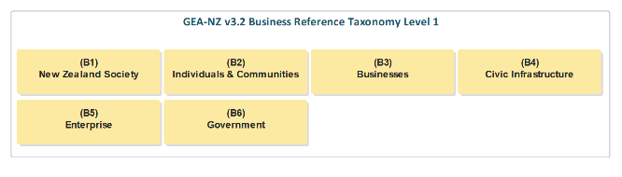
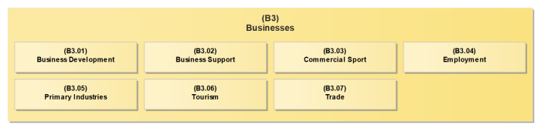
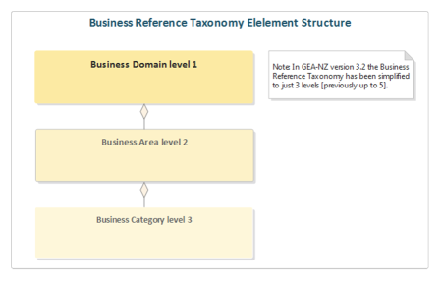
Example B3 Business

Slide 40
We can sort and view services by the taxonomy elements
Business Taxonomy | NZ Supplier | Service | Description
B1.10.01 Accident Insurance | ACC | Get info on personal injury cover | The Accident Compensation Corporation (ACC) provides comprehensive, no-fault personal injury cover for all New Zealand residents and visitors to New Zealand.
B2.04.02 Community Care | Age+ | Get info on Retirement Matters | AgePlus is a non-profit community resource centre s - Large online information centre with many brochures and fact sheets on a wide range of topics such as health, accommodation, consumer rights, advocacy, support, care and local services. Click here. - etc
B1.01.01 Customs Inspection | Air NZ | Get info on Checked-in baggage | To keep everyone safe, there are some things you must not pack in your checked-in baggage and some you can only pack under special conditions.
B1.03.13 Defence Communications | Airforce | Obtain the Air Force News | Air Force News is the official magazine of the Royal New Zealand Air Force.
B2.08.02 Community Health Services B2.08.15 Public Health Services | Alcohol New Zealand drinking patterns | Get info on Achohol use and addiction
B2.08.18 Special Needs Services | Autism New Zealand Inc. | Obtain Support for Autism | Information, advice, research and resources to help prevent and reduce alcohol-related harm and to inspire New Zealanders to make better decisions about drinking alcohol.
B4.01.01 Planning Permission | Building.govt | Get info on building projects | Autism New Zealand Inc. provides support, training, advocacy, resources and information on Autism Spectrum disorders including
B3.01.06 Providing Business Advice | business.govt | Get info on business continuity planning | Information to help you plan your building project, get consent, build to the consent and legally complete your project.
B3.01.06 Providing Business Advice | business.govt | Get info on business planning | There isn’t a one-size-fits-all formula to create a business continuity plan. But there are some key things you should consider.
B1.06.06 Rebates | CAB Citizens Advice Bureau | Get info on Superannuation | There isn’t a one-size-fits-all formula to create a business plan. But there are some key things you should consider.

Slide 41
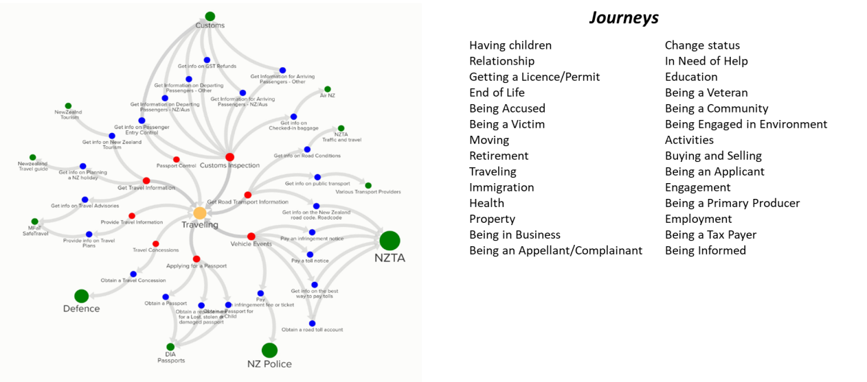
Prototype took 2014 services from 205 Government entities, linked to 638 Events grouped under 33 Journeys

Slide 42

The services provided by Governments are assets, and most customers interact with the government through these services.
We are keen to collaboarate and work with other governments
We are still working on our Service Catalogue.

Slide 43
Presentation from Logius, Ministerie van Binnenlandse Zaken en Koninkrijksrelaties (The Netherlands)

Slide 44
UPL
Generic Public Services in the Netherlands

Slide 45
The Dutch Public Service standard
Samenwerkende Catalogi (SC) – Cooperating Catalogues
  Exchanging Public Service metadata
  A subset of CPSV
  Building a national virtual Catalogue
Government organisations publish their catalogue in the SC format
  Local, regional, national
Open API to query the Virtual Catalogue
  And integrate all relevant products & services in your website/portal

Slide 46
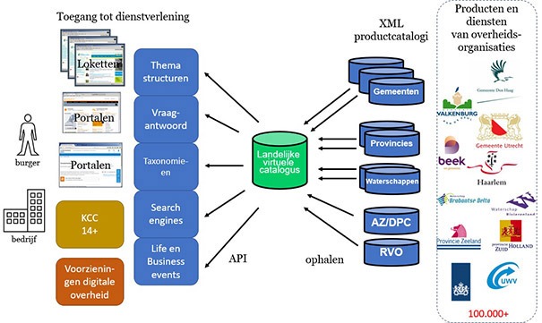

Slide 47
Why generic services
Multiple entries for the same service
  380 municipalities = possibly 380 variants of the same service!
  Information about a service offered at both local and national level
We have 60.000 services in our virtual catalogue
By applying generic service labels, we can bring this down to 1.000!
This makes it much easier to:
  Point to a specific place in a local catalogue
  integrate the content in a portal or website (i.e. connect to a life event or category)
  Offer citizens and business a complete, coherent package of services

Slide 48
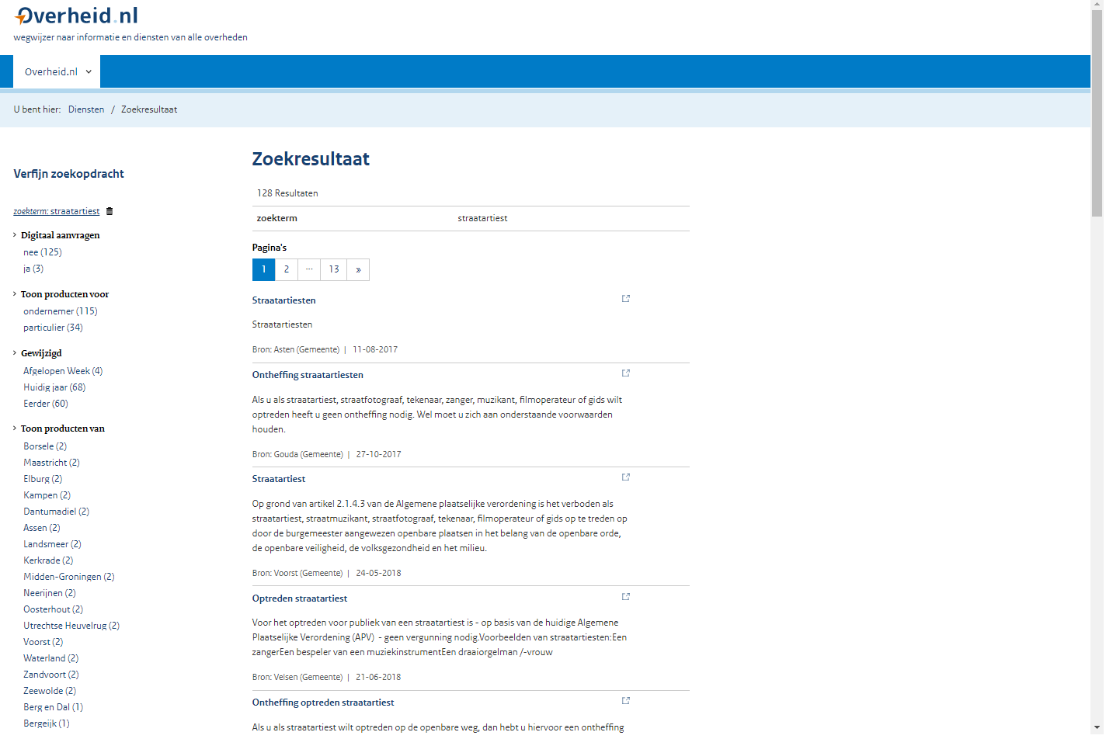
Straatartiest
Straatartiest
Straatartiest
Straatartiest
Straatartiest
Straatartiest

Slide 49
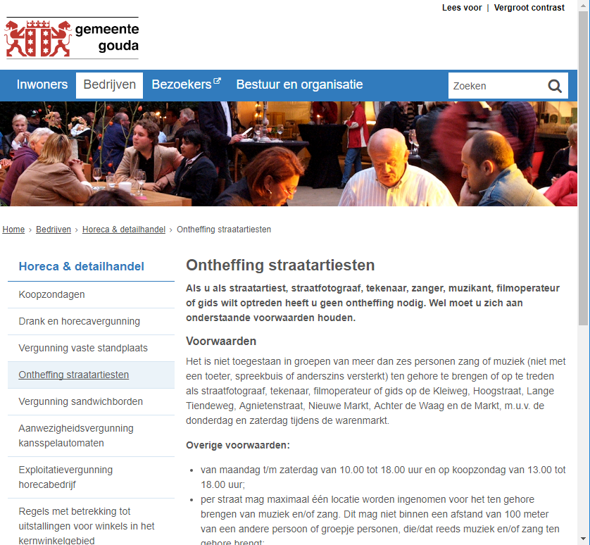

Straatartiest
Central
portal
Virtual catalogue

Slide 50
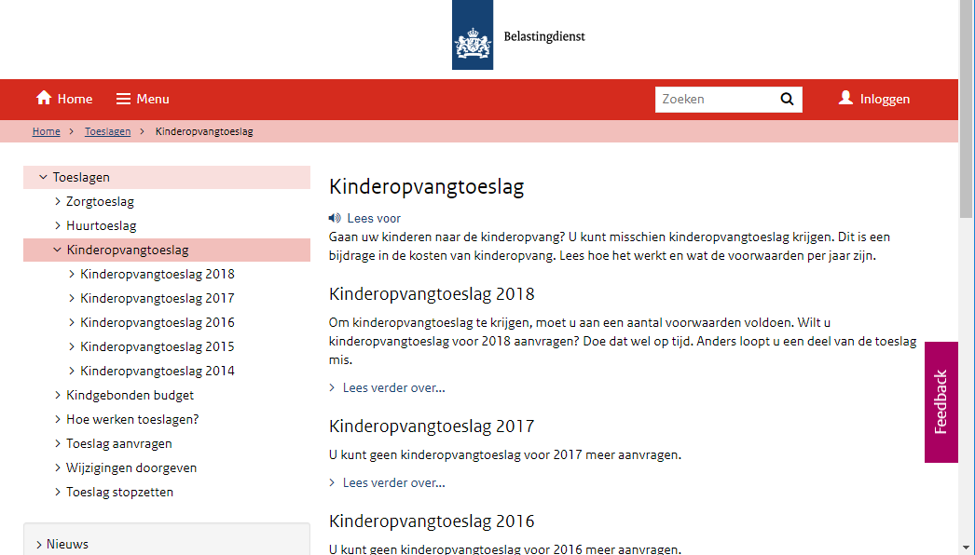

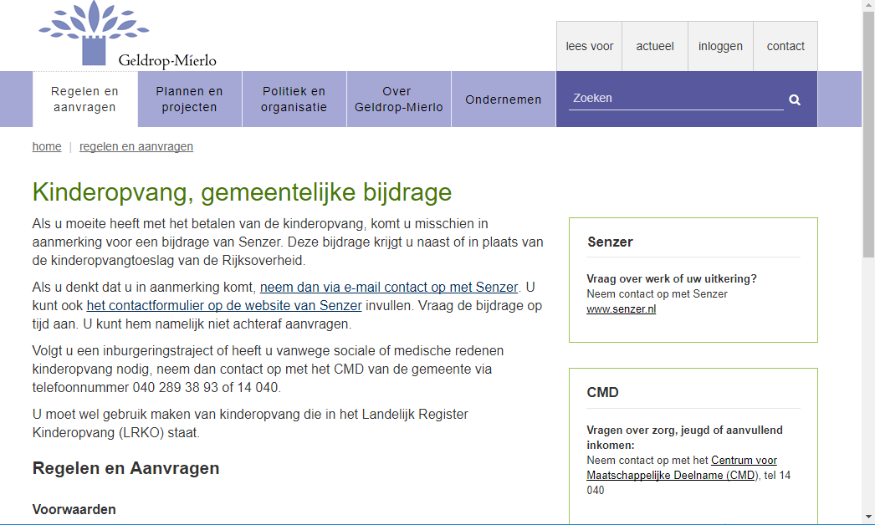
National
Kinderopvang
toeslag
Life event: a child is born
Virtual catalogue
Local

Slide 51
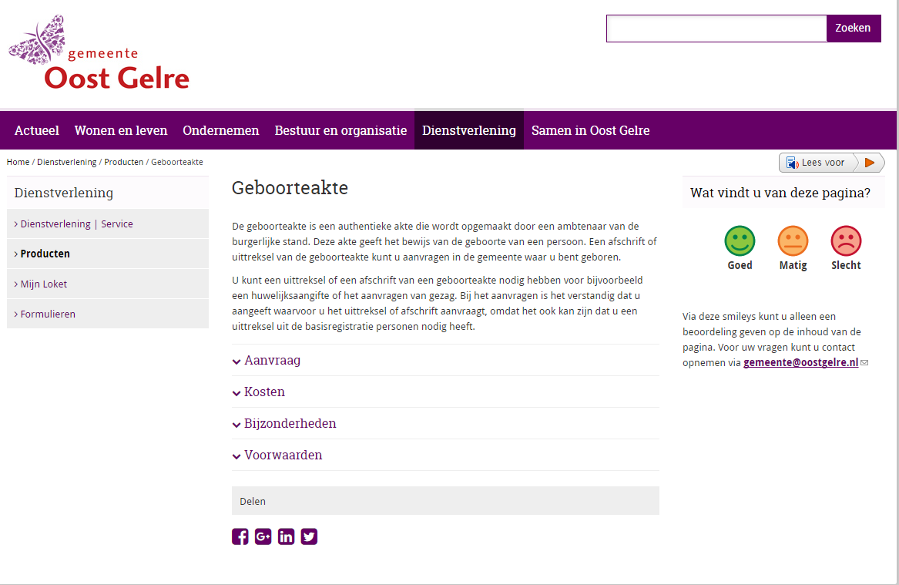
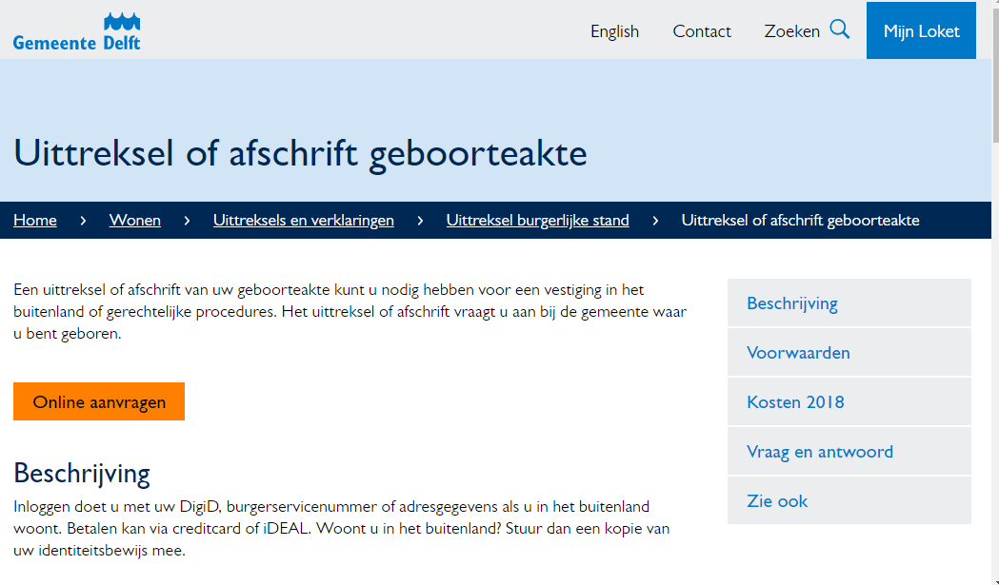
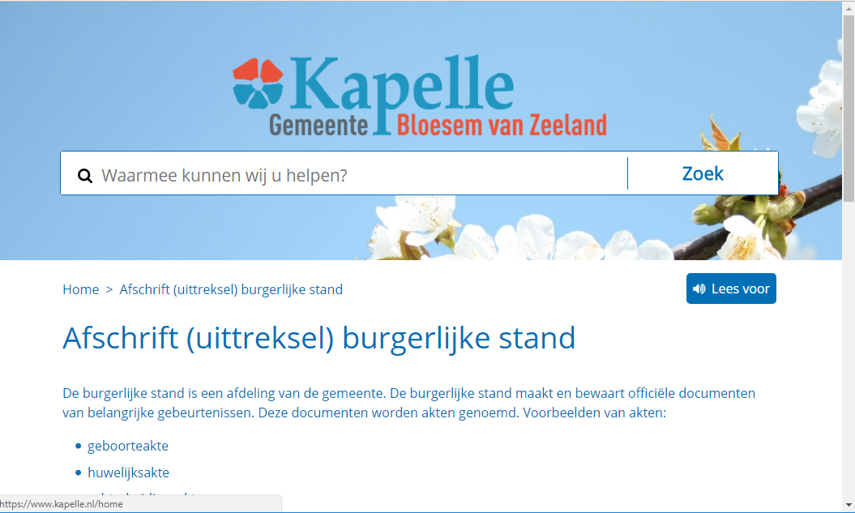
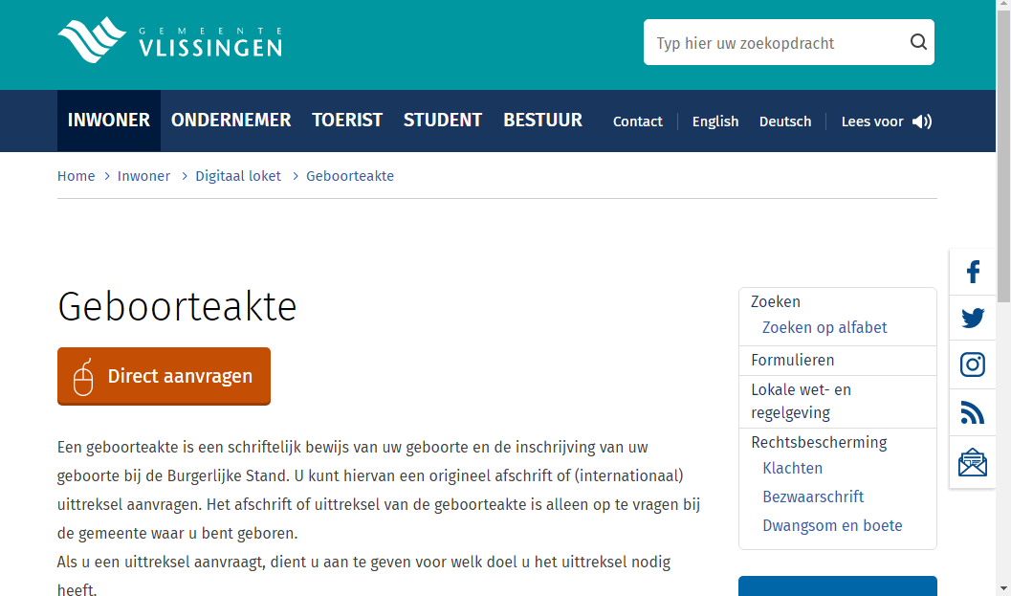
Geboorte akte
SDG: Birth certificate
Virtual catalogue
x 380 municipalities

Slide 52
What it looks like
A flat list of Uniform Product Names with attributes:
  Resource Identifier (URI)
  Label
  Formal framework (text and juriconnect link)
  Possible end date and successor
  Government level
Upcoming (Q4):
  Alternative names, category, product type, audience
SPARQL queries possible
  i.e. return only current services offered by municipalities

Slide 53
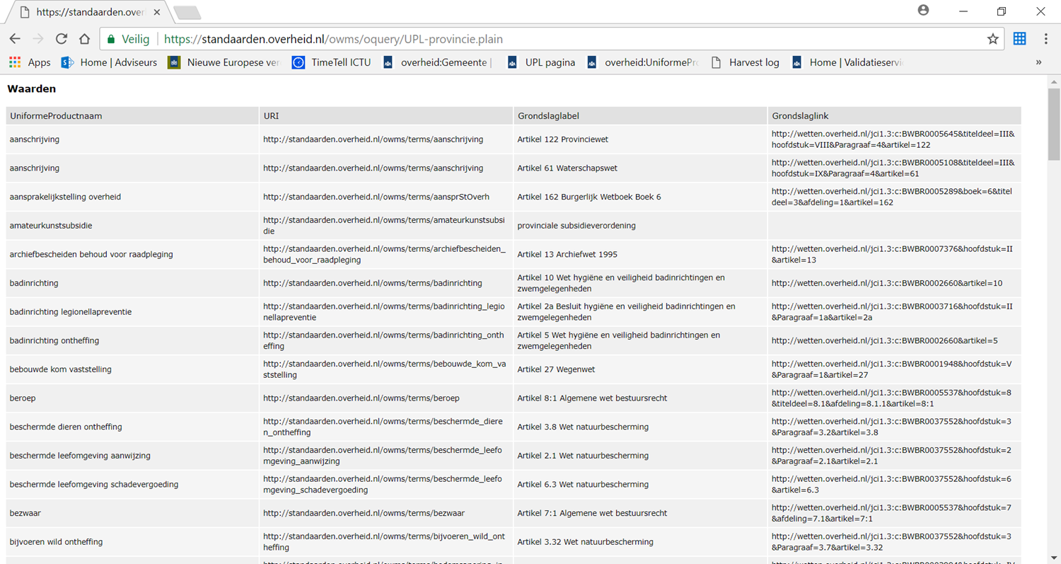
(Plaatje)

Slide 54
How we did it
We analysed the virtual catalogue (60.000 records) and distilled a unique set of services
We applied uniform names using fixed writing rules
We consulted with:
  Suppliers of product & service catalogues (commercial)
  Umbrella organisations for municipalities, provinces, waterboards, central government
Our legal expert makes the final decisions
We publish the ‘list’ as linked data
Maintenance: 4x/year in coordination with above parties

Slide 55
UPL in practice
30% of organisations apply UPL labels, number is growing
May be used for connecting to products and services:
  Ondernemersplein.nl: generic product pages -> specific local pages
  Rijksoverheid.nl: product pages, topic pages, life events
  Overheid.nl: theme structure
  SDG: connecting to and monitoring local product pages
Also used as the basis for:
  municipal product catalogues
  Generic service texts

Slide 56
Lessons Learned I
Allow organisations to use their own terminology; use the generic names only ‘under the hood’
Pluriformity = discussion
  Stick to the legal terms for consensus
Involve all relevant players:
  Content suppliers (signaling new/changes in legislation -> new services)
  Government organisations and CMS suppliers for easier adoption

Slide 57
Lessons Learned II
Granularity will be an issue
  Municipality with one parking permit vs separate parking permit for visitors, companies, disabled, etc.
Information vs actions
  Make a clear distinction of actions and information (i.e. information on identification vs applying for a passport)
Thesaurus vs flat list
  You may want to capture every aspect of a product in a conceptually clean model, but this will add complexity for those implementing the list
  This is why we kept it simple: a flat list of ‘tags’ or ‘labels’

Slide 58




Where to learn more
UPL page:
  https://standaarden.overheid.nl/owms/4.0/doc/waardelijsten/overheid.uniformeproductnaam
Samenwerkende Catalogi specifications:
  https://www.logius.nl/diensten/samenwerkende-catalogi/
Central portals
  www.overheid.nl
  www.ondernemersplein.nl
  www.rijksoverheid.nl
marco.aarts@ictu.nl
https://www.linkedin.com/in/marcoaarts/

Slide 59
Questions?

Slide 60
AOB and wrap-up

Slide 61
AOB and wrap-up

Slide 62


Thank you!
Project Officer:
Miguel Alvarez-Rodriguez Miguel.ALVAREZ-RODRIGUEZ@ec.europa.eu
https://github.com/catalogue-of-services-isa/cpsv-ap
https://joinup.ec.europa.eu/collection/semantic-interoperability-community-semic
Notes:
Logo Joinup: https://joinup.ec.europa.eu/contact
Logo GitHub: https://commons.wikimedia.org/wiki/File:Github.com-SunghanKim.png

