Slide 1
ABR Webinar Brussels, 9 October 2019 EUROPEAN COMMISSION Directorate - General Informatics Directorate D – Digital Services DIGIT D2 – Interoperability Unit Specific Contract n° 157 under ABC IV – Lot 3 Framework Contract
Access to Base Registries ISA² action 2016.28
Project Officer:
Peter Burian

Slide 2
Disclaimer
The information and views set out in this publication are those of the author(s) and do not necessarily reflect the official opinion of the European Commission. The European Commission does not guarantee the accuracy of the data included in this document. Neither the European Commission nor any person acting on the European Commission’s behalf may be held responsible for the use which may be made of the information contained therein.
This publication is used to support a webinar that will be recorded and made available to the participants.
© European Union, 2019

Slide 3
Agenda
Welcome note
ISA² Action 2016.28 'Access to Base Registries'
Presentations from Member States
Progress on Specification / Data Model
Highlights on improvement of Framework
Q&A

Slide 4
Welcome Note
Project Team
Project
Scope & Approach
Project Context
Client’ Expectations
Short-term Actions
Assumptions

Slide 5
ISA² Action 2016.28
ISA² Action 2016.28 ‘Access to Base Registries’ (ABR)
ABR Purpose:
Ensure interconnection and access to the information in different types of base registries of Member States (MS) in order to be able to deliver cross-border and cross sector public services.
ABR Outcomes:
The semantic specifications facilitating further creation of EU Registry of Registries;
The Framework as a guidance on how to grant access to the data in Base Registries and how to interconnect them;
The exchange of Best Practices that is of great interest of many Member States
ABR Scope:
Finalisation of a framework for Base Registry Access and Interconnection (BRAIF);
Maintenance of ABR Collection on Joinup;
Elaboration of Registry of Registries (RoR) specification/ data model
The valuable impact of this work will be an easier exchange of information cross-sector and cross-border, and the eventual set-up of cross-border European public services

Slide 6
Presentations from Member States

Slide 7
Presentations from
Member States
ABR Webinar - Presentation Belgium
ABR Webinar – Presentation Bulgaria

Slide 8
BREGDCAT-AP
Progress on Specification /
Data Model

Slide 9
DCAT Application profile for base registries
BRegDCAT-AP
BRegDCAT-AP aims at describing base registries, the information they contain and the services they provided.
Objective: to enable cross-border interoperability between base registries, defining a semantic model to describe base registries and their contents.
Based on existing EU standards:
Data Catalogue Vocabulary (DCAT) Application Profile for describing PSI in Europe;
Core Public Vocabularies (Core Public Sector Vocabulary, Core Public Organisation Vocabulary);
European Legislation Identifier (ELI);
Common taxonomies by the EU Publications Office (e.g. Eurovoc, territories, themes, locations)

Slide 10
Why is this DCAT application profile needed?
BRegDCAT-AP
The BRegDCAT-AP will contribute to describe base registries and their contents aiming at:
Facilitating data discovery;
Reducing redundancy and supporting the Once-Only principle;
Facilitating exchange of data;
Improving transparency;
Reducing cultural/language barriers in the exchange of data;
Enabling a mechanism for subsequent update of base registries and content.

Slide 11
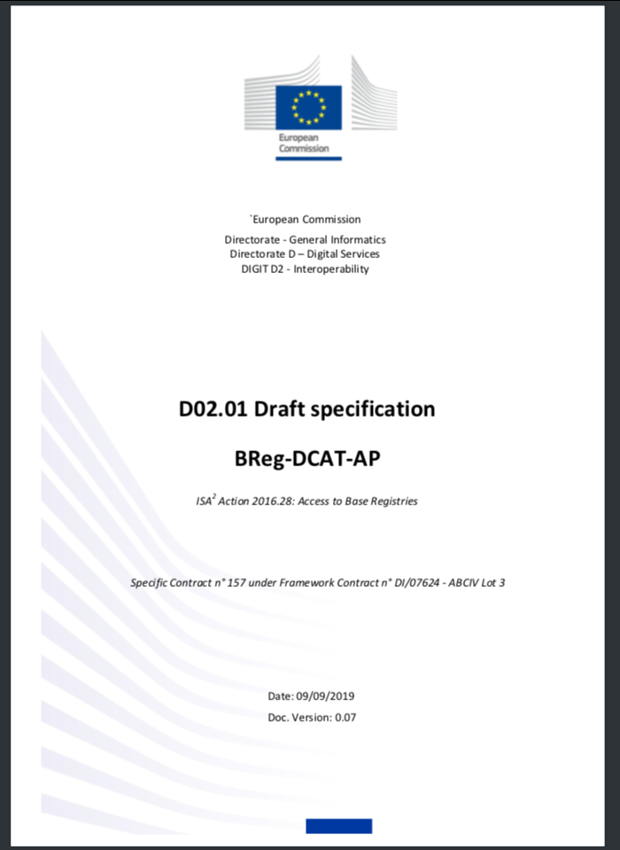
The Specification/ Data Model
BRegDCAT-AP
ABR Working Group launched in March 2019
3 ABR WG meetings with 24 members
8 main issues discussed on Joinup and via email
Feedback from CPSV-AP, SDG, and other EU initiatives
Ongoing discussion open to everyone
Aligned to DCAT 2 (and DCAT-AP 2)
Join us!!!
https://joinup.ec.europa.eu/solution/abr-specification-registry-registries/

Slide 12
25 Members, including nominated members from ISA² Committee
ABR Working Group
Portugal
Scotland
Slovakia
Slovenia
Spain
Sweden
Belgium
Croatia
Czech Republic
Denmark
Estonia
Germany
Greece
Italy
Latvia
Lithuania
Luxembourg
Malta
Montenegro
Netherlands
Norway

Slide 13
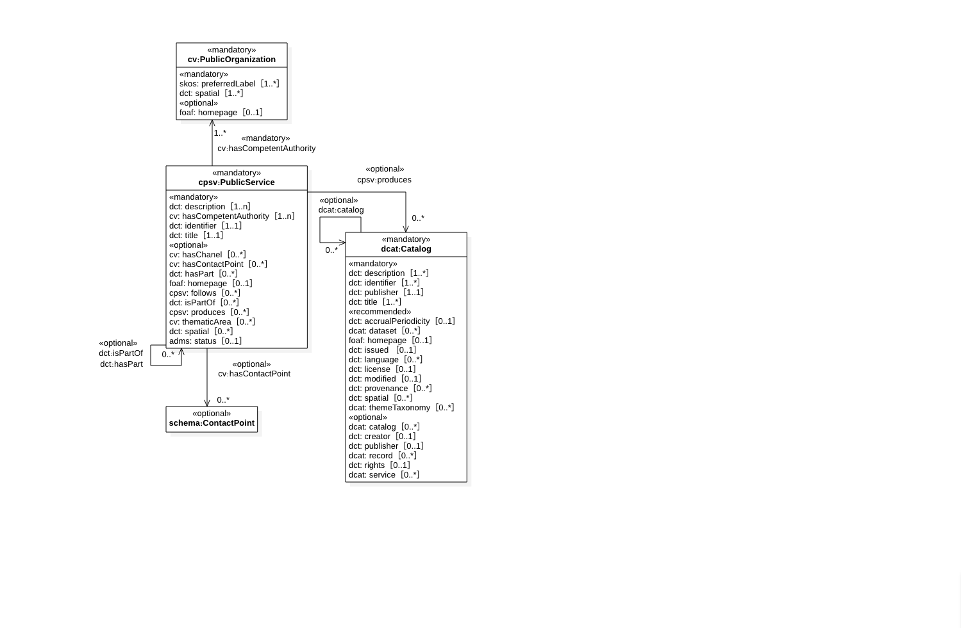
Register
BRegDCAT-AP

Slide 14
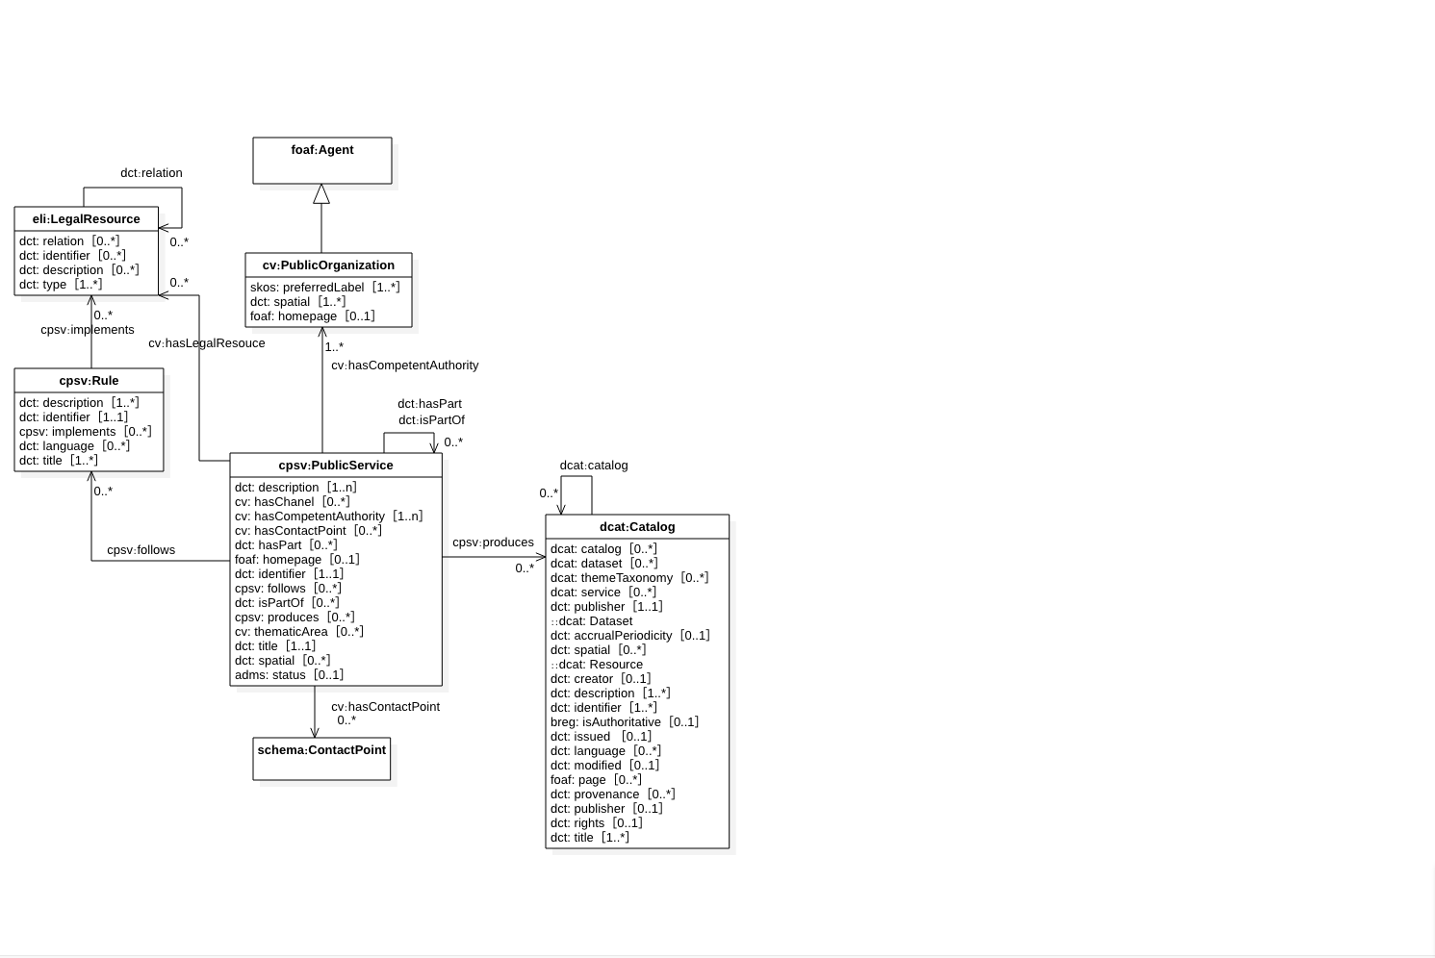
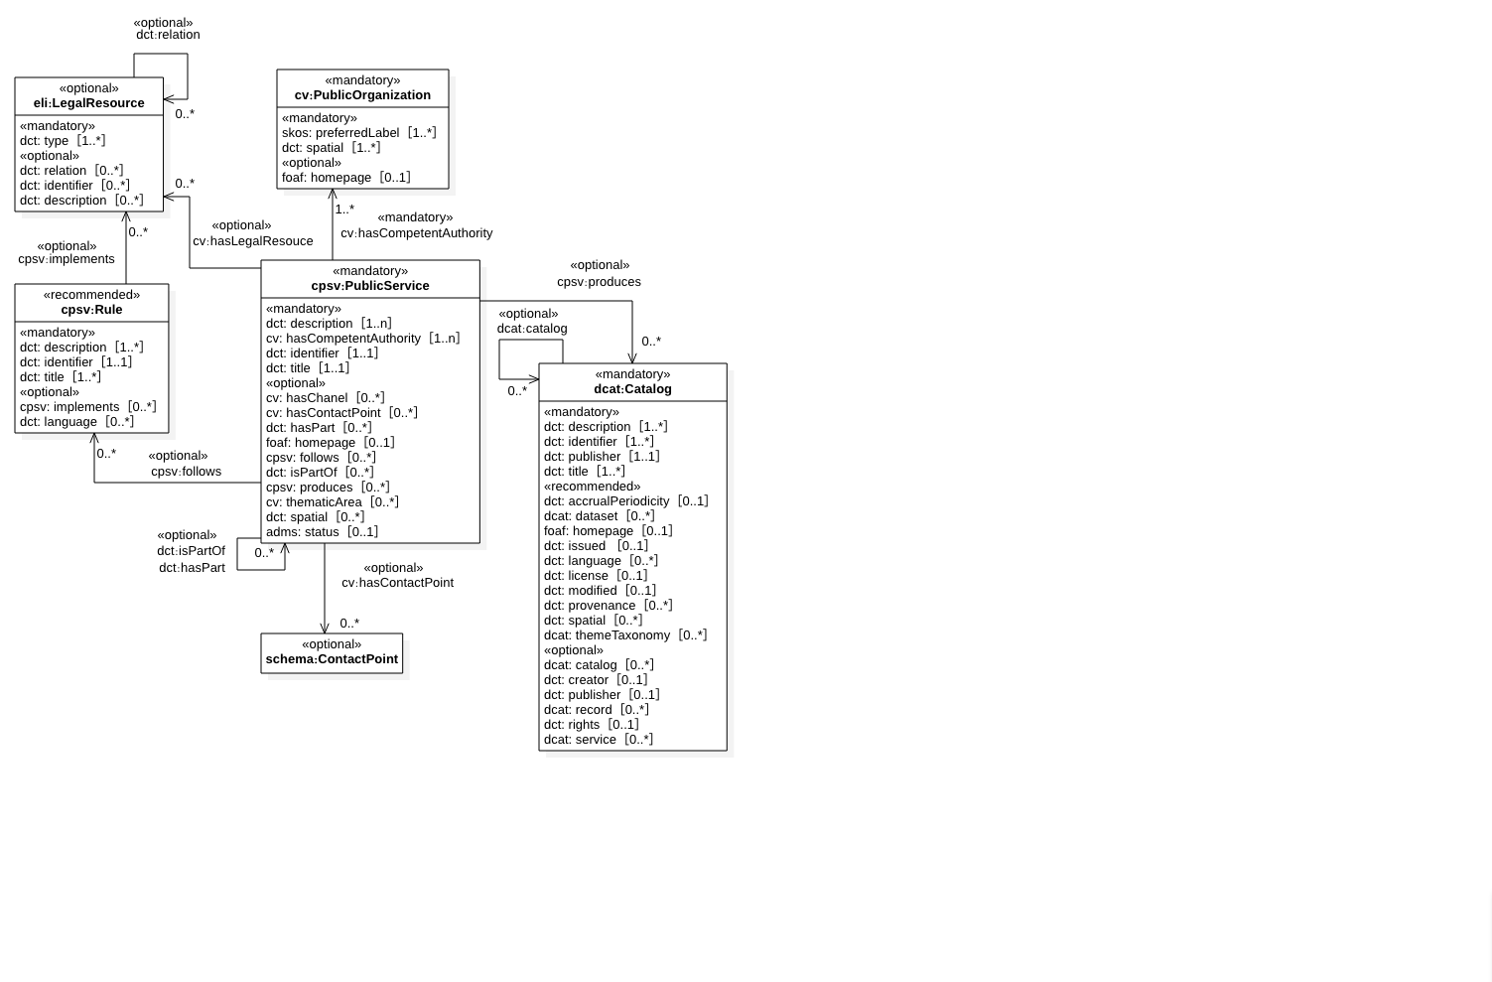
Legal Base
BRegDCAT-AP

Slide 15
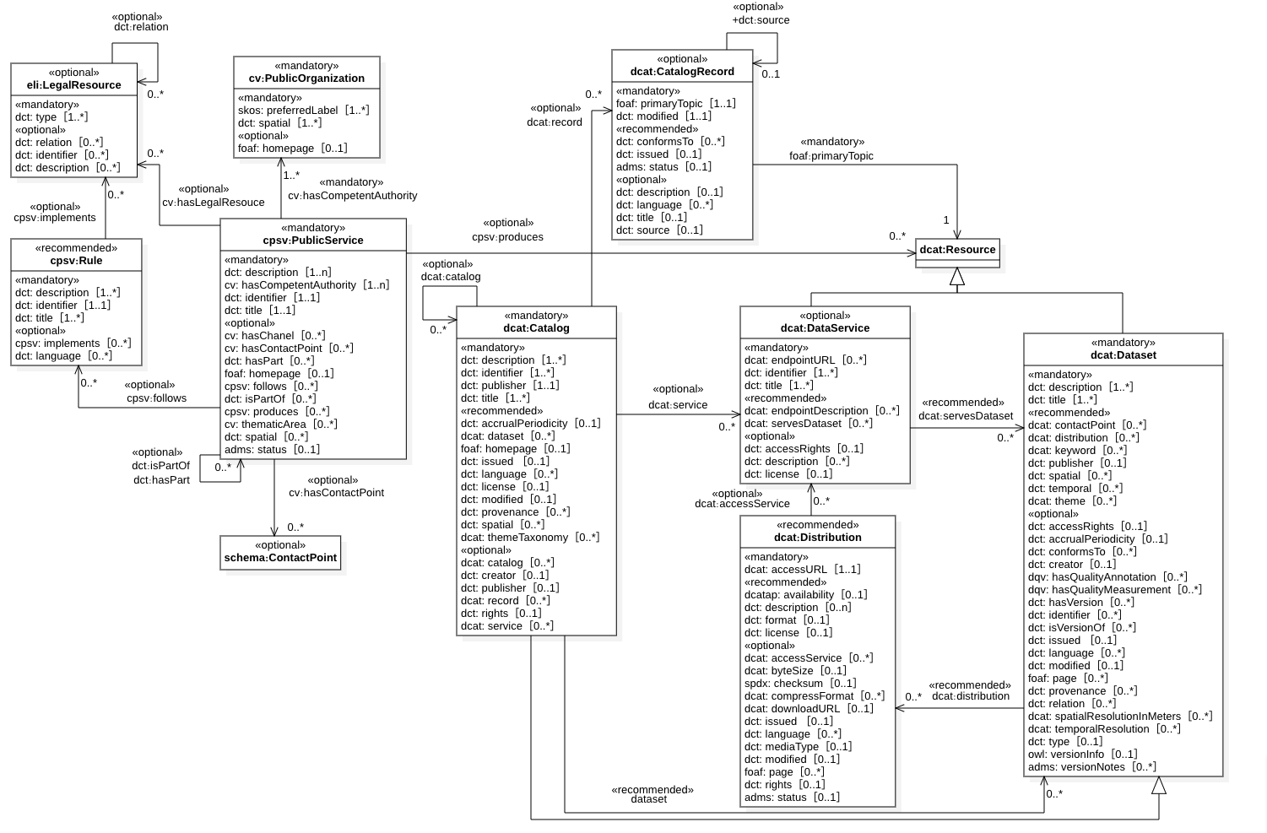
Registry
BRegDCAT-AP

Slide 16
What’s next?
BRegDCAT-AP
To close discussion topics:
[Issue #02] property 'isAuthoritative' for datasets
[Issue #05] Content of Datasets (DataElement)
[Issue #06] Quality of Datasets
Last WG meeting on BRegDCAT-AP: 24th October, 14:30CEST
Collect use cases and implement proof of concepts to verify the model and the vocabulary

Slide 17
Highlights on improvement of Framework

Slide 18
Vision
BRAIF
A series of steps to take in order to establish structure-based Base Registries that enables the interconnection within the Member State and the delivery of cross-border integrated public service governance

Slide 19
Strategy
BRAIF
The Base Registries Access and Interconnection Framework (BRAIF) helps enabling Base Registry access, interconnection and integration
It defines a common terminology and regulated procedures on a national and cross-border levels between Member States (BRI)
It will provide the means for data quality and management plans
It will improve the coordination and control between state officials as the common language of BRI
It will support the development of technical and semantic requirements that in turn will support the creation of Base Registries
It will strengthen policy drafting and a national and cross-border interoperability strategy
It will enable the efficient, agile and secure reuse of data and services to better serve its citizens and businesses

Slide 20
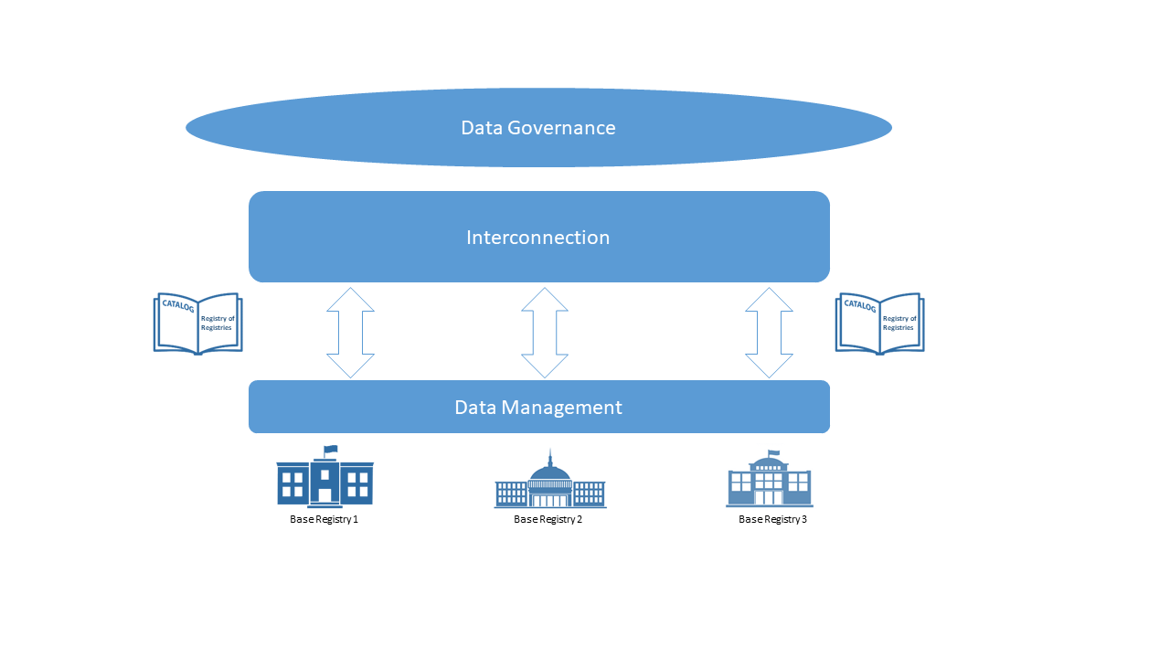
BRAIF* Conceptual model
BRAIF
* Base Registries Access and Interconnection Framework

Slide 21
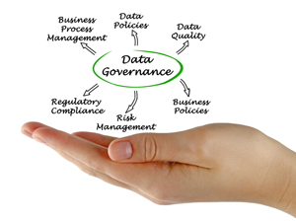
Data Governance
BRAIF
“The creation of rules, the execution of those rules, and the adjudication of any violation of the rules”
Its implementation requires primarily the following aspects:
organisational structures, roles and responsibilities for the management of data, its access and interconnection
standards, rules and policies to formalise data management across the public administration
processes to monitor and evaluate the adoption and effectiveness of the data management practices by the organisation

Slide 22
Data Governance - Q&A
BRAIF
How do you handle data governance in your country?
Is it effective, taking into consideration four dimensions of Interoperability Governance i.e. legal, organisational, semantic, technical?
How data governance could be done better in your country?

Slide 23
Data Architecture
BRAIF
The main goals of data architecture in the realm of the access and the interconnection of Base registries are:
The identification of entities and attributes required to manage the information within the organisation
The definition of processes related to acquisition, transformation, enrichment, publication and storage of data
The provision of data exchanges with both data suppliers and consumers

Slide 24
Data Architecture - Q&A
BRAIF
How the tools and systems, that base registries currently use in your country, are interconnected? Do you have plans on how better integrate them with each other?
What kind of data do you have, and where does it come from?
How complex is the data acquisition process?

Slide 25
Master Data Management
BRAIF
Plan
Acquire
Maintain
Archive
Purge
Specify
Enable
Create
Focus is placed on improving data quality, establishing guidelines for data governance and ensuring that data can be easily managed and accessed across the business

Slide 26
Master Data Management - Q&A
BRAIF
From different MDM styles, which one - or combination of styles – do you use in your country and why?
What are the challenges that you have faced in implementing MDM in your country?

Slide 27
Metadata Management
BRAIF
Type | Definition | Examples
Descriptive metadata | For finding or understanding a resource | Title Author Subject
Structural metadata | Relationships of parts of resources to one another
Markup languages | Integrates metadata and flags for other structural or semantic features within content
Administrative metadata
Technical metadata | For decoding and rendering files | Physical database table and column names Column properties Data lineage documentation
Business metadata | Include non-technical information, attribute properties, calculations, algorithms, business rules and valid domain values and their definitions | Data models Data standards Data quality rules Definitions and descriptions of data sets, tables and columns
Operational metadata | For describing details of the processing and accessing data | Error logs History of extracts and results Technical roles and responsibilities, contacts
All physical data and knowledge from within and outside an organization, containing information about organization’s physical data, industry, technical and business processes
Provide organisational understanding of business terms and usage
Collect and integrate metadata from different sources
Provide a standard way to access metadata
Ensure metadata quality, consistency, currency and security

Slide 28
Metadata Management – future needs:
BRAIF
Creation of a Semantic mapping of metadata from the Member States' repositories with a common abstract model
This abstract model will be driven by real implementations across Europe and based on the Core Vocabularies that help us to describe public bodies, public services, legal resources and registries themselves.

Slide 29
Metadata Management - Q&A
BRAIF
What are the primary goals of the metadata management strategy for your base registry?
What types of metadata are you working with?
Are there any standard that you should follow to complete metadata strategy?

Slide 30
Data Quality
BRAIF
Accuracy – The degree to which data correctly describes the "real world" object or event being described
Completeness – the proportion of data stored against the potential for 100%
Timeliness – the degree to which data represents reality from the required point in time
Uniqueness/Deduplication – none data will be recorded more than once
Validity – data is valid if it conforms to the syntax (format, type, range) of its definition
Consistency - the absence of difference, when comparing two or more representations of a thing against a definition

Slide 31
Data Quality - Q&A
BRAIF
What is a cost of bad data?
What are a data quality issue(s) that you currently face in your base registry?
Do you have a specific role(s) responsible of data quality for your base registry?
What steps are you following to analyse and solve a data quality issue?
What is the communication plan to inform all related parties about the resolution of the issue?

Slide 32
Data Security
BRAIF
Data security management is the planning, development and execution of security policies and procedures to provide proper authentication, authorization, access and auditing of data and information assets
Create a trust environment for the organisation by ensuring that data is managed and updated by the right actors at each moment
Stakeholders Concerns
Government Regulations
Proprietary Business concerns
Legitimate Access needs

Slide 33
Data Security - Q&A
BRAIF
Do you encrypt data for your base registry?
What are the backup plan and failover capabilities?
Do you conduct security testing?
How do you monitor your systems and applications to prevent breaches or fraud?
Have you identified all regulations and standards that apply to your base registries?

Slide 34
Technical Architecture
BRAIF
A service-oriented architecture is composed of services that are self-contained and independent from the context or state of the other services they communicate to
Modular, loosely coupled service components, and interconnected through an infrastructure layer

Slide 35
General questions - Q&A
BRAIF
Are you aware of the different frameworks related to base registries that are implemented in other MS i.e. Denmark, Estonia?
If yes, which one would suite your needs in your country?
What are the main challenges that you face in implementation of frameworks?
From your point of view, what are the main challenges to create a pan-European interconnection data framework for freely master data exchange among member states?
What types of tools do you use for the creation of a registry of registries in your country?
What type of tools might you need to facilitate creation of a registry of registries in your country?

Slide 36
What’s next?
What’s Next?
Finalise specification/ data model – testing and validation in 2020
Follow the progress on data model here: ABR – Specification of Registry of Registries
Finalise Framework – validation in 2020
Follow the progress on framework here: ABR Collection on Joinup
Create tools reusable by MS in their work on creation of RoR – in 2020
...and continuous exchange of experiences on RoR creation !

Slide 37
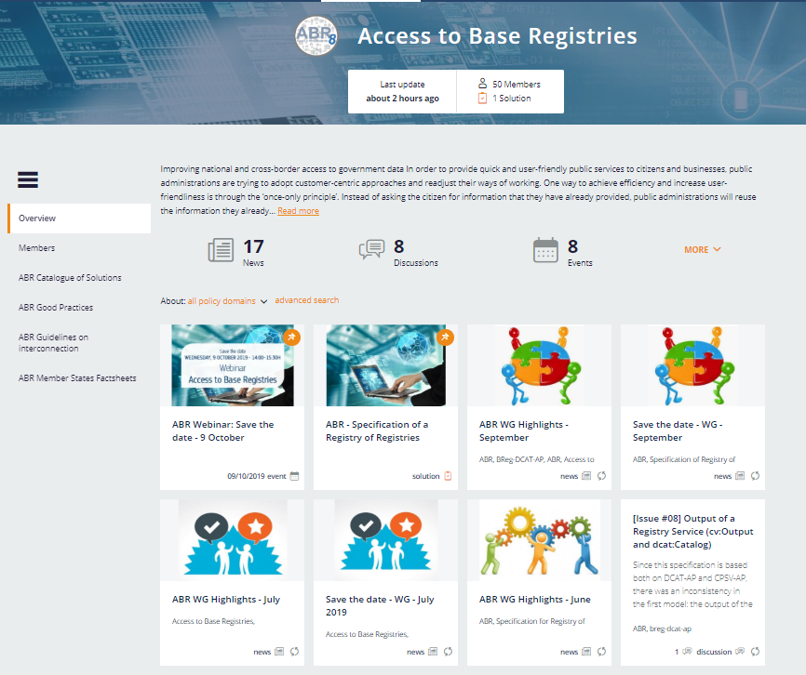
ABR on Joinup
Sign up now!
If you do not have an account on Joinup,
Create it here: https://joinup.ec.europa.eu/user/register
Join ABR Collection on Joinup: https://joinup.ec.europa.eu/collection/access-base-registries

Slide 38
Q&A
Thank you for your participation!

