Slide 1
ISA² Action:
Catalogue of public services
Single Digital Gateway

Slide 2
Agenda
1
Who are we?
Why do we need a common data layer for the SDG?
What can help us achieve this common data layer?
How do we build the SDG data model and its classifications together?
2
3
4

Slide 3
1
Who are we?
2
Why do we need a common data layer for the SDG?
What can help us achieve this common data layer?
How do we build the SDG data model and its classifications together?
3
4

Slide 4
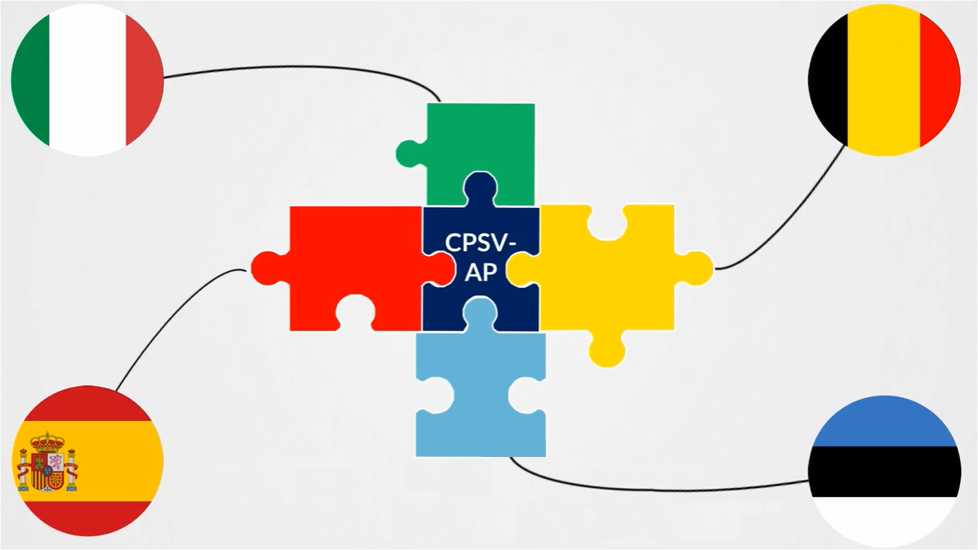
The ISA² Programme and the action of ‘Catalogue of Public Services’
Goal:
Enhancing the interoperability and the exchange of information about public services within and across the Member States on local, regional or national level.
Solution:
Development of a common language and format for describing public services, in a user-oriented way, grouped into life and business events.
Result:
Data standard CPSV-AP:
Core Public Service Vocabulary Application Profile

Slide 5
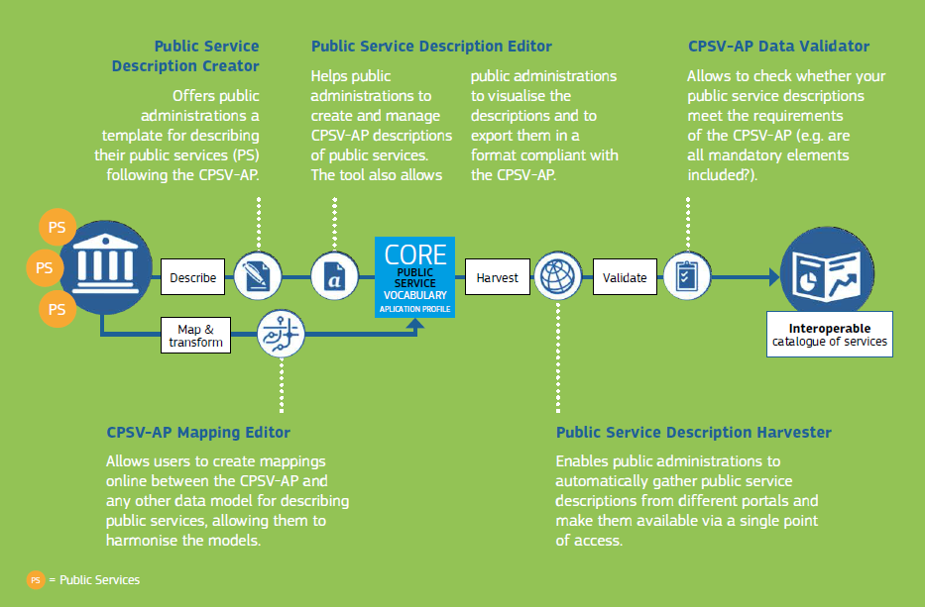
We support European public administrations throughout the entire lifecycle of their public service descriptions
Input:
Own data model of Member State
Tools:
Description Creator
Mapping Editor
Description Editor
Description Harvester
Data validator
Output:
Common data model used for building an interoperable catalogue of services
Collaboration with Member States:
Pilots for different applications such as chatbots or APIs.

Slide 6
Catalogue of Services for SDG
CPSV-AP is a light and flexible core data model for describing public services, but it was not made in the context of the SDGR.
The ISA² Catalogue of Services team has a strong experience in creating and applying core data models for national and international public administrations.
Together with DG GROW we see that there is a strong need for Member States to create a common SDG data model and classifications for public services (especially for Annexes I and II).
The adoption success of such data model would depend on:
The active participation of the Member States to reach a consensus
The level of granularity of the model obtained
Notes:
The level of granularity of the model obtained:
Too high-level would lead to an abstract model without added-value for the SDG and its end-users
Too detailed would lead to a too restrictive model. Making impossible for public administrations to apply it.

Slide 7
1
Who are we?
Why do we need a common data layer for the SDG?
2
What can help us achieve this common data layer?
How do we build the SDG data model and its classifications together?
3
4

Slide 8
The need for the common data model
Makes all services provided through the SDG more easy to find across countries and languages
Helps users to compare systems in different countries before making use of their single market rights
Provides an important building block for the implementation of the once-only system
Makes collecting comparable statistics much more easy and accurate
Enables you to map your current models against one (only), structure your information for exchanging it across borders and automate to a large extent the validation of the quality of your descriptions
SDG

Slide 9
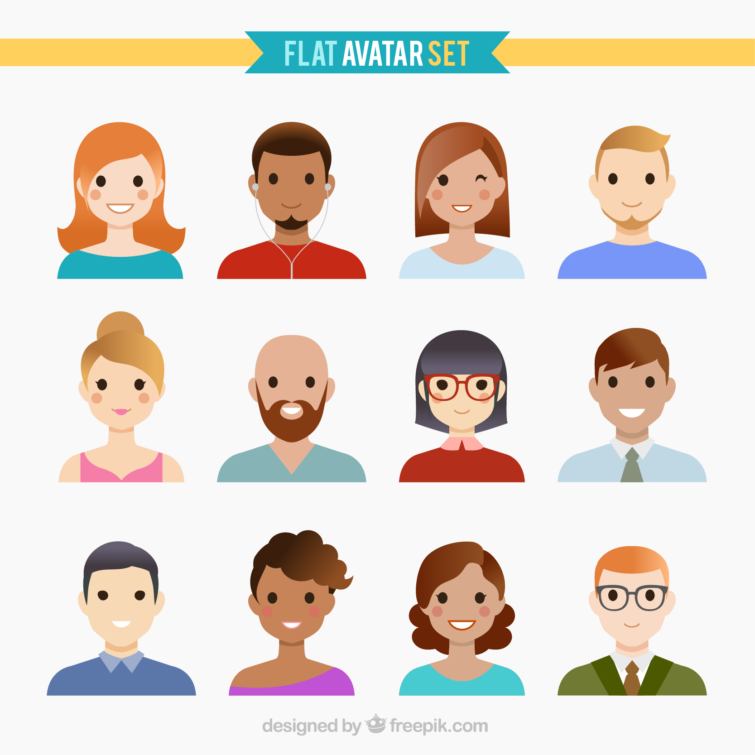
Markus is an Italian student who would like to go on exchange in Finland
Where can he access the information he is looking for?
What are the steps he needs to go through in order to apply for a scholarship?
What if he is not happy with the result of the procedure?
Notes:
Does he need to register in the new country? If yes, where?
Is he eligible to a scholarship?
What are the documents he needs to share to receive those different services?

Slide 10

Notes:
To achieve the SDG, we need applications for end-users and public administrations

Slide 11
All those applications are using data
We need to adopt a common approach for this layer as well!
Application layer
Search
Chatbot
Website
Feedback
Statistics
Authenticate
Fed by
Data layer
Sensitive
Structured
Machine-readable
Secured
Consistent

Slide 12
1
Who are we?
Why do we need a common data layer for the SDG?
What can help us achieve this common data layer?
2
3
How do we build the SDG data model and its classifications together?
4

Slide 13
What is a data model?
“An abstract model that organizes elements of data and standardizes how they relate to one another and to the properties of real-time entities.”
Two well-known examples
Schema.org from Google, Microsoft, Yandex and Yahoo!
Common Data Model (CMD) from Microsoft
Benefits
Reconcile different applications using the same information
Automate the interactions between machines
https://en.wikipedia.org/wiki/Data_model
Notes:
CMD: https://github.com/microsoft/CDM
The Common Data Model (CDM) is a standard and extensible collection of schemas (entities, attributes, relationships) that represents business concepts and activities with well-defined semantics, to facilitate data interoperability. Examples of entities include: Account, Contact, Lead, Opportunity, Product, etc.
The Common Data Model is a declarative specification, and definition of standard entities that represent commonly used concepts and activities across business and productivity applications, and is being extended to observational and analytical data as well. CDM provides well-defined, modular, and extensible business entities such as Account, Business Unit, Case, Contact, Lead, Opportunity, and Product, as well as interactions with vendors, workers, and customers, such as activities and service level agreements.
Within Microsoft: CDM is already supported in the Common Data Service, Dynamics 365, PowerApps, Power BI, and upcoming Azure data services, directly accruing value towards the Open Data Initiative.
Schema.org: https://schema.org/docs/gs.html
Need for information about what that a text string tagging a webpage means—"Avatar" could refer to the hugely successful 3D movie, or it could refer to a type of profile picture—and this can make it more difficult for search engines to intelligently display relevant content to a user. Schema.org provides a collection of shared vocabularies webmasters can use to mark up their pages in ways that can be understood by the major search engines

Slide 14
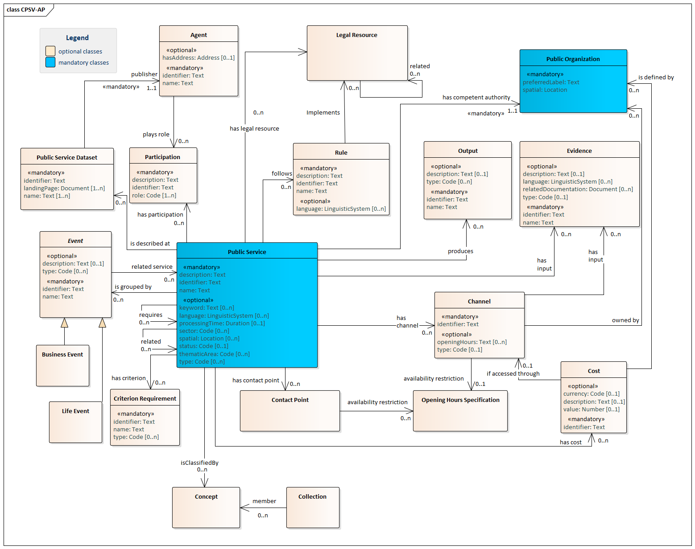
One example of human-readable data model
Notes:
https://joinup.ec.europa.eu/solution/core-public-service-vocabulary-application-profile/distribution/cpsv-ap-specification-v221-png

Slide 15
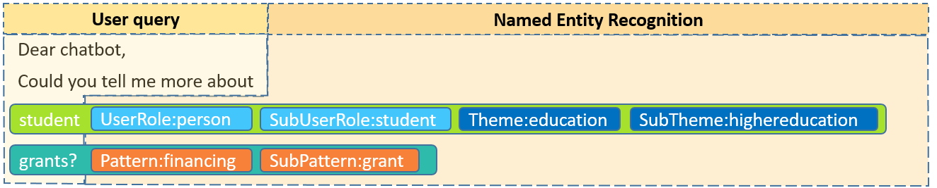
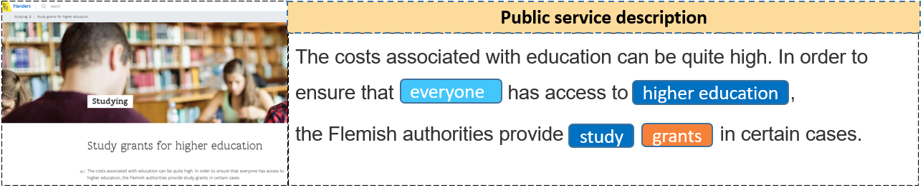
What is a classification?
A knowledge organisation system that aims to increase semantic interoperability by organising information within a certain domain.
Two examples
Identified classifications
User role
Theme
Pattern
And many others!
Notes:
What data types are available?
Where are certain data located?
What access levels are implemented?
What protection level is implemented and does it adhere to compliance regulations? “

Slide 16

How can public administrations exchange their data ?
Mike works for the public digital agency of Spain and wants to provide and receive public service information across Europe.
He is facing several interoperability challenges: data flowing from the different countries to Spain follow various structures, classifications and formats.
This makes it challenging for him to understand the information provided. To address this challenge, Mike would need to map each specific data model to the Spanish data model.

Slide 17
Data model for the Single Digital Gateway
With a common data model, Mike will (only) need to map the Spanish model to this common model, supporting directly the exchange of data from different countries.
SDG

Slide 18


Interoperability challenges
SDG portal
Search Facility
Mike
Common Assistance Finder
Public service data
Markus
Harmonize data
User Feedback tool on service quality
Collect data
SDG
repository
Member State
Index data sources
Public service data
User Feedback tool on SM obstacles
Collect data
Local/national catalogue of public services
Harmonize data
Public service data
Statistics
Dashboard

Slide 19
A common SDG data model and its classifications
SDG portal
Search Facility
Mike
SDG data model
Common Assistance Finder
Public service data
Markus
Harmonize data
User Feedback tool on service quality
Collect data
SDG
repository
Member State
Index data sources
Public service data
User Feedback tool on SM obstacles
Collect data
Local/national catalogue of public services
Harmonize data
Public service data
Statistics
Dashboard

Slide 20
1
Who are we?
Why do we need a common data layer for the SDG?
What can help us achieve this common data layer?
How do we build the SDG data model and its classifications together?
2
3
4

Slide 21
Roadmap and role for Member States
Public review
Approx. 3 weeks for you to review in detail what we propose based on our discussions and your input
Publication
Publication of the data model and first classifications
ICT Meeting
Present and explain the approach
NOW
6th Nov
12th Nov
End Nov
2020
21st Feb
Early March
Mid-March
Q2 2020
Webinar
Data model and classifications -
Initial results of analysis and discussion
Start application
Data model and initial classifications available for you to reuse
Workshop - Brussels
Consensus on the data model

Slide 22
Role for Member States
DATE
ACTIVITY
ROLE
6 NOV 2019
ICT Meeting
Understand the objectives, the approach and the timeline
12 NOV 2019
Webinar
Give input on the SDG model and its classifications and how it should look like
END NOV 2019
Public Review
Review the proposition for the SDG data model and its classifications
21 FEB 2020
Workshop
Agree with other Member States on the data model and its classifications
EARLY MARCH 2020
Publication
Agree on the governance of the model and its classifications
MID MARCH 2020
Start application
Test out the agreed data model and its classifications

Slide 23
How can you take part in all those steps? (1)
Share your input to be considered in our analysis:
Template
Example
Title | Name of the data model/ classification
Description | Short description of the data model/ classification
Owner | Owner of the data model/classification
Administrative level | E.g. National level
Link(s) to the data model(s) | Links to the data models or classifications
Other documentation | Other documentation
Title | business.belgium.be
Description | The PSC offers simple, quick and user-friendly access to public service information for businesses. In particular, the “Guide To Procedures” (link) enables users to find information about the procedures and requirements incumbent upon Belgian and foreign businesses wishing to set up in Belgium or carry out temporary activities there. In this guide, the user is invited to answer three basic questions and, according to the answers, the user will be navigated to respective public service information as follows: · “Where are you from?” the user can select among three possible answers, i.e. “Belgium”, “EU (except Belgium)” and “Non-EU”. · “What do you want to do?” three answers are available here: “Set up a company”, “Run a company” and “Close down a company”. Users can also select the sector and the activity that they are interested in. · “Where do you want to exercise your activity?” the user can select “In Belgium” or “In the community” and specify the community where they want to exercise their activity. A number of filters are available for receiving refined results according to preferred “Type of company”, “Domain” and “Entity involved”. Additionally, the PSC provides informational content for running a business in Belgium. Content is organised in five basic categories: “Setting up a business”, “Financing”, “Site”, “Taxation and accounting” and “Human resources”. Most procedures in the Belgian PSC are described in French, Dutch and/or German (English documentation is available only for a few procedures). Thus, the class and property names in the table below were given by the authors based on Google Translation.
Owner | FPS Chancellery of the Prime Minister
Administrative level | National
Electronic PSCs in BE | http://business.belgium.be/
Other documentation | N/A

Slide 24
How can you take part in all those steps? (2)
Participate in the webinar of the 12th of November:
We will send you an invite with all information you need to participate (slides, agenda, WebEx link).
What can you expect during this webinar?
Discussions on specific parts of the first proposed model.
For example: how should the authentication, identification and signature be modeled?
Initial input from the models shared by the Member States
Existing recognized models (e.g. proposed by international groups such as W3C, schema.org, the European Commission)
Are we covering the different cases from the SDG?
Validate the specific proposition as part of the bigger picture of the SDG data model

Slide 25
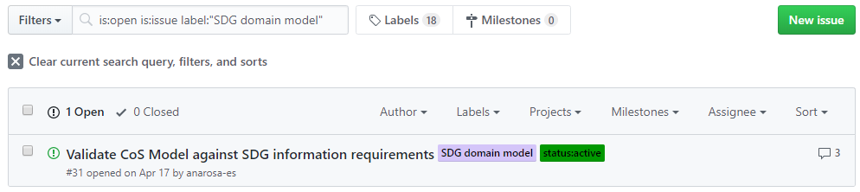
How can you take part in all those steps? (3)
Take part in the public review
We will indicate at the beginning of the public review where you can find all information about the proposed model and how to contribute to its review.
In the meantime, you can use the following GitHub space and create issues, using the label “SDG domain model”:
Other activities - we will keep you informed

Slide 26
Thank you!
Project Officer
Miguel Alvarez-Rodriguez Miguel.ALVAREZ-RODRIGUEZ@ec.europa.eu
PwC
Florian Barthelemy
barthelemy.florian@pwc.com
Single Digital Gateway: https://ec.europa.eu/growth/single-market/single-digital-gateway_en
CPSV-AP: https://ec.europa.eu/isa2/solutions/core-public-service-vocabulary-application-profile-cpsv-ap_en
Github Repository CPSV-AP: https://github.com/catalogue-of-services-isa/CPSV-AP

