Slide 1
ISA² Action:
Catalogue of public services
Webinar
Notes:
Ask if it is okay for the recording

Slide 2
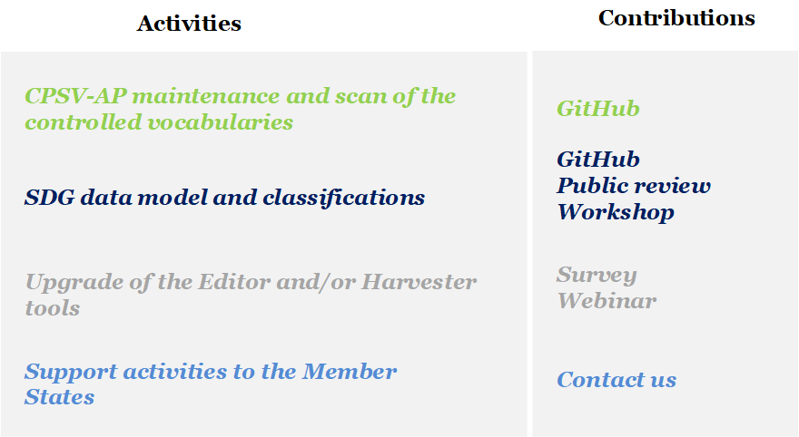
Overview of the activities and objectives of this webinar
Focus of this webinar
Understand the context and the needs
Agree on the approaches
Discuss the main concepts to collect your feedback

Slide 3
Agenda
1
What is the context of this work?
Why do we need a common data layer for the SDG?
Approach & objectives
Starting from article 10, identifying and mapping the most important SDG concepts in a common data model
How do we continue from here?
2
3
4
5

Slide 4
Agenda
1
What is the context of this work?
2
Why do we need a common data layer for the SDG?
Approach & objectives
Starting from article 10, identifying and mapping the most important SDG concepts in a common data model
How do we continue from here?
3
4
5

Slide 5
How can the Member States and the European Commission deliver high-quality digital services through the Single Digital Gateway in the next three years while minimising the human interventions?
ISA²
experience
SDG
Regulation
Building Core Public Service Vocabulary in a participatory approach
Supporting its implementation in public administrations
Developing applications such as chatbots, APIs
Preamble (55):
“The common ICT support tools might use the Core Public Services Vocabulary (CPSV) to facilitate interoperability with national service catalogues and semantics. Member States should be encouraged to use the CPSV, but are free to decide to use national solutions.”
Notes:
“To minimise human intervention in the updating of the links to be used by the common user interface, a direct connection between the relevant technical systems of the Member States and the repository for links should, where technically possible, be established. The common ICT support tools might use the Core Public Services Vocabulary (CPSV) to facilitate interoperability with national service catalogues and semantics. Member States should be encouraged to use the CPSV, but are free to decide to use national solutions. The information included in the repository for links should be made publicly available in open, commonly used and machine-readable format, for example by application programming interfaces (APIs), in order to enable its reuse.”

Slide 6
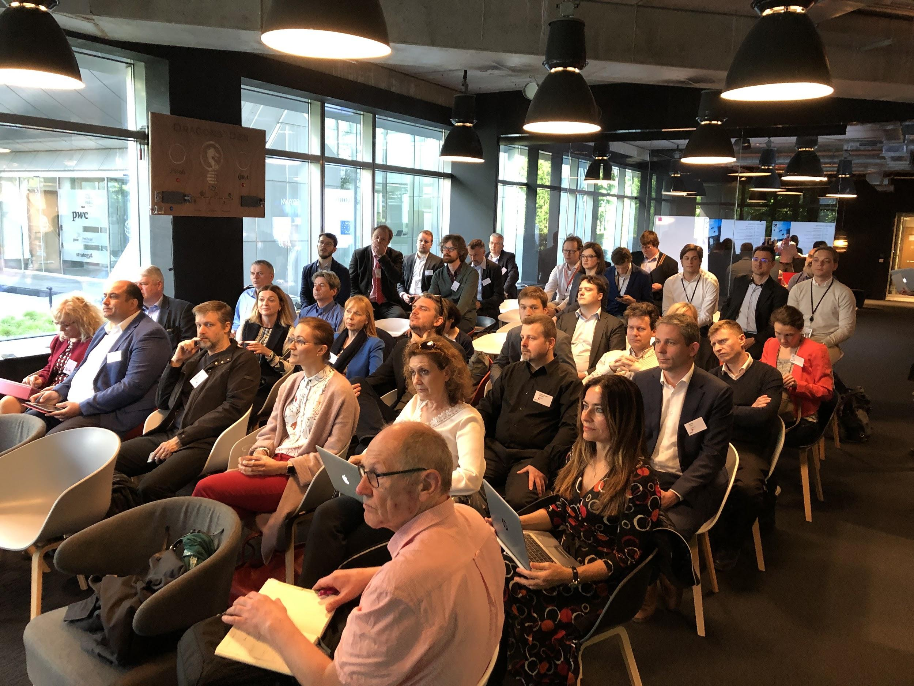
Most of all, the demand arose from the Member States
CPSV-AP
A light and flexible core data model
Proof-tested for several years
Some Member States face difficulties in using it
Not tailored to the context of the SDG
Workshop in Brussels on the 16th of May 2019

Slide 7
Agenda
1
What is the context of this work?
Why do we need a common data layer for the SDG?
2
3
Approach & objectives
Starting from article 10, identifying and mapping the most important SDG concepts in a common data model?
How do we continue from here?
4
5

Slide 8
The needs for a common data layer
Makes all services provided through the SDG more easy to find across countries and languages
Helps users to compare systems in different countries before making use of their single market rights
Provides an important building block for the implementation of the once-only system
Makes collecting comparable statistics much more easy and accurate
Enables you to map your current models against one (only), structure your information for exchanging it across borders and automate to a large extent the validation of the quality of your descriptions
SDG

Slide 9
To achieve the SDG, we need applications for end-users and public administrations
We need to adopt a common approach for this layer as well!
Application layer
Search
Chatbot
Website
Feedback
Statistics
Authenticate
Fed by
Data layer
Sensitive
Structured
Machine-readable
Secured
Consistent

Slide 10
There are challenges
Objectives
From the regulation
Challenges
Findability of information on the single market in user-centric approach
Article 2.2: The gateway shall give access to information on online and offline procedures and links to online procedures, including procedures covered by Annex II
Information quality and structure, exchange, maintenance
Article 10: [users] have access to a sufficiently comprehensive, clear and user-friendly explanation of the following elements [...]
Article 18: Common user interface
Article 21.1: Search engine for the SDG
Data quality, data structure, user friendliness
Transforming all procedures to be online available cross-border
Article 6: Each Member State shall ensure that users can access and complete any of the procedures listed in Annex II fully online, provided that the relevant procedure has been established in the Member State concerned.
Article 13.2 users are able to access the instructions for completing the procedure in an official language of the Union
Naming conventions, granularity, translation, OOP, common representation of the instructions, integration of the different service requirements for digital procedures (eID, eSignature, evidence, payments etc.)
Human intervention in updating links of public services
Paragraph 55: To minimise human intervention in the updating of the links to be used by the common user interface, a direct connection between the relevant technical systems of the Member States and the repository for links should, where technically possible, be established.
Data exchange, machine-readability
...
...
...

Slide 11
What do we understand with a data layer?
Semantic interoperability focus
Using a common SDG data model and its classifications is not mandatory, but… we identified it as the best option for answering the requirements from the SDGR.
It is urgent*
However, we should not create a monster
*Deadlines in the notes
Common
data model
Classifications
Notes:
Article 2, Article 4, Articles 7 to 12, Article 16, Article 17, Article 18(1) to (4), Article 19, Article 20, Article 24(1), (2) and (3), Article 25(1) to (4), Article 26 and Article 27 shall apply from 12 December 2020.

Slide 12
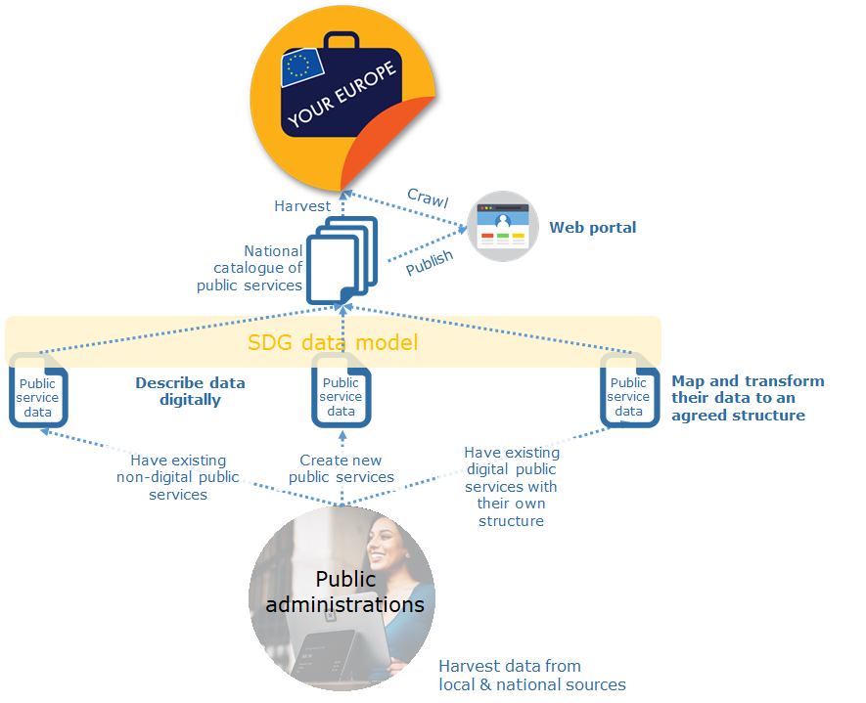
Semantic interoperability metadata layer
Public service metadata
Name
Description
URI
Competent authority
Territorial area
Procedure
Abstract
Audience
Photo by Patrick Tomasso on Unsplash

Slide 13
Agenda
1
What is the context of this work?
Why do we need a common data layer for the SDG?
Approach & objectives
2
3
Starting from article 10, identifying and mapping the most important SDG concepts in a common data model
How do we continue from here?
4
5

Slide 14
Our principles
1
Light (as simple as possible) and flexible
Data model and classifications
2
Designed with the goal of interoperability
3
Tailored to the SDG requirements and deadlines
4
Easy to map or to use for the Member States
5
Compatibility to the CPSV-AP

Slide 15
Our proposed approach for a common data model
1
Gather all relevant concepts from the SDGR, such as:
Art. 2: Annex I & Annex II
Art. 6: ‘Procedures to be offered fully online’
Art. 10: ‘Quality of information on procedures’
Note:
In alignment with our principles, the model and the classifications proposed should distinguish clearly the elements mandatory for implementing the SDG from other elements.
2
Map this list to:
CPSV-AP
Member State models
Core Vocabularies
Other relevant data models
3
Propose new classes, properties and classifications to cover SDG concepts
Notes:
Record webinar /// distinguish what is mandatory and what not (eg stuff in the regulation) /// marketing (change name, e.g. SDG CDM?)

Slide 16
Our proposed approach: concrete example
Start from the regulation - here with article 10
Concepts from the SDGR | Reference
Step | Article 10
Means of identification | Article 10
Evidence | Article 10
Type | Article 10
Format | Article 10
Authenticity | Article 10
Signature | Article 10, 30
Electronic signature | Article 30
Means of appeal | Article 10
Means of redress | Article 10
Applicable fees | Article 10
Deadline | Article 10
Period of time | Article 10
... | ...
Link the concepts with relations
Quality of information on procedures
1. The Member States and the Commission shall, [...] before users have to identify themselves prior to launching the procedure, [...]
(2):(a) the relevant steps of the procedure to be taken by the user, [...]
(b) the name of the competent authority responsible for the procedure, including its contact details;
(c) the accepted means of authentication, identification and signature for the procedure;
(d) the type and format of evidence to be submitted;
(e) the means of redress or appeal which are generally available in the event of disputes with the competent authorities; [...]
Notes:
3 columns (SDGR text, list of concepts, searching glass)
Searching glass -> CPSV-AP /

Slide 17
Our proposed approach: sources
1
2
3
4
CORE
PUBLIC SERVICE
VOCABULARY
APPLICATION
PROFILE
CORE
PERSON
VOCABULARY
DCAT-AP
FOR
DATA PORTALS
IN EUROPE
Member State
data models
We need your input
Other data models
ELI
W3C Verified Credentials
...
CORE
PUBLIC ORGANISATION
vocabulary
CORE
CRITERION & EVIDENCE
VOCABULARY
CORE
BUSINESS
VOCABULARY
CORE
LOCATION
VOCABULARY
Links to data models to be found in the Annex of the slides

Slide 18
How can you take part?
Follow us on GitHub and take part in the public review
You can use the following GitHub space and create issues, using the label “SDG domain model”:

Slide 19
Discussion
Comments or suggestions on the approach and objectives?
Notes:
Agreeing on the approach and objectives

Slide 20
Our proposed approach: classifications
Classification
A knowledge organisation system that aims to increase semantic interoperability by organising information within a certain domain.
User search
Classification
Why do we need classifications?
Improve search for public services in a structured way
Search on keywords
Use common unique classifier
Public service description
Notes:
Procedural tagging?

Slide 21
Our proposed approach: classifications
Start from the regulation - Annexes
Lists from existing classifications
Person
Status
Self-employed
Jobseeker
Pensioner
Student
Employee
Are there gaps?
Are the existing classifications fit for purpose?
Can we find a consensus?
E.g. Core Person Vocabulary
Public administration’s classifications
Notes:
From the scan of controlled vocs: list the vocs

Slide 22
Our proposed approach: classifications
Start from the regulation - Annexes
Lists from existing classifications
Person
Status
Self-employed
Jobseeker
Pensioner
Student
Employee
Are there gaps?
Are the existing classifications fit for purpose?
Can we find a consensus?
E.g. Core Person Vocabulary
Public administration’s classifications
We need your input!
Notes:
From the scan of controlled vocs: list the vocs

Slide 23
Discussion
Fit-for-purpose
What should be the flexibility of the classifications (e.g. tags vs fixed term)?
Can it differ between classifications?
Consensus
How do we decide to include or not the different classifications and their terms?
Notes:
Options:
You are free to use personal classifications

Slide 24
Agenda
1
What is the context of this work?
Why do we need a common data layer for the SDG?
Approach & objectives
Starting from article 10, identifying and mapping the most important SDG concepts in a common data model
2
3
4
5
How do we continue from here?

Slide 25
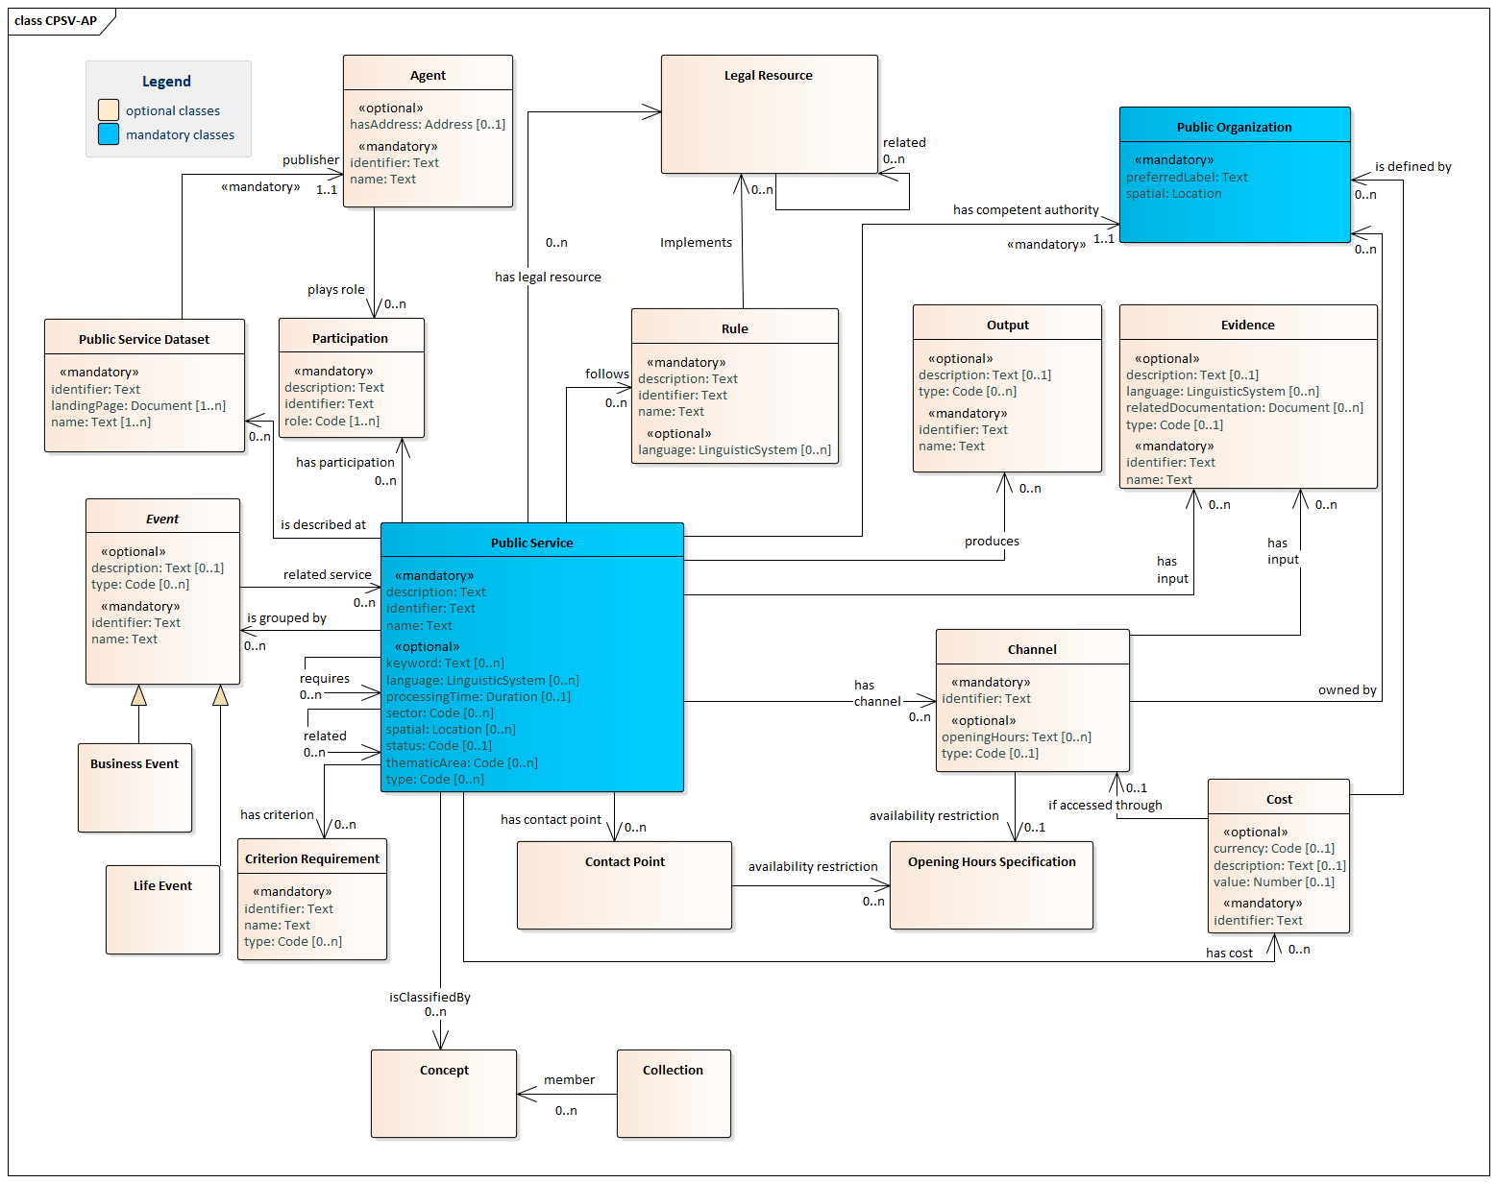
Notes:
CPSV-AP
Basis, common data model
>>> Is this a good start for mapping SDG concepts?

Slide 26
Concepts from the SDGR | Reference
Evidence | Article 10
Period of time | Article 10
Life event | Annex II
Business event | Annex II
Applicable fees, price | Article 10
Competent authority | Annex II
Public body | Annex II
Law | Article 4
Event | Annex II
Citizen | Article 2
Rule | Annex I
Address | Annex 2
Output | Article 6
Language | Article 2
Service | Article 11
Contact details | Article 10
...
Notes:
As you remember, the first step was identifying the concepts

Slide 27
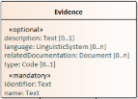
Concepts from the SDGR | Reference
Evidence | Article 10
Period of time | Article 10
Life event | Annex II
Business event | Annex II
Applicable fees, price | Article 10
Competent authority | Annex II
Public body | Annex II
Law | Article 4
Event | Annex II
Citizen | Article 2
Rule | Annex I
Address | Annex 2
Output | Article 6
Language | Article 2
Service | Article 11
Contact details | Article 10
...
Notes:
Then we mapped the SDG concepts. Here you can see a small sample we used.
After analysis, the SDG concepts can be mapped to all classes of CPSV-AP except one. This is thus a very strong foundation for a common SDG data model

Slide 29
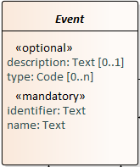

Slide 30
List of CPSV-AP’s Recommended Controlled Vocabularies (= classifications)
Class | Property | Recommended Controlled Vocabulary
Business Event | Type | CPSV-AP
Life event | Type | CPSV-AP
Public Service | Type | -
Public Service | Thematic Area | -
Public Service | Language | ‘Named Authority List’ Languages
Public Service | Sector | NACE
Public Service | Spatial | ‘Named Authority List’ Countries, Places & Geonames
Public Service | Status | ADMS
Participation | Role | -
Criterion Requirement | Type | -
Evidence | Type | -
Evidence | Language | ‘Named Authority List’ Languages
Output | Type | CPSV-AP
Cost | Currency | ‘Named Authority List’ Currencies
Channel | Type | CPSV-AP
Rule | Language | ‘Named Authority List’ Languages
This list can be found in the CPSV-AP specification, chapter 4.
https://joinup.ec.europa.eu/solution/core-public-service-vocabulary-application-profile/releases
We will share a classification scan on GitHub soon.
We are also looking for input: are you using a classification for public services?

Slide 31
List of CPSV-AP’s Recommended Controlled Vocabularies (= classifications)
Class | Property | Recommended Controlled Vocabulary
Business Event | Type | CPSV-AP
Life event | Type | CPSV-AP
Public Service | Type | -
Public Service | Thematic Area | -
Public Service | Language | ‘Named Authority List’ Languages
Public Service | Sector | NACE
Public Service | Spatial | ‘Named Authority List’ Countries, Places & Geonames
Public Service | Status | ADMS
Participation | Role | -
Criterion Requirement | Type | -
Evidence | Type | -
Evidence | Language | ‘Named Authority List’ Languages
Output | Type | CPSV-AP
Cost | Currency | ‘Named Authority List’ Currencies
Channel | Type | CPSV-AP
Rule | Language | ‘Named Authority List’ Languages
Having a child
Becoming a (social) caretaker
Starting education
Looking for a new job
Losing/quitting a job
Looking for a place to live
Changing relationship status
Driving a vehicle
Travelling abroad
Moving to/from the country
Going into military service
Facing an emergency / health
problem
Facing a crime
Retirement
Death of a relative

Slide 32
List of CPSV-AP’s Recommended Controlled Vocabularies (= classifications)
Class | Property | Recommended Controlled Vocabulary
Business Event | Type | CPSV-AP
Life event | Type | CPSV-AP
Public Service | Type | -
Public Service | Thematic Area | -
Public Service | Language | ‘Named Authority List’ Languages
Public Service | Sector | NACE
Public Service | Spatial | ‘Named Authority List’ Countries, Places & Geonames
Public Service | Status | ADMS
Participation | Role | -
Criterion Requirement | Type | -
Evidence | Type | -
Evidence | Language | ‘Named Authority List’ Languages
Output | Type | CPSV-AP
Cost | Currency | ‘Named Authority List’ Currencies
Channel | Type | CPSV-AP
Rule | Language | ‘Named Authority List’ Languages
Having a child
Becoming a (social) caretaker
Starting education
Looking for a new job
Losing/quitting a job
Looking for a place to live
Changing relationship status
Driving a vehicle
Travelling abroad
Moving to/from the country
Going into military service
Facing an emergency / health
problem
Facing a crime
Retirement
Death of a relative
Procedures from the SDGR | Reference
Requesting proof of registration of birth | Annex II
Applying for a tertiary education study financing, such as study grants and loans from a public body or institution | Annex II
Claiming pension and pre-retirement benefits from compulsory schemes | Annex II
Requesting information on the data related to pension from compulsory schemes | Annex II
...

Slide 33
List of CPSV-AP’s Recommended Controlled Vocabularies (= classifications)
Class | Property | Recommended Controlled Vocabulary
Business Event | Type | CPSV-AP
Life event | Type | CPSV-AP
Public Service | Type | -
Public Service | Thematic Area | -
Public Service | Language | ‘Named Authority List’ Languages
Public Service | Sector | NACE
Public Service | Spatial | ‘Named Authority List’ Countries, Places & Geonames
Public Service | Status | ADMS
Participation | Role | -
Criterion Requirement | Type | -
Evidence | Type | -
Evidence | Language | ‘Named Authority List’ Languages
Output | Type | CPSV-AP
Cost | Currency | ‘Named Authority List’ Currencies
Channel | Type | CPSV-AP
Rule | Language | ‘Named Authority List’ Languages
Having a child
Becoming a (social) caretaker
Starting education
Looking for a new job
Losing/quitting a job
Looking for a place to live
Changing relationship status
Driving a vehicle
Travelling abroad
Moving to/from the country
Going into military service
Facing an emergency / health
problem
Facing a crime
Retirement
Death of a relative
Procedures from the SDGR | Reference
Requesting proof of registration of birth | Annex II
Applying for a tertiary education study financing, such as study grants and loans from a public body or institution | Annex II
Claiming pension and pre-retirement benefits from compulsory schemes | Annex II
Requesting information on the data related to pension from compulsory schemes | Annex II
...

Slide 34
Important classifications for the SDG data model
List of CPSV-AP’s Recommended Controlled Vocabularies (= classifications)
Class | Property | Recommended Controlled Vocabulary
Public Service | Type | -
Public Service | Thematic Area | -
Participation | Role | -
https://github.com/catalogue-of-services-isa/Taxonomy
Notes:
Ask for input
Role; eg. service provider, publisher, (potential) consumer, enmployer, employee, … (also part of SDGR)

Slide 35
Should we consider the following as classifications to be added?
Phase ~ procedural step
Purpose
SDGR, art. 11
[...] have access to a clear and user-friendly explanation of the following: (a) the type, purpose and expected results of the service offered
Notes:
Or purpose in description

Slide 36
Concepts from the SDGR | Reference
Procedure | SDGR
Step of a procedure | Art. 6, 10
from
is implemented by
follows
Procedure
NEW

Slide 37
Concepts from the SDGR | Reference
Feedback | Art. 1
Obstacle | Art. 1
Appeal | Art. 10
from
Feedback
on
Quality
on
Obstacle
implies
resolves
on
is implemented by
FEEDBACK
VOCABULARY
follows
Procedure
NEW
Notes:
cORE FEEDBACK VOC IS STILL UNDER CONSTRUCTION

Slide 38
from
Feedback
Person
on
Quality
Legal Entity
on
Obstacle
implies
resolves
on
is implemented by
FEEDBACK
VOCABULARY
Concepts from the SDGR | Reference
Person, user | SDGR
Business | SDGR
ID | Annex I
Passport | Annex I
Driving licence | Annex I
CORE
PERSON
VOCABULARY
Document
owns
follows
NEW
Procedure
NEW
Notes:
cORE FEEDBACK VOC IS STILL UNDER CONSTRUCTION

Slide 39
Concepts from the SDGR | Reference
Evidence | Art. 10
Business register | Annex II
Register | Annex II
from
Feedback
Person
on
Quality
Legal Entity
on
is generated by
Obstacle
implies
resolves
on
Evidence Service Provider
is implemented by
does asses
CORE
FEEDBACK
VOCABULARY
Dcat:resource
(base registry)
Evidence
Identifier: Identifier
Name: Text
Type: Code
Description: Text
Related Documentation: URI
Language: Code
Purpose of Evidence: Text
Base Registries: URI
CORE
PERSON
VOCABULARY
Document
owns
DATA CATALOG VOCABULARY
FOR DATA PORTALS
APPLICATION PROFILE
follows
NEW
Procedure
NEW
Notes:
cORE FEEDBACK VOC IS STILL UNDER CONSTRUCTION

Slide 40
Concepts from the SDGR | Reference
Plate Number | Annex II
Signature | Annex II
from
Feedback
Person
on
on
Quality
Legal Entity
on
is generated by
on
Obstacle
implies
resolves
on
Evidence Service Provider
is implemented by
does asses
CORE
FEEDBACK
VOCABULARY
Dcat:resource
(base registry)
contains
Information
CORE
PERSON
VOCABULARY
NEW
Document
owns
DATA CATALOG VOCABULARY
FOR DATA PORTALS
APPLICATION PROFILE
follows
NEW
Procedure
NEW
Notes:
cORE FEEDBACK VOC IS STILL UNDER CONSTRUCTION

Slide 41
from
Feedback
Person
on
on
Quality
Legal Entity
on
is generated by
on
Obstacle
implies
resolves
on
Evidence Service Provider
is implemented by
does asses
FEEDBACK
VOCABULARY
Dcat:resource
(base registry)
contains
Information
CORE
PERSON
VOCABULARY
NEW
Document
owns
DATA CATALOG VOCABULARY
FOR DATA PORTALS
APPLICATION PROFILE
follows
NEW
Procedure
NEW
Notes:
cORE FEEDBACK VOC IS STILL UNDER CONSTRUCTION

Slide 42
Agenda
1
What is the context of this work?
Why do we need a common data layer for the SDG?
Approach & objectives
Starting from article 10, identifying and mapping the most important SDG concepts in a common data model
How do we continue from here?
2
3
4
5

Slide 43
Roadmap
Public review
Approx. 3 weeks for you to review in detail what we propose based on our discussions and your input
Publication
Publication of the data model and first classifications
ICT Meeting
Present and explain the approach
NOW
6th Nov
12th Nov
End Nov
2020
21st Feb
Early March
Mid-March
Q2 2020
Webinar
Data model and classifications -
Initial results of analysis and discussion
Start application
Data model and initial classifications available for you to reuse
Workshop - Brussels
Consensus on the data model

Slide 44
Role for Member States
DATE
ACTIVITY
ROLE
6 NOV 2019
ICT Meeting
Understand the objectives, the approach and the timeline
12 NOV 2019
Webinar
Give input on the SDG model and its classifications and how it should look like
END NOV 2019
Public Review
Review the proposition for the SDG data model and its classifications
21 FEB 2020
Workshop
Agree with other Member States on the data model and its classifications
EARLY MARCH 2020
Publication
Agree on the governance of the model and its classifications
MID MARCH 2020
Start application
Test out the agreed data model and its classifications

Slide 45
How can you take part in the current step?
Share your input to be considered in our analysis:
Template
Example
Title | Name of the data model/ classification
Description | Short description of the data model/ classification
Owner | Owner of the data model/classification
Administrative level | E.g. National level
Link(s) to the data model(s) | Links to the data models or classifications
Other documentation | Other documentation
Title | business.belgium.be
Description | The PSC offers simple, quick and user-friendly access to public service information for businesses. In particular, the “Guide To Procedures” (link) enables users to find information about the procedures and requirements incumbent upon Belgian and foreign businesses wishing to set up in Belgium or carry out temporary activities there. In this guide, the user is invited to answer three basic questions and, according to the answers, the user will be navigated to respective public service information as follows: · “Where are you from?” the user can select among three possible answers, i.e. “Belgium”, “EU (except Belgium)” and “Non-EU”. · “What do you want to do?” three answers are available here: “Set up a company”, “Run a company” and “Close down a company”. Users can also select the sector and the activity that they are interested in. · “Where do you want to exercise your activity?” the user can select “In Belgium” or “In the community” and specify the community where they want to exercise their activity. A number of filters are available for receiving refined results according to preferred “Type of company”, “Domain” and “Entity involved”. Additionally, the PSC provides informational content for running a business in Belgium. Content is organised in five basic categories: “Setting up a business”, “Financing”, “Site”, “Taxation and accounting” and “Human resources”. Most procedures in the Belgian PSC are described in French, Dutch and/or German (English documentation is available only for a few procedures). Thus, the class and property names in the table below were given by the authors based on Google Translation.
Owner | FPS Chancellery of the Prime Minister
Administrative level | National
Electronic PSCs in BE | http://business.belgium.be/
Other documentation | N/A

Slide 46
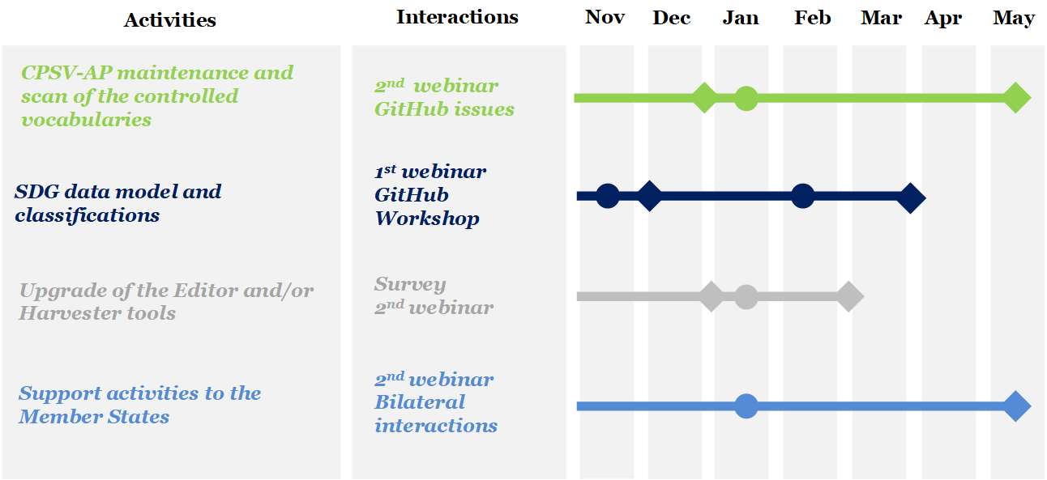
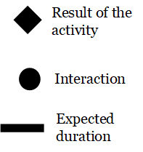
Stay tuned for our other streams of activities in this phase

Slide 47
The ISA² Programme and its action ‘Catalogue of Public Services’
Upgrade of the tools
Link to the surveys: Editor and Harvester
Deadline: Friday 15th of November

Slide 48
Thank you!
Project Officer
Miguel Alvarez-Rodriguez Miguel.ALVAREZ-RODRIGUEZ@ec.europa.eu
PwC
Florian Barthelemy
barthelemy.florian@pwc.com
Single Digital Gateway: https://ec.europa.eu/growth/single-market/single-digital-gateway_en
CPSV-AP: https://ec.europa.eu/isa2/solutions/core-public-service-vocabulary-application-profile-cpsv-ap_en
Github Repository CPSV-AP: https://github.com/catalogue-of-services-isa/CPSV-AP

Slide 49
Annex I
Examples

Slide 50
Why do we need to care about a common approach to this data layer?
1
It will make all services provided through the SDG much more easy to find (e.g. search and chatbots) across countries and languages
An Italian man is moving to the Netherlands and wants to know the steps for registering a new home
2
It will help users to compare systems in different countries before making use of their single market rights
Polish man, married to an Italian woman, living in Germany, having a baby - where to request the birth certificate
3
It will provide an important building block for the implementation of the once-only system
A German woman request sa direct exchange of here data held by a German authority to any other authority
4
It will make collecting comparable statistics much more easy and accurate
A civil servant checks which services are requested the most and which services need updating based on the feedback
5
It will enable you to structure your information for exchanging it across borders and automate the validation of the quality of your descriptions.
A Spanish civil servant processes the personal data from a Belgian student registering in Barcelona
...

Slide 51
Annex II
Existing data models

Slide 52
Data model | Abbreviation | Link
Core Public Service Vocabulary Application Profile | CPSV-AP | https://joinup.ec.europa.eu/solution/core-public-service-vocabulary-application-profile/releases
e-Government Core Vocabularies Core Person Vocabulary Core Business Vocabulary Core Location Vocabulary |  | https://joinup.ec.europa.eu/solution/e-government-core-vocabularies/releases
Core Criterion and Core Evidence Vocabulary | CCCEV | https://joinup.ec.europa.eu/solution/core-criterion-and-core-evidence-vocabulary/releases Major update under construction
Core Public Organisation Vocabulary | CPOV | https://joinup.ec.europa.eu/solution/core-public-organisation-vocabulary/releases

Slide 53
Data model | Abbreviation | Link
Data Catalogue Vocabulary Application Profile | DCAT-AP | https://joinup.ec.europa.eu/solution/dcat-application-profile-data-portals-europe/releases
European Legislation Identifier | ELI | https://op.europa.eu/en/web/eu-vocabularies/eli
Core Public Event Vocabulary |  | https://joinup.ec.europa.eu/solution/core-public-event-vocabulary/releases
Core Feedback Vocabulary |  | Under construction
Digitally-Signed Credentials |  | https://joinup.ec.europa.eu/sites/default/files/release/documentation/2019-07/Presentation_0.pdf

Slide 54
What is a data model?
“An abstract model that organizes elements of data and standardizes how they relate to one another and to the properties of real-time entities.”
Two well-known examples
Schema.org from Google, Microsoft, Yandex and Yahoo!
Common Data Model (CMD) from Microsoft
Benefits
Reconcile different applications using the same information
Automate the interactions between machines
https://en.wikipedia.org/wiki/Data_model
Notes:
CMD: https://github.com/microsoft/CDM
The Common Data Model (CDM) is a standard and extensible collection of schemas (entities, attributes, relationships) that represents business concepts and activities with well-defined semantics, to facilitate data interoperability. Examples of entities include: Account, Contact, Lead, Opportunity, Product, etc.
The Common Data Model is a declarative specification, and definition of standard entities that represent commonly used concepts and activities across business and productivity applications, and is being extended to observational and analytical data as well. CDM provides well-defined, modular, and extensible business entities such as Account, Business Unit, Case, Contact, Lead, Opportunity, and Product, as well as interactions with vendors, workers, and customers, such as activities and service level agreements.
Within Microsoft: CDM is already supported in the Common Data Service, Dynamics 365, PowerApps, Power BI, and upcoming Azure data services, directly accruing value towards the Open Data Initiative.
Schema.org: https://schema.org/docs/gs.html
Need for information about what that a text string tagging a webpage means—"Avatar" could refer to the hugely successful 3D movie, or it could refer to a type of profile picture—and this can make it more difficult for search engines to intelligently display relevant content to a user. Schema.org provides a collection of shared vocabularies webmasters can use to mark up their pages in ways that can be understood by the major search engines

