Slide 1
WEBINAR on Preliminary Market Consultations
Intellectual Property – how is it relevant?
Elena Kostadinova, Intangible Economy, DG GROW

Slide 2
What is Intellectual Property?

Slide 3
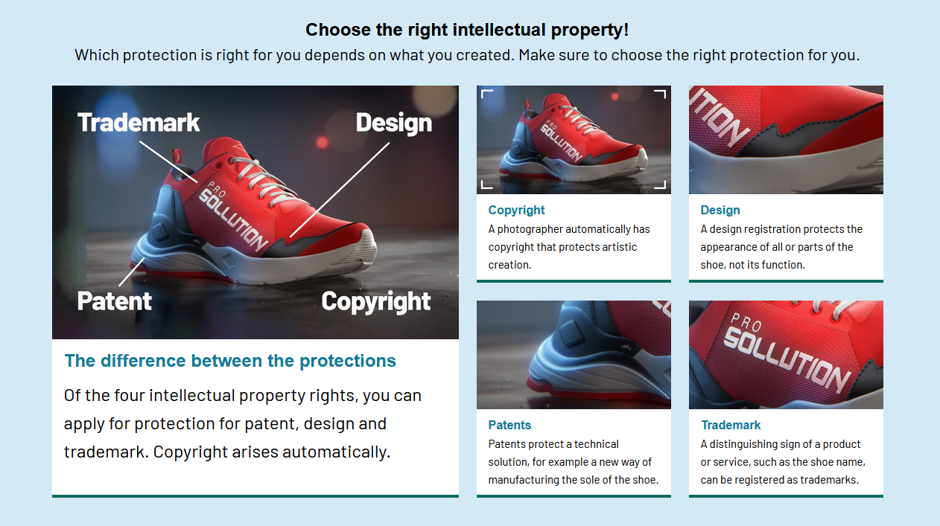
Source: Swedish Intellectual Property Office https://www.prv.se/en/

Slide 4
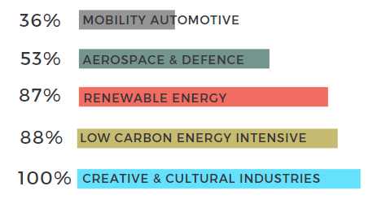
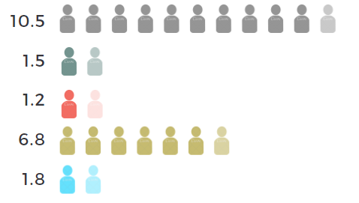
A driver for growth and jobs
in key industrial ecosystems
IPR-intensive industries within key ecosystems
GDP
Employment (million jobs)
7,10 %
1,60 %
1,30 %
5,60 %
1,20 %
During the period
2014-2016 45% of EU GDP was generated by IPR-intensive industries.
During the period 2014-2016 29,2% of EU jobs
were generated by
IPR-intensive industries.
Notes:
IP is of key importance for EU’s economy: IPR-intensive industries are major components of the 14 ecosystems; they increasingly contribute to EU’s economy (GDP & job creation)
- IP policy as a crucial element of the EU’s Industrial and Recovery Strategies
“IP Policy as part of Industrial Policy” – explain why and how IPRs stimulate growth
Contribution of IPR-intensive sectors to the EU economy – is increasing – trend observed throughout the three reports prepared jointly by the EUIPO and EPO
IPR-intensive industries are defined in the EPO-EUIPO studies as those having an above-average ownership of IPRs per employee, as compared with other IPR-using industries. In principle, this means that an industry is identified as IPR-intensive in the EU if for at least one of the IP rights under consideration, the number of those IPRs per employee exceeds the average of all EU industries that make use of that same IP right. These industries are concentrated in the manufacturing, technology and business services sectors.
Copyright also an important component – e.g. the music, publishing and film industries rely heavily on copyright and are amongst the IPR-intensive industries. These industries have been badly hit by the Covid crisis.
The contribution of trade mark-intensive industries to overall GDP is 37%, of design-intensive industries 16%, of patent-intensive industries 16% and of copyright-intensive industries 7%
IP-intensive industries are responsible for a large amount of external trade (imports and exports). Overall IP-intensive industries created a trade surplus of 160 billion in 2016, with patents being the biggest contributor to external trade, and copyright being second.

Slide 5
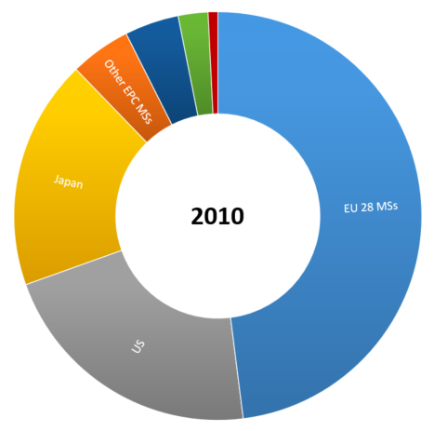
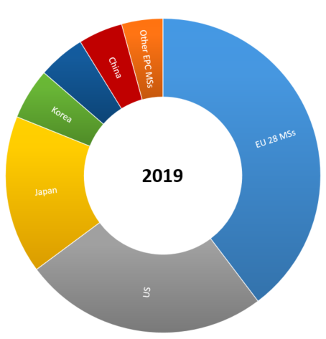
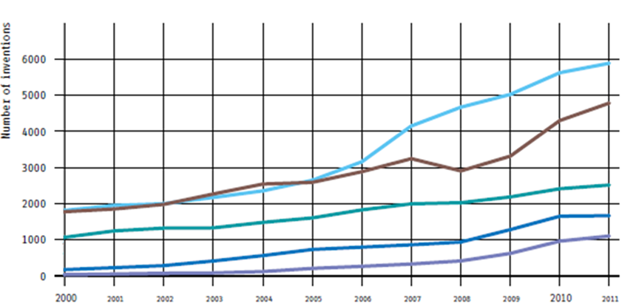
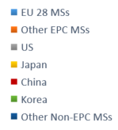
A key asset to compete globally
LEADING ROLE OF EUROPE IN KEY AREAS
INCREASING GLOBAL COMPETITION & TECHNOLOGICAL RACE
High-value inventions for Climate Change Mitigation Technologies in the major innovation centres 2000-2011
58 117 European patents granted
EU – 48%
Non-EU – 52%
137 784 European patents granted
EU – 40%
Non-EU – 60%
Notes:
Increasing global competition and technological race
EU’s creators and innovators continue to lead the way; our position is less dominant than in the past though, as other economies are catching up; while the decrease of dominance is a natural consequence of growth in other parts of the world, we need to make sure that our creative and innovative industries keep their competitive advantage.
Looking into the future, we need to make sure that EU’s businesses remain leaders in key areas of technological development – for example, the technologies crucial to achieve the digital and green transitions, strengthening the EU’s resilience in the spirit of ‘open strategic autonomy’.
Sources: European patents – Annual report 2010 and Patent Index 2019 (patents granted), CCMT inventions – report of EPO and UNEP, 2015

Slide 6
Thank you
© European Union 2020
Unless otherwise noted the reuse of this presentation is authorised under the CC BY 4.0 license. For any use or reproduction of elements that are not owned by the EU, permission may need to be sought directly from the respective right holders.
Slide xx: element concerned, source: e.g. Fotolia.com; Slide xx: element concerned, source: e.g. iStock.com
Notes:
Update/add/delete parts of the copy right notice where appropriate.
More information: https://myintracomm.ec.europa.eu/corp/intellectual-property/Documents/2019_Reuse-guidelines%28CC-BY%29.pdf

