Slide 1
e-procurement ontology
Second Working Group Meeting
26 April 2017

Slide 2
Agenda
Round table
Introduction and objectives of this meeting
Current status
Three existing use cases
Conceptual model
Additional use cases
Proposed new use cases
Use cases from the landscaping report
Actions and tasks
Next steps

Slide 3
Round table

Slide 4
Introduction and objectives of this meeting

Slide 5
Introduction and objectives of this meeting
Discuss the use cases
Use cases from landscaping report
New proposed use cases
Decision on relevance
Volunteers for further development of use cases
Discuss modelling issues and proposed resolutions
Decide on next steps and planning

Slide 6
Current Status

Slide 7
Current status of the project
10 issues raised on GitHub:
5 issues on use cases
5 issues on the conceptual model
Opportunities for the members to provide content on:
The deliverables:
D02.01 Specification of the process and methodology: https://joinup.ec.europa.eu/node/159883
D02.02 Project Charter: https://joinup.ec.europa.eu/node/159884
The use cases
The conceptual model
Other points you might want to raise to the whole working group.

Slide 8
Questions
?

Slide 9
Use cases

Slide 10
Use cases
1.2. Data journalism
Description
Citizens want to have insights in the way that contracting authorities are procuring services, hence spending public money. For example, they want to know who the selected tenderer is, what was the volume and/or the value of the contract, what were the criteria, who is accountable etc.
Example
Clara, who is employed for the HighWay newspaper in Spain, is calculating the total number of tenders and their volume in terms of EUR regarding public transport in the country. In particular, she is assessing the contract value, net of VAT, for tram maintenance at country level in order to compare it with other countries including Belgium and France. With access to up-to-date and machine-readable information contained on the TED portal, red.es, publicprocurement.be and boamp.fr, Clara notices that the cost for tram maintenance in Spain is much higher than in Belgium and France. She then finds out that the company MyRails requires more money per kilometre to repair the same type of rails used in Belgium and France. The payment evidence adduced proves that, despite the initial agreement, the public administration in Spain is paying more than other countries. Clara publishes the newspaper article highlighting her findings and explaining how she reached those conclusions by Thanks to the article, citizens become aware of the spending on tram maintenance between countries.

Slide 11
Use cases
2.1. Automated matchmaking of procured services and products with businesses
Description
In the first phase of the e-procurement process, e-notification, a system provided by contracting authorities or an independent private provider checks the procurement criteria across the capabilities of economic operators. In the case an economic operator fulfils the criteria, the system automatically informs them about the new opportunity. In the case of the criteria is partially fulfilled, the system provides information about complementary economic operators with whom they can cooperate to answer the call for tender.
Example
As part of a regular process, a system finds a call for paperclips. It then maps the capabilities of economic operators available in their own repository, which is aggregating data from European business registries to check if there exist companies that produce the required type of paperclips according to the procurement criteria. From this mapping, the system identifies a partial match with the company BudgetClip and sends a message to Bob, the bid manager at BudgetClip to make him aware of the opportunity and propose him to cooperate with another company, CustomSteel, in order to be able to fulfil all the requirements defined in the selection criteria. In partnership with CustomSteel, Bob prepares the tender and sends it to the contracting authority, awaiting a positive outcome and looking forward to reading his company’s name in the contract award notice.

Slide 12
Use cases
3.1. Verifying VAT payments on intracommunity service provision
Description
In the post-award procurement process, interoperable systems between contracting authorities of Member States enable contracting authorities to access information about economic operators across Member States such as profile, invoicing and payment details.
Example
The Bulgarian Tax Authority is monitoring the activity of the local economic operator, DigiServices, by reviewing the payments made to them by a contracting authority in Belgium, EcoEnv. In particular, the Bulgarian Tax Authority wants to compare the information about EcoEnv provided by the Belgian Tax Authority including the value of the contract awarded to DigiServices with the information included in the last annual VAT statement that DigiServices has submitted. The Belgian Tax authority provides then the information about EcoEnv to the Bulgarian Tax Authority in machine-readable format following the e-procurement ontology specifications. This makes it easy to compare the information against the reporting templates followed by the Bulgarian Tax Authority, as mappings to the e-procurement ontology have been created, allowing the easy data transformation and comparison. The Bulgarian Tax Authority then verifies that the determined amount of the VAT was properly declared and paid in Belgium and therefore there is no need to apply taxation.

Slide 13
Use cases
Information requirements:
Review and add information requirements based on the three use cases
Reviews should be available by 10 May
Example: procurement criteria – MUST/SHOULD
Link to GitHub: https://github.com/eprocurementontology/eprocurementontology/wiki/Information-Requirements
Classes and properties that support the three use cases
Review and add new classes or properties based on the three use cases, propose definitions/attributes for the classes and properties existing.
Reviews should be available by 10 May
Example: hasVAT – cardinality [1…n]
Link to GitHub: https://github.com/eprocurementontology/eprocurementontology/wiki/CM---Classes

Slide 14
Questions
?

Slide 15
Conceptual model

Slide 16
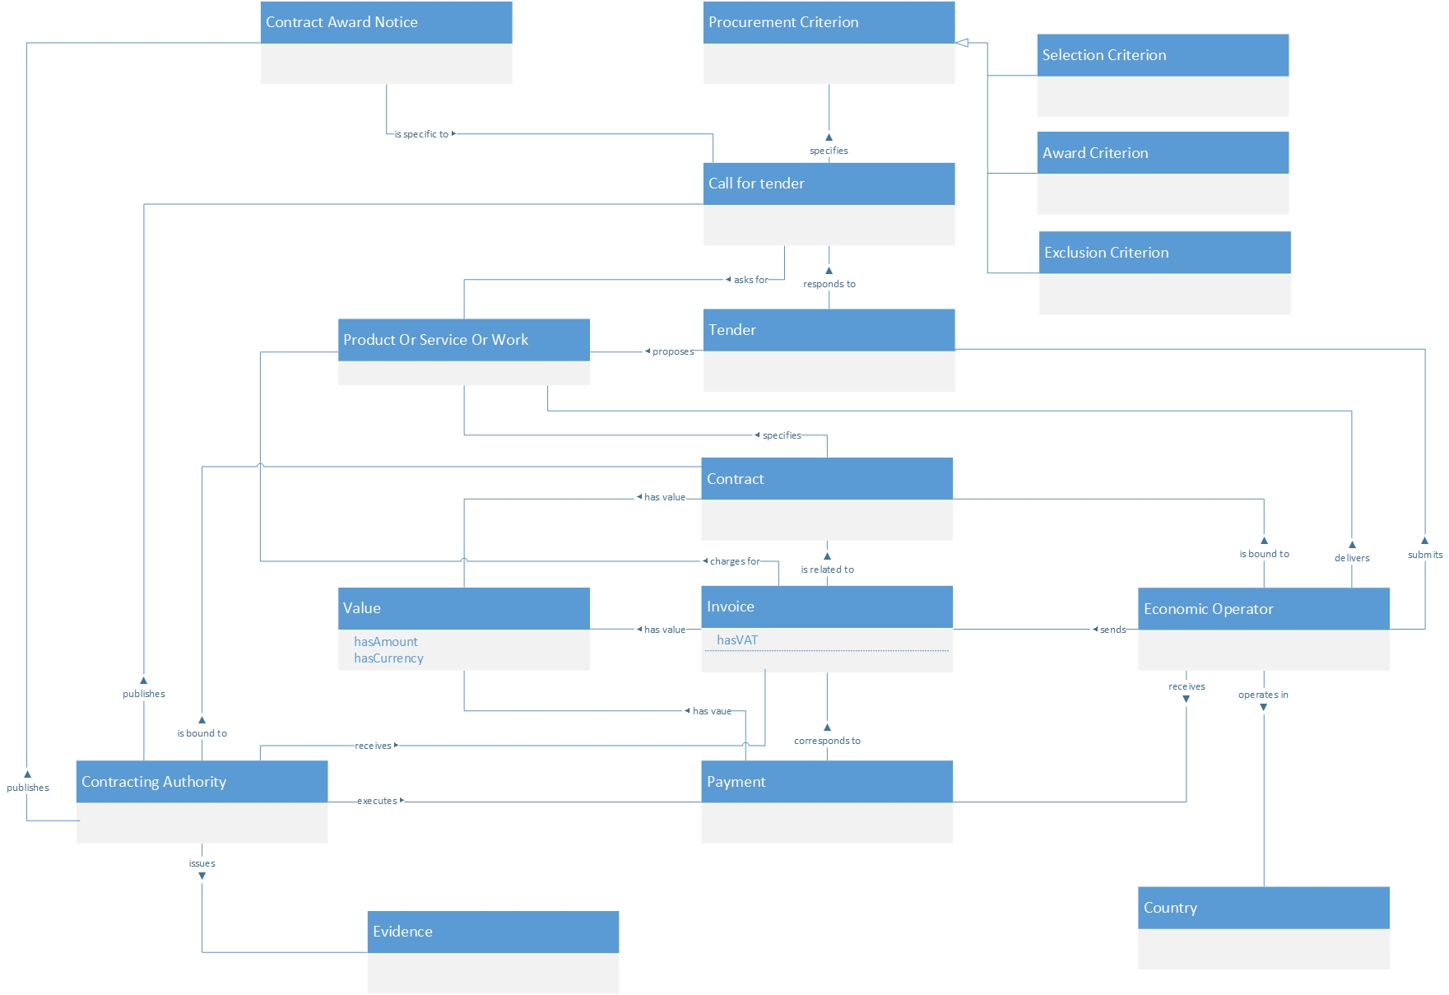

Slide 17
Modelling issues
Issues raised on the conceptual model:
Contracting Authority class https://github.com/eprocurementontology/eprocurementontology/issues/3
Is bound to – relationship https://github.com/eprocurementontology/eprocurementontology/issues/4
Responds to – relationship https://github.com/eprocurementontology/eprocurementontology/issues/5
Contracting Authority – Extend roles https://github.com/eprocurementontology/eprocurementontology/issues/6
Call For Tender - Distinction between Framework Agreement and Specific Contract https://github.com/eprocurementontology/eprocurementontology/issues/7
Open discussion

Slide 18
Questions
?

Slide 19
Additional use cases

Slide 20
New use cases
e-tendering process
Status: The suggested use case has been introduced in GitHub.
Link to GitHub: https://github.com/eprocurementontology/eprocurementontology/issues/8
Proposed resolution: to be discussed in the working group

Slide 21
New use cases
e-procurement procedures
Status: The use case has been described using the template with some level of detail.
Link to GitHub: https://github.com/eprocurementontology/eprocurementontology/issues/11
Proposed resolution: submitted description can be reviewed by the working group.

Slide 22
New use cases
Financial exclusion grounds
Status: Idea for a use case brought forward in an issue on GitHub.
Link to GitHub: https://github.com/eprocurementontology/eprocurementontology/issues/13
Proposed resolution: to be discussed in the working group

Slide 23
Use cases from the landscaping report
1.1. Public understandability
Description
Give access to procurement data in structured and machine-readable format for stakeholders who need to understand the public procurement process (e.g. parties involved, citizens, journalists, regulators etc.).
Example
Examples of information requirements
All documents from each phase of the procurement process
All metadata about elements of the procurement process
Is this use case relevant? Who is interested in developing it?
A watchdog is interested to understand how a public administration purchases goods and services. Their main goals are to understand the procedure and gain visibility of all the procedure steps. Procurement procedures often consist of complicated documents and processes, which are scattered on different platforms and websites, and are not always understood by the wide public. As all procurement data is now represented and made available using the e-procurement ontology, the watchdog can easily bring it together and combine it with data from different sources, thus providing them with the necessary context for understanding the available information.

Slide 24
Use cases from the landscaping report
1.3. Monitor the money flow
Description
In order to obtain an exhaustive and unified view of the flow of public money, from tax collection and budget over to procurement until spending, e-Procurement data should be integrated with other datasets such as budget, spending and location data.
Link to GitHub: https://github.com/eprocurementontology/eprocurementontology/issues/9
Example
Examples of information requirements
Data for economic operators, contract or exclusion criteria.
Is this use case relevant? Who is interested in developing it?
A procurement watchdog is analysing the flow of public money during an interval of two years. Using the e-procurement ontology as the common model for representing data, allows the watchdog to find their way through the different sources that have to be consulted, e.g. budget dataset, calls for tender and procurement notices, and to interlink the data in order to identify the trails. Examples of data could be: the contract value, the name and location of the warded tender etc.

Slide 25
Use cases from the landscaping report
1.4. Detect fraud and compliance with procurement criteria
Description
In order to improve and further automate the audit process, different data should be made available in structured, machine-readable formats so different data sources can be referenced and integrated. The creation of the e-procurement ontology will be a first step towards achieving such integration.
Example
Examples of information requirements
Evidences, contract, procurement criteria (e.g. location)
Is this use case relevant? Who is interested in developing it?
While auditing the evidences submitted by the tenderer who was awarded the contract, the auditor noticed that the supplier did not comply with the location criteria that were agreed during the signing of the contract. The payment evidence adduced, proved that besides the initial agreement, the supplier leased services outside the European Union to reduce the cost of the works. Publishing e-Procurement data in a structured, linked and machine-readable format, allows the interconnection of data on transactions, criteria, contracts and evidences from different sources.

Slide 26
Use cases from the landscaping report
1.5. Audit procurement process
Description
In order to monitor the correct use of funds it is necessary to cross-check data from different sources. In the case of public procurement, when the payment and invoice data is represented as linked data through the ePO, it is possible to link it with budget data. In this way one can check if the amounts resulting from the invoices do correspond to the initially budgeted amounts.
Example
Examples of information requirements
Payments, contract terms, or link the data of the e-procurement ontology with budget data
Is this use case relevant? Who is interested in developing it?
A governing body wants to make sure that no payment through public procurement on any specific category exceeds the decided upon amount. For this the government body can easily organise all the invoice data of all procurements by category, combine it with budget data and cross-check if the numbers add up correctly.

Slide 27
Use cases from the landscaping report
1.6. Cross-validate data from different parts of the procurement process
Description
Representing all phases of procurement in a linked data format can allow for better cross-validation of the data of any part of the process.
Example
Examples of information requirements
Contract awarded, the criteria of the contract, the details of the supplier.
Link the data of the e-procurement ontology to data in other databases such as databases containing financial data about businesses.
Is this use case relevant? Who is interested in developing it?
After a contract has been awarded to a specific tenderer a watchdog wants to check if the criteria for the awarding of the contract are surely met. By having all parts of the process linked, the watchdog can by identifying the specific contract immediately identify the tenderer and the criteria of the contract. Through linking this data with data about the tenderer from other sources, such as his financial data, he can double check if the tenderer does actually fulfil the requirements.

Slide 28
Use cases from the landscaping report
2.2. Automated validation of procurement criteria
Description
In order for a contracting authority to automatically validate whether the criteria are met by an economic operator, data, both from the contracting authority’s side as well as from the economic operator’s side, should be cross-checked. In order to automate this process, both the data and the evaluation criteria should be made available in machine-readable formats.
Example
Examples of information requirements
Tenders, notices or the relationship between offers and procurement criteria
Is this use case relevant? Who is interested in developing it?
An economic operator submits a tender to DG Informatics of the European Commission. The offer is written based on the criteria defined by the contracting authority in the tender specifications. Through the semi-automated validation of the tender, the economic operator is notified whether the tender meets the procurements in terms of evidences required that check against financial and other exclusion criteria. Otherwise the tenderer is provided with a list of evidences that are further required to fulfil said criteria, and only after their submission does the process move on to the manual evaluation of technical requirements. Such preliminary automation allows for gains in speed and efficiency.

Slide 29
Use cases from the landscaping report
2.3. Alerting services
Description
In order to automate alerting services, e-Procurement data such as tenders and information about economic operators should be machine-processable, so they can be integrated, matched, and the right data should be delivered to the right person (depending on their subscription to the alerting services).
Link to GitHub: https://github.com/eprocurementontology/eprocurementontology/issues/10
Example
Examples of information requirements
Calls for tenders and the details within it.
Is this use case relevant? Who is interested in developing it?
A Spanish public administration procures stationery and textbooks for the forthcoming year. The public administration publishes the call for tenders on an online platform. Since the call for tenders is published in a machine-readable format, following the structure of the ePO, third-party applications can process the call for tender and send alerts to interested parties who are subscribed in their client bases. Usually, such third party applications offer their clients the ability to define criteria for which they want to be automatically alerted.

Slide 30
Use cases from the landscaping report
2.4. Data analytics on public procurement data
Description
Businesses and public administrations often fail to efficiently manage data and extract useful and qualitative information from them. In the field of e-procurement, applying data analytics could be advantageous for economic operators, contacting authorities and external parties such as journalists and watchdogs. Applying data analysis techniques to e-procurement data allows stakeholders not only to better understand public procurement, but also to take better informed, evidence-based decisions.
Example
Examples of information requirements
Link the data of the e-procurement with data from other sources providing data on fees, pricing, cost of materials etc.
Is this use case relevant? Who is interested in developing it?
The European Commission aims to leverage its decision making capability during a call for tenders in telecommunications by analysing all the data available about the potential suppliers and forecast a fair market price. The European Commission aims at securing that the contract will be awarded to the supplier that provides the best services at the best price. In order for the European Commission to conduct its analysis, e-Procurement data should be integrated with a large amount of data coming from different sources, such as data about fees and pricing, qualifications, technical specifications and cost of materials.

Slide 31
Use cases from the landscaping report
3.2. Introduce automated classification systems in public procurement systems
Description
Improved and automated classification of documents received during the procurement procedure would facilitate and make more efficient their processing and archiving. The e-procurement ontology will set the grounds for common ways and rules for classifying such documents.
Example
Examples of information requirements
Product categories, evidences regarding tender offers.
Is this use case relevant? Who is interested in developing it?
A contracting authority procuring agricultural products is receiving different types of documents and evidences from potential suppliers via its electronic submission platform. When uploading documents, suppliers are asked to complete core metadata coming from the e-procurement ontology. For example, implementing the e-procurement ontology facilitates the provision of the specifications of their products, the financial state and the contact details of the suppliers in a commonly agreed and structured way. The platform of the procurer can then automatically classify all received documentation, using machine learning techniques, based on different dimensions such as the price of the tender or the compliance to criteria.

Slide 32
Questions
?

Slide 33
Actions and tasks

Slide 34
Summary of agreed actions – use cases
Title | Responsible
e-tendering process
e-procurement procedures
Financial exclusion grounds
Public understandability
Monitor the money flow
Detect fraud and compliance with procurement criteria
Audit procurement process
Cross-validate data from different parts of the procurement process
Automated validation of procurement criteria
Alerting services
Data analytics on public procurement data
Introduce automated classification systems in public procurement

Slide 35
Next steps

Slide 36
Further planning
Review of the use cases, properties, and information requirements
→ 10 May 2017 (Working Group)
Proposals for the use cases on GitHub
→ 15 May 2017 (Working Group)
New draft of methodology, charter and initial ontology taking into account comments received
→ 17 May 2017 (PwC)
Third Meeting of the Working Group
→ 23 May 2017 (to be decided)

Slide 37
Questions
?

Slide 38
e-procurement ontology
Join the e-Procurement Community
https://joinup.ec.europa.eu/asset/eprocurementontology
Contact us:
Natalie.Muric@publications.europa.eu
eprocurementontology@joinup.ec.europa.eu

