Slide 1


COLABORAR | SIMPLIFICAR | INOVAR
Portuguese
Interoperability and eID Platforms
Technological and Reusability aspects
Paulo Lobo paulo.lobo@ama.pt
March 2017 | AGÊNCIA PARA A MODERNIZAÇÃO ADMINISTRATIVA
Notes:
Good Afternoon
Thank you all for your presence
I´m going to make a short passage through our journey in Electronic Government
When we started we soon realized we needed key enablers

Slide 2


Interoperability and eID Platforms
COLABORAR | SIMPLIFICAR | INOVAR
2
Fundamental Concepts
MARCH 2017 | AGÊNCIA PARA A MODERNIZAÇÃO ADMINISTRATIVA
Notes:
We had 2 fundamental concepts and challenges to address in both
In Interoperability we needed to:
Share and Rationalization of transversal e-services
Make available webservices that are supported in very different information systems
Assure that information is always up to date
Semantic normalization
Compliance with data protection legislation
In order to deliver public services we needed:
Electronic Identification with high security for the Citizen
So we built key enablers like an Interoperability platform and the Citizen Card.

Slide 3

Interoperability and eID Platforms
COLABORAR | SIMPLIFICAR | INOVAR
3
Interoperability strategy definition
Interoperability Platform in production with Citizen Card
2004
2007
2009
2011
2012
2014
2016
2017
2017
2017
2018
MARCH 2017 | AGÊNCIA PARA A MODERNIZAÇÃO ADMINISTRATIVA
Notes:
Starting with Interoperability our strategy was initiated a long time ago, back in 2004.
With de Citizen Card Project we develop the Interoperability Platform that allow message exchange between different Ministries like Justice, Social Security, Finance, Health and Social Security.

Slide 4
Interoperability and eID Platforms
COLABORAR | SIMPLIFICAR | INOVAR
4
Barriers/challenges to Interoperability
Silos within Public Administration
Personal Data Privacy Concerns
Legacy technology
Cultural Change
MARCH 2017 | AGÊNCIA PARA A MODERNIZAÇÃO ADMINISTRATIVA
Notes:
Our main barriers were:
… so Organizational Interoperability was a main focus
We where far from the no legacy principle stated in the new EIF
Cultural change is always a barrier to overcame in this technological process

Slide 5
















Interoperability and eID Platforms
COLABORAR | SIMPLIFICAR | INOVAR
5
Other Portals
and information
systems
Citizen Portal
Authentication
Identity Federation
Security
Users
Management
Transactions
engine
Services
Management
Process Workflow
Services Orchestration
e-Payment
Engine
Message
Engine
Public Body
Logging and
Auditing
Systems
Management
Directory
Services
Identity
Provider
Back-office
Security
Logging and
Auditing
Authentication
Services
Internal Systems
MARCH 2017 | AGÊNCIA PARA A MODERNIZAÇÃO ADMINISTRATIVA
Notes:
Our goal was to develop a central Platform to publish transversal electronic services focused on the need of Citizen and business.
One of the main focus was services reuse and catalogue availability.
So we pass from a point to point integration without shared services to a central Platform with high security and shared services.
Also this Platform doesn't store data but it get’s it in real time from the authentic sources of information

Slide 6
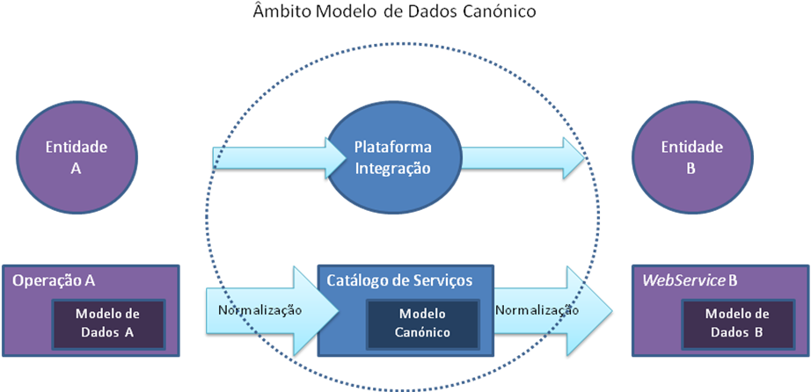
Interoperability and eID Platforms
COLABORAR | SIMPLIFICAR | INOVAR
6
Canonical data Model
MARCH 2017 | AGÊNCIA PARA A MODERNIZAÇÃO ADMINISTRATIVA
Notes:
We also implemented an informational architecture trough a canonical data model that allowed us to overcome legacy systems problem because we didn't had to change the systems data models

Slide 7
Interoperability and eID Platforms
COLABORAR | SIMPLIFICAR | INOVAR
7
Central Federation
I
d
Justice
e
n
t
i
d
a
d
ID Local
e
1
ID Local
I
1
F
NIC
d
ID Global
e
e
d
n
e
t
r
i
a
d
d
a
a
C
d
I
e
N
Finance
N
I
F
ID Local
2
ID Local
2
I
NIF
d
ID Global
e
n
t
i
d
a
N
d
S
e
N
S
Health
ID Local
3
ID Local
I
3
d
ID Global
NSNS
e
n
t
i
d
a
d
Cidadão
e
MARCH 2017 | AGÊNCIA PARA A MODERNIZAÇÃO ADMINISTRATIVA
Notes:
And an Identity Federation Mechanism to overcome data privacy concerns and to exchange information about the same citizen even with different sectorial identifications

Slide 8

Interoperability and eID Platforms
COLABORAR | SIMPLIFICAR | INOVAR
8
Address change from Citizen Card to public entities
Lower health fare
for fireman
Address change in Citizen Card
Energy Social Fare – 2 stage
E-Procurement Platforms
Medical certificate for drivers license
Other Simplex initiatives
Interoperability strategy definition
Orchestration Capability
Interoperability Platform in production with Citizen Card
Energy Social Fare – 1 stage
2004
2007
2009
2011
2012
2014
2016
2017
2017
2017
2018
MARCH 2017 | AGÊNCIA PARA A MODERNIZAÇÃO ADMINISTRATIVA
Notes:
Address change started the implementation of the once only principle.
This Platform is an excellent way to operationalize this principle that is already in our legislation.

Slide 9
Interoperability and eID Platforms
COLABORAR | SIMPLIFICAR | INOVAR
9
Extension to main land
Pilot for Citizen Card project - Azores
2007
2007
2008
2010
2015
2017
2018
MARCH 2017 | AGÊNCIA PARA A MODERNIZAÇÃO ADMINISTRATIVA

Slide 10
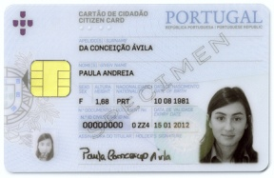
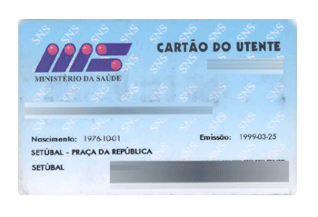
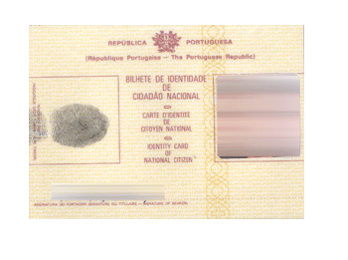

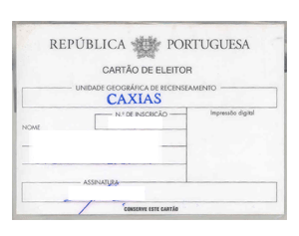
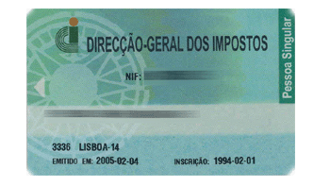
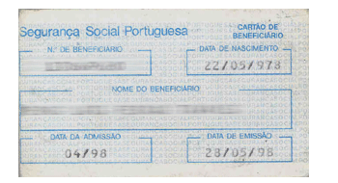
Interoperability and eID Platforms
COLABORAR | SIMPLIFICAR | INOVAR
10
It is a physical document that allows the visual identification of a citizen and it is also a digital document that allows the citizen to identify himself/herself to electronically sign documents or to authenticate in different Portals.
Has the legal validity of a manuscript signed document
It replaces 5 ID Cards:
National Identity Card
Tax Card
Social Security Card
Voters Card
Health Care Card
MARCH 2017 | AGÊNCIA PARA A MODERNIZAÇÃO ADMINISTRATIVA

Slide 11
Interoperability and eID Platforms
COLABORAR | SIMPLIFICAR | INOVAR
11
Extension to main land
Identity provider with Citizen Card
Pilot for Citizen Card project - Azores
2007
2007
2008
2010
2015
2017
2017
2017
2017
2018
MARCH 2017 | AGÊNCIA PARA A MODERNIZAÇÃO ADMINISTRATIVA
Notes:
We based the code and architecture on Stork pilot specifications making a excellent reuse of this early building block.

Slide 12
Interoperability and eID Platforms
COLABORAR | SIMPLIFICAR | INOVAR
12
MARCH 2017 | AGÊNCIA PARA A MODERNIZAÇÃO ADMINISTRATIVA
12

Slide 13
Interoperability and eID Platforms
COLABORAR | SIMPLIFICAR | INOVAR
13
Barriers to the adoption of the Identity Provider and digital signature
Citizens lost the pins
Citizens do not have a smart card reader
Few adherent Portals
Cultural Change
MARCH 2017 | AGÊNCIA PARA A MODERNIZAÇÃO ADMINISTRATIVA

Slide 14
Interoperability and eID Platforms
COLABORAR | SIMPLIFICAR | INOVAR
14
MARCH 2017 | AGÊNCIA PARA A MODERNIZAÇÃO ADMINISTRATIVA
Notes:
Mais de 50 entidades/Portais públicos a usar

Slide 15
Interoperability and eID Platforms
COLABORAR | SIMPLIFICAR | INOVAR
15
Extension to main land
Digital Mobile Key app
Digital Mobile Key
Identity provider with Citizen Card
Pilot for Citizen Card project - Azores
2007
2007
2008
2010
2015
2017
2017
2017
2017
2018
MARCH 2017 | AGÊNCIA PARA A MODERNIZAÇÃO ADMINISTRATIVA

Slide 16
Interoperability and eID Platforms
COLABORAR | SIMPLIFICAR | INOVAR
16
Complementary tool for electronic Identification
Much safer than username and password
2 factor authentication (“WHAT I KNOW” + “WHAT I HAVE”)
        Citizen PIN code + Safety token via SMS
        SIMPLE
        EFICIENT
        EFICACY
+
MARCH 2017 | AGÊNCIA PARA A MODERNIZAÇÃO ADMINISTRATIVA

Slide 17




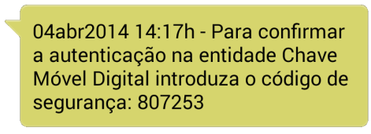
Interoperability and eID Platforms
COLABORAR | SIMPLIFICAR | INOVAR
17
Autenticação
Citizen Identification Support Systems
.
Gov
Web Portal
Attribute Supplier A
iAP
-
Interoperability
Internet
Platform
Attribute Supplier B
iAP
-
SMS Gateway
via
web browser
Authentication Circuit
(
)
SAML Protocol
Citizen
System Interaction
(with
mobile
)
User Interaction
MARCH 2017 | AGÊNCIA PARA A MODERNIZAÇÃO ADMINISTRATIVA

Slide 18
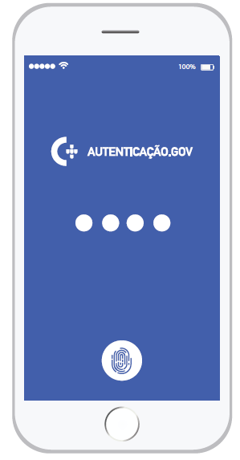
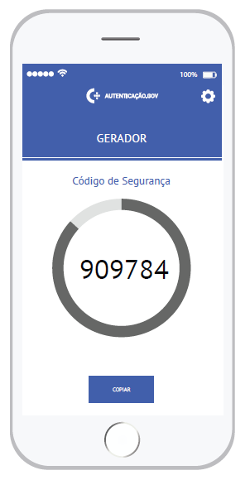
Interoperability and eID Platforms
COLABORAR | SIMPLIFICAR | INOVAR
18
Soon… Safety token in an App
MARCH 2017 | AGÊNCIA PARA A MODERNIZAÇÃO ADMINISTRATIVA

Slide 19
Interoperability and eID Platforms
COLABORAR | SIMPLIFICAR | INOVAR
19
Extension to main land
Digital Mobile Key app
Digital Mobile Key
Professional Certificates with Citizen Card
Identity provider with Citizen Card
Pilot for Citizen Card project - Azores
2007
2007
2008
2010
2015
2017
2017
2017
2017
2018
MARCH 2017 | AGÊNCIA PARA A MODERNIZAÇÃO ADMINISTRATIVA

Slide 20






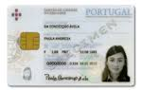




Interoperability and eID Platforms
COLABORAR | SIMPLIFICAR | INOVAR
20
User sends authenticated + attributes
website/ Services Provider System
User sends signed + attributes
Service (R/R, http)
Local SW with citizen info
Attributes (R/R)
Attributes Validity System
Access to SCAP
Attributes certification system
DB of certificate entity
MARCH 2017 | AGÊNCIA PARA A MODERNIZAÇÃO ADMINISTRATIVA
Notes:
This project allowed us to extend this authentication and signature functionality to embrace the Professional attributes but without making any change to the Citizen card.
The authentic sources of information are the ones that assure the professional quality of the Citizen.

Slide 21
Interoperability and eID Platforms
COLABORAR | SIMPLIFICAR | INOVAR
21
Digital signature with Digital Mobile Key
Extension to main land
Digital Mobile Key app
Digital Mobile Key
Professional Certificates with Citizen Card
eIDAS implementation
Identity provider with Citizen Card
Pilot for Citizen Card project - Azores
2007
2007
2008
2010
2015
2017
2017
2017
2017
2018
MARCH 2017 | AGÊNCIA PARA A MODERNIZAÇÃO ADMINISTRATIVA

Slide 22
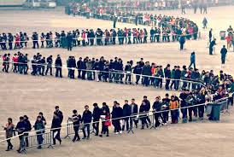

Interoperability and eID Platforms
COLABORAR | SIMPLIFICAR | INOVAR
22
MARCH 2017 | AGÊNCIA PARA A MODERNIZAÇÃO ADMINISTRATIVA

Slide 23
Interoperability and eID Platforms
COLABORAR | SIMPLIFICAR | INOVAR
23
PAULO LOBO paulo.lobo@ama.pt
March 2017 | AGÊNCIA PARA A MODERNIZAÇÃO ADMINISTRATIVA

