Slide 2
The Danish government and Local Government Denmark entered into an agreement on basic data in October 2012
Investments of approx. €85 million 2012-2020
Open access to public-sector basic data for everyone, including enterprises and individuals
A common single distribution solution: the Data Distributor
Initiatives for real property, address, geographic, personal and business data
The establishment of a cross-institutional basic-data committee
Notes:
The agreement includes:
In the area of real properties, registers will be improved so that information about real properties and buildings, as well as their owners, will be registered uniformly in the relevant authentic registers.
In the area of addresses, a coherent infrastructure will be set up and the data basis will be improved to ensure that data on addresses, place names and administrative units are made available to everyone efficiently.
In the area of utilities management, national common public-sector basic-data sets will be established for watercourses.
With regard to geodata, access to this data will be made open for all and the need for a more efficient and binding model for geodata maintenance will be discussed up to the finance agreement in 2014.
With regard to business data, the data basis in the Central Business Register will be improved and there will be open access to business and company data.
Common distribution of basic data will be established in a common public-sector infrastructure data distributor, which is to ensure more efficient and cheaper distribution of basic data.

Slide 3
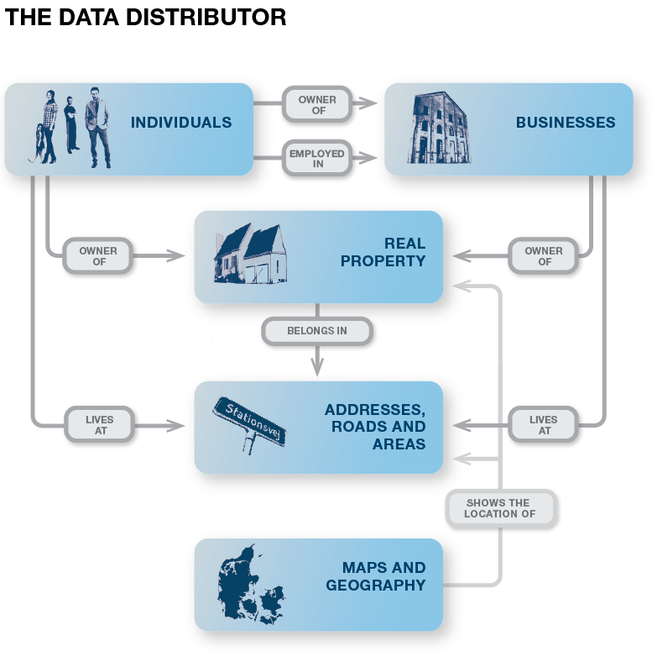
Basic data in brief

Slide 4
Common data model – The Basic Data model
Each register develops and maintains its own part
13 rules – that’s it
Hard governance
Format requirements (XMI, EA)

Slide 5
The real data model

Slide 7
Service types
Web Services (REST)
File downloads
Event messages
… plus a lot of geo-stuff

Slide 8
Service patterns
Simple lookups
REST or batch
XML or JSON
Subscription to changes
Event messages or delta files
Cross register services
Joining data from multiple sources
Geospatial searches
Based on administrative border or polygon

Slide 9
Access Management
3 ”modes” of access:
Anonymous
Known user
Individual permission
Access is managed by the responsible register
Username/password or eID

Slide 10
For more information
Please contact Lead Architect Adam Arndt
arndt@digst.dk
Tel. +45 2092 0894
Read more about
Basic data at: www.grunddata.dk/english
The data distributor at: www.datafordeler.dk (Danish only)
The data model at: http://data.gov.dk/model/ (Danish only)

