Slide 1
Norway - Approaches and challenges related to “Registry of Registries”
Jim J. Yang
informasjonsforvaltning@difi.no
Senior Adviser
2019-04-08, ABR-Webinar

Slide 2
Outline
The national data catalog
As a first step towards “once only”
Containing descriptions of all data sets (not only open data)
thus also as a Registry of Registries
Need to describe aspects currently not covered by DCAT-AP (incl. geo and stat)
DCAT-AP-NO, with Norwegian extensions
Planned to be revised during 2019
This presentation
Only overview (no details) of needs and solutions in DCAT-AP-NO
Some links to online recourses (in Norwegian only) included at the end

Slide 3
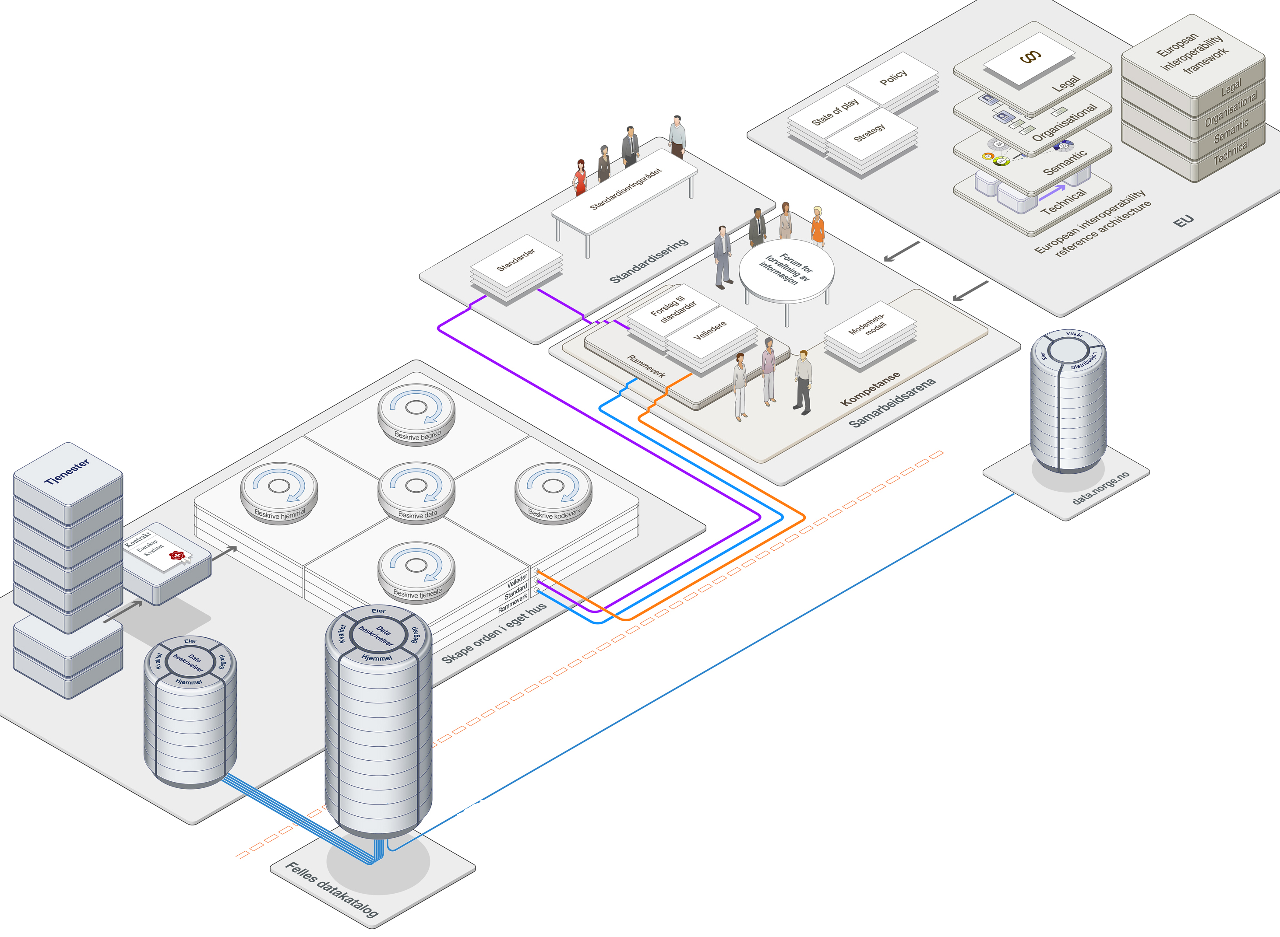
The national data catalog
Automatic harvesting
Standardized formats
National framework
for info. governance
All agencies
Data set descr.
The national data catalog

Slide 4
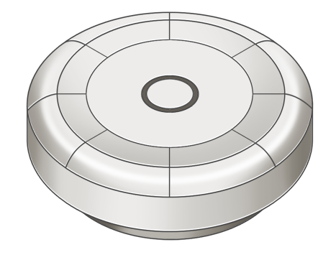
In order to evaluate
if a data set is reusable
Descriptions of
accuracy
completeness
consistency
…
Descriptions of
data elements
concepts
reference data
data models
…
Descriptions of
purpose of processing
legal basis for processing
legal basis for non-disclosure
legal basis for disclosure
…
quality
semantics
legal
data catalog
owner
APIs
DCAT-AP doesn’t cover all the aspects
➔DCAT-AP-NO
…
testdata
…

Slide 5
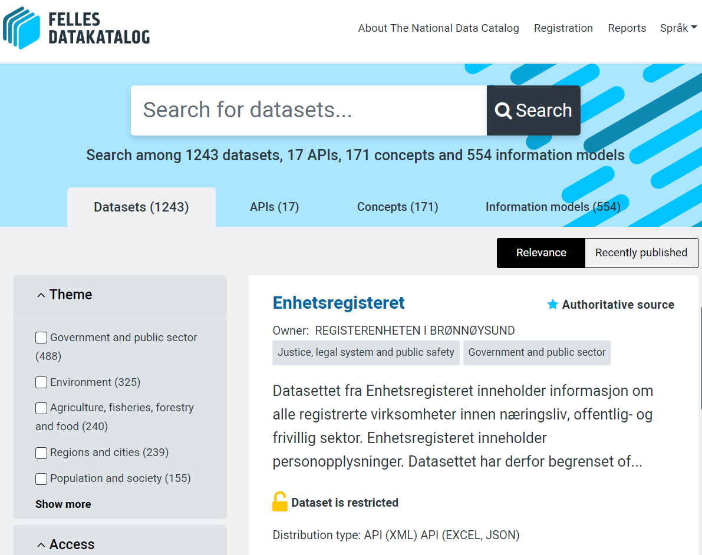
The national data catalog (running and under dev.)
https://fellesdatakatalog.brreg.no
Data sets
APIs
Concepts
Information models
…
Where applicable, linked together using URIs
Based on DCAT-AP-NO

Slide 6
To summarize
The national data catalog
https://fellesdatakatalog.brreg.no/about
As a first step towards “once only”
Containing descriptions of all data sets (not only open data)
Thus also as a Registry of Registries
Descriptions of Data sets, APIs, Concepts, Information models, …, linked together where applicable
Running and under further development
Need to describe aspects currently not covered by DCAT-AP (incl. geoDCAT-AP and statDCAT-AP)
DCAT-AP-NO, https://doc.difi.no/dcat-ap-no/
Planned to be revised during 2019
to align with DCAT-AP 1.2
to incorporate solutions for descriptions of quality, legal aspects, etc.

Slide 7
Some online recourses (in Norwegian only)
National framework for information governance: https://difi.no/informasjonsforvaltning
National data set catalog, currently with descriptions of data sets, concepts, APIs, info.models: https://fellesdatakatalog.brreg.no/about
Standards and specifications
Norwegian application profile of DCAT-AP, DCAT-AP-NO: https://doc.difi.no/dcat-ap-no/
Standards for (machine-readable) descriptions of concepts: https://difi.no/referansekatalogen/begrepsstandarder
Specification for descriptions of legal aspects of data sets: https://doc.difi.no/data/spesifikasjon-for-beskrivelse-av-formal-og-hjemmel/
Specification for descriptions of data set quality (based on DQV/W3C): https://doc.difi.no/data/kvalitet-pa-datasett/

Slide 8
informasjonsforvaltning@difi.no
https://difi.no/informasjonsforvaltning (in Norwegian only)
https://fellesdatakatalog.brreg.no/about

