Slide 1
Training Module 1.2
Introduction to Linked Data
PwC firms help organisations and individuals create the value they’re looking for. We’re a network of firms in 158 countries with close to 180,000 people who are committed to delivering quality in assurance, tax and advisory services. Tell us what matters to you and find out more by visiting us at www.pwc.com.
PwC refers to the PwC network and/or one or more of its member firms, each of which is a separate legal entity. Please see www.pwc.com/structure for further details.

Slide 2
This presentation has been created by PwC
Authors:
Michiel De Keyzer, Nikolaos Loutas, Christophe Colas and Stijn Goedertier
Presentation metadata
Disclaimers
The views expressed in this presentation are purely those of the authors and may not, in any circumstances, be interpreted as stating an official position of the European Commission.
The European Commission does not guarantee the accuracy of the information included in this presentation, nor does it accept any responsibility for any use thereof.
Reference herein to any specific products, specifications, process, or service by trade name, trademark, manufacturer, or otherwise, does not necessarily constitute or imply its endorsement, recommendation, or favouring by the European Commission.
All care has been taken by the author to ensure that s/he has obtained, where necessary, permission to use any parts of manuscripts including illustrations, maps, and graphs, on which intellectual property rights already exist from the titular holder(s) of such rights or from her/his or their legal representative.
This presentation has been carefully compiled by PwC, but no representation is made or warranty given (either express or implied) as to the completeness or accuracy of the information it contains. PwC is not liable for the information in this presentation or any decision or consequence based on the use of it.. PwC will not be liable for any damages arising from the use of the information contained in this presentation. The information contained in this presentation is of a general nature and is solely for guidance on matters of general interest. This presentation is not a substitute for professional advice on any particular matter. No reader should act on the basis of any matter contained in this publication without considering appropriate professional advice.
Open Data Support is funded by the European Commission under SMART 2012/0107 ‘Lot 2: Provision of services for the Publication, Access and Reuse of Open Public Data across the European Union, through existing open data portals’(Contract No. 30-CE-0530965/00-17).
© 2014 European Commission

Slide 3
Learning objectives
By the end of this training module you should have an understanding of:
What is linked data;
What is open data;
What is the difference between linked and open data;
How to publish linked data (5-star schema);
The economic and social aspects of linked data.

Slide 4
Content
This module contains ...
An introduction to the linked data principles;
An introduction to linked data technologies;
An outline of the 5-star scheme for publishing linked data;
  An example of how tabular data can be published as linked data using Open Refine;
The expected benefits of linked data for governments;
An overview of linked data initiatives in Europe.

Slide 5
What is linked data?
Evolution from a document-based Web to a Web of interlinked data.

Slide 6
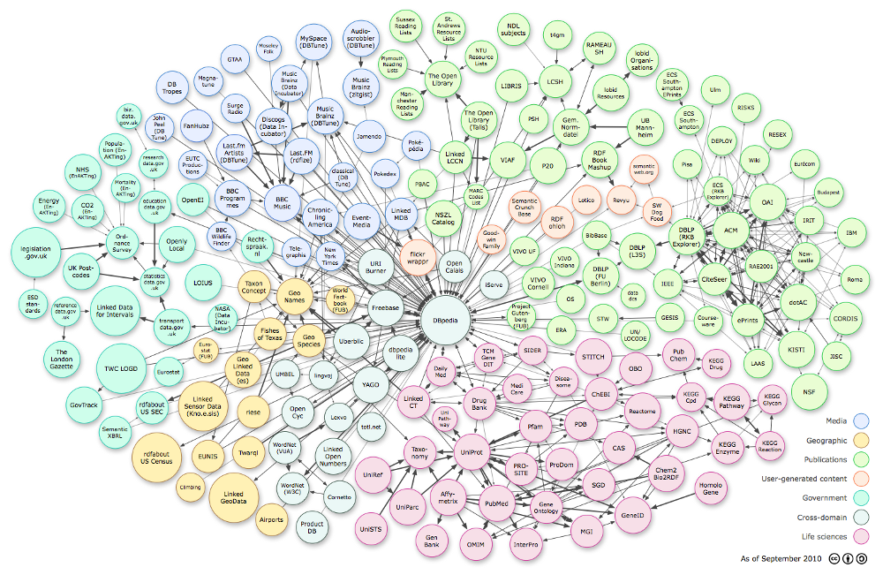
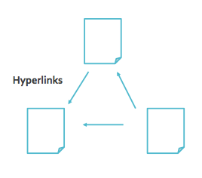
The Web is evolving from a “Web of linked documents” into a “Web of linked data”... (1/2)
Web of documents...
Web of linked data...

Slide 7
The Web is evolving from a “Web of linked documents” into a “Web of linked data”... (2/2)
  The Web started as a collection of documents published online – accessible at Web location identified by a URL.
  These documents often contain data about real-world resources which is mainly human-readable and cannot be understood by machines.
  The Web of Data is about enabling the access to this data, by making it available in machine-readable formats and connecting it using Uniform Resource Identifiers (URIs), thus enabling people and machines to collect the data, and put it together to do all kinds of things with it (permitted by the licence).
Machine-readable data (or metadata) is data in a format that can be interpreted by a computer.
2 types of machine-readable data:
  human-readable data that is marked up so that it can also be understood by computers, e.g. microformats, RDFa;
  data formats intended principally for computers, e.g. RDF, XML and JSON.
See also:
http://www.ted.com/talks/tim_berners_lee_on_the_next_web.html
http://linkeddatabook.com/editions/1.0/

Slide 8
Defining linked data...
“Linked data is a set of design principles for sharing machine-readable data on the Web for use by public administrations, business and citizens.”
EC ISA Case Study: How Linked Data is transforming eGovernment
The four design principles of Linked Data (by Tim Berners Lee):
Use Uniform Resource Identifiers (URIs) as names for things.
Use HTTP URIs so that people can look up those names.
When someone looks up a URI, provide useful information, using the standards (RDF*, SPARQL).
Include links to other URIs so that they can discover more things.
See also:
http://www.youtube.com/watch?v=4x_xzT5eF5Q
http://www.w3.org/DesignIssues/LinkedData.html http://www.youtube.com/watch?v=uju4wT9uBIA

Slide 9
Linked (open) government data – value proposition
  Flexible data integration: LOGD facilitates data integration and enables the interconnection of previously disparate government datasets.
  Increase in data quality: The increased (re)use of LOGD triggers a growing demand to improve data quality. Through crowd-sourcing and self-service mechanisms, errors are progressively corrected.
  New services: The availability of LOGD gives rise to new services offered by the public and/or private sector.
  Cost reduction: The reuse of LOGD in e-Government applications leads to considerable cost reductions.
See also:
ISA Study on Business Models for LOGD https://joinup.ec.europa.eu/community/semic/document/study-business-models-linked-open-government-data-bm4logd

Slide 10

The four principles in practice... (1)
Use Uniform Resource Identifiers (URIs) as names for things.
Use HTTP URIs so that people can look up those names.
  E.g. for an organisation: UNICEF
    http://publications.europa.eu/resource/authority/corporate-body/UNICEF

Slide 11
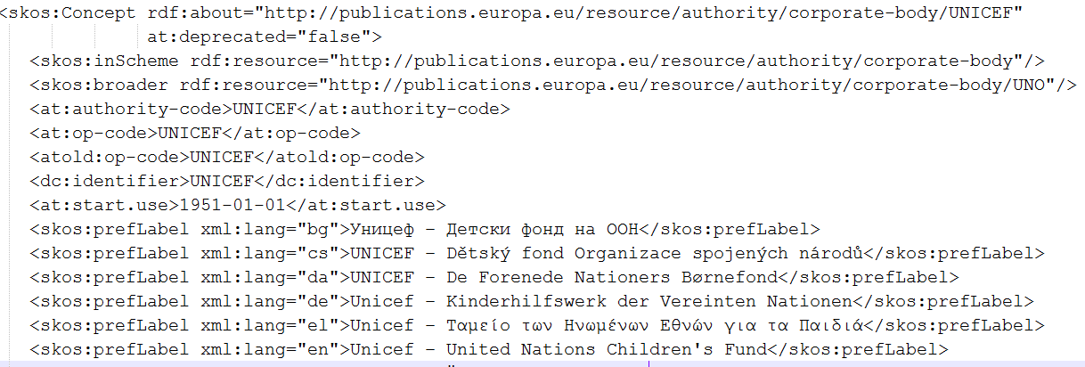
The four principles in practice... (2)
When someone looks up a URI, provide useful information, using the standards (RDF*, SPARQL).
Include links to other URIs so that they can discover more things.

Slide 12

Linked data vs. open data
“Open data is data that can be freely used, reused and redistributed by anyone – subject only, at most, to the requirement to attribute and sharealike.”
- OpenDefinition.org
Open data
Data can be published and be publicly available under an open licence without linking to other data sources.
Linked data
Data can be linked to URIs from other data sources, using open standards such as RDF without being publicly available under an open licence.
See also:
Cobden et al., A research agenda for Linked Closed Data
http://ceur-ws.org/Vol-782/CobdenEtAl_COLD2011.pdf

Slide 13
Linked data foundations
URIs for naming things, RDF for describing data and SPARQL for querying it.

Slide 14


Uniform Resource Identifier (URI)
“A Uniform Resource Identifier (URI) is a compact sequence of characters that identifies an abstract or physical resource.”
– ISA’s 10 Rules for Persistent URIs
  A country, e.g. Belgium
    http://publications.europa.eu/resource/authority/country/BEL
  An organisation, e.g. the Publications Office
    http://publications.europa.eu/resource/authority/corporate-body/PUBL
  A dataset, e.g. Countries Named Authority List
    http://publications.europa.eu/resource/authority/country/
BE
See also:
http://www.slideshare.net/OpenDataSupport/design-and-manage-persitent-uris

Slide 15
RDF & SPARQL
The Resource Description Framework (RDF ) is a syntax for representing data and resources in the Web
RDF breaks every piece of information down in triples:
Subject – a resource, which may be identified with a URI.
Predicate – a URI-identified reused specification of the relationship.
Object – a resource or literal to which the subject is related.
SPARQL is a standardised language for querying RDF data.
http://example.org/place/Brussels is the capital of “Belgium”.
OR
http://example.org/place/Brussels is the capital of http://example.org/place/Belgium.
Subject
Predicate
Object
See also:
http://www.slideshare.net/OpenDataSupport/introduction-to-rdf-sparql

Slide 16
How to publish linked data?
Paving the way towards 5-star linked data

Slide 17
5 star-schema of Linked (Open) Data
★ | Make your stuff available on the Web (whatever format) under an open license.
★★ | Make it available as structured data (e.g., Excel instead of image scan of a table)
★★★ | Use non-proprietary formats (e.g., CSV instead of Excel)
★★★★ | Use URIs to denote things, so that people can point at your stuff
★★★★★ | Link your data to other data to provide context
optional

Slide 18
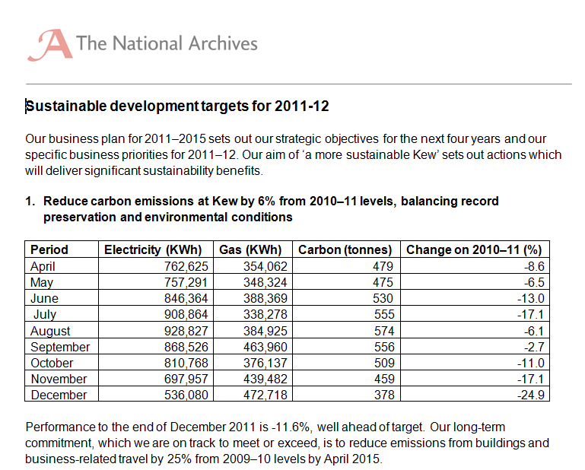

★ Make your stuff available on the Web under an open licence

Slide 19
Pros & cons of ★ open data
As a consumer... | As a publisher...
You can access the data. | It is simple to publish.
You can store it locally. | You do not have explain repeatedly to others that they can use your data.
You can enter the data into any other system.
You can change the data.
You can share the data with anyone.

Slide 20
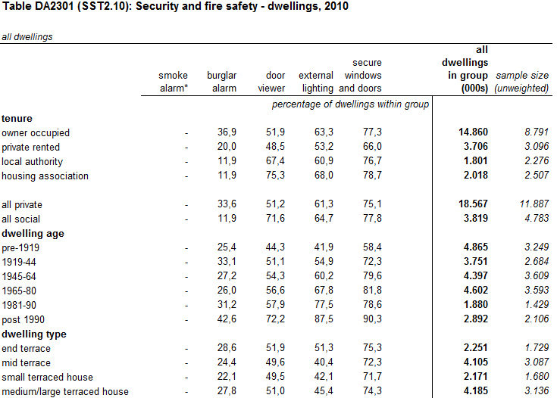

★ ★ Make it available as structured data

Slide 21
Pros & cons of ★ ★ open data
All the benefits of ★ open data; plus
As a consumer... | As a publisher...
You can directly process it with proprietary software to aggregate it, perform calculations, visualise it, etc. | It is still simple to publish.
You can export it into another (structured and/or non proprietary) format.

Slide 22
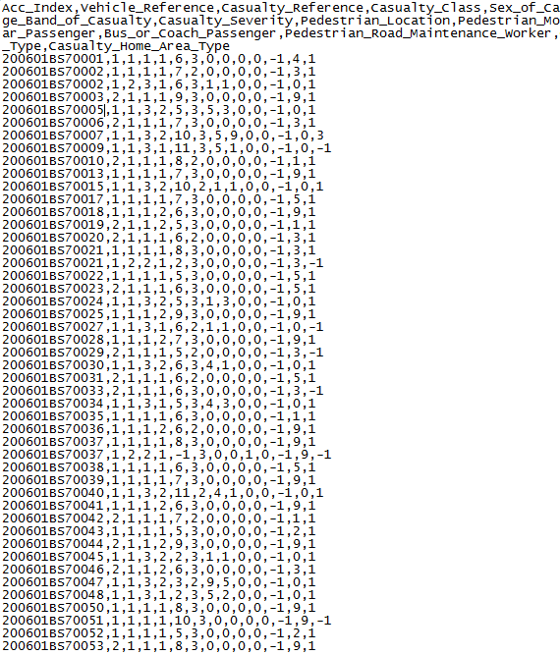

★ ★ ★ Use non-proprietary formats
Proprietary: Excel, Word, PDF...
Non-proprietary: XML, CSV, RDF, JSON, ODF...
Road safety- Accidents 2006:

Slide 23
Pros & cons of ★ ★ ★ open data
All the benefits of ★ ★ open data; plus
As a consumer... | As a publisher...
You can manipulate the data in any way you like, without being confined by the capabilities of any particular software. | It is still simple to publish.
 | - But, you may need converters or plug-ins to export the data from the proprietary format.

Slide 24
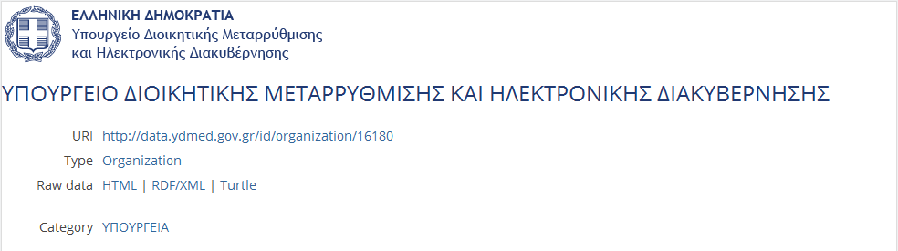
★ ★ ★ ★ Use URIs to denote things
For example, creating an URI for one of the units of the Greek Ministry of the Administrative Reform and e-Governance.
http://data.ydmed.gov.gr/doc/organization/16180
See also:
http://www.slideshare.net/OpenDataSupport/design-and-manage-persitent-uris

Slide 25
Pros & cons of ★ ★ ★ ★ open data
All the benefits of ★ ★ ★ open data; plus
As a consumer... | As a publisher...
You can link to it from any other place. | Other data publishers can now link into your data, promoting it to 5 star.
You can bookmark it. | You will be able to reuse vocabularies, data and metadata, and URI design patterns instead of creating them from scratch.
You can access information about a particular resource directly through its URI, without having to download the complete dataset.
You may be able to reuse existing tools and libraries. | - But you typically need to invest some time in identifying the resources and assigning URIs.
You can combine the data with other data. | - You need to invest in a stable policy, management and infrastructure for persistent URIs.
- But understanding the technology requires effort and can have a steep learning curve.

Slide 26
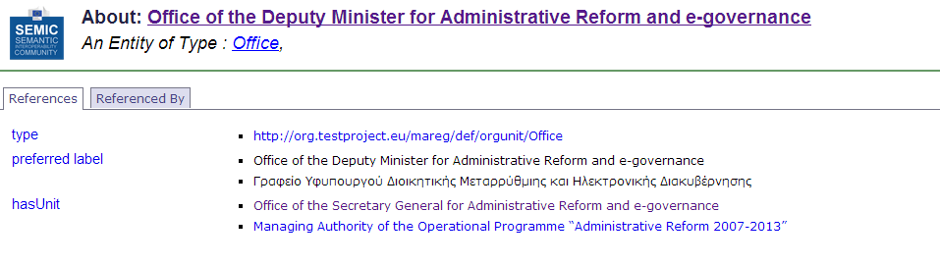
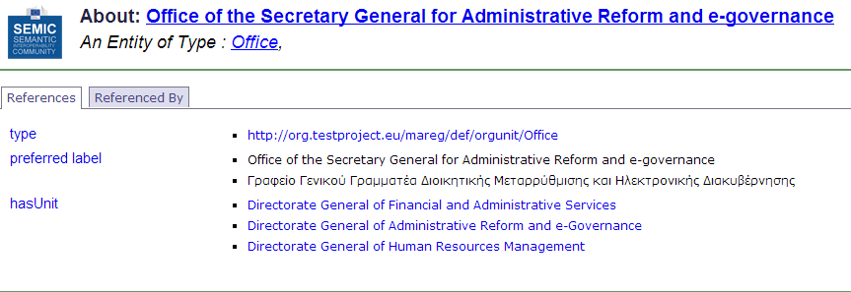
★ ★ ★ ★ ★ Link your data to other data to provide context

Slide 27
Pros & cons of ★ ★ ★ ★ ★ open data
All the benefits of ★ ★ ★ ★ open data; plus
As a consumer... | As a publisher...
You can discover more (related) data while consuming the data. | You make your data discoverable.
You can directly learn about the data schema. | You increase the context, expressivity, quality and value of your data (and consequently you give visibility to your organisation).
You can combine data from different source, be innovative, gain new knowledge, be an entrepreneur... | - This requires an investment in time, money, technology and competencies/ skills.
- But, you now have to deal with broken data links. Not all publishers/data sources will be reliable.

Slide 28
Prepare your data for publishing
The LOGD lifecycle

Slide 29
LOGD and metadata lifecycle focusing on supply and demand
Supply
Demand

Slide 30
Selection of high-value data
Several dimensions can be considered in the selection process of Linked Open Government Data, both from the publisher’s and the re-user’s point of view:
  Transparency: Does the publication of the dataset increase transparency and openness of the government towards its citizens?
  Legal requirements: Is there a law that makes open publication mandatory or is there no specific obligation?
  Relation to public task: Is the data the direct result of the primary public task of government or is it a product of a non-essential activity?
  Current status of open publication: Is the data already openly available or does it still need to be opened up?
  Type of value: Is the data useful for social engagement or does it have commercial value?
  Audience: Is the data primarily intended for the public or is it primarily aimed at back-office integration?
Notes:
UPDATE: added “both from the publisher’s and the re-user’s point of view” + added “Transparancy: Does the publication of the dataset increase transparency and openness of the government towards its citizens?”

Slide 31
Modelling your data & metadata is about ...
  Making your data available in a structured, comprehensible and machine-readable way.
  Reusing what already exists in terms of vocabularies and reference data.
Reaching the right quality level by cleansing your data.
  Providing licensing information so that data consumers know what the conditions of reuse are.
  Providing a rich description (metadata).
  Using semantic technologies (RDF, HTTP URIs...) for describing your data.

Slide 32
Cleansing your data & metadata
To ensure data and metadata can be published with an appropriate level of quality and minimum errors.
This means:
Fixing errors.
Transforming/homogenising formats.
Aligning inconsistencies in data and metadata.
Removing duplicate/redundant information.
Adding lacking information.
Making sure the information is up-to-date.
See also:
http://www.slideshare.net/OpenDataSupport/introduction-to-rdf-sparql
Cleanse your data with Open Refine (Google Refine) - https://code.google.com/p/google-refine/

Slide 33
Cleansing data - example
Duplicate
Formatting issue
error
Company_name | Registration date | Country | E-mail | # Establishments
Nikè | 1991-04-28 | Belgium | niké | 7
BARCO | 15 September 1986 | BE | Barco@email.be | 2
Nikè |  | België
Coca-Cola |  | United States | coca@cola.com | 3
Missing information
Redundant information
Cleansing operations
Inconsistent
information
Company_name | Registration date | Country | E-mail
Nikè | 1991-04-28 | BE | niké@sport.org
BARCO | 1986-09-05 | BE | Barco@email.be
Coca-Cola | 1964-03-26 | US | coca@cola.com

Slide 34
Publishing linked data is about ...
    Breaking down the walls of the silos in order to create more value.
  Making your data and metadata publically and easily accessible on the Web.
  Linking your data and metadata to other data (or metadata) in order to:
    Attach meaning and content to it.
    Give context to it.
    Enrich it.
    Allow people to discover more.

Slide 35
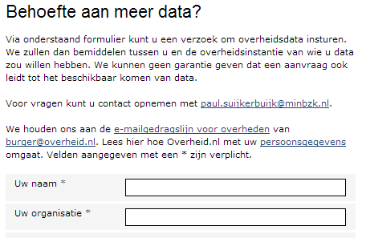
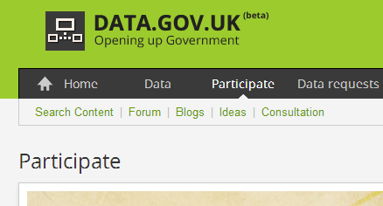
Collecting feedback from the reusers of your data
Ask feedback to the (potential) users of data:
Which data do they need.
How did they use the data.
  What did they think about the quality.
  Make sure that requests and fixes reach you – crowdsource data quality!
data.overheid.nl
data.gov.uk

Slide 36
Example
Using Open Refine for RDF to publish tabular data as Linked Data.

Slide 37

What is Open Refine RDF extension
Open Refine RDF extension, allows you to easily import data in different formats such as :
    CSV;
    Excel(.xls and .xlsx);
    JSON;
    XML; and
    RDF/XML.
And then determine the intended structure of an RDF dataset, by drawing a template graph.
See also:
LOD 2 Webinar – Open Refine http://www.youtube.com/watch?v=4Ve93C238gI

Slide 38
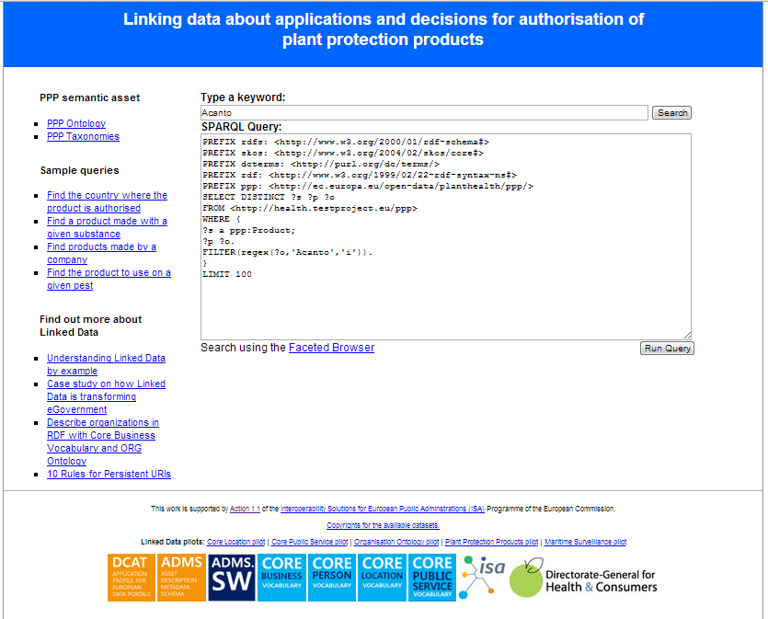
Case study: Linking data about plant protection products
We will show how a dataset of the Greek Ministry of Rural Development and Food was described using an ontology developed by DG Health and Consumers and was then published as Linked Data.
The dataset was in CSV format.
http://health.testproject.eu/PPP/
See also:
http://joinup.ec.europa.eu/asset/core_business/document/linking-data-about-applications-and-decisions-authorisation-ppp

Slide 39
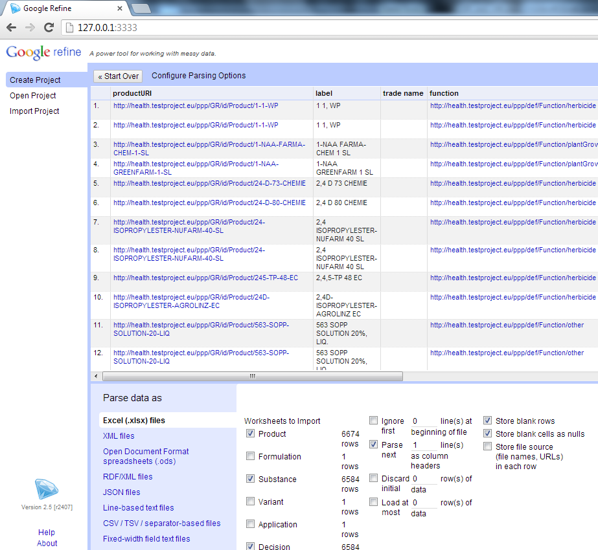
Creating the project in Open Refine
  Make sure that Open Refine and the RDF extension are installed on your machine.
  Launch Open Refine.
  Upload the spreadsheet and selected the sheets that you want.
  Confirm the creation of the project.

Slide 40
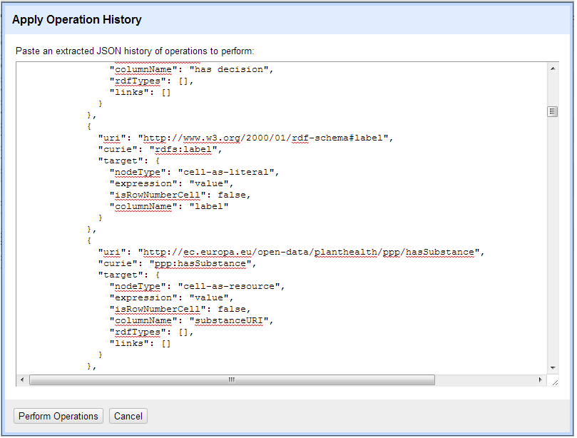
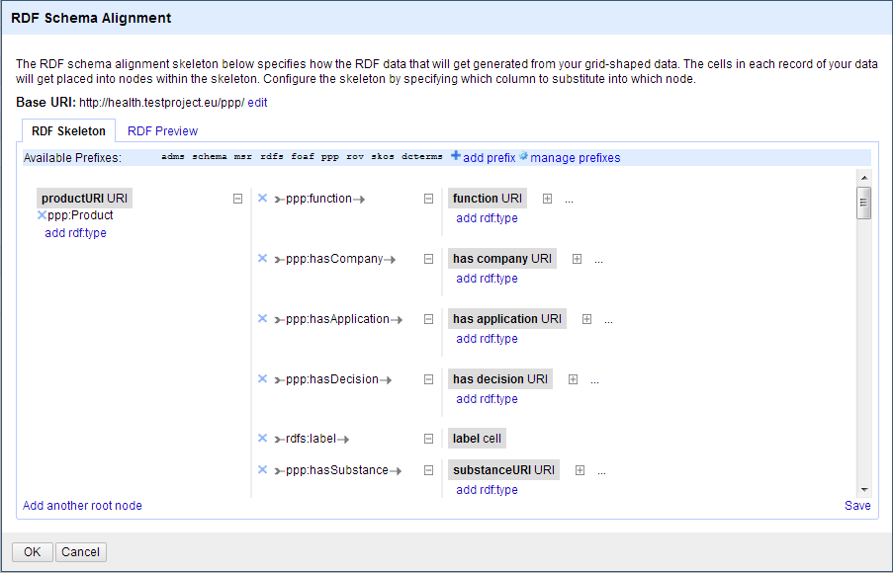
Mapping the raw data to the ontology
You can map the data to the ontology using a simple graphical interface to create or edit an existing RDF skeleton.
You can set the base URI for the data.
Graphical interface to edit an RDF skeleton
Graphical interface to copy/paste an existing RDF skeleton

Slide 41
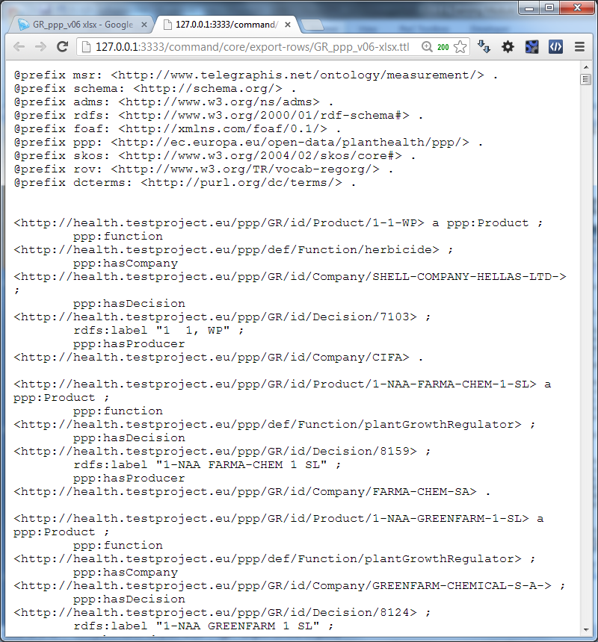
Exporting the data in RDF – Linked Data
You can now export your data in:
RDF/XML; or
Turtle
Export of the data in Turtle

Slide 42
LOGD enablers & roadblocks
From the study on Business Models for LOGD of the ISA Programme of the European Commission.

Slide 43
LOGD enablers
Efficiency gains in data integration – the network effect.
Forward-looking strategies.
Increased linking and integrated services.
Ease of model updates.
Ease of navigation.
Open licensing and free access.
Enthusiasm from ‘champions’.
Emerging best practice guidance.
See also:
ISA Study on Business Models for LOGD https://joinup.ec.europa.eu/community/semic/document/study-business-models-linked-open-government-data-bm4logd

Slide 44
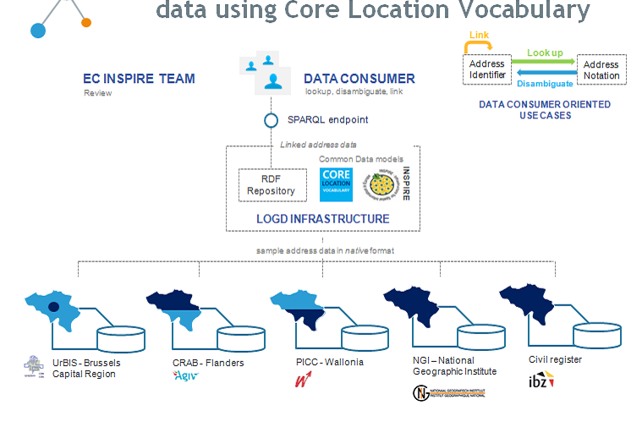
Linked data can help you publish structured data and integrate data from different sources
Building a common view on address data in Belgium
See also:
https://joinup.ec.europa.eu/asset/core_location/document/core-location-pilot-interconnecting-belgian-address-data
http://location.testproject.eu

Slide 45
LOGD roadblocks
Necessary investments.
Lack of necessary competencies.
Perceived lack of tools.
Lack of service level guarantees.
Missing, restrictive, or incompatible licences.
Surfeit of standard vocabularies.
The inertia of the status quo – change is accomplished slowly.
See also:
ISA Study on Business Models for LOGD https://joinup.ec.europa.eu/community/semic/document/study-business-models-linked-open-government-data-bm4logd

Slide 46
Linked data initiatives in Europe
Some examples on supra-national, national, regional and private initiatives in the area of linked (open) data across Europe.

Slide 47
Member State initiatives – some examples
DE – Bibliotheksverbund Bayern
Linked data from 180 academic libraries in Bavaria, Berlin and Brandenburg.
IT – Agenzia per l’Italia digitiale
Three datasets published as linked data: the Index of Public Administration, the SPC contracts for web services and conduction systems and the Classifications for the data in Public Administration.
NL – Building and address register
The Dutch Address and Buildings base register published as linked data.
UK – Ordnance Survey
Three OS Open Data products published as linked data: the 1:50 000 Scale Gazetteer, Code-Point Open and the administrative geography taken from Boundary Line.
UK – Companies House
Publishing basic company details as linked data using a simple URI for each company in their database.
See also:
ISA Study on Business Models for LOGD https://joinup.ec.europa.eu/community/semic/document/study-business-models-linked-open-government-data-bm4logd

Slide 48
















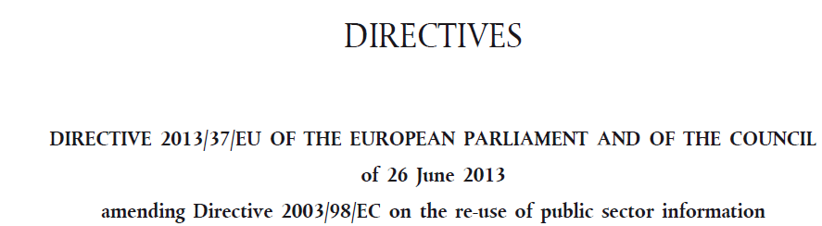
Linked Government Data & Metadata initiatives funded by the European Commission

Slide 49
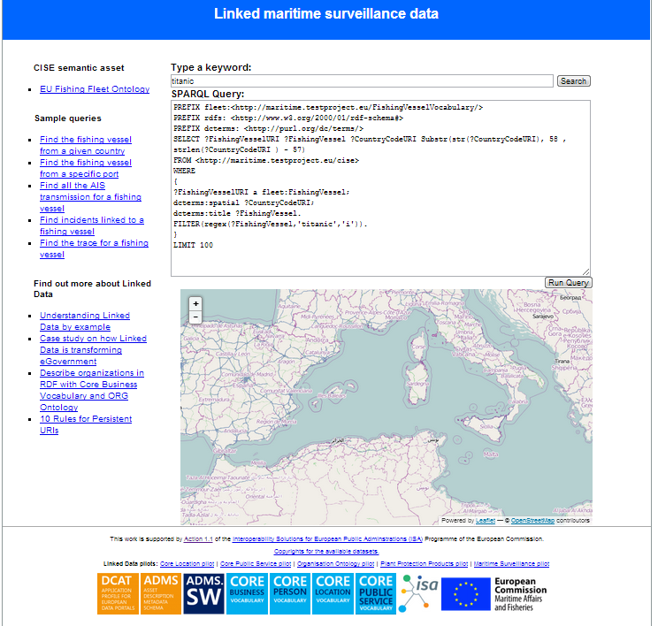
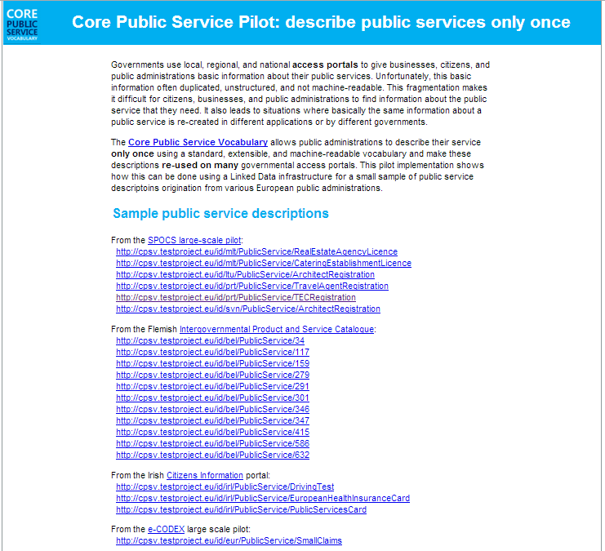
The Linked Government Data Pilots of ISA
http://health.testproject.eu/PPP/
http://maritime.testproject.eu/CISE/
http://cpsv.testproject.eu/CPSV/

Slide 50
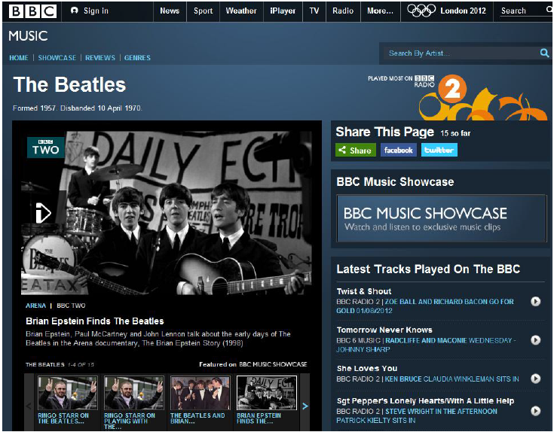
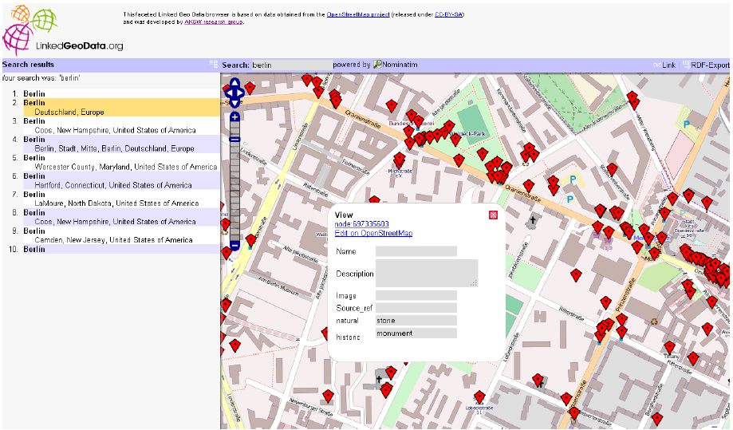
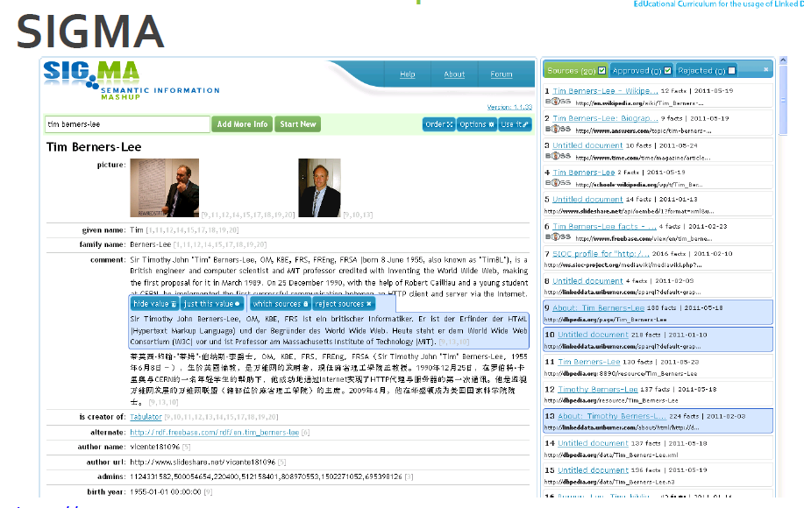
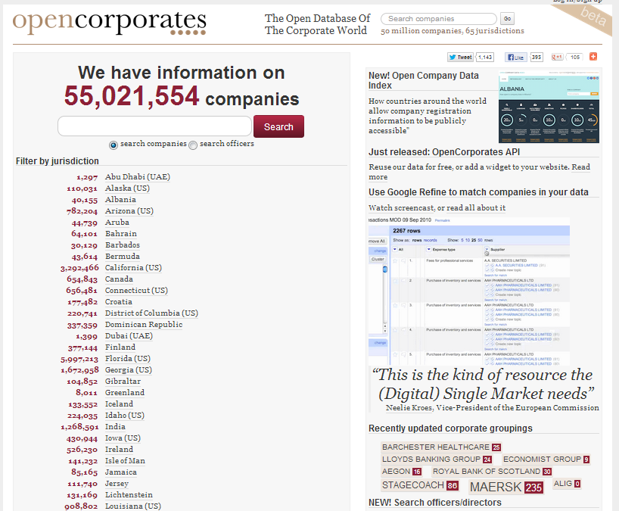
Non-governmental applications

Slide 51
Conclusions
  Linked data is a set of design principles for sharing machine-readable data on the Web.
Linked data and open data are not the same.
URIs, RDF and SPARQL form the foundational layer for Linked data.
Linked data offers a number of advantages for:
    Data integration with small impact on legacy systems;
    Enables for semantic interoperability;
    Enables creativity and innovation through context and knowledge-creation.

Slide 52

Group questions
  Is there supply and demand for (Linked) Open Government Data in your country?
  What are, in your opinion, the expected benefits and pitfalls of Linked Data?
  Are there any Linked (Open) Data initiatives in your country? If so, how many stars would you give them?
http://www.visualpharm.com
http://www.visualpharm.com
http://www.visualpharm.com
Take also the online test here!

Slide 53
Thank you!
...and now YOUR questions?

Slide 54
References
Slide 6:
  EUCLID. Course 1: Introduction and Application Scenarios. http://www.euclid-project.eu/modules/course1
  Linking Open Data cloud diagram, by Richard Cyganiak and Anja Jentzsch. http://lod-cloud.net/
Slides 8:, 13, 36, 38:
  ISA Programme. Case study on how Linked Data is transforming eGovernment. https://joinup.ec.europa.eu/community/semic/document/case-study-how-linked-data-transforming-egovernment
  Tim Berners-Lee. Linked Data. http://www.w3.org/DesignIssues/LinkedData.html
Slide 9:,
ISA Programme Study on Business Models for LOGD
  https://joinup.ec.europa.eu/community/semic/document/study-business-models-linked-open-government-data-bm4logd
Slide 12:
  The Open Knowledge Foundation. Open Data – An Introduction. http://okfn.org/opendata/
Slides 18-28:
5 ★ Open Data. http://5stardata.info/
Slide 19:
  UK National Archives, Sustainable development targets 2011-12.
Slide 21:
Data.gov.uk. Housing stock. http://data.gov.uk/dataset/uk-housing-stock
Slide 23:
  Data.gov.uk. Road Safety Data. http://data.gov.uk/dataset/road-accidents-safety-data
Slide 25 & 27:
  ISA Organization Ontology pilot - Linking public sector's organisational data, https://joinup.ec.europa.eu/asset/core_business/document/organization-ontology-pilot-linking-public-sectors-organisational-data
  http://data.ydmed.gov.gr/
Slide 37:
  ISA Programme. Core Location Pilot - Interconnecting Belgian Address Data. https://joinup.ec.europa.eu/asset/core_location/document/core-location-pilot-interconnecting-belgian-address-data
Slides 30-34:
Open Refine: https://github.com/OpenRefine
RDF Extension: http://refine.deri.ie/
  ISA Programme, Linking data about applications and decisions for authorisation of PPP, http://joinup.ec.europa.eu/asset/core_business/document/linking-data-about-applications-and-decisions-authorisation-ppp
Slide 40
Bibliotheksverbund Bayern, http://lod.b3kat.de/doc
Agenzia per l’Italia Digitale, http://spcdata.digitpa.gov.it/data.html
NL – Building and address register, http://lod.Geodan.nl
UK Ordnance Survey, http://data.ordnancesurvey.co.uk/
UK Companies House, http://companieshouse.gov.uk/

Slide 55



Further reading
Linked Open Data: The Essentials. Florian Bauer, Martin Kaltenböck.
http://www.semantic-web.at/LOD-TheEssentials.pdf
Linked Data: Evolving the Web into a Global Data Space. Tom Heath and Christian Bizer.
http://linkeddatabook.com/editions/1.0/
Linked Open Government Data. Li Ding Qualcomm, Vassilios Peristeras and Michael Hausenblas.
http://ieeexplore.ieee.org/stamp/stamp.jsp?tp=&arnumber=6237454
EUCLID - Course 1: Introduction and Application Scenarios
http://www.euclid-project.eu/modules/course1

Slide 56






Related projects and initiatives
LOD2 FP7 project, http://lod2.eu/
The Open Knowledge Foundation, http://okfn.org/
  W3C Semantic Web, http://www.w3.org/standards/semanticweb/
  EUCLID, http://projecteuclid.org/
  ISA Programme, http://ec.europa.eu/isa/
  W3C LOGD WG, http://www.w3.org/2011/gld/wiki/Main_Page
  LOD Around The Clock FP7 project, http://latc-project.eu/
  Data.gov.uk, http://data.gov.uk/linked-data

Slide 57





Be part of our team...
Find us on
Join us on
Open Data Support
http://www.slideshare.net/OpenDataSupport
Open Data Support
http://goo.gl/y9ZZI
http://www.opendatasupport.eu
Follow us
Contact us
@OpenDataSupport
    contact@opendatasupport.eu

