Slide 1
Webinar ABR - Specification of Registry of Registries Brussels, 8 April 2019 EUROPEAN COMMISSION Directorate - General Informatics Directorate D – Digital Services DIGIT D2 – Interoperability Unit Specific Contract n° 157 under ABC IV – Lot 3 Framework Contract
Access to Base Registries ISA² action 2016.28
Project Officer:
Peter Burian

Slide 2
Disclaimer
The information and views set out in this publication are those of the author(s) and do not necessarily reflect the official opinion of the European Commission. The European Commission does not guarantee the accuracy of the data included in this document. Neither the European Commission nor any person acting on the European Commission’s behalf may be held responsible for the use which may be made of the information contained therein.
This publication is used to support a webinar that will be recorded and made available to the participants.
© European Union, 2019

Slide 3
Agenda
Welcome note
ISA² Action 2016.28 'Access to Base Registries'
Presentations on Best Practices and Challenges
Specification of Registry of Registries:
Base Registries DCAT-AP
Data Model and Vocabulary (early editor’s draft)
ABR Working Group
5. Q&A

Slide 4
Welcome Note
Project Team
Project
Scope & Approach
Project Context
Client’ Expectations
Short-term Actions
Assumptions

Slide 5
ISA² Action 2016.28
ISA² Action 2016.28 ‘Access to Base Registries’ (ABR)
ABR Purpose:
Ensure interconnection and access to the information in different types of base registries of Member States (MS) in order to be able to deliver cross-border and cross sector public services.
ABR Outcomes:
The semantic specifications facilitating further creation of EU Registry of Registries;
The Framework as a guidance on how to grant access to the data in Base Registries and how to interconnect them;
The exchange of Best Practices that is of great interest of many Member States
ABR Scope:
Finalization of a framework for Base Registry Access and Interconnection;
Maintenance of ABR Collection on Joinup;
Elaboration of Specification of Registry of Registries
The valuable impact of this work will be an easier exchange of information cross-sector and cross-border, and the eventual set-up of cross-border European public services

Slide 6
Presentations on
Best practices and challenges

Slide 7
Presentations on Best Practices
and Challenges
Norway – ‘Approaches and challenges related to “Registry of Registries”’
Denmark – ‘Good basic data for everyone – a driver for growth and efficiency’
Malta – ‘The National Data Portal (Register of Registers)’

Slide 8
Base registries DCAT-AP
Specification of
Registry of Registries.

Slide 9
DCAT & DCAT-AP
Base Registries DCAT-AP
The DCAT Application Profile for Data Portals in Europe (DCAT-AP) is a specification based on the W3C Data Catalogue Vocabulary (DCAT).
DCAT-AP provides a common specification for describing public sector datasets in Europe to enable the exchange of descriptions of datasets among data portals.
There are two existing DCAT-AP extensions:
GeoDCAT-AP for describing geospatial datasets, data series and services;
StatDCAT-AP for describing statistical datasets within the statistical domain.
DCAT-AP and its extensions were created and are maintained in an open process with dedicated Working Groups and public review.

Slide 10
BRegDCAT-AP
Base Registries DCAT-AP
The DCAT Application profile for base registries in Europe (BRegDCAT-AP) is an extension of DCAT-AP for describing base registries, and the base information they contain, as well as the services they provide.
This specification is based on the Data Catalogue vocabulary (DCAT) Application profile for describing public sector datasets in Europe.
It is based on a use case to enable cross-border interoperability between base registries, defining a semantic model to describe base registries and their contents.
The work will be aligned with the new version of W3C DCAT (DCAT 2), and with DCAT-AP.
This DCAT Application profile for base registries will contribute to develop an European Registry of Base Registries.

Slide 11
Why is this DCAT application profile needed?
Base Registries DCAT-AP
One of the long-term goals of a European Registry of Base Registries (ERBR) is to provide a full interconnection of base registries at the European level.
The BRegDCAT-AP will contribute to describe base registries and their contents, aiming at:
Facilitating data discovery;
Reducing redundancy and supporting the Once-Only principle;
Facilitating exchange of data;
Improving transparency;
Reducing cultural / language barriers in the exchange of data;
Enabling a mechanism for subsequent update of base registries and content.

Slide 12
Cornerstone of Interoperability
Base Registries DCAT-AP
BRegDCAT-AP will define an abstract model, a vocabulary and taxonomies to describe BRs and deliver reusable metadata (e.g. by an API)
“In a long run, the ERBR should allow searching for base registries and the items contained in them either through a GUI or an API.”
Vision Document for European Registry of Registries

Slide 13
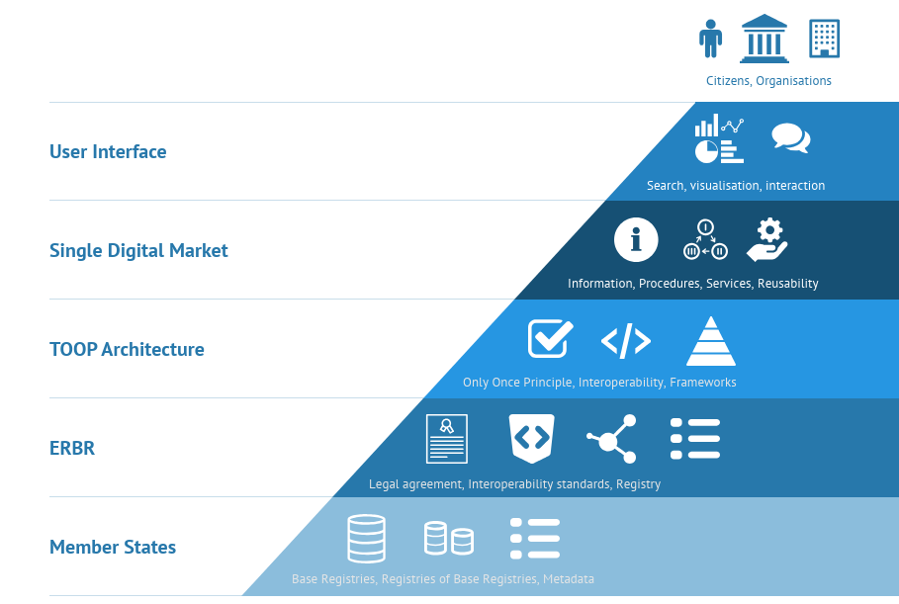
European Registry of Base Registries
Base Registries DCAT-AP
Need for Legal, Technical, Organizational Standards

Slide 14
INSPIRE and EDP as reference
Base Registries DCAT-AP
An important step to achieve an ERBR is to exchange a homogeneous descriptive information about registries and their content. For this, we need standards such as DCAT, cornerstone of the European Data Portal — a reference in terms of metadata interoperability — that allows it to collect and aggregate information from all Member States automatically.
INSPIRE Register of Registers is based also in DCAT (GeoDCAT-AP).
Since DCAT is a generic vocabulary to represent Data catalogues, the BRegDCAT Application profile would have additional descriptive elements that fit the reality of Base Registries in Europe (and in the rest of the World).

Slide 15
Semantic interoperability challenge
Base Registries DCAT-AP
The work will be based on ISA² Core Vocabularies.
Although it might be expected to have multiple languages describing Base Registries, WG will recommend the use of specific multilingual taxonomies, and the EuroVoc thesaurus for the work of the BRegDCAT Application profile.
The work will be based on the Publications Office recommendations, relying on Named Authority Lists (value lists): Access right, Administrative territorial unit, Country, Data theme, Dataset types, Language, Organization type, Target audience, etc.

Slide 16
Data Model and vocabulary (early editor’s draft)
Specification of
Registry of Registries.

Slide 17
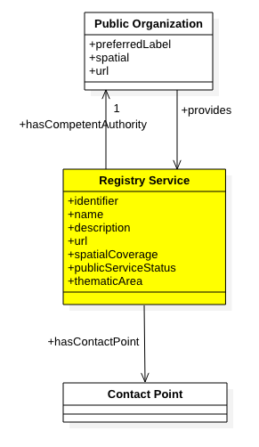
Base Registry (Service)
Data Model and Vocabulary
cpsv:PublicService
cv:PublicOrganization

Slide 18
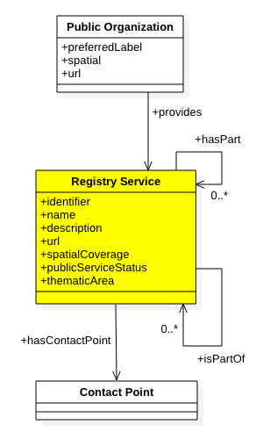
Registry of Base Registries (Service)
Data Model and Vocabulary
cpsv:PublicService
hasPart/isPartOf

Slide 19
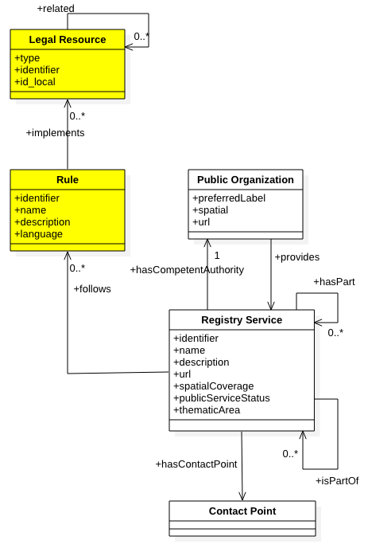
Legislation
Data Model and Vocabulary
cpsv:Rule
eli:LegalResource

Slide 20
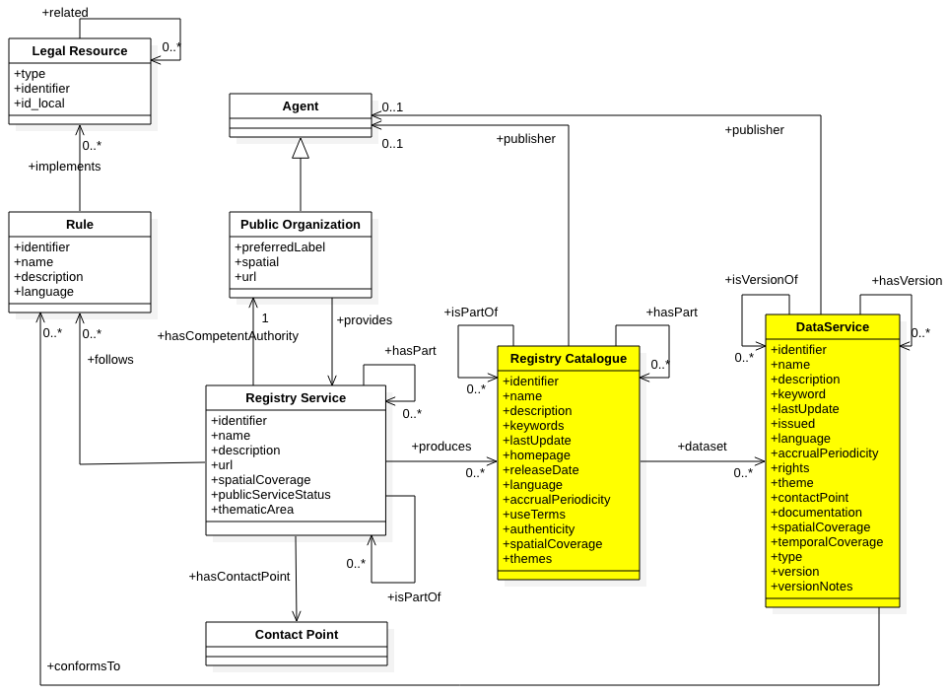
Registry Data
Data Model and Vocabulary
dcat:Catalogue
dcat:Resource
dcat:Dataset
dcat:DataService

Slide 21
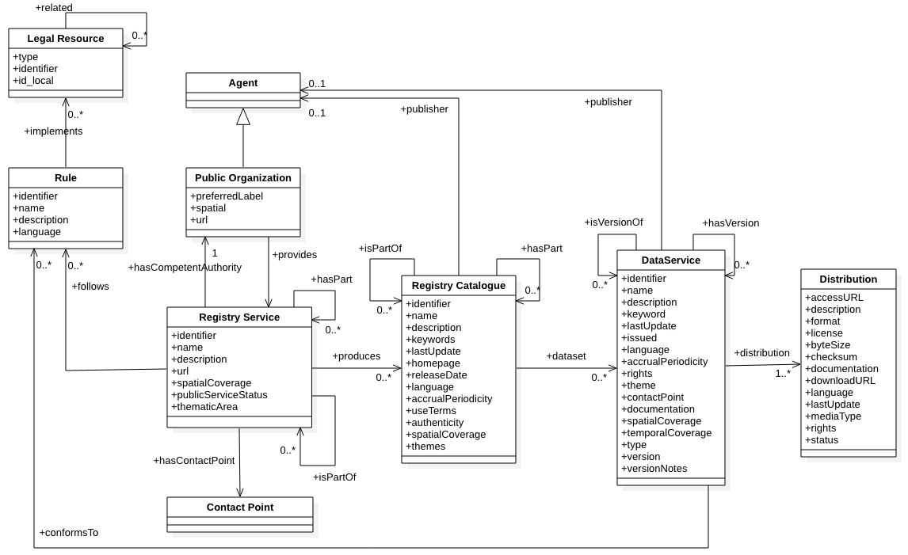
Data Model
Data Model and Vocabulary

Slide 22
Challenges to further discussion within the group
Data Model and Vocabulary
Statuses of a Registry?
Registry/Dataset Themes?
New Type of Dataset for Master Data in
https://publications.europa.eu/en/web/eu-vocabularies/at-concept-scheme/-/resource/authority/dataset-type/
Contact Points? In Registry Service, also in Datasets?
Data Access Rights: http://publications.europa.eu/resource/authority/access-right
Data Quality/Authenticity: https://www.w3.org/TR/vocab-dcat-2/#quality-information
Provenance: https://www.w3.org/TR/vocab-dcat-2/#examples-dataset-provenance
Other points

Slide 23
Abr working group
Specification of
Registry of Registries.

Slide 24
ABR Working Group Principles
ABR Working Group
Transparent
Open to everybody
Decisions based on consensus
Public outcomes on Joinup
Asynchronous work (to facilitate participation)
Collaborative
Attribution of Work
Based on current standards
Europe > Worldwide Application Profile

Slide 25
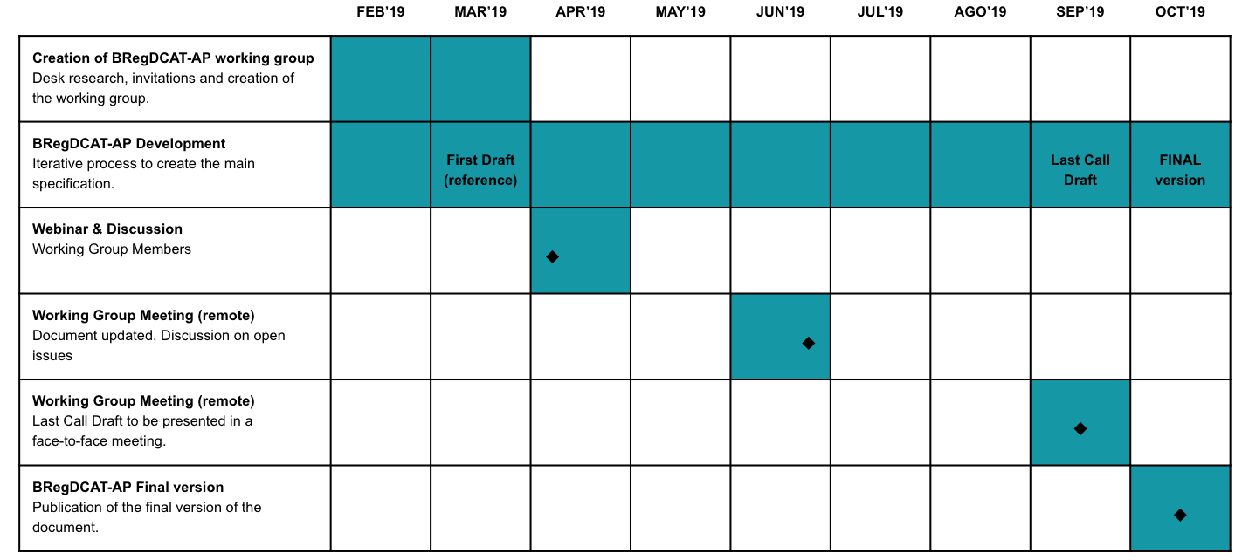
Base Registries DCAT-AP - Roadmap
ABR Working Group

Slide 26
Nominations of WG Members from ISA² Committee
ABR Working Group
Norway
Portugal
Slovakia
Slovenia
Spain
Sweden
Belgium
Croatia
Czech Republic
Estonia
Germany
Italy
Latvia
Lithuania
Luxembourg
Malta
Montenegro

Slide 27
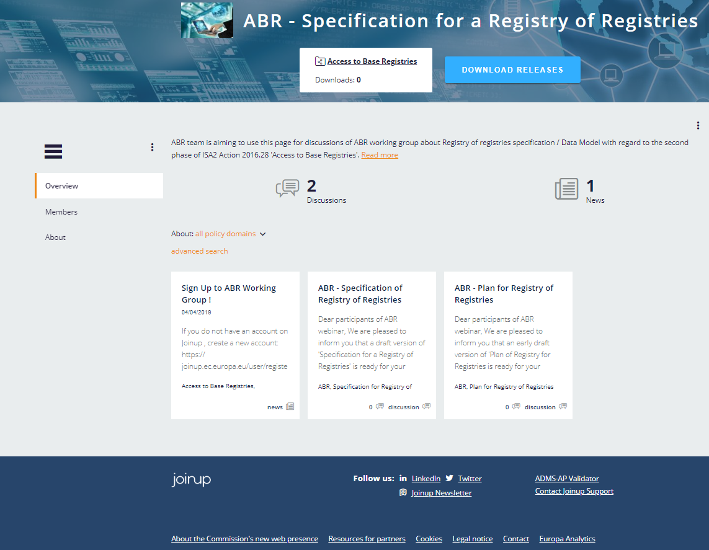
Let us know you joined via: ABR@trasysinternational.com
ABR Working Group
Sign up now!
If you do not have an account on Joinup,
Create a new account: https://joinup.ec.europa.eu/user/register
Join ABR Collection on Joinup: https://joinup.ec.europa.eu/collection/access-base-registries
ABR Team will add you as a Member of
ABR – Specification of Registry of Registries

Slide 28
Q&A
Thank you for your participation!

