Slide 1
BRegDCAT-AP DCAT Application profile for Base Registries
ABR WG Meeting
Brussels, 24 June 2020
Access to Base Registries ISA2 Action 2016.28
Project Officer: Peter Burian
EUROPEAN COMMISSION Directorate - General Informatics Directorate D – Digital Services DIGIT D2 – Interoperability Unit
Specific Contract n° 380 under ABC IV – Lot 3 Framework Contract

Slide 2
Disclaimer
The information and views set out in this presentation are those of the author(s) and do not necessarily reflect the official opinion of the European Commission. The European Commission does not guarantee the accuracy of the data included in this document. Neither the European Commission nor any person acting on the European Commission’s behalf may be held responsible for the use which may be made of the information contained therein.
This publication is used to support a meeting that will be recorded and made available to the participants.
© European Union, 2020

Slide 3
Agenda
Welcome note
Updates on BRegDCAT-AP
Timeline: Status of work & Planned activities
Acknowledgments & Endorsement;
Q&A

Slide 4
Welcome !
Introductions around the table

Slide 5
Updates on BRegDCAT-AP

Slide 6
Feedback received
The main changes of the document v1.04 since v1.02 relate to comments and recommendations from:
Jim J. Yang (Norway)
Sebastian Sklarss (Germany)
The SDG / TOOP Team
*An intermediate v1.03 with related changelog is also available online

Slide 7
Long changelog (tl;dr > next slide)
- Class Public Organisation: typo in the range of identifier (rdfs:Literal instead of rdf:Literal).
- Class Registry Service: typo in ranges of properties (Text changed to rdfs:Literal).
- Class Dataset is recommended instead of mandatory.
- Class Registry Catalog: removed duplicate (optional) publisher property.
- Class cv:PublicOrganization and cpsv:PublicService are recommended instead of mandatory to cover the use case proposed by Norway: harvesting information from private organisations that are related to the public sector. Also required to cover SGD/TOOP requirements.
- Class Public Organization: property org:classification was duplicated and the optional was removed, preserving the recommended.
- Class Agent: extended the description in the document according to DCAT-AP 2.0.
- Class Agent: included dct:identifier as recommended as proposed by DCAT-AP-NO.
- Class Agent: included ADMS publisher types controlled vocabulary.
- Class Catalog: Included hasPart and isPartOf.
- Class Thematic scheme and Theme: described in detail, and included mandatory properties, according to DCAT-AP 2.0.
- Class Dataset: Added optional dct:isRequiredBy and dct:requires (Dataset) property proposed by DCAT-AP-NO (compatible with DCAT-2).
- Class Dataset: Added optional dct:isReferencedBy and dct:references (Resource) property from DCAT-AP (compatible with DCAT-2).
- Class Dataset: Added optional dct:isReplacedBy and dct:replaces (Dataset) property proposed by DCAT-AP-NO (compatible with DCAT-2).
- Class Distribution: included dcat:spatialResolutionInMeters property (compatible with DCAT-AP-2)
- Class Distribution: included dct:conformsTo property (compatible with DCAT-AP-2)
- Class Distribution: included dcat:packageFormat property (compatible with DCAT-AP-2)
- Class Distribution: included odrl:hasPolicy property (compatible with DCAT-AP-2)
- Class Distribution: included dct:rights property (compatible with DCAT-AP-2)
- Class Distribution: included adms:status property (compatible with DCAT-AP-2)
- Class Distribution: included dcat:temporalResolution property (compatible with DCAT-AP-2)
- Class Distribution: included dct:title property (compatible with DCAT-AP-2)
- Class LegalResource: included new optional rdfs:seeAlso property.
- Class LicenseDocument: included description with a recommended licence type.
- Class spdx:Checksum: with the mandatory properties (algorithm and checksum value) according to DCAT-AP 2.0.
- Class Data Service: includes the optional dct:conformsTo property.
- Class adms:Identifier: included as recommended, the skos:notation property.
- Cass Location: Added the recommended and optional properties according to DCAT-AP 2.
- Cass PeriodofTime: Added the recommended and optional properties according to DCAT-AP 2.0.
- Class dcat:Relationship: described in the document, including the mandatory properties according to DCAT-AP 2.0.
- Controlled vocabularies: Datasets, and Data Services must include the level of access rights. References to Catalogues and Distributions have been removed.
- Controlled vocabularies: DataService removed in the description of dct:ceator; dct:language; dct:publisher; and dcat:theme. It does not apply.
- Removed references to Data Cube vocabulary.
- Recommended the use of The Profiles Vocabulary to describe conformance standards.
…

Slide 8
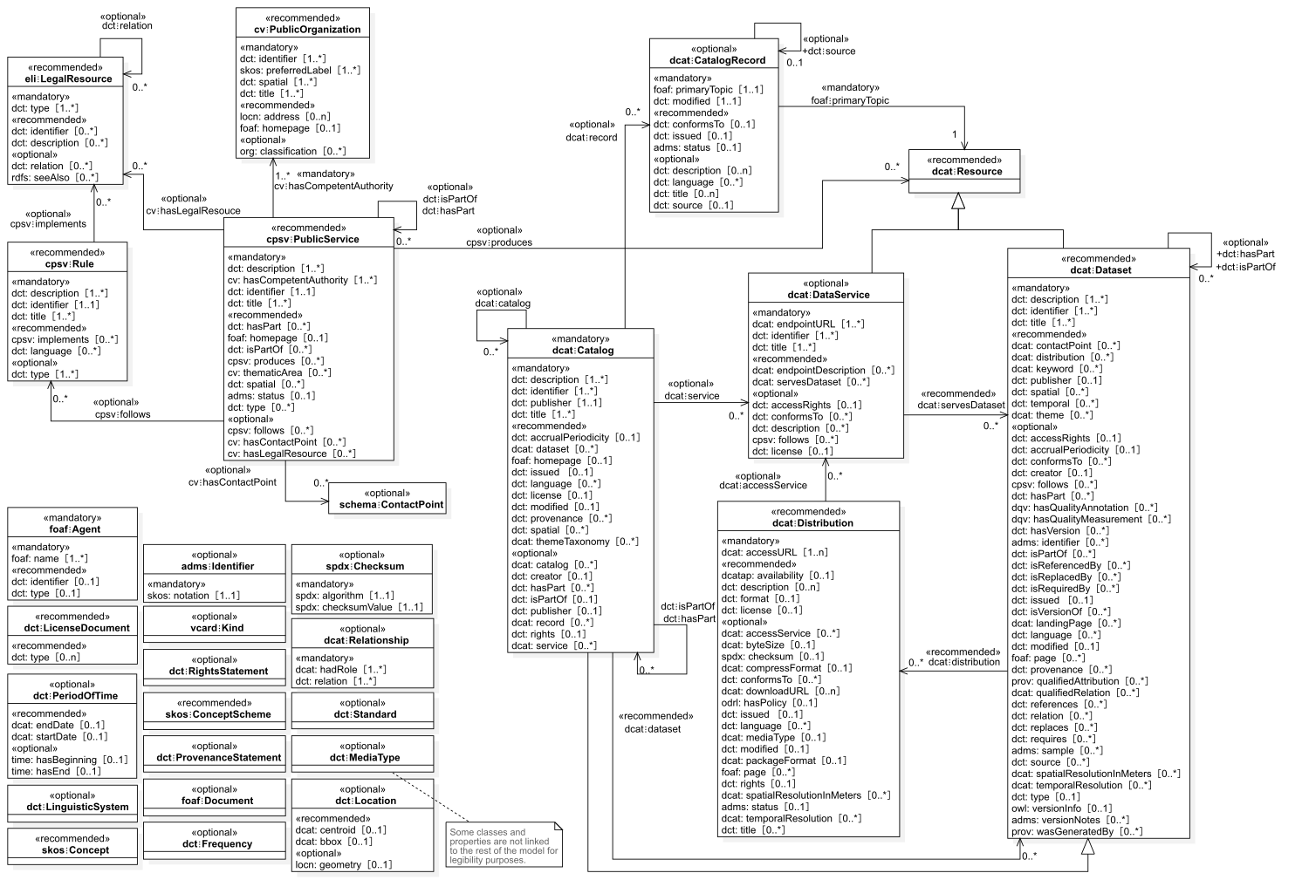
Mandatory
Recommended

Slide 9
All the main classes

Slide 10
Optional Dataset relationships + DCAT-APv2.0 properties

Slide 11
Packaging
Conformance
Status
Granularity
Title

Slide 12
Other changes
Editorial changes for content homogeneity
Removed references to Data Cube Vocabulary
Included explicit references to The Profiles Vocabulary for standard conformance purposes

Slide 13
Timeline
Status of work & planned activities

Slide 14
Timeline
MAR-DEC 2019
Working Drafts, WGs and discussions
APR-MAY 2020
WG, discussion & feedback
JUL 2020
BRegDCAT-AP Tools
NOV 2020
Pilot report and adjustments
Testing with Interoperability Testbed
Piloting
Interoperable BRegDCAT-AP and supporting tools
FEB 2020
SDG & TOOP Feedback
TODAY
Stable BReg-DCAT-AP
OCT 2020
Pilot implementations in MS

Slide 15
Alignment with real-world implementations
Pilot of the specification and supporting tools in MS: Norway, Spain, Lithuania
Adjustments after the implementation of real use-cases
Proposal to extend the vocabulary to cover aspects like:
Conformance to standard data patterns/models;
Registry credentials management;
Terms of use of data: this is, legal, organisational, and operational restrictions to make registries interoperable; etc.
Report on the pilot & outcomes in Public Webinar - Autumn
Specification and tools available to all MS to be reused as standard for BRs
Open door for European Registry of Registries (ERBR)

Slide 16
BRegDCAT-AP – Online Open Source Tools
Creator
Mapping
Editor
Editor
Data Harvester
Approach: Reuse & Adapt CPSV-AP, ISA Interoperability Testbed and other applicable tools

Slide 17
Pilot
The purpose of pilot is to prove the feasibility of the model and specification, and created set of reusable tools:
Implementation of specification and tools in up to 5 MS to test them
Try to simulate a Registry of Registries with metadata from MS
Do you want to participate?

Slide 18
Acknowledgments & Endorsement

Slide 19
Closing WG Facts & Acknowledgments
Elaboration Timeline:
March 2019 – June 2020
6 Working Group meetings &
1 public webinar
© European Union
9 open discussions;
over 50 comments;
Numerous bilateral meetings & interactive
Feedback via email
70 Participants
19 Member States + SCT, UK & ME
Public administrations
Semantic Experts, Academia
ISA2 Committee representatives
EU Institutions (DIGIT, OP) and EU Projects (SDG/ TOOP), etc.
Notes:
Photo by Daniele Levis Pelusi on Unsplash
Photo by Rae Tian on Unsplash
Photo by Etienne Girardet on Unsplash
Photo by Boudewijn Huysmans on Unsplash
Photo by Andy Holmes on Unsplash
Photo by Anton Darius | @theSollers on Unsplash

Slide 20
Thank you for your active participation and valuable feedback !
BRegDCAT-AP stable for testing and piloting to implement proof of concepts in MS

Slide 21
Q&A

Slide 22
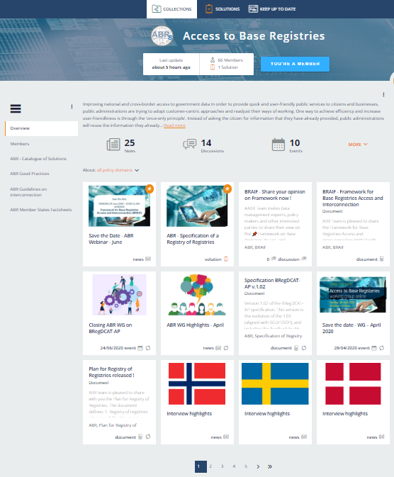
Sign Up Now !
If you do not have an account on Joinup, create it here: https://joinup.ec.europa.eu/user/register
Join ABR Collection on Joinup: https://joinup.ec.europa.eu/collection/access-base-registries
We will add you to our Specification page: https://joinup.ec.europa.eu/solution/abr-specification-registry-registries
And future Reusable Tools page

Slide 23
Thank you
© European Union 2020
Unless otherwise noted the reuse of this presentation is authorised under the CC BY 4.0 license. For any use or reproduction of elements that are not owned by the EU, permission may need to be sought directly from the respective right holders.

